Slide 1
Transport & Logistics Conference
22. 03. 2018
Brussels
Violeta Bulc
European Commissioner for Transport

Slide 2

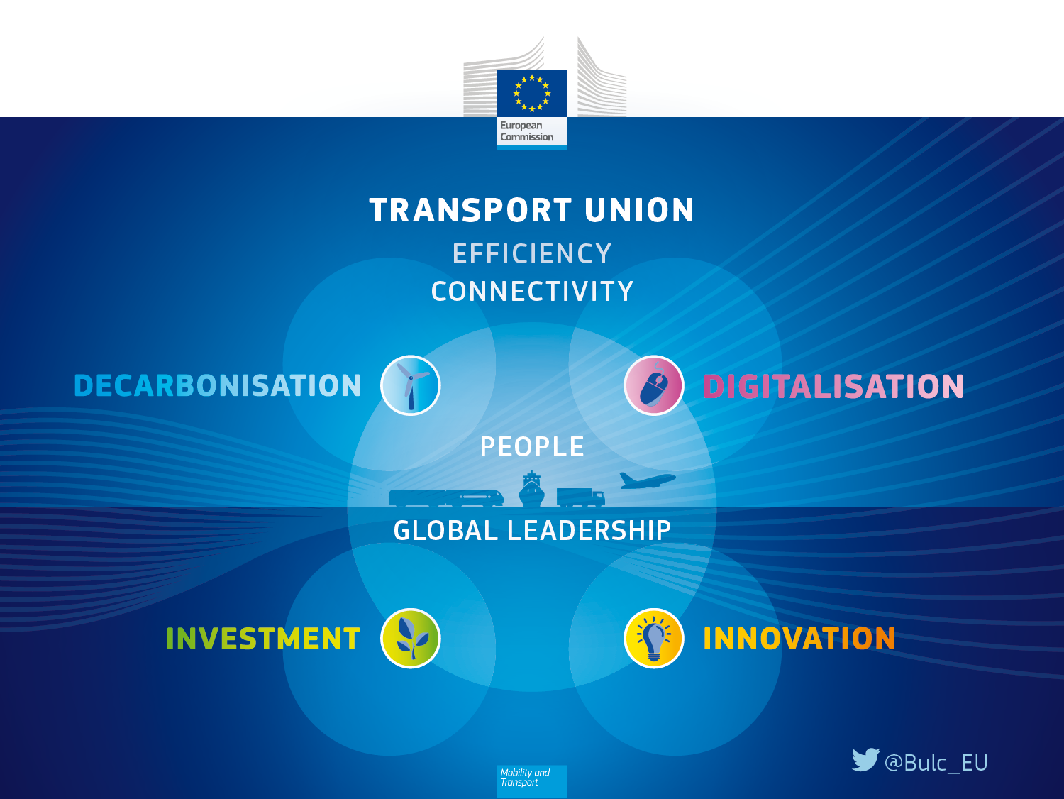
TRANSPORT UNION
Notes:
externalities

Slide 3
3 objectives of EU transport policies
EFFICIENCY
  0 pollution by 2050
CONNECTIVITY
  Completion of TEN-T Core Network by 2030
MANAGEMENT of EXTERNALITIES
  0 road fatalities by 2050
  Not more than 15750 by 2020

Slide 4
Decarbonisation
Increasing the efficiency of the transport system
Speeding up the deployment of low-emission alternative energy for transport
Moving towards zero-emission vehicles

Slide 5
Digitalisation
More efficient transport
E-documents
More digital tools
  Better efficiency of freight and logistic networks

Slide 6
Next MFF - 4 key areas and opportunities
Focus on results
Use of the TEN-T corridor logic
Synergies in Connectivity sector and between Transport modes
Optimise EU financing support

Slide 7

Investment

Slide 8


Thank you for your attention
@Bulc_EU
twitter.com/Bulc_EU
facebook.com/VioletaBulc.EU

