Slide 1
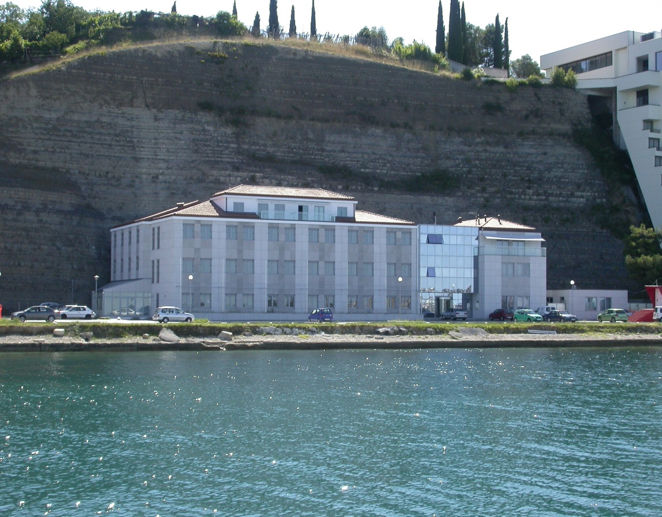
NATIONAL INSTITUTE OF BIOLOGY - NIB
Marine Biology Station Piran
    Department of Biotechnology and Systems Biology
    Department of Genetic Toxicology and Cancer Biology
    Department of Organisms and Ecosystems Research
    Technology Transfer Office
Notes:
Established in 1960: by the Republic of Slovenia
Leading research institution in biological sciences
Basic and applied research in natural sciences
Applications to agriculture, environment, defense and human health protection
60 years. MBP 50 years

Slide 2
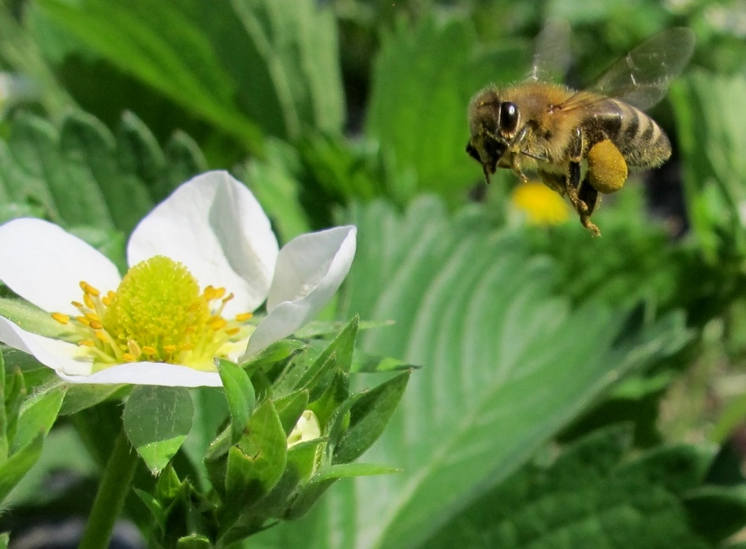
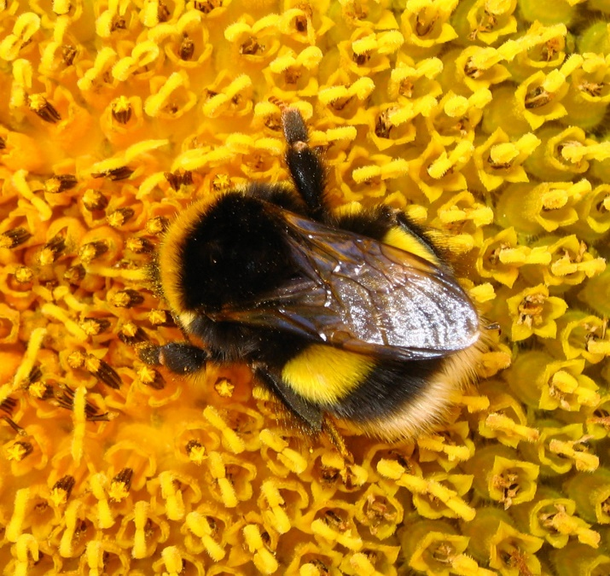
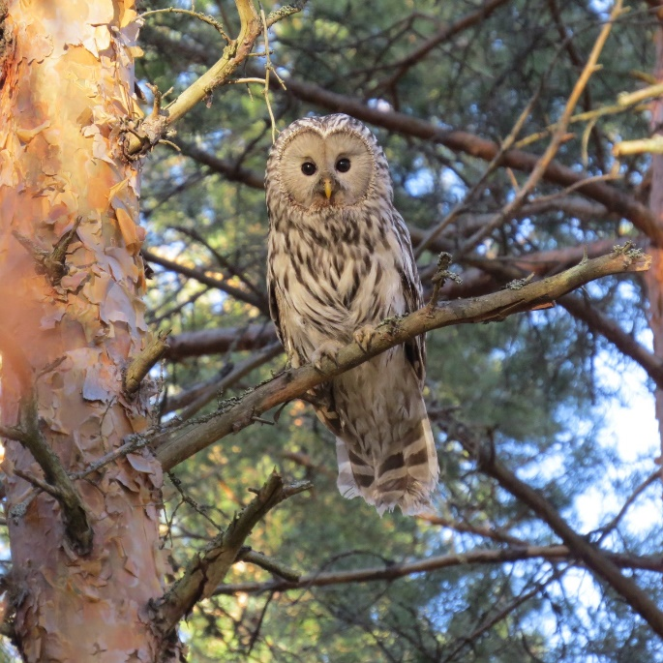
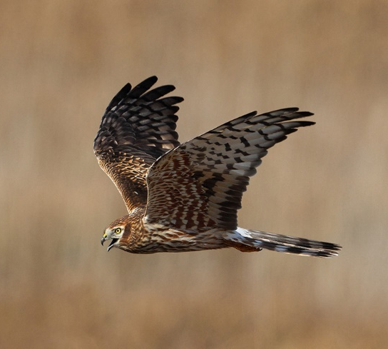
Can Biodiverstity has a business case?

Slide 3

Biodiverstity in a city?
Biodiversity in big cities is becoming huge issue. Many European cities are experiencing massive drop in biodiversity due to massive urban area extension.
In the EU alone, around 84 % of crop species and 78 % of wild flower species depend on animal pollination.
Cities are not often thought of as havens of biodiversity (but they should be when it comes to pollinators).

Slide 4
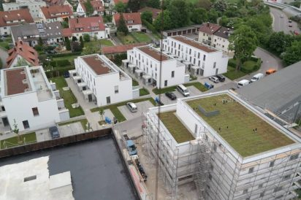
Green Roofs
retain rainwater
reduce the heat flux through the roof
less ground level ozone + less heat = less smog
polinators urban habitat
Urbanscape® is supporting EU Pollinator Initiative aiming for measuresto improve urban habitat for pollinators
Notes:
Vegetated rooftop habitats can serve as stepping stones, to create corridors connecting other patches (roofscape or at grade) across an urban sea to natural habitats beyond the city.

Slide 5
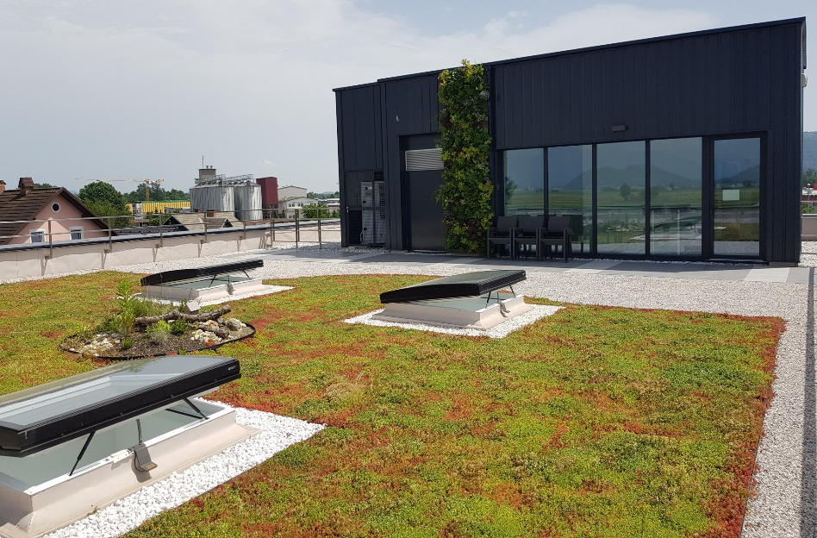
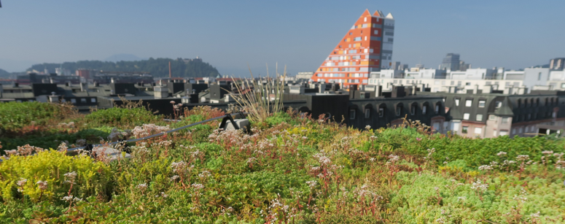
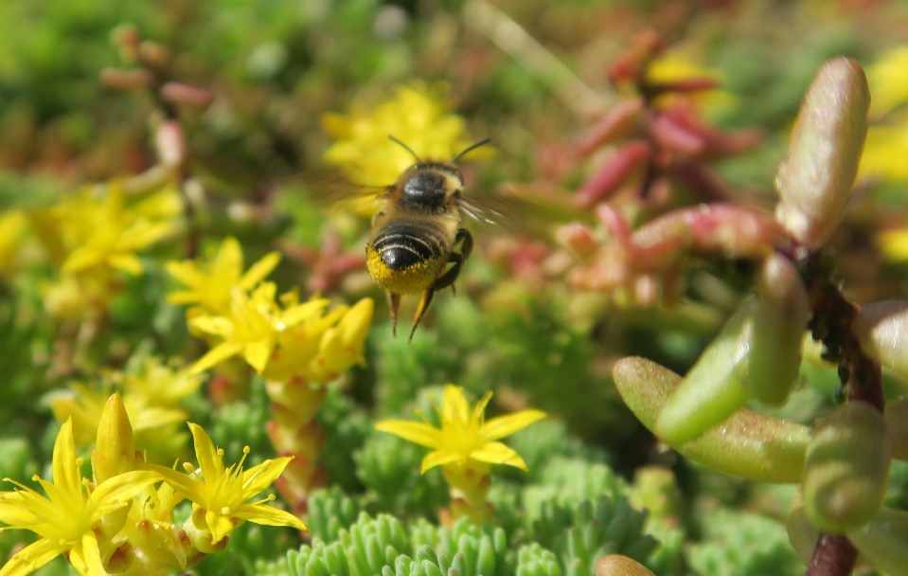
Polinators in a city - improving the green roof business case
Urbanscape® Green Roof on KI Experience Center – Škofja Loka, Slovenia, is a polygon to investigate amount of pollinators being attracted by this rooftop garden.
The research is performed in dense urban & industrial area by Slovenian National Institute for Biology.
Result → flowering green roofs have relatively high density of pollinators, up to 11 per square meter.
The initial installation cost of a green roof is more than a traditional roof; however, the life cycle cost is competitive.

Slide 6
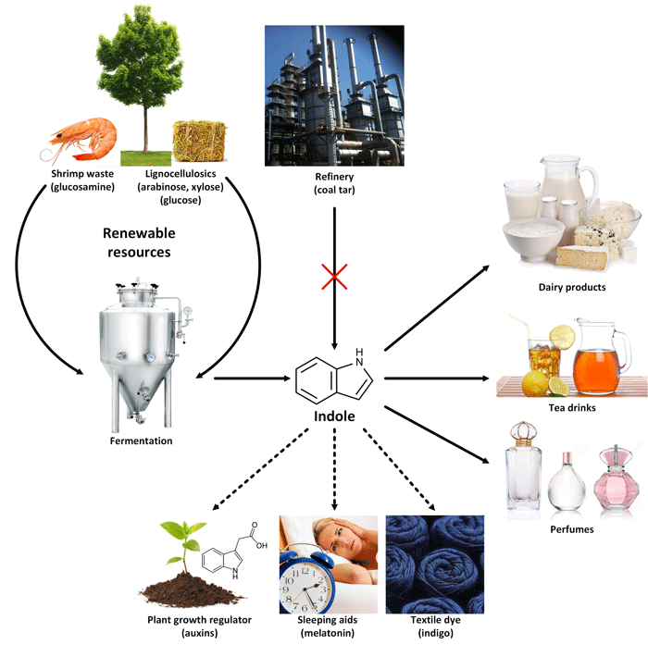
Biotechnological production of sustainable indole
Indole is an important flavouring compound
used in dairy, tea drinks and fine fragrances
with 30 million EUR market size
Currently produced from coal tar
produces hazardous chemicals at high temperatures
consumes a lot of energy

Slide 7

Biotechnological production of sustainable indole
Employ a sustainable bioproduction of natural indole

Slide 8


Biotechnological production of sustainable indole
Recruit Corynebacterium glutamicum (industrial amino acid producer) for indole production.
Identify of biosynthetic enzymes in bacteria in plants.
Pathway design and optimization.
Set up industrial scale production, using renewable resources.
Notes:
German Flavours and Fragnance company

Slide 9

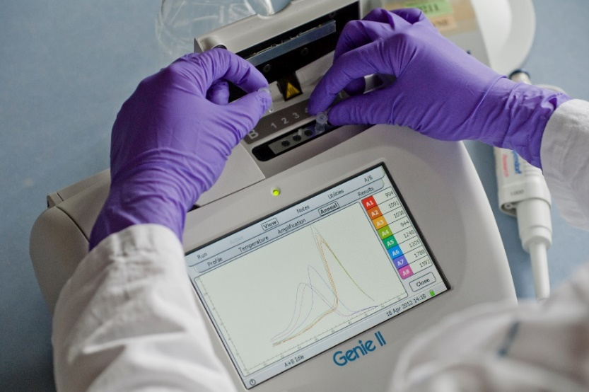
Quality control in bioprocess development
Nucleic acid quantification: ddPCR, Next Generation Sequincing (NGS)
Product purity evaluation
Microbiological control in downstream
Metagnomics
Metagenome in the bioreactor
Imaging: Confocal, transmission and cryo electron microscopy
Evaluation of final product ultrastructural properties

Slide 10
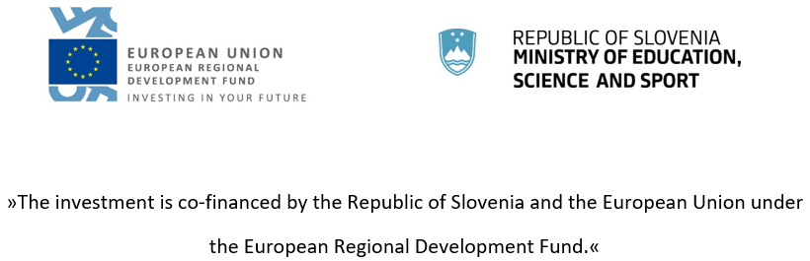

Animal physiology
Biodiversity
Bioinformatics
Biology of organisms
Biomaterials
Biotechnology
Biotremology
Cancer biology
Cell biology
Ecophysiology
Ecotoxicology
Evolutionary biology
Freshwater ecology
Genetics, genomics
Genetic toxicology
Genetically modified organisms
Marine ecosystem research
Microbiology
Neurobiology
Oceanography
Plant physiology
Phylogenomics
Pollinating
Sytematic biology
Systemic biology
Terrestrial ecology
Transcriptomics
Virology
Wood pests
Contact:
National Institute of Biology
Technology Transfer Office
jure.vindisar@nib.si

