Slide 1

Supporting Circular Economy Initiatives in Lithuania
MANTAS VILYS
LITHUANIAN INNOVATION CENTRE

Slide 2


Regular Innovation Ecosystem
Business support institutions
Business
Research & Development
Government
What do we need to make a shift from Regular to Circular?

Slide 3
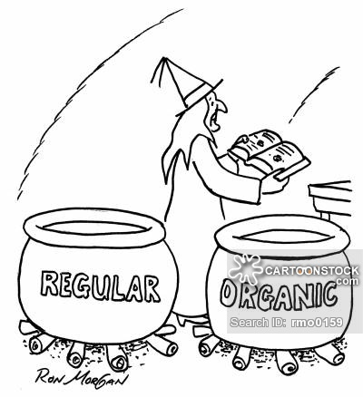
How to support Circular Economy Initiatives?
Matchmaking for Circular initiatives (Science meets Business)
Transnational Coaching for SMEs (Circular Economy Initiatives)
Circular Public Procurement
REGULAR
CIRCULAR

Slide 4
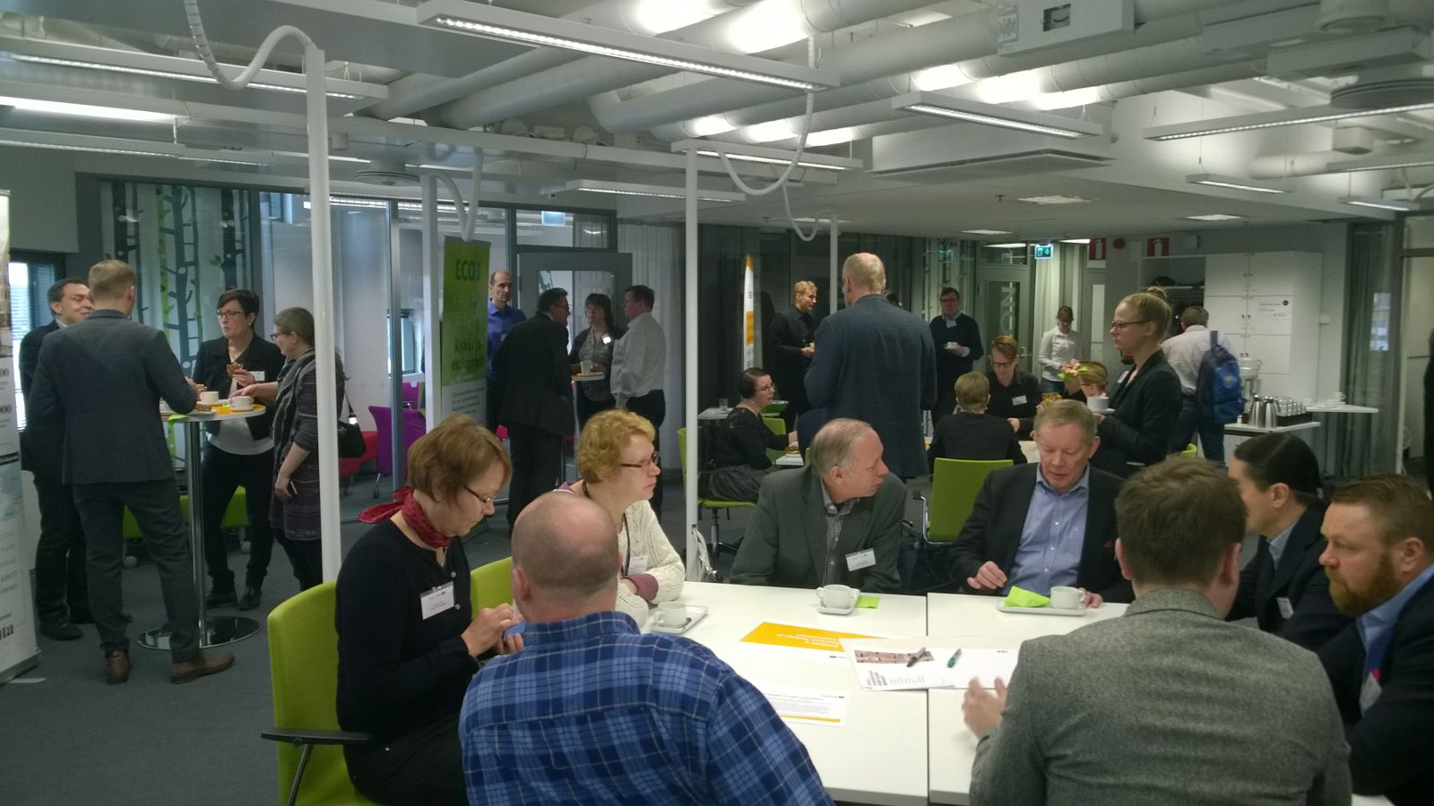
New Concept for Matchmaking:
  Facilitated by experts;
  Focused on business/public challenges;
  Followed-up by innovation coaching;

Slide 5
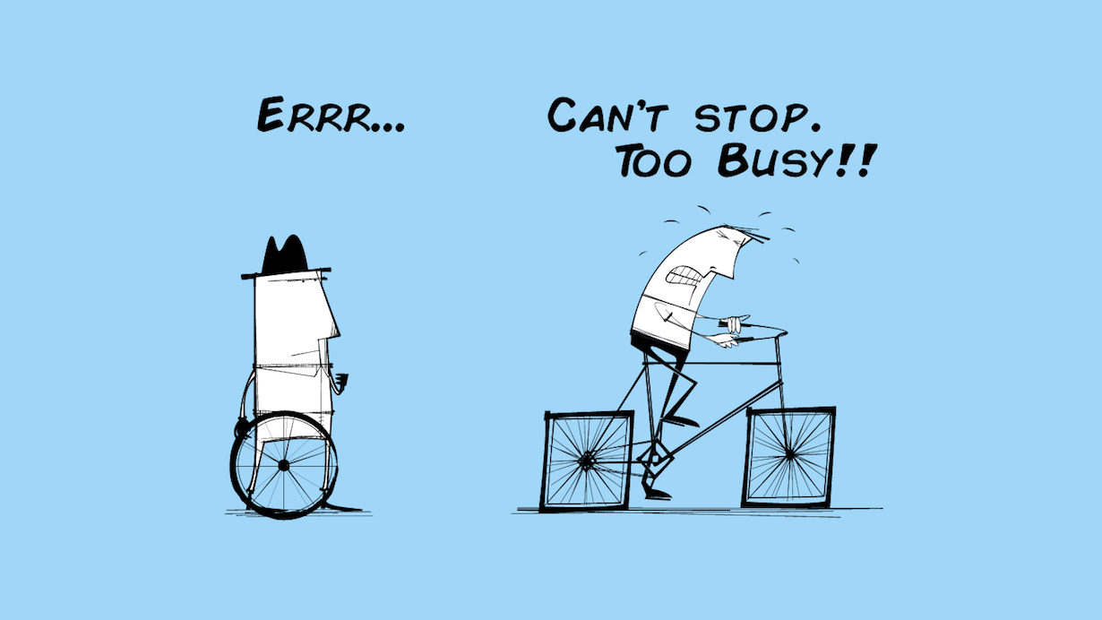
New Concept for Transnational Coaching:
60+ cases pre-selected (SMEs with CE initiatives)
Continuous support/coaching for SMEs has been provided by following demand driven approach
Local KAM (Key Account Manager) + international (DK, SE) coach working on a SME case

Slide 6
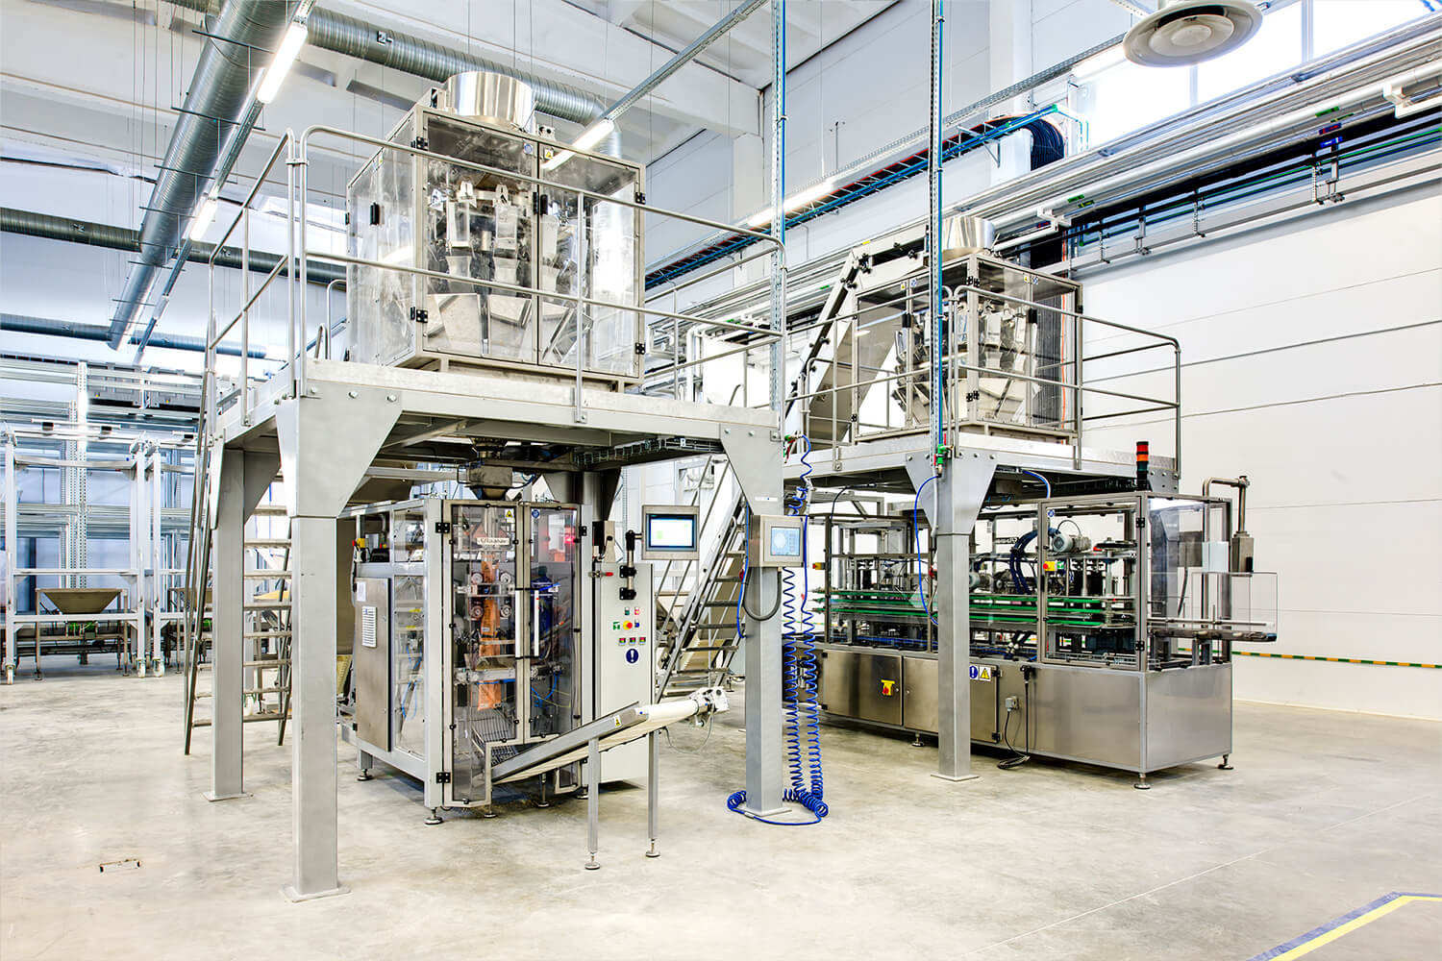

Matchmaking + Transnational Coaching for SMEs with CE initiatives. First results:
  Hyperhappy SMEs
  Action plans for CE initiatives developed
  More than 10 cases of highly prommising cooperation between LT-SE-DK SMEs on new CE projects

Slide 7
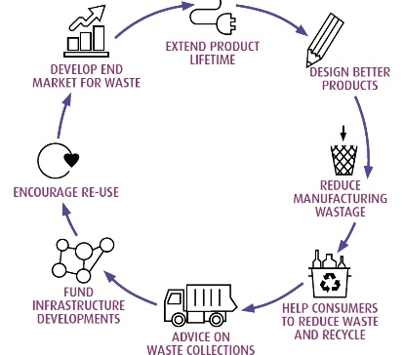
  Why Circular Procurement (CP) ?
  large proportion of EU consumption (~20% of EU GDP)
  Can be effective in boosting risky innovation as well as CE initiatives
  More focus on market dialogue

Slide 8
  Thank you for your attention!
  MANTAS VILYS
  m.vilys@lic.lt
  LITHUANIAN INNOVATION CENTRE

