Slide 1
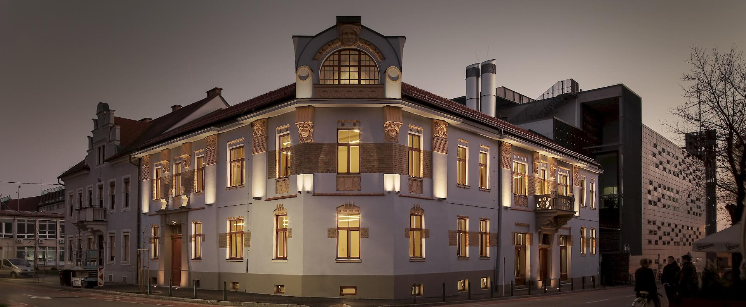
Institute of Informatics
UM FERI
UM FERI is an internationally recognized, ambitious technical faculty, which successfully transfers top technical knowledge and research results into industry.
By strongly interlacing ICT disciplines we are creating an arena of deep knowledge, where their synergies allow for the innovative breakthrough of the faculty.
Institute of informatics has over 25 years of experience in implementation of R&D projects related to analysis, design, implementation, integration, and evaluation of innovative software solutions.
The leading role in the world in processing massive amounts of structured and unstructured data, as well as designing transparent classification models.
Top expertise in
AI and machine learning approaches, algorithms, methods and tools.
In-depth knowledge on transferring emerging technologies (e.g. blockchain) into practice.
Large experience in implementing and managing IT projects.
University of Maribor, Faculty of Electrical Engineering and Computer Science, Institute of Informatics

Slide 2
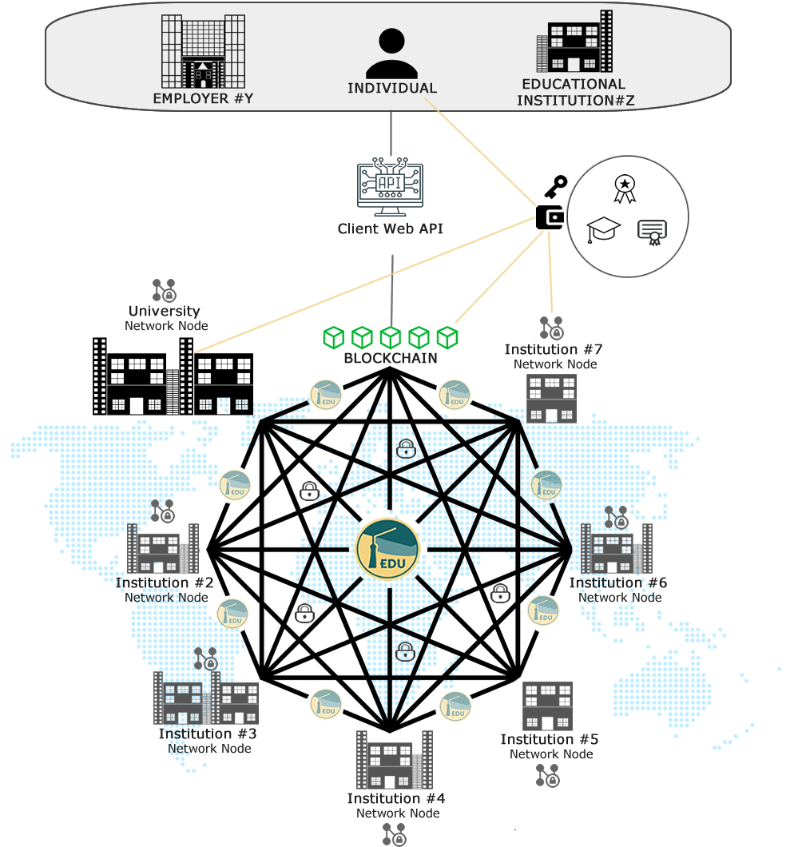
Our research and projects
57 EU projects
17 active EU projects
35 bilateral projects
100+ industrial projects … in the last five years
Arivu: AI powered system, that enhances the work of information gathering from various document sources with the use of text mining, natural language processing and Deep Learning.
EduCTX: A global, decentralized platform for assigning, managing, storing, sharing and showcasing digital micro certificates based on blockchain technology.
University of Maribor, Faculty of Electrical Engineering and Computer Science, Institute of Informatics
Notes:
We have actively participated in FP5, FP6 and FP7 programmes, ERA NET, Marie Curie, ESA, LLP (Erasmus+, Tempus & Leonardo da Vinci) programmes, COST, NATO SPS, Interreg SI-AT & SI-HU, European Regional, Development Fund & Ministry of Higher Education, Science & Technology and Norway Grants and more.

Slide 3
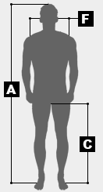





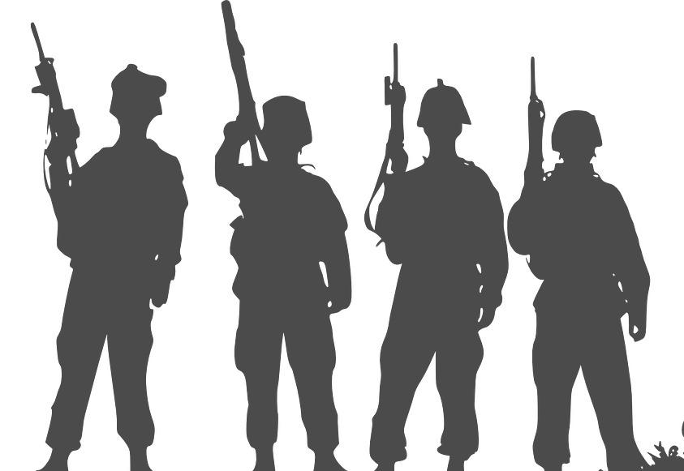
Unit formation and role selection
With Text Mining, Natural Language Processing and Deep Learning
Problem: How to create personnel profiles that can be used in military unit formation and role selection problems.
Solution: System that uses Text Mining, Natural Language Processing and Deep Learning to create mathematical tensor representation of an individual, that can effectively be used for unit formation and role selection.
Usage: Personnel profiles are used in consideration to the military doctrine, organizational structure, decision cycle concept, minimization of conflicts, and maximization of effectiveness and cooperation.
INPUTS
Written reports
Physical abilities
Mental capacities
Skills and expertise
TEXT MINING, NLP,
DEEP LEARNING
0 0 1 1 0 0 0 1 0 0 1 1 0 1 1 0 1 1 1 0 0 0 1 0 0 1 1 0 0 1
OUTPUT
University of Maribor, Faculty of Electrical Engineering and Computer Science, Institute of Informatics

Slide 4

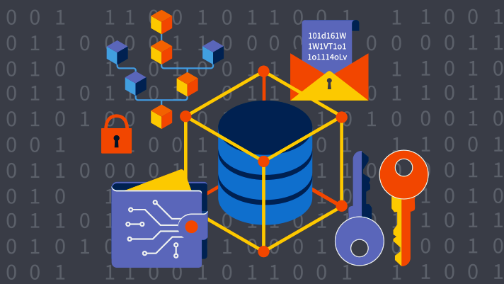
Blockchain as Cybersecurity Shield
Problem: Providing security in communication and logistics (tracking delivery supplies) for a distributed environment (alliance), in an ever-more globally connected and dispersed network.
Solution & Usage:
Using Blockchain Technology, thus control and verification in a distributed manner, for tracking the purchase goods and parts.
Creating a communication service that is secure and impenetrable. It builds on the idea that if one node is destroyed, the system is not compromised (the internet was developed by the military for the same reason).
“Using cryptography to ensure confidentiality and integrity in a distributed environment.”
University of Maribor, Faculty of Electrical Engineering and Computer Science, Institute of Informatics

Slide 5

Possible cooperation?
Synergies and future
The presented technologies can integrate the existing IT infrastructure of alliance members into an ad hoc network defined by the operational needs.
The blockchain communication service can be used in alliance (distributed environment among alliance members) as a secure document exchange platform.
Documents in the proposed system can serve as an input for the AI powered unit formation and role selection system.
The proposed system provides means for agile construction of international military and supportive groups.
University of Maribor, Faculty of Electrical Engineering and Computer Science, Institute of Informatics

Slide 6
Contacts
University of Maribor
Faculty of Electrical Engineering and Computer Science
Institute of Informatics
Koroška cesta 46, 2000 Maribor, Slovenia
W: ii.feri.um.si
assist. dr. Aida Kamišalić Latifić aida.kamisalic@um.si
assist. dr. Sašo Karakatič saso.karakatic@um.si
assist. prof. dr. Muhamed Turkanović muhamed.turkanovic@um.si
prof. dr. Vili Podgorelec vili.podgorelec@um.si

