Slide 1
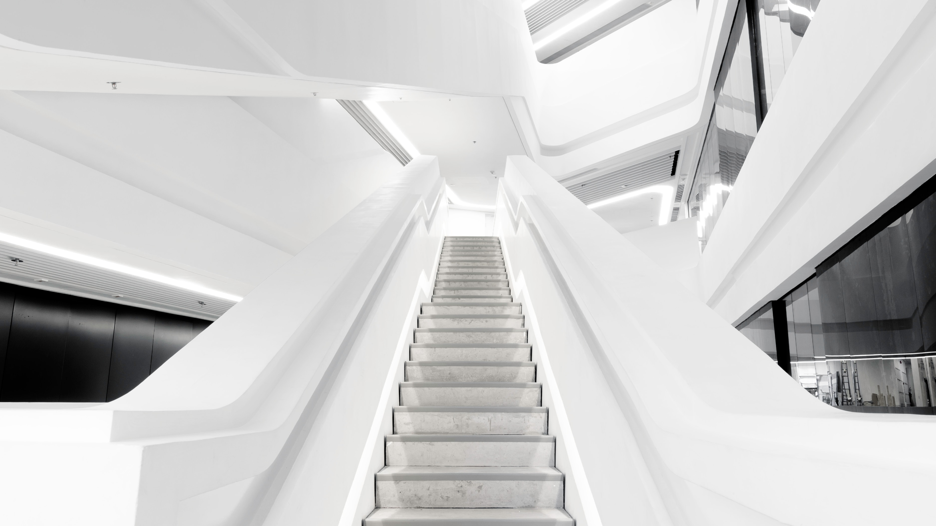

AI-Powered Language Technologies
and removing linguistic barriers
Tom Eric Hansons
Development Project Manager
TILDE
Networking event on Digital and Emerging Technologies and
Human-Centered AI
24 January, 2022

Slide 2

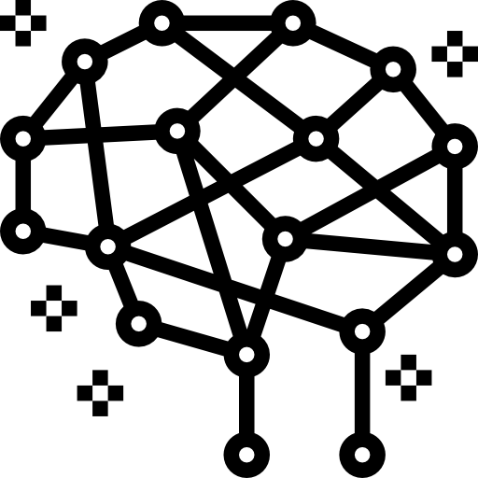
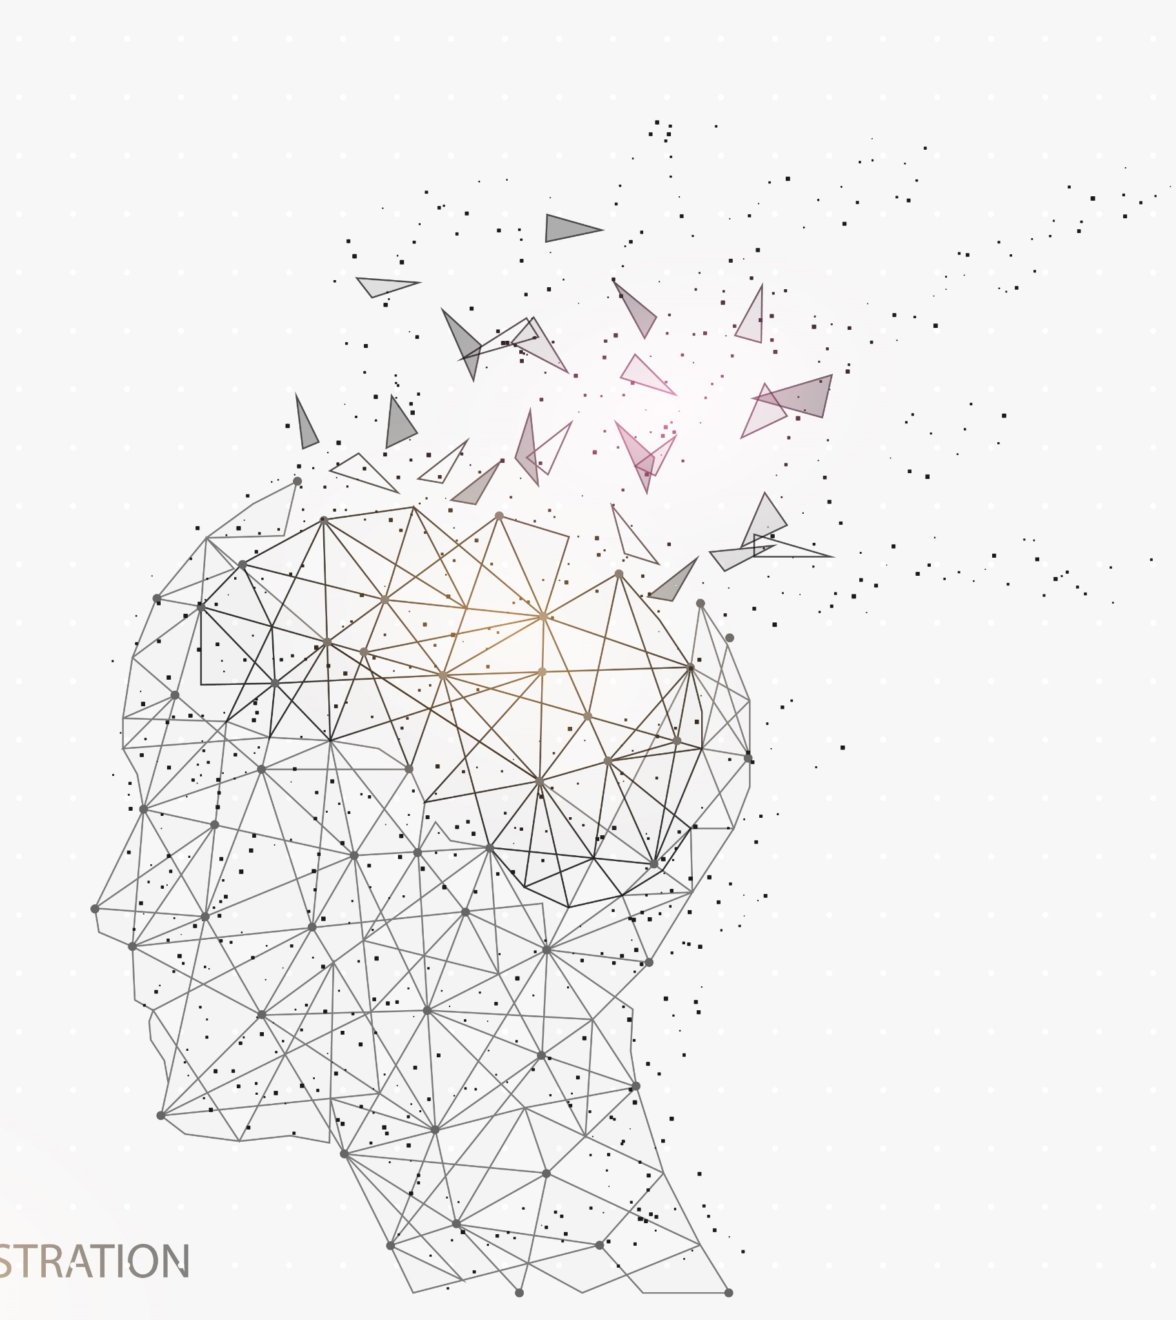





Specialized in Multilingual AI
Deep Learning and Artificial Neural Networks
Market leading products and technologies
Tilde Machine Translation, Tilde Term, Tilde Virtual Assistants, Tilde Speech Solutions
TOP80 Global Language Service Provider
Award-winning MT
1st place at the global Machine Translation competition WMT for four consecutive years
International experience of various scale
Extensive experience in domestic and EU projects, currently Leading EuroTermBank and National Language Technology platform consortiums
Excellence in research & innovation
11 PhDs, 220+ scientific publications
Cooperation with with 30+ universities
Notes:
Trusted partner for
European Commission
and clients worldwide

Slide 3





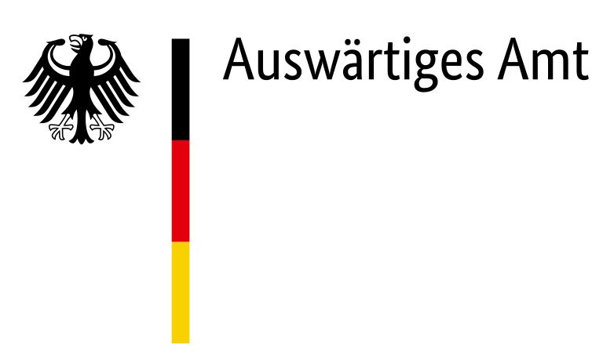




Trusted partner for clients worldwide
Some of our clients ->
  And many more
  (url)

Slide 4
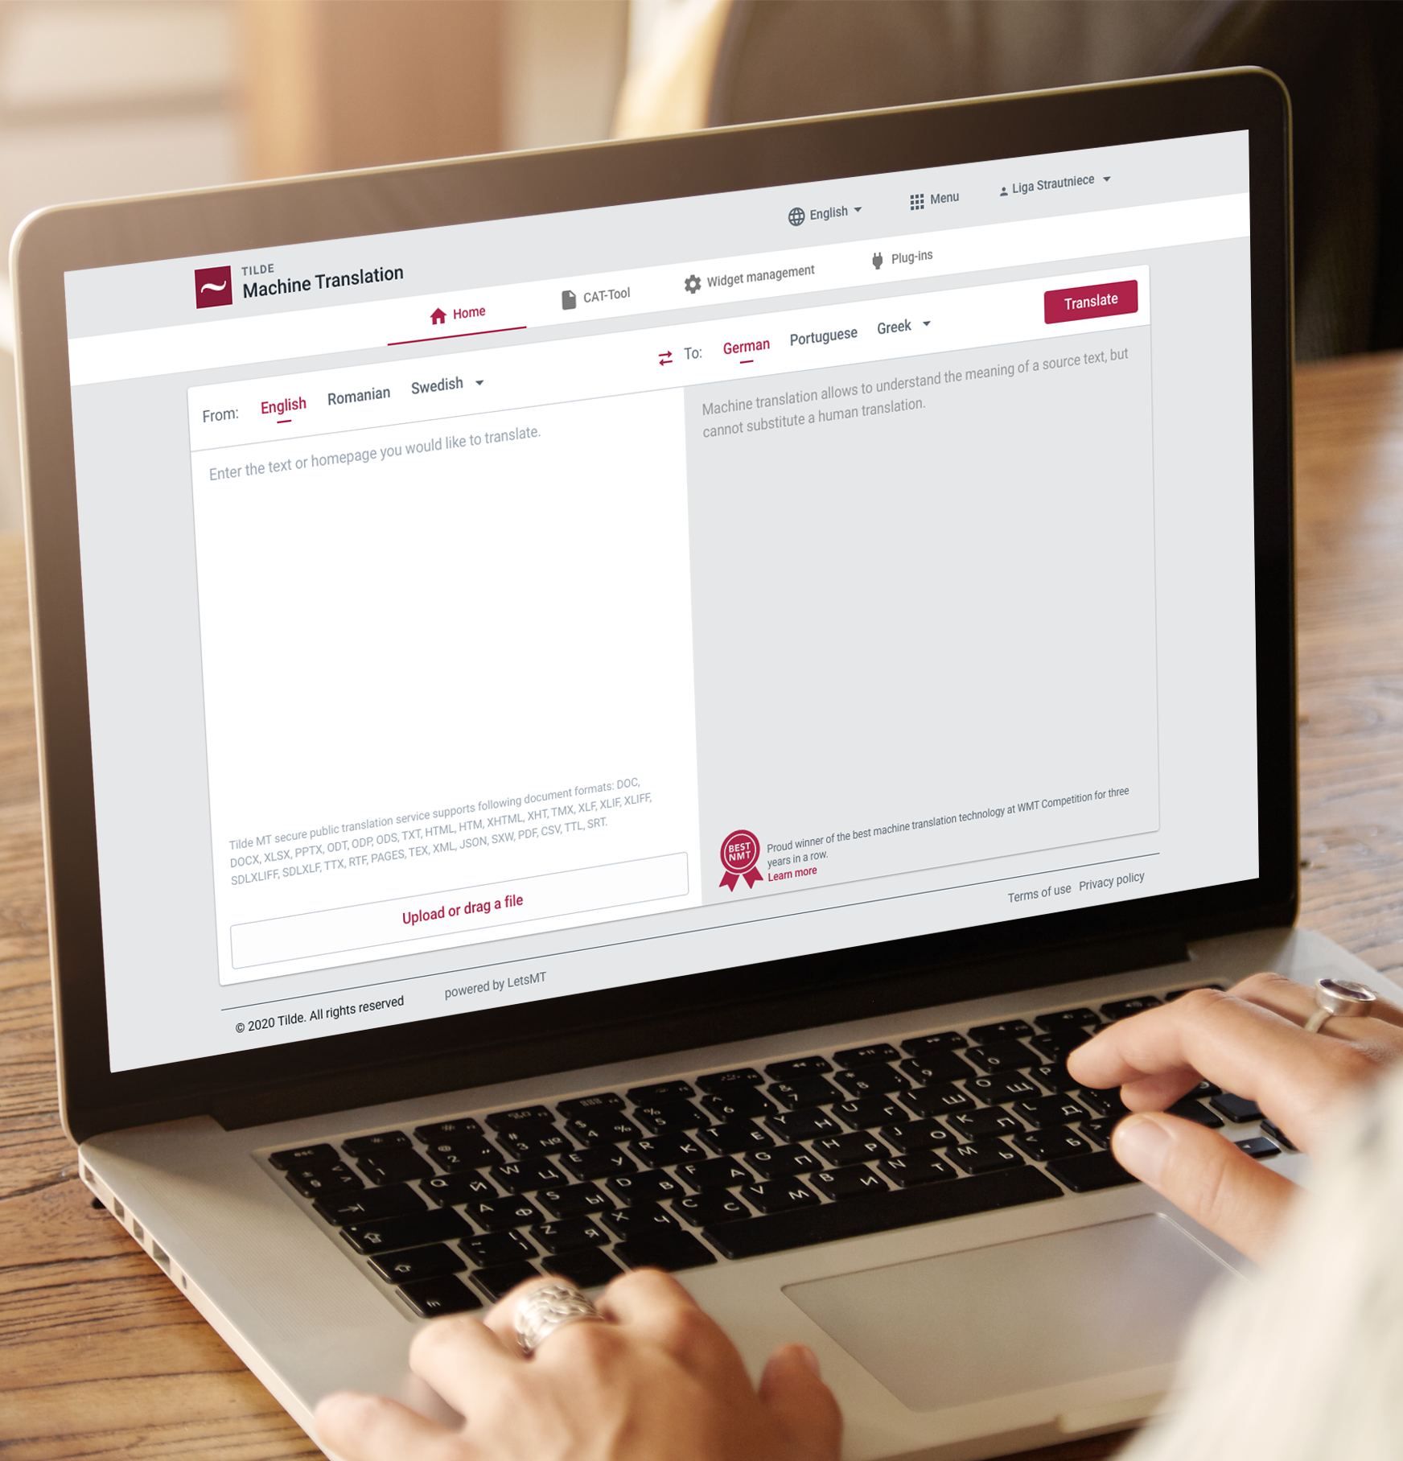
Thank you for your attention
Get in touch
toms.hansons@tilde.com
Find out more about our projects and capabilities at:
ntlp-info.eu
Eurotermbank.com
Tilde.com

