Slide 1
Measuring social progress in European regions and cities. Bucharest-Ilfov Region case
Simona Curpan,
Bucharest-Ilfov Regional Development Agency

Slide 2
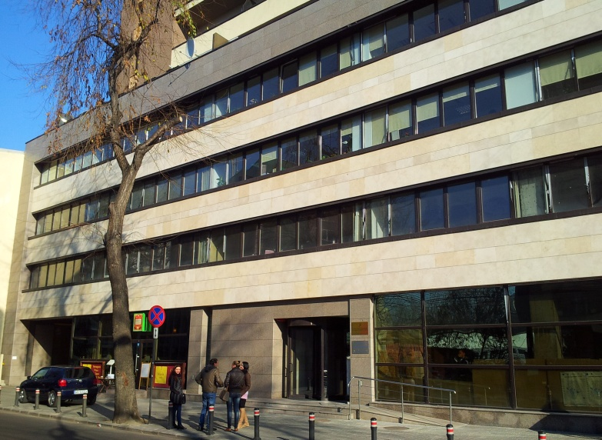
BIRDA – Bucharest-Ilfov Regional Development Agency
1999 – founded as non-profit NGO for public utility
2004 – up date regional development law
2007-2020 – intermediate body for REGIO
163 Mihai Eminescu Street, Bucharest
BIRDA provides specific services to the local public administration as well as to the private sector for the development of the Bucharest-Ilfov Region

Slide 3
Regional development system
ROMANIA - 8 NUTS 2 regions for socio-economic development
Law nr. 315 / 2004
Following the principles of EU regional development and cohesion policy
CDRBI – decisional body
BIRDA – executive body

Slide 4
Urbanization data
Bucharest Capital City
8 cities
32 communes
91 villages
Bucharest 17.6% of urbanized population in RO
Source: 2011, Population and housing Census

Slide 5
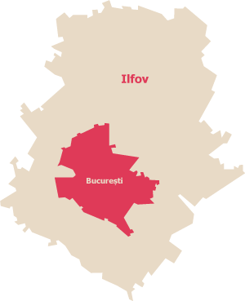
Bucharest-Ilfov Region data
144% GDP/capita (PPS) of EU28 average, while Romania is at 62% of EU28
229% GDP of the Romanian national average (decreasing*)
60,3% of the total national FDI (increasing*)
20% of the total national SMEs (decreasing*)
Less than 1% of the Romania surface, but more than 11% of the population
Ranked 11th in the world (1st in the EU) on Tom Tom Traffic Index (congestion level 48%)
*) 2018-2019,from the previous year

Slide 6
Bucharest-Ilfov SPI
One of the ten regions in the DG Regio pilot project “Measuring What Matters to EU Citizens” (https://eu-spi.eu/)
February 2016: BI ranked 255 out of 272 regions for SPI and 50/272 for GDP PPP per capita (data from 2011)*
Bucharest-Ilfov GDP: €30,700, Romania GDP: €12,812.50
Bucharest-Ilfov SPI (the best performance in RO): 2 indicators neutral, 10 indicators underperforming
2019**: Romania SPI rank 45/149, Romania GDP PPP per capita rank 45/149 with $24,544 (€22,418,24)
Romania SPI: 8 indicators “Performing within expected range”, 4 indicators underperforming
=> Improvement of the SPI at regional level
*) https://ec.europa.eu/regional_policy/en/information/maps/social_progress
**) Social Progress Imperative https://www.socialprogress.org/?tab=2&code=ROU

Slide 7
BI Strengths / Weaknesses
Weaknesses
Congested traffic
Social exclusion and fragmentation
Disparities between the capital and the surrounding Ilfov county (education, sanitation, health, IT/telecom infrastructure)
Strengths
Access to basic knowledge
Access to Advanced Education
High speed Internet

Slide 8
Shelter / Housing
This thematic area faces significant challenges in Romania, respectively Bucharest-Ilfov region.
Bucharest-Ilfov ranks on the position of 263 out of 272 in the field of shelter, showing negative results in terms of costs of housing, satisfaction with housing, overcrowding and lack of adequate heating
EU owner-occupied dwellings – Romania 96.8% (1st rank) to Germany (51,4%) of population
Living in overcrowded dwellings: 15 % of the EU population; the highest rate among the Member States was in Romania (47.0 %) Eurostat, June 2019

Slide 9
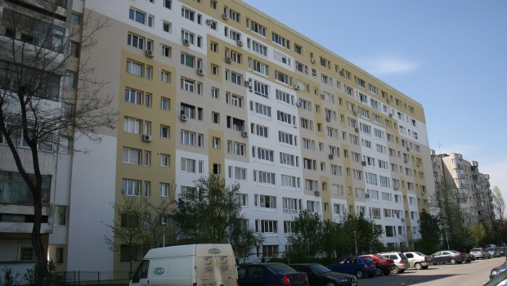
Shelter / Housing
During the communist period the Capital City was a magnet for industrial development and workforce
Entire neighborhoods were built near industrial platforms:
1960s – 1800 blocks of flats
1970s – 3000 blocks of flats (65% more)
1980s – 2600 blocks of flats
1990s – <800 new blocks of flats
the population has doubled in
five decades
Today: 65% of the population
(1,5 million) lives in apartments

Slide 10
Legislation framework and public policies
Regions have no decision-making power in general, not in the governance structure of housing policies
Some programmes at national level (Ministry of Regional Development and the National Agency for Housing)*:
a programme for building new housing stock for the socially disadvantaged young persons (18-35 years old), destined to be rented
“The first house” programme, which offers loan guarantees to persons buying a house or an apartment for the first time
the National Programme on Social Housing, which supports city halls in building social houses, based on the local needs identified by city councils / county councils
a programme supporting housing construction through guarantees of mortgage loans
a programme for building social housing targeting the tenants evacuated from nationalised buildings.
*) Technopolis Group EU SPI Study

Slide 11
Axis 3 Energy Efficiency and Sustainable Urban Mobility | 299.986.174
Axis 5 Cultural heritage and urban regeneration | 40.771.278
Axis 6 County roads | 13.297.873
Axis 9 Local development under the responsibility of the community | 11.820.332
Axis 10 Educational Infrastructure | 53.191.488
Total (million Euros) | 419.067.145

Slide 12
Investment Priority 3.1 A:
Energy efficiency of housing buildings
Eligible activities:
thermal rehabilitation of the envelope
thermal rehabilitation of the heating system/warm comsumption water supply system
the installation of alternative systems of energy generation from renewable sources
other activities that lead to energy efficiency
Assigned value for BI region: 99.4 million Euro

Slide 13
1.004
rehabilitated
blocks

Slide 14
BUCHAREST-ILFOV REGIONAL DEVELOPMENT AGENCY
Intermediary Body for Regional Operational Programme
THANK YOU FOR YOUR ATTENTION!
163 M. Eminescu Street, Bucharest, Romania
Phone /Fax: +4 021.315.96.59; +4021.315.96.65
Phone helpdesk: + 4021.313.80.99
Email: helpdesk@adrbi.ro
www.facebook.com/adrbi

