Slide 1
Slovenian Presidency of the Council of the EU
Research and innovation

Slide 2
Context
Trio DE-PT-SI
COVID-19
Recovery

Slide 3
4 main dossiers
European partnerships
European research area
International cooperation
Gender equality

Slide 4
European research area
Directionality: cross-sectoral approach (governance, initiatives), link to missions, ERA Forum for Transition
Governance: Pact for R&I, governance framework (CCs) including ERA Forum for Transition, synergies HE-R&I
Research infrastructures, researchers careers: addressed through topical conferences, Pact and CCs
Bridge to implementation: ERA Policy Agenda, conference

Slide 5
International cooperation
Western Balkans
Associations of 3rd countries to Horizon Europe
Global approach to R&I

Slide 6
Gender equality
First presidency conference
Political visibility, declaration
Part of Pact for R&I

Slide 7
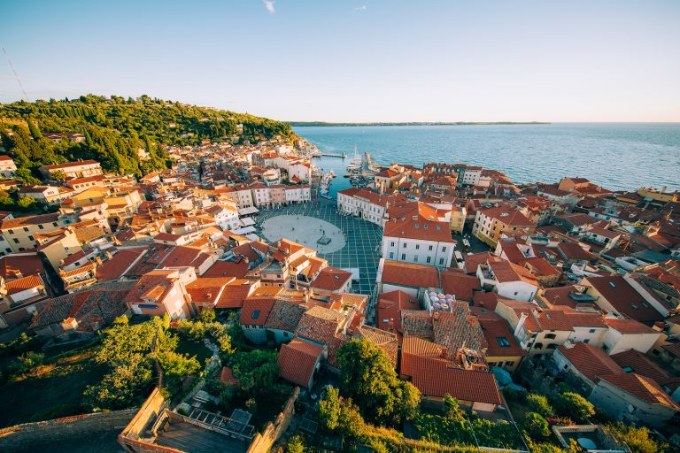


GENDERACTION (July 8-9)
Informal COMPET (July 19)
1st formal COMPET (Sept. 28)
Inf. ERAC/RWP in SI, back-to-back with HE DGs (September 30 – October 1)
Future of ERA conference (October 26-27)
MSCA conference (Nov. 15-16)
2nd formal COMPET (Nov. 26)
RI & ESFRI conference (Dec. 6-8)
Main events and meetings

Slide 8
N.B.: priorities are pending final government adoption

