Slide 1
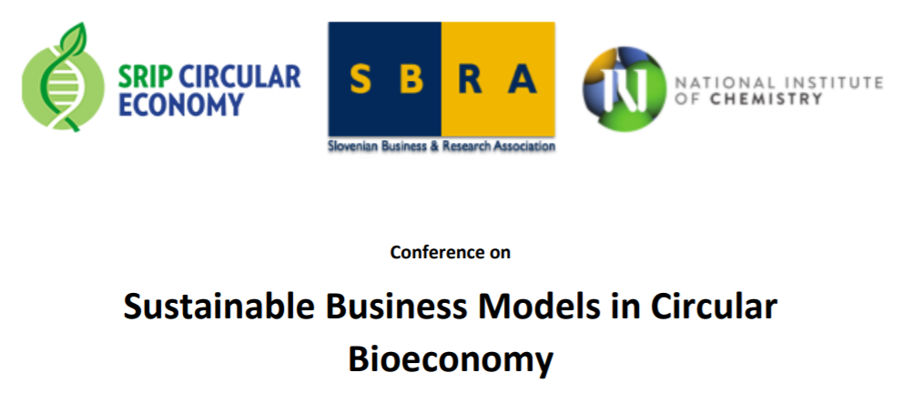
The importance of Biorefineries in Building Value Chains in the Vanguard Bioeconomy Pilot.
Driven by a political commitment to use our Regional Smart Specialization Strategies to boost new economic growth through entrepreneurial innovation and industrial renewal in the BioEconomy.
Willem Sederel
Brussels
23 September 2019

Slide 2



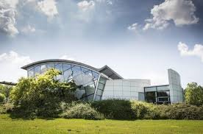







Willem Sederel – Leader of Democase LC Biorefineries
10 years university
9 years biobased economy
36 years in industry
6 years retired
Process development – Scale-up
Product development – Global impact
Application development
Marketing – Automotive, B&C
Democase leader Lignocellulosic
Biorefinery within the Bioeconomy
Pilot of VI (2018)
You can reach me at willem.sederel@biobaseddelta.nl

Slide 3
Why are Biorefineries relevant ?
Biorefinening is conversion of biomass into valuable products with low/no waste
Products can be intermediate chemicals, materials, heat, electricity, energy carriers
Examples are cellulose, sugars, lignin, rosins, tall oil, pyrolysis oil, gasses, biochar, tar, water, DDGS
BIC/Nova report 224 biorefineries in Europe (2017)
EU Science Hub: >803 biorefineries In EU (2018)

Slide 4
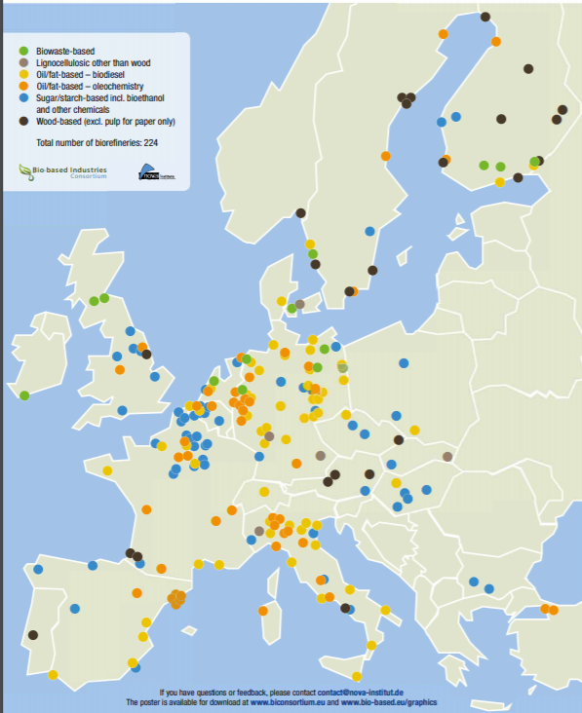
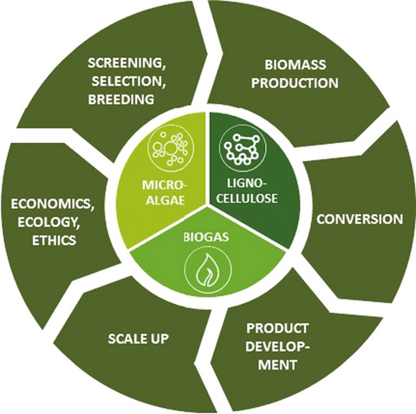

Biorefineries in Europe
Crops & feedstock
Biorefinery: a plant converting
biomass or biomass derived
feedstocks into valuable
products & energy
Products & Markets
Iris Lewandowski et.al
https://onlinelibrary.wiley.com/toc/17571707/2019/11/1

Slide 5
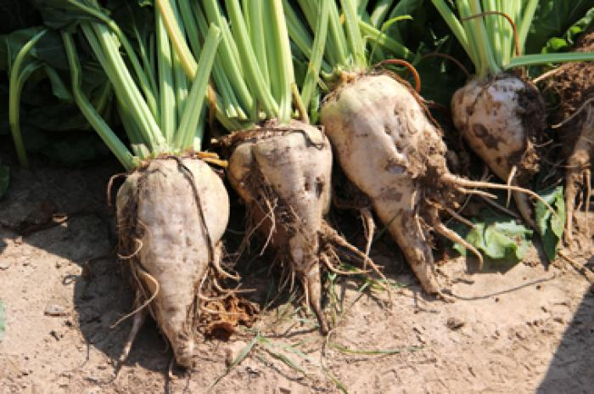
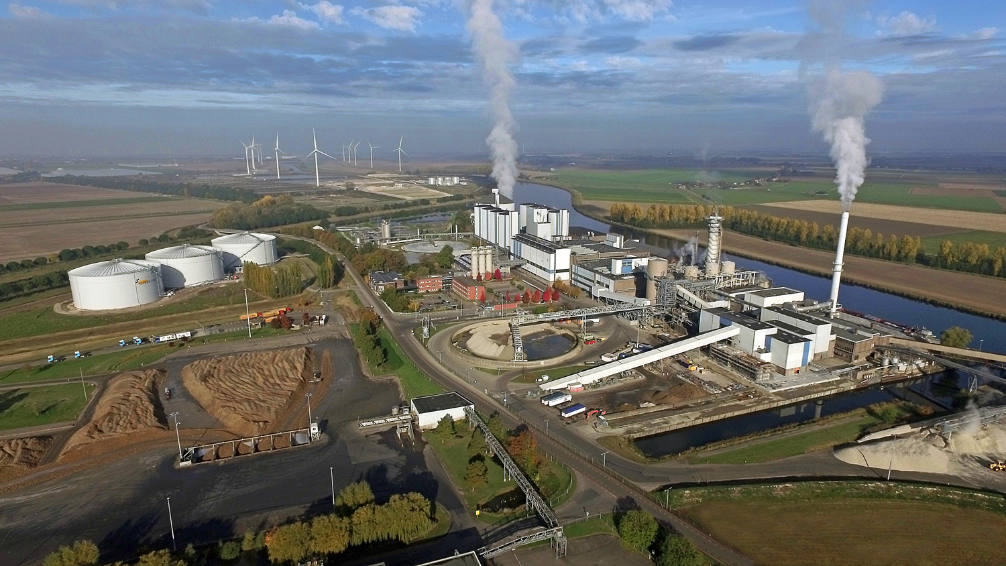
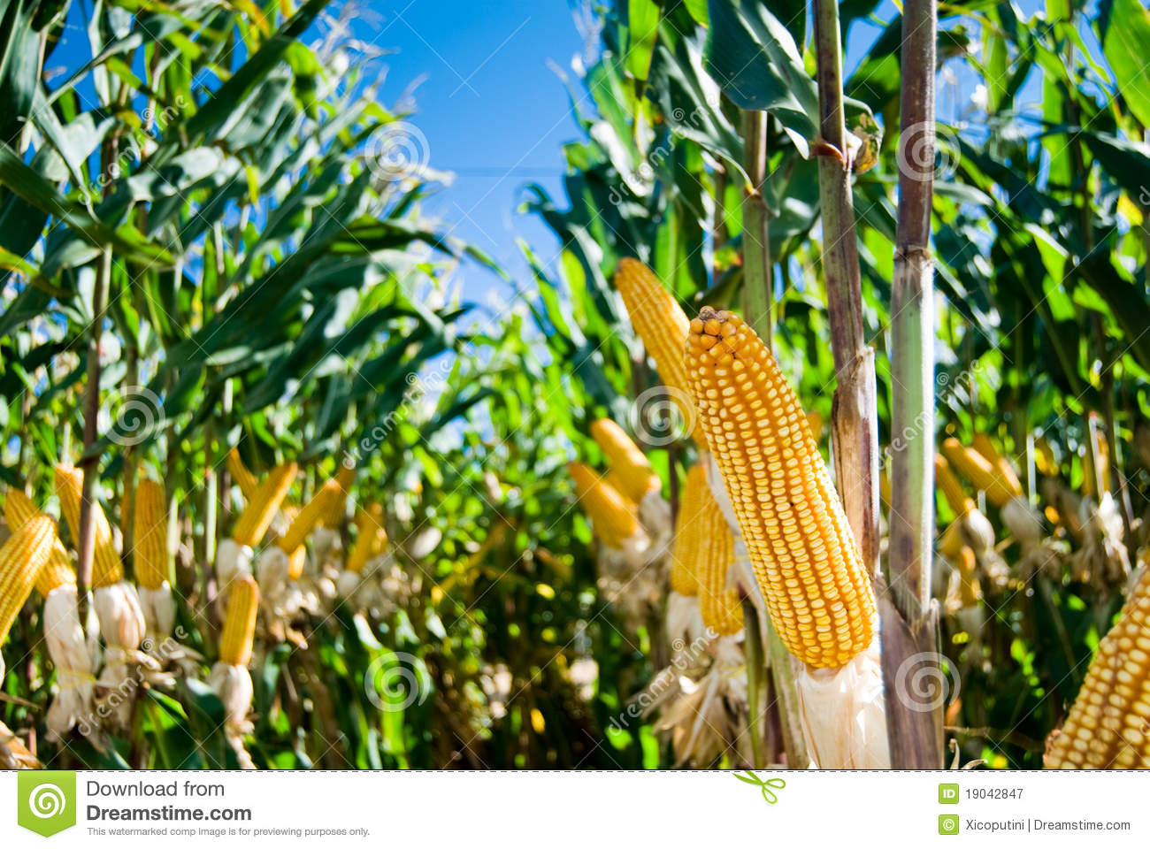
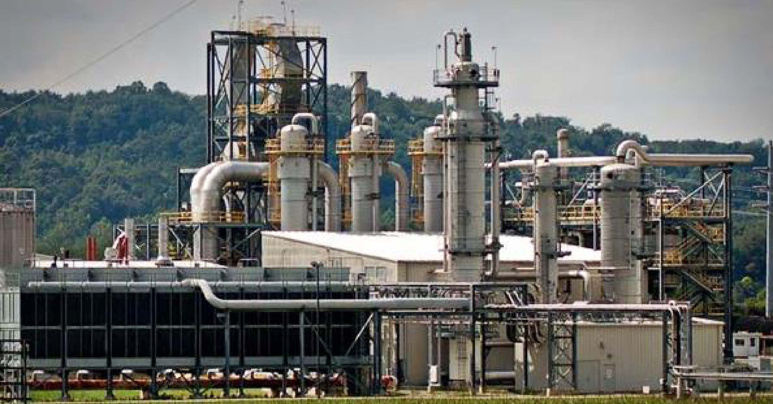
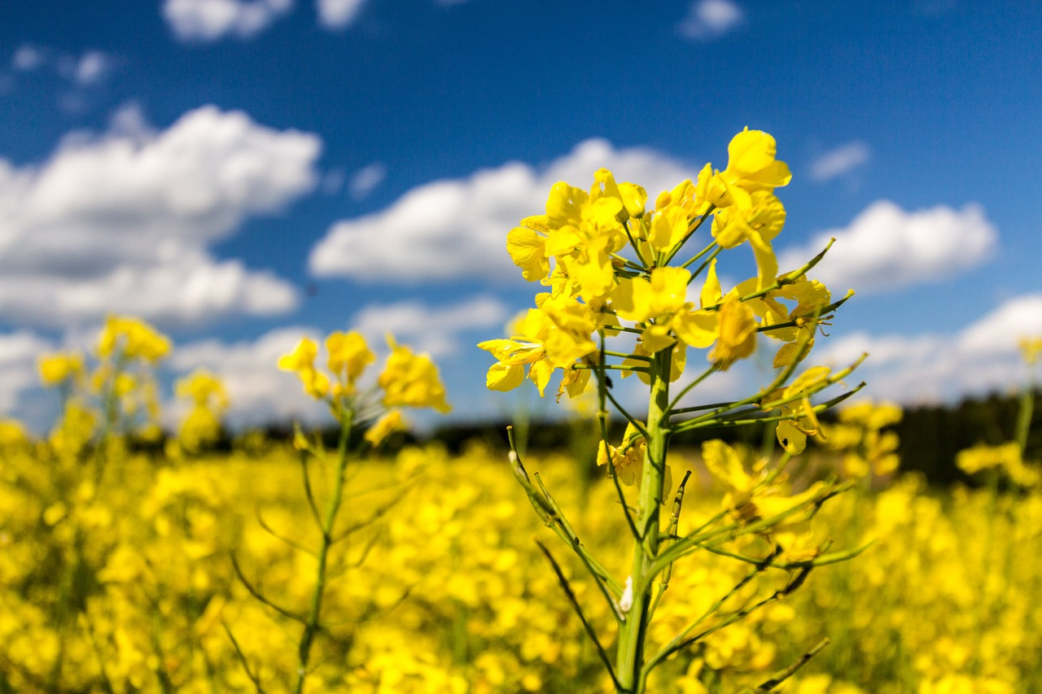
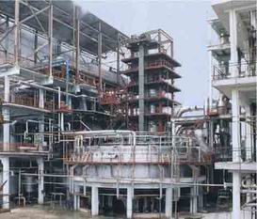
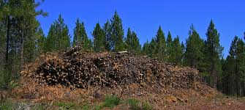
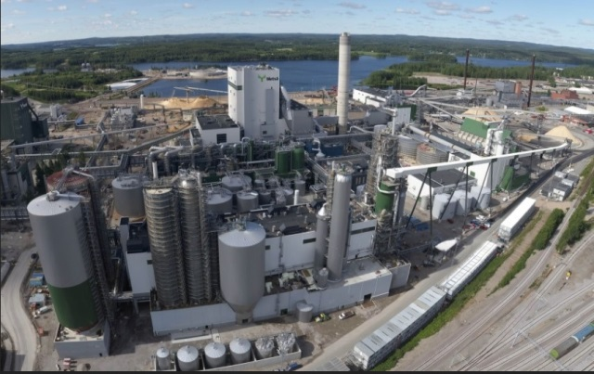
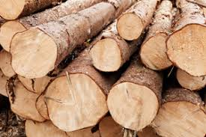
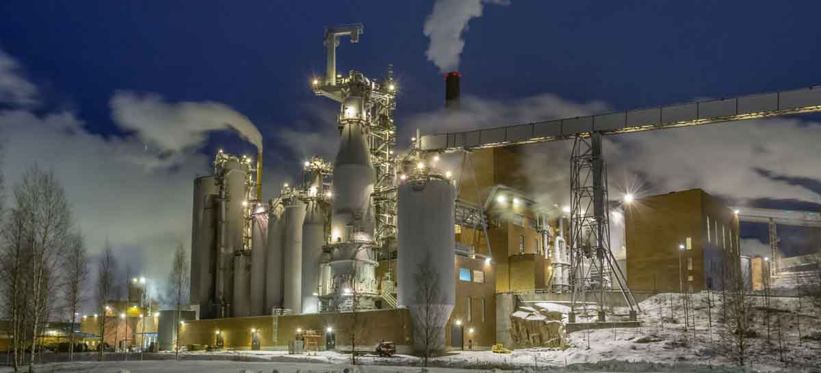
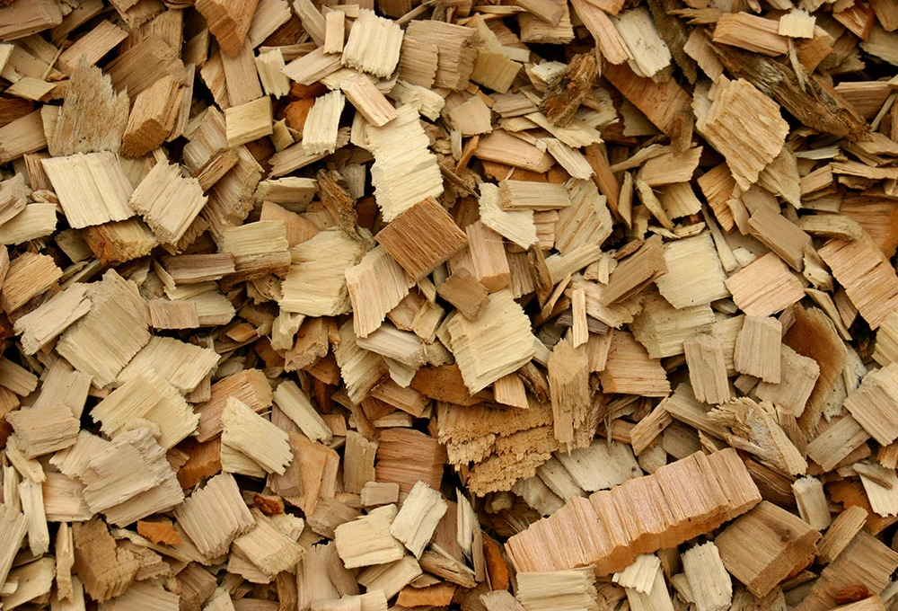
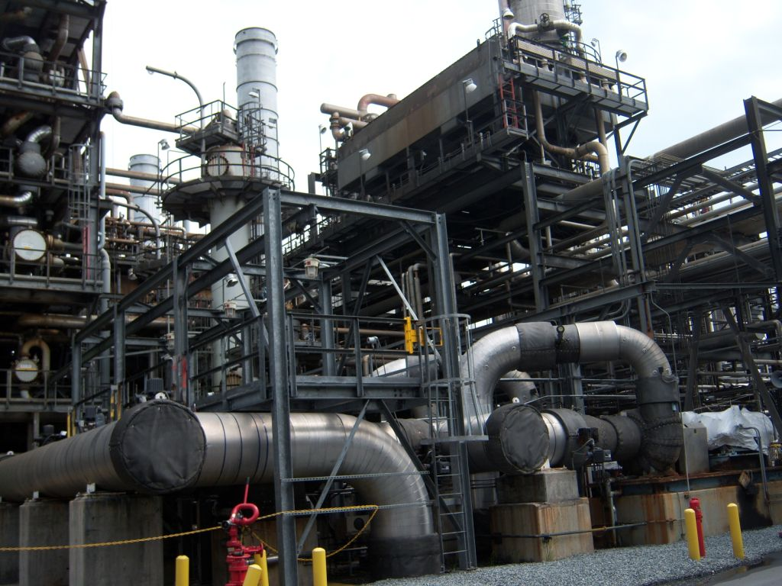
Biorefinery in the heart of the value chain
Biomass Biorefinery 1 Biomass derived Feedstock Biorefinery 2 Products
Sucrose Lactic, succinic Lactide, Bioplastics
Thick Juice CO2, DDGS Agro, Feed
Melasse Fermentor Alcohol
Pulp Pulp2Value MCF, arabinose, Gal
Starches Glucose to ethanol, butanol Biofuel, DDGS, CO2
Glucose to lactic, Lysine etc Bioplastics, Amino acids
Gluten Purification Food/Feed
Fiber Food/Feed
Vegetable oils Biodiesel FAME, glycerin
Oleochemistry Fatty acids/alcohols
Meal or cake Feed
Cellulosic sugars Ethanol Biofuel, chem
Tall oil, turpentine, lignin Tall oil to diesel, lignin to chem Energy
Cellulosic Fibers Paper making, non-wovens Paper,tissues,materials
Hemi-cellulose/lignin Lignoboost, Lignoforce Lignin, E
Pyrolisis Oil Upgrading with H2 Biofuels, Nafta
Methane (Low T) Energy, Chemicals
Syngas (High T) Gas fermentation, Fischer-Tr Biofuels, Chemicals
1G
2G
P&P
TC

Slide 6
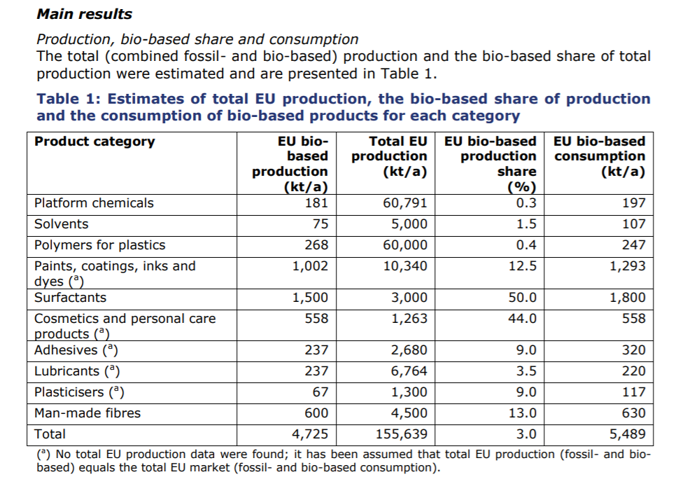
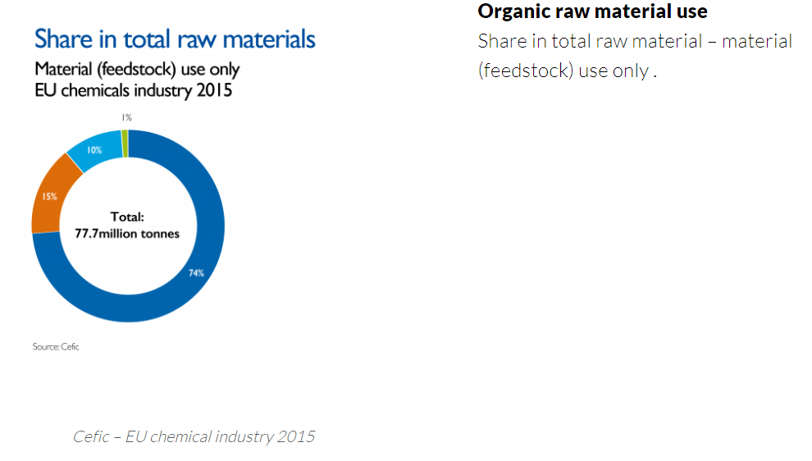
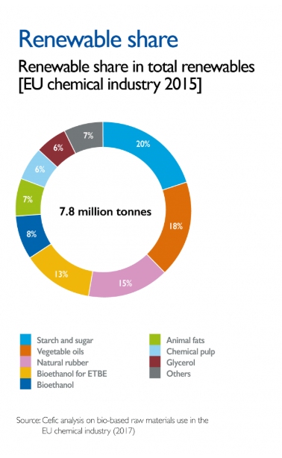
Facts & Figures

Slide 7
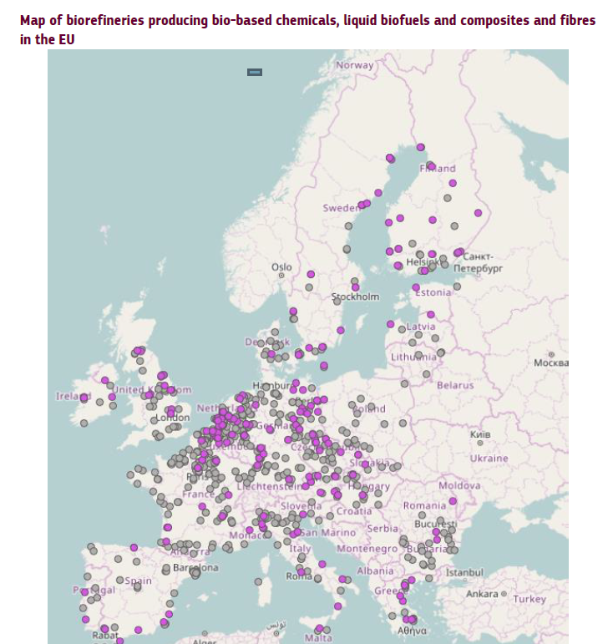
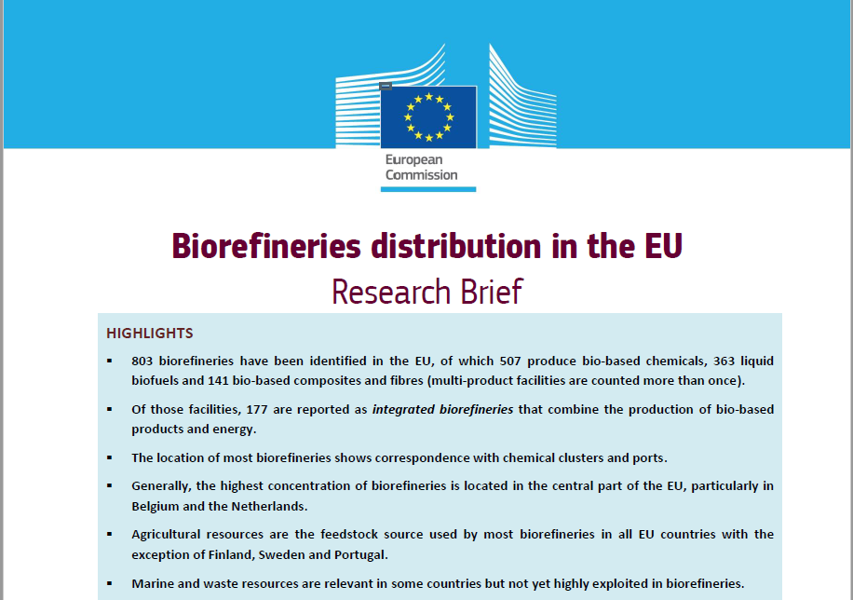
Biorefineries according to EC report 2018
How to cite: Parisi, C. (2018). "Research Brief: Biorefineries distribution in the EU". European Commission - Joint Research Centre. AUTHOR: CONTACT:
PARISI Claudia

Slide 8
Why is Lignocellulosic biomass relevant ?
Lignocellulosic is the most abundant biomass feedstock on earth
All regions have various varieties present
Wood, straw, grass, stover, reed, miscantus
Residue/waste streams under utilised
Not used for food, no direct competition (2G)

Slide 9
Key Challenges for lignocellulosic biorefinery
Lignocellulosic biomass is recalcitrant
Total valorization of all streams is challenging
By-products impact the business case
Only smart, integrated approaches will do!
Scale-up to pilot and demo takes $$ and time
Scale is a very important factor (small or large)
Close to feedstock or close to market ?

Slide 10
Example Biorefining & Value Chain Models
“Nordic” “Rotterdam” “Slovenia”
Soft wood Hard wood Forestry, Agro, MSW
Pulp mill biorefinery Biorefinery in cluster Small scale
100 -150 KT 500-600 KT Typical 30-50 KT
Integrated operations Integrated operations Spoke-in-wheel
mixed C5/C6, lignin C6, C5/C6, lignin Cellulose, sugars, Lignin
UPM/IBIOIC SEKAB -tech Various
C5/C6 Bioethanol C6 to chem C5/C6 Fibers, chem
Lignin to panels Lignin to bitumen L to syngas

Slide 11
THANKS!
Any questions?
You can find me at
Willem.sederel@biobaseddelta.nl

