Slide 1


Can we have climate-friendly freight?
Samuel Kenny
samuel.kenny@transportenvironment.org

Slide 2
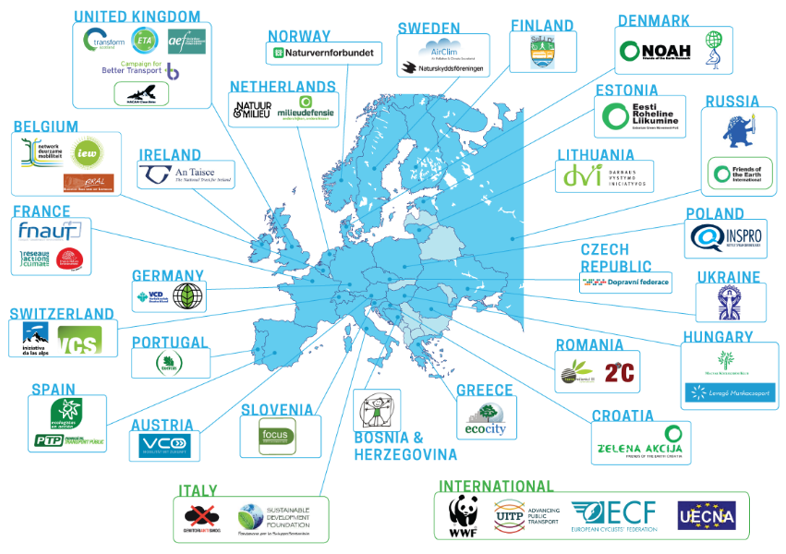
T&E: 27 COUNTRIES
50+ MEMBERS & SUPPORT GROUPS

Slide 3
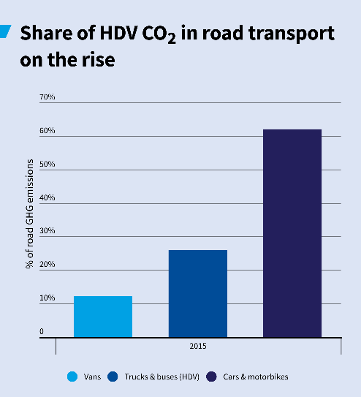
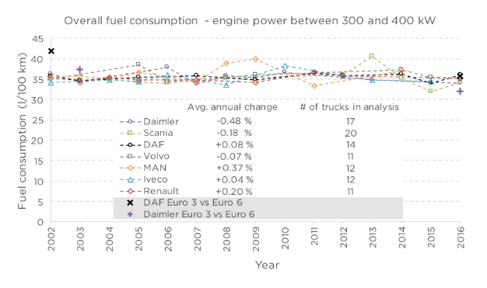
EU climAte Context (ESR: -30% by 2030)
Stagnating fuel consumption

Slide 4



Modal Shift!
Competition
Business Practice
Pricing with other modes
Infrastructure communication

Slide 5
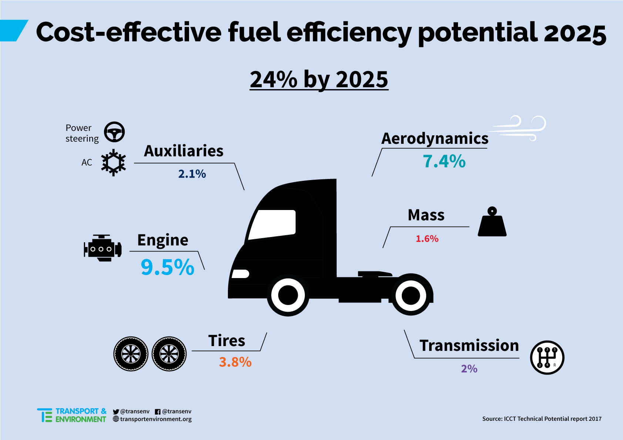
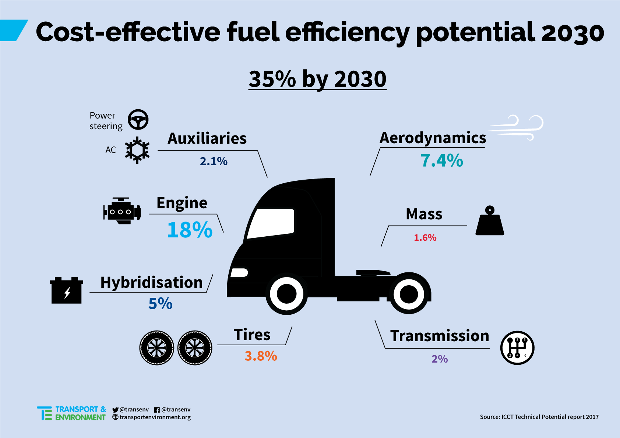
Fuel efficiency standards
9,5%
23%
Fixed 2025 target of 24%: Full vehicle and engine standards are the preferred option (as in US phase I)
Range 2030 target: Final target should be set during review in co-decision (2021). Give long term guidance to OEMs.

Slide 6
Huge return on investment!
2025 fuel efficiency improvements of 27%:
Extra cost of 7,500 euro per tractor trailer
Fuel savings first five years: 28,000 – 62,000 euro!
2030 fuel efficiency improvements of 43%:
Extra cost of 32,000 euro per tractor trailer
Fuel savings first five years: 45,000 – 98,000 euro!

Slide 7
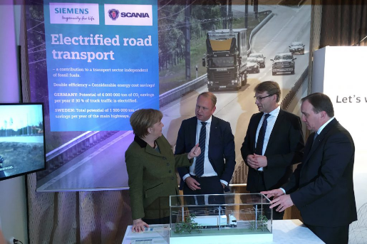
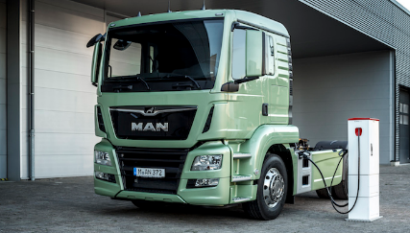

PROMOTE ZERO EMISSION
E-HGVs Coming soon:
MAN, Siemens, Daimler, Tesla and others investing in E-HGVs

Slide 8
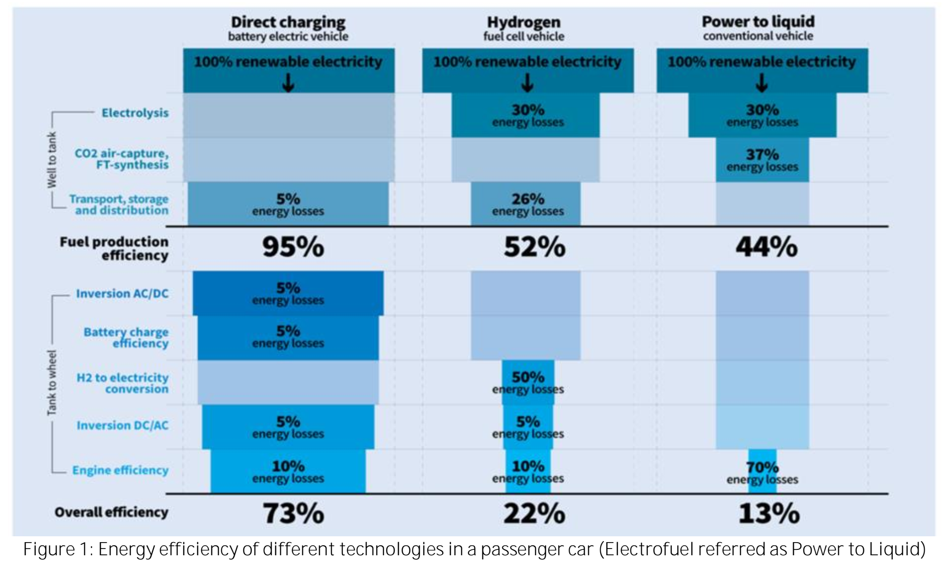
Efficiency first
Supplying 50% of truck energy demand with PtL would require 36% of EU electricity

Slide 9
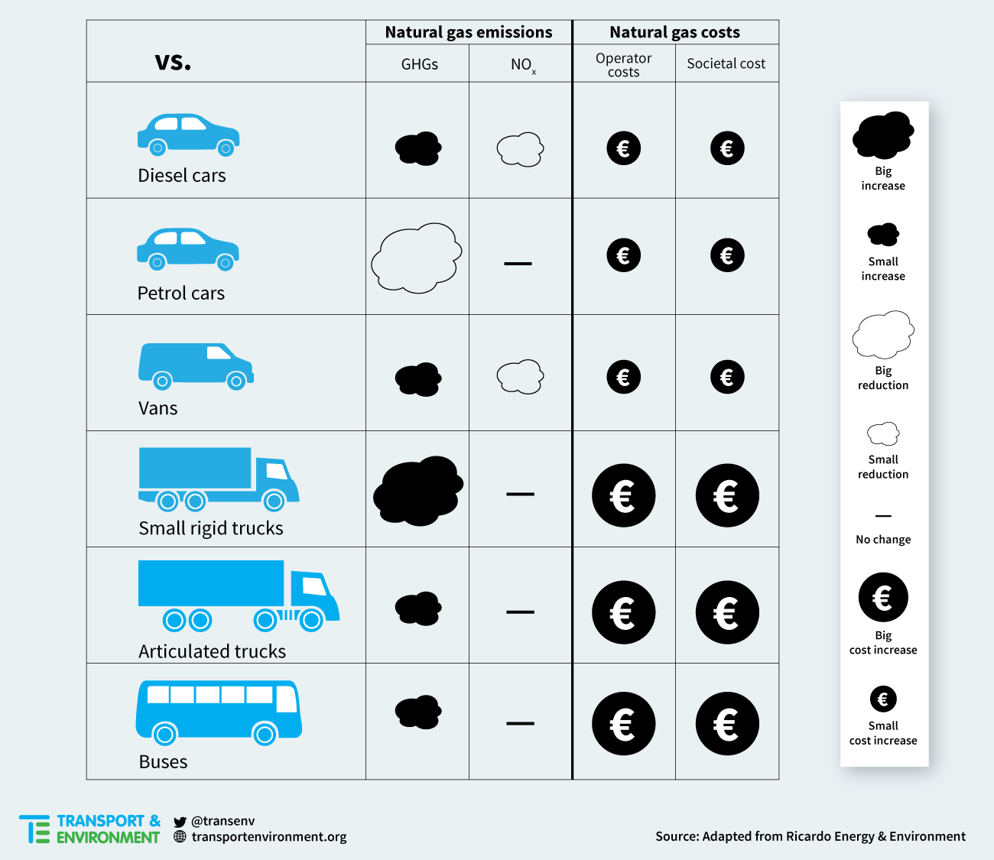
Natural Gas – LNG and CNG

Slide 10
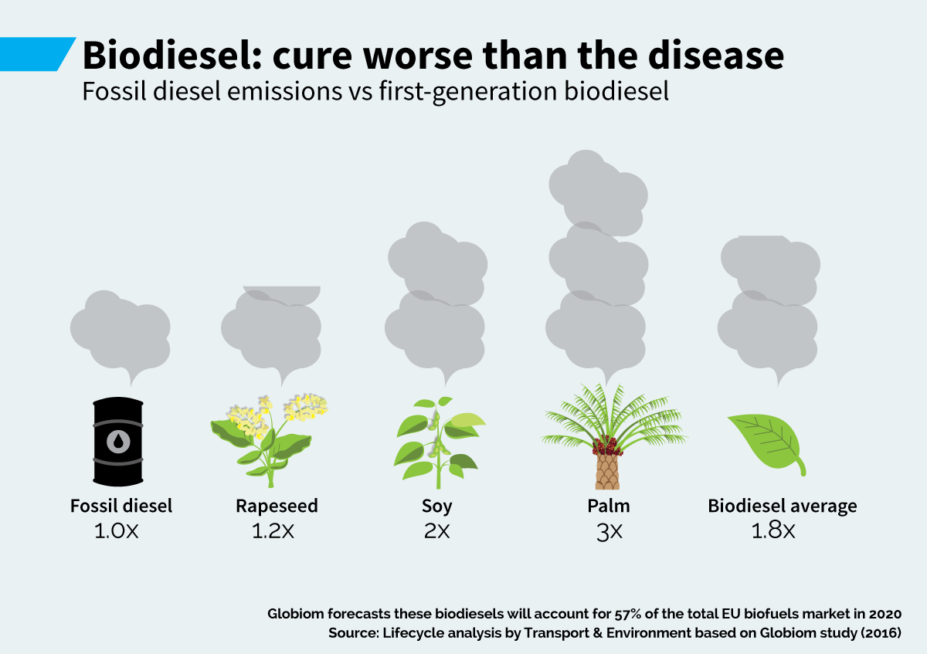
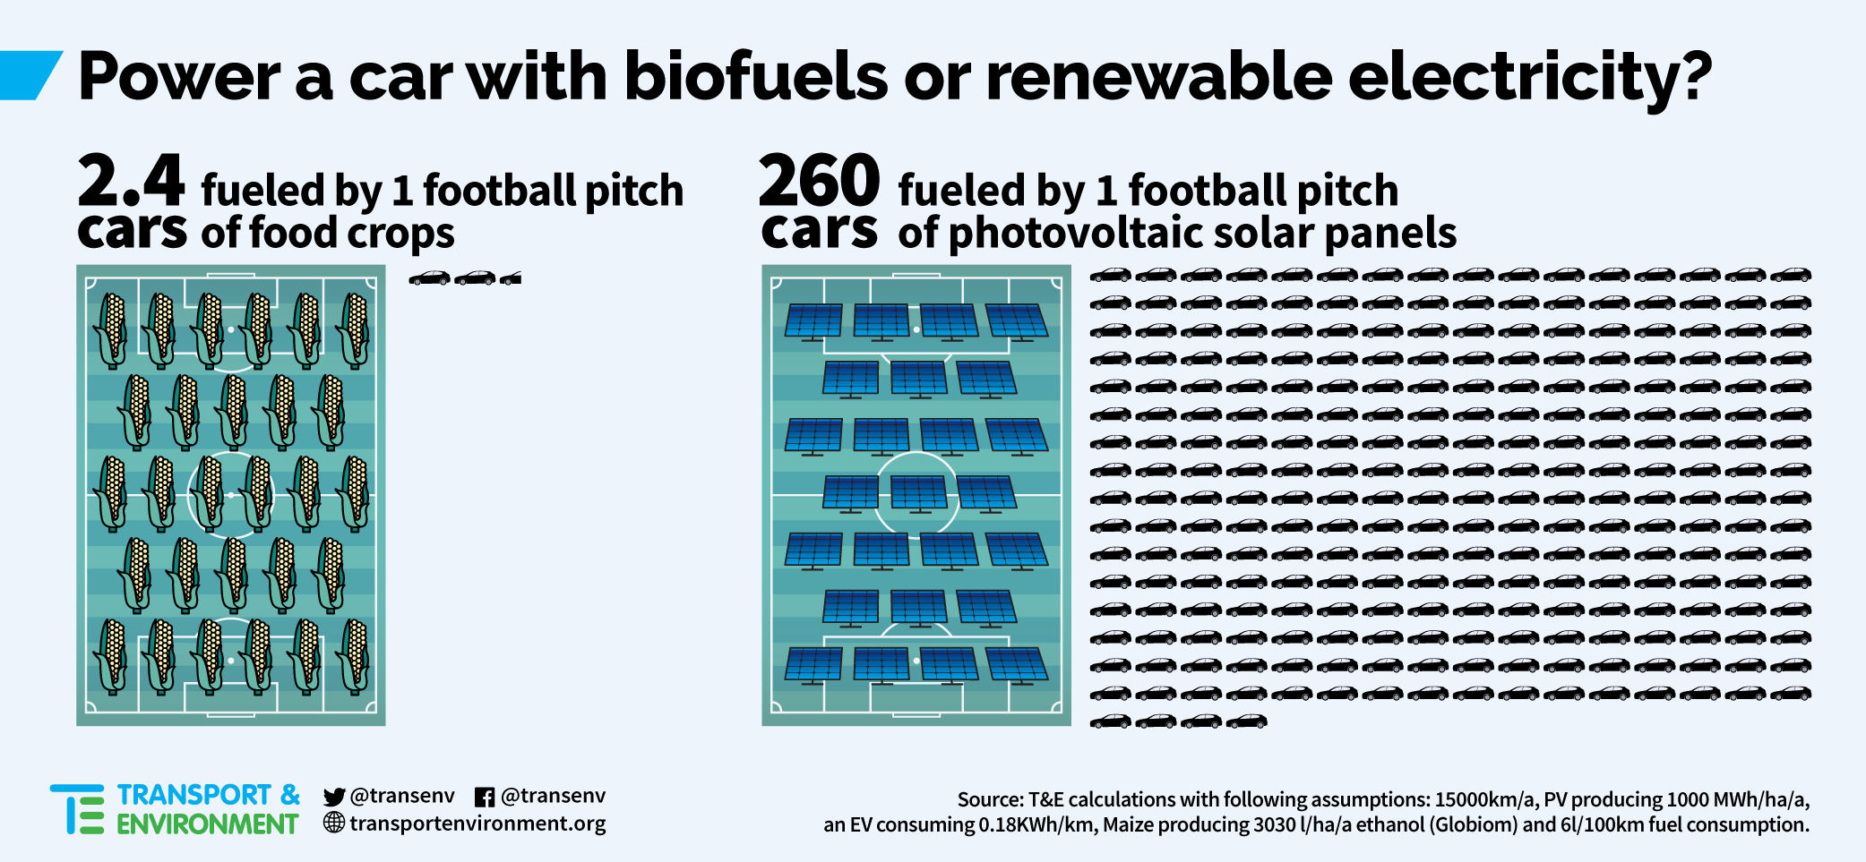
biofuels
First generation crop based biofuels are not a solution (ILUC etc.)
Advanced biofuels can be part of the solution BUT scalability issues and sustainability criteria

Slide 11
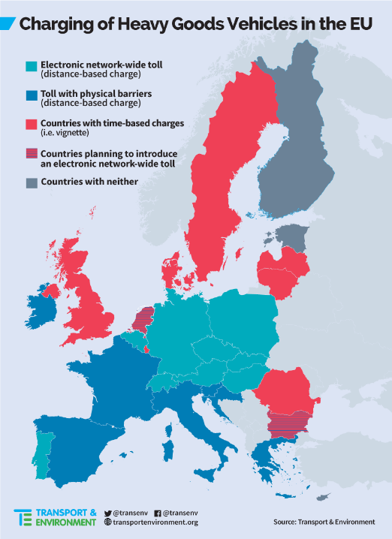
Logistic Efficiency
Distance-Based is better for:
Promoting efficient transport behaviour
Reducing air pollution, noise, and congestion
Increasing the uptake of cleaner vehicles
Generating revenue for Member States

Slide 12
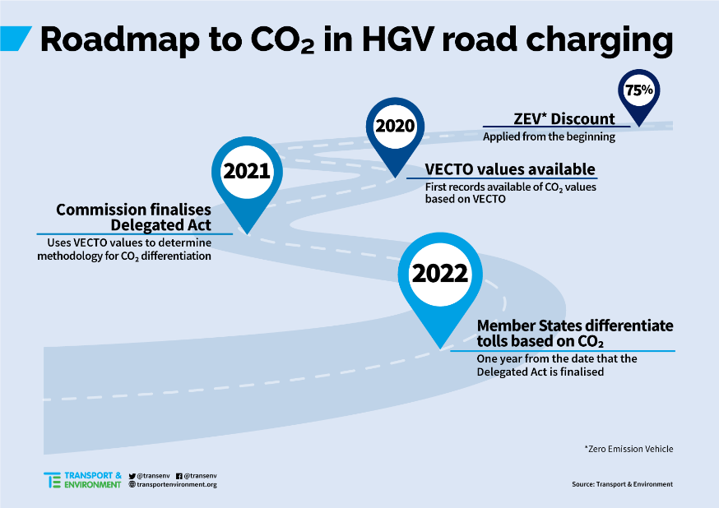
CO2 DIFFERENTIATION

Slide 13
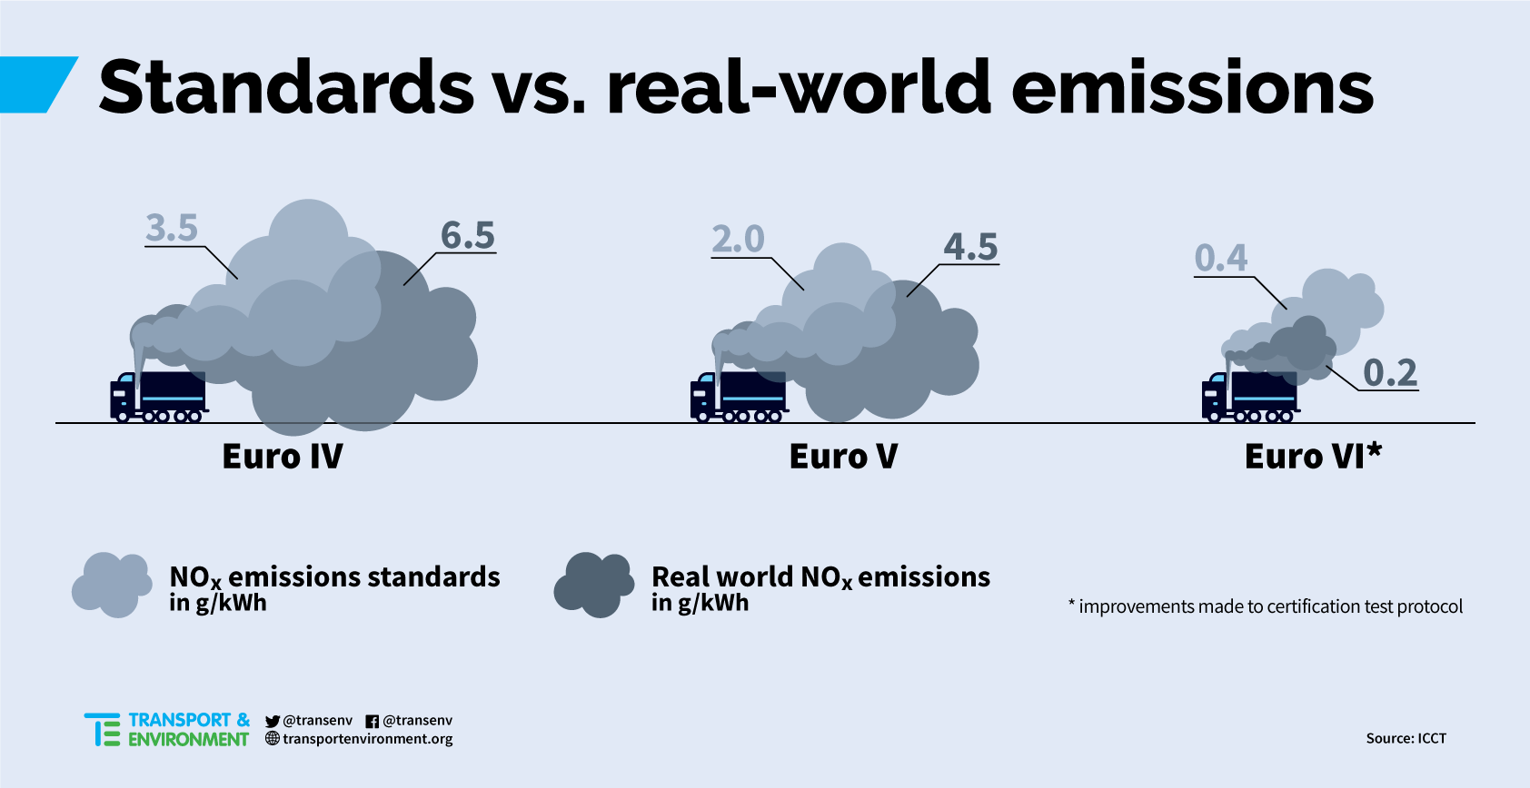
EXTERNAL COSTS FOR ALL TOLLED ROADS

Slide 14

3 Steps forward
Adopt fuel efficiency targets for trucks
Introduce Distance-Based Tolls across the entire road network differentiated by environmental performance
Promote Zero-Emission Freight – Modal Shift and ZEVs

