Slide 1

Cooperate and Grow
Andrea E. Reinhardt
Co-chair Nanofutures a.s.b.l
www.nanofutures.eu

Slide 2
Circular Economy and Nanofutures
  “A circular economy is an industrial economy that promotes greater resource productivity aiming to reduce waste and avoid pollution by design or intention….This is contrast to a linear economy which is a 'take, make, dispose' model of production”
  Nanofutures is your tool to find partners and taking benefit from the latest research results in using nanotechnology to make circular economy efficient.

Slide 3
RAW Nano Value
  European Innovation Partnership:
  Critical Raw Materials, their role in nanotechnology based value chains. Nanotechnology as a vehicle for substitution.
  RAWNANOVALUE will have a direct impact over the way that the EU industrial development of Nanotechnology is conceived, by ensuring that new EU Nanotechnology developments, Value Chain designs, EU roadmaps, and innovation solutions relaying on Nanotechnology, pay attention to a proper management and efficiency of the use of CRMs and incorporate the Circular Economy basis
  Contact: scuesta@ubu.es
  http://www.nanofutures.info/groups

Slide 4

NANOfutures ETIP: brief introduction
Pilot lines
Cooperation and Growth
Q&A

Slide 5

INTRODUCTION
NANOfutures is the European Technology Integrating and Innovation Platform on nanotechnology
Its main objective is to facilitate the nanotechnology development and commercialization by connecting all relevant nanotechnology stakeholders
It fosters a responsible development of the Nanotechnologies by balancing:
Industrial Profit
Safety
Quick access to Market
Regulation
Deep Knowledge
Cost of Research
All the main actors need to be involved in this process for tracing a Roadmap
Companies, Industrial Clusters, …
Research& Institutions and HE
Policy Makers, Governments…

Slide 6
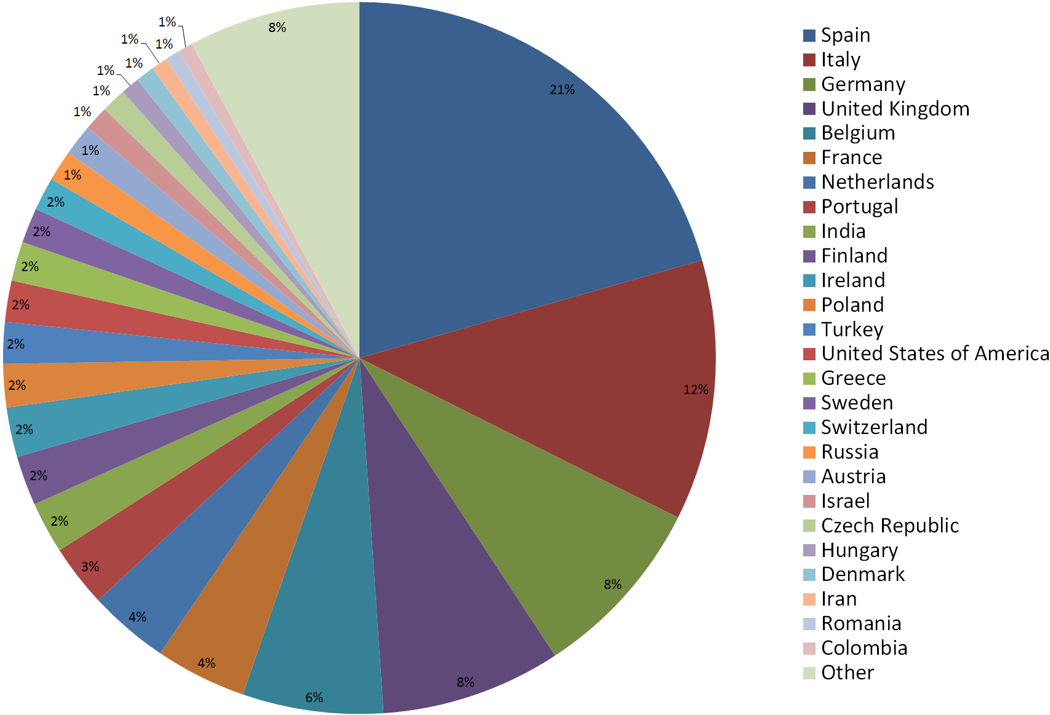
INTRODUCTION
The community has now more than 1100 members from 60 different countries.
~35% of them are from industry and industry associations

Slide 7
INTRODUCTION
CROSS-SECTORIAL Tech. –non-Tech. ISSUES
REGIONS/
COUNTRIES
MARKET -SECTORS
Help exploiting complementarities to avoid duplication and fragmentation: alignment of private and public efforts, expertise, …
Wider focus: Sectorial issues , but commonalities : common needs/barriers….
Design competitive alliances to drive to market: effective integration and coordination of stakeholders

Slide 8




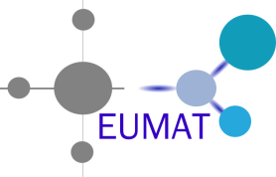
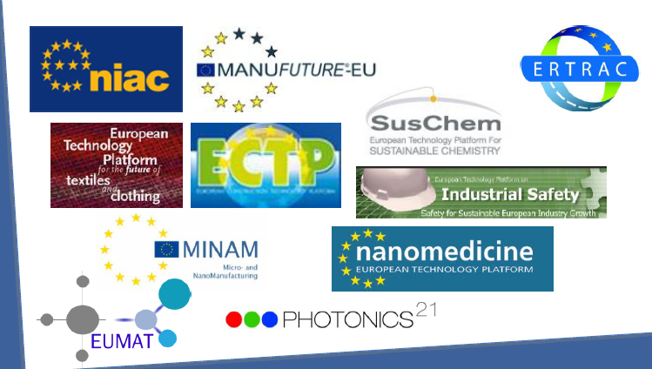




NfA ENVIRONMENT
Bringing together the interests of several ETPs
10 Working Groups covering broad and key technological and non technological issues
CROSS-SECTORIAL Tech. –non-Tech. ISSUES
REGIONS/
COUNTRIES
MARKET -SECTORS
Industralisation
Research and Technology
Communication
Regulation
Networking
Safety
Standarization
Skills and Education
Tech. Transfer and innovation Financing
Lighthouses’ network: 26 local contact points
Critical Raw Materials
http://www.nanofutures.eu/structure

Slide 9

WHAT’s FOR ME?
Apply existing results
Be aware of tendencies/
developments
Extend your knowledge
Find new applications
Build business one2one
Run your own pools
Consortiums: find suitable partners
MEMBER
Promote your events, results, work....
Get in touch with other key players
Influence on EU activities
… all this, free of charge!
Become a member at: http://www.nanofutures.eu/user/register

Slide 10
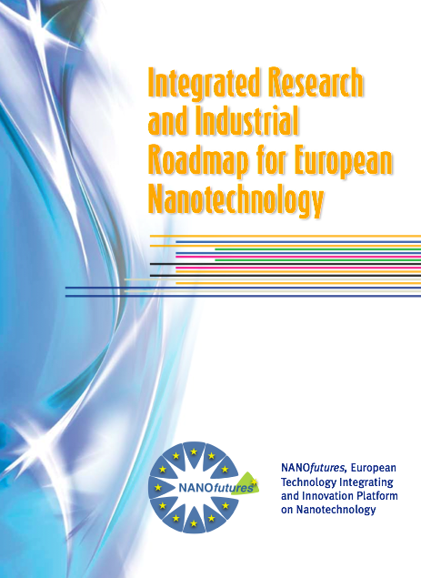
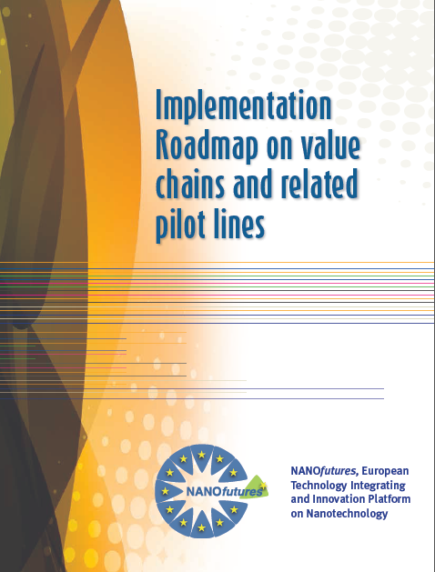
ROADMAPPING
2012
2015
Find them at: http://www.nanofutures.eu/documents

Slide 11
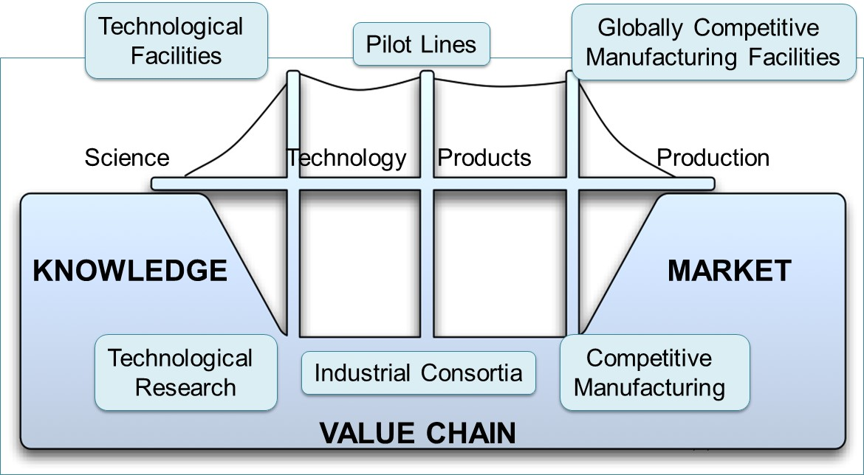
VALUE CHAIN APPROACH
A value chain approach was adopted in order to contribute to bridge the current gap between nanotechnology knowledge and successful commercialization of nano-enabled products
PULL: Availability of technological facilities, pilot line and globally competitive manufacturing
facilities;
PUSH: outcomes of technological research, availability of outstanding industrial consortia
and competitive manufacturing.

Slide 12
VALUE CHAIN APPROACH
That PRODUCT would be:
-EFFICIENT, in terms of resources and energy consumption
-SPECIALIZED, as it is the European Industry
-SAFE, because we had the knowledge to make them safe by design
How we get such NANO-Enabled product?
As for any other product: developing its Production Chain
Materials
Tools
Components
Assembly
PRODUCTION CHAIN
The PRODUCTS

Slide 13
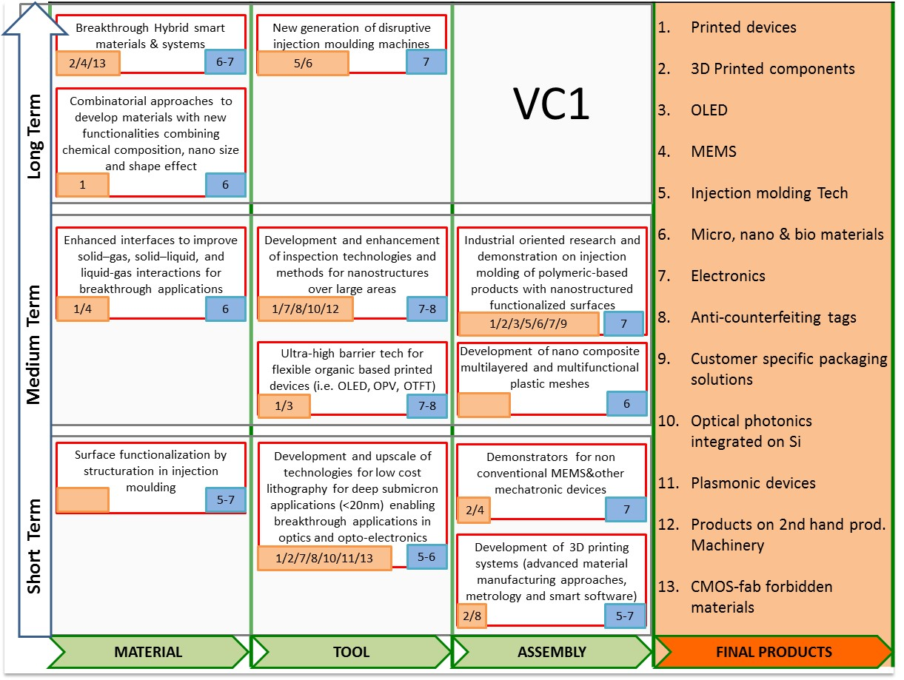
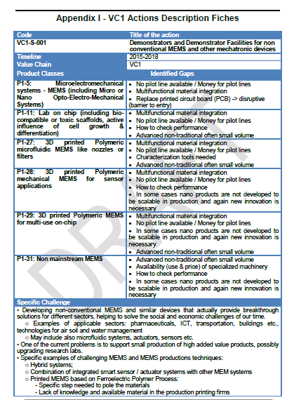
VC ROADMAP: Results’ example
First identify priority VC connected to most needed end-product and then breaks this into the required elements that can form the basis for deciding on investments and timeline for a successful implementation by industry.
Adressed Products
product categories
Expected TRL
Tech. actions
13
Timeline
VC stage position

Slide 14
PILOT LINES
The complex structure of the whole value chain reflects the complexity of real problems.
A pilot production that do not arrive to a final product does not create a real economic growth.
FINAL PRODUCT AT PILOT LEVEL
The focus is in providing the support to increase up to TRL 7, corresponding to pilot lines

Slide 15
European Pilot Production Network EPPN
The European Pilot Production Network (EPPN) acts as coordination and "bridging" platform in the area of nanotechnology and advanced materials technology upscaling and pilot production.
The overall objective of EPPN is to provide infrastructure and advisory services, facilitate access for SME's and start-ups under favourable conditions, and hereby maximise the impact of these facilities.
The initiative would also seek better coordination of innovation
programmes and finance opportunities from H2020, regional and private sources, in order to maximise synergies and impact of the various investments.
More information will soon be available via EPPN Webpage.

Slide 16
EPPN at work
  Establish future research and innovation needs.
  Coordinate input to future research policy and innovation directions.
  Identification and recommendation for strategy developments at European, national and regional level, with particular focus on innovation barriers and the exploitation of pilot production facilities
  Explore Synergies with national, regional initiatives including RTD&I Programming (smart specialisation)
  Establish national and regional contacts with interest to work with the EPPN
  Establish contacts and monitor best international practices related to the pilot production facility development
  Establish Value Chain and Ecosystem development needs related to pilot plants and support further integration

Slide 17
Pilots at EuroNanoForum 2017 Malta
  Session 14 11.30-14.00 21th of June
  Pilot lines for industrial implementation
  This session will focus on pilot line activities as efficient catalysts for innovation. They open up the bottleneck and enable crossing of the valley of death between invention and market. In addition, Open Infrastructures bring together, integrate on European scale, and open up key national and regional research infrastructures to all European researchers, from both academia and industry, ensuring their optimal use and joint development.

Slide 18
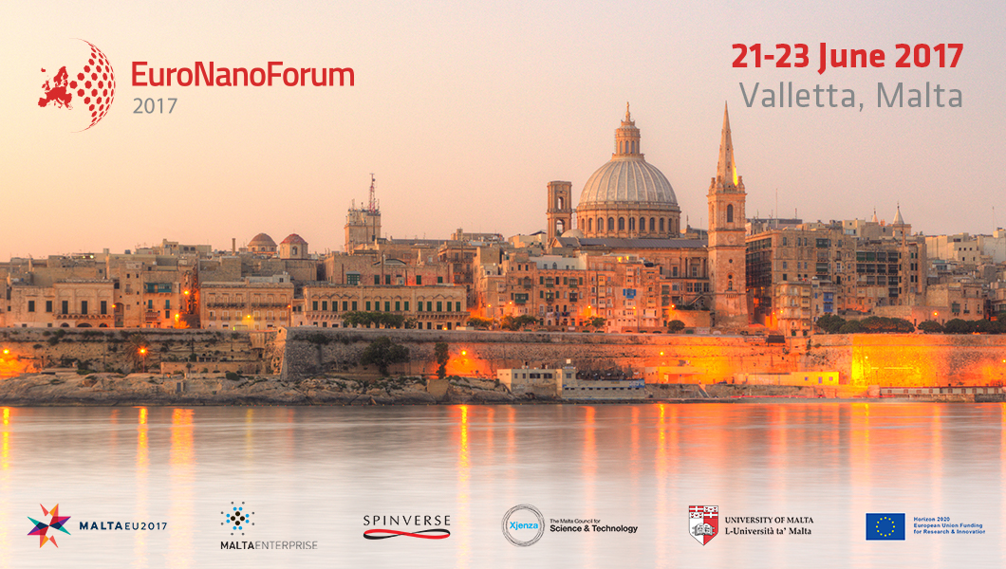
EuroNanoForum

Slide 19


Thank you!
www.nanofutures.eu
@nanofutures
Andrea E. Reinhardt
Co-chair of NANOfutures ETIP
reinhardt@nanofutures.info

