Slide 1



Sustainable Business Models in Circular Bioeconomy
JANEZ POTOČNIK
Co-chair UNEP International Resource Panel (IRP)
Partner SYSTEMIQ
23th September 2019

Slide 2
Let’s start the story in my home country Slovenia
Slavoj Žižek
“It is clear that we are approaching the ecological and digital apocalypse … but we should not loose nerves.”
“Everything under heaven is in utter chaos;
the situation is excellent.”

Slide 3
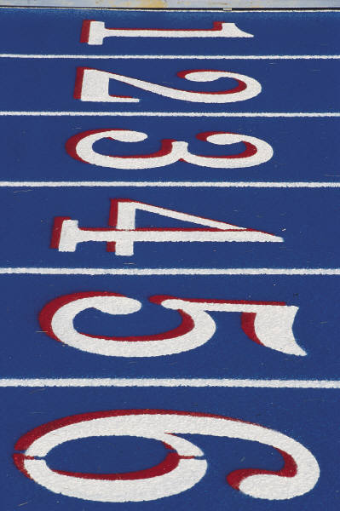
THE TASTE OF “UTTER CHAOS”
Population growth (2050 – 9.7 billion)
Few people own the same as the poorest half of the world and the richest 1% is more wealthy than the rest of the world
We throw away one third of the food we produce
More than 50% of urban fabric expected to exist by 2050 still needs to be constructed. 2011-13 China has used more cement than USA in 20th century
Climate change experts warned us that emissions need to be about halved by 2030 to limit warming to 1.5˚C
Biodiversity: Living Planet Index – 60% fall in just 40 years. Biomass of the mammals living in the nature has been reduced in recent decades for 82%
A million of plastic bottles are bought every minute (9% of plastic recycled, 12% incinerated, 79% landfills or environment). If drinking only bottled water one consumes 130,000 plastic particles per year from that source alone, compared to 4,000 from tap water
We are the first generation more likely to die as a result of lifestyle choices than infectious disease

Slide 4
For the first time in a human history we face the emergence of a single, tightly coupled human social-ecological system of planetary scope.
We are more interconnected and interdependent than ever.
Our individual and collective responsibility has enormously increased.

Slide 5
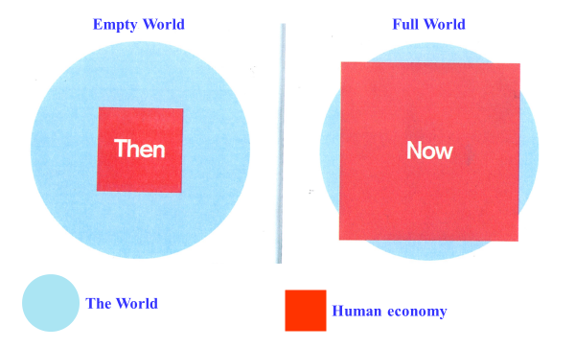
Empty World and Full World
Source: Club of Rome: Simplified after Herman Daly
Labour and Infrastructure limiting factors of human wellbeing
Natural resources and Environmental sinks limiting factors of human wellbeing

Slide 6
Our Economy

Slide 7
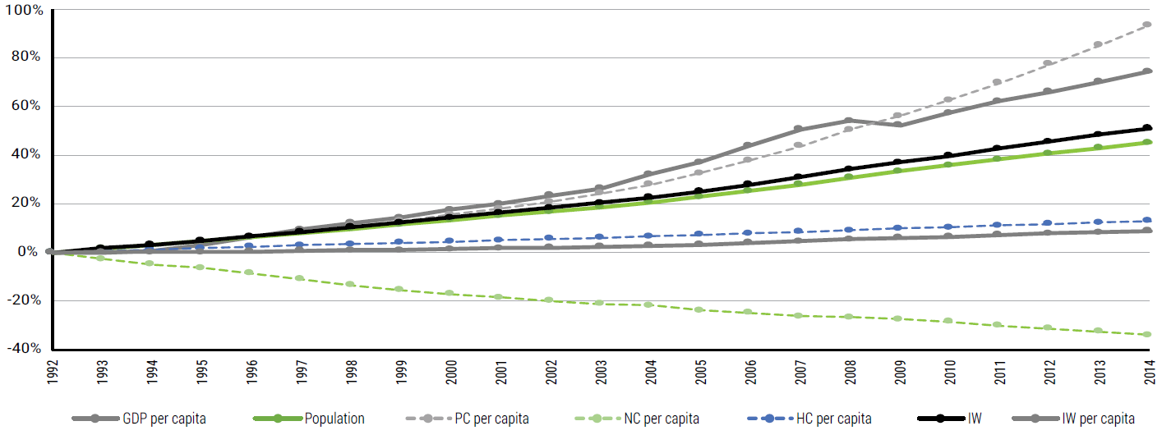
Inclusive Wealth (IW) Index (and its components) evolution - 1992 to 2014
IW – Inclusive Wealth
PC – Production capital
HC – Human capital
NC – Natural capital
Growth of GDP in the past decades has been achieved at the cost of depleting natural capital

Slide 8
Producers/Consumers
Rational Behaviour
Market Economy
Production capital overvalued
Human capital undervalued
Natural capital not valued
Economic, social and environmental (in)balance

Slide 9

LIVING WELL WITHIN ECOLOGICAL LIMITS
ECONOMIC SYSTEM FUNCTION OF ECOSYSTEM
ECOSYSTEMS
Deposits Emissions Pollution
SOCIO-TECHNICAL SYSTEMS
providing social needs and value
Withdrawals from the ecosystems
Profits privatized
Policy
system
Industry
  Ecosystem
  services
Energy
system
Food
system
Environmental externalities
Environmental externalities
system
system
Mobility
system
Values
Market
Costs socialized
Science
Technology
Notes:
We therefore need a new model of change that will allow us to live well within planetary boundaries. This is what the green economy should be. It aims not only at efficiency, but also at ecosystem resilience and at human well-being.
We need instead to completely rethink our systems and the business models that support them, and a transition to new systems that fulfil societal needs but do so in an essentially sustainable way.
The circular economy is a fundamental part of this transition, and it is a crucial element of the 2050 vision in the 7th EAP. The upcoming communication of the European Commission on circular economy will propose some important steps towards this transition.
Transitions in our socio-technical systems will not occur all at once. Historically, changes in these systems and the business models that support them did not occur in a big bang. Instead, socio-technical systems often emerged via small ‘niche’ innovations in business and other places. Niche innovations happen all the time, but only a few of these niche innovations are successful enough to be up-scaled and distributed more widely.

Slide 10
RESOURCES
THE MISSING LINK

Slide 11

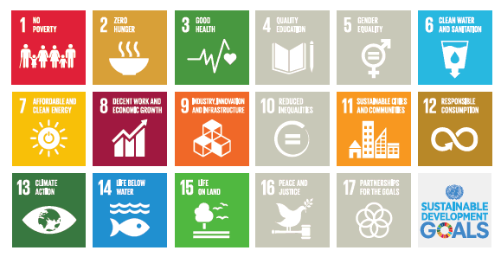
SDGs DIRECTLY DEPENDENT ON NATURAL RESOURCES

Slide 12
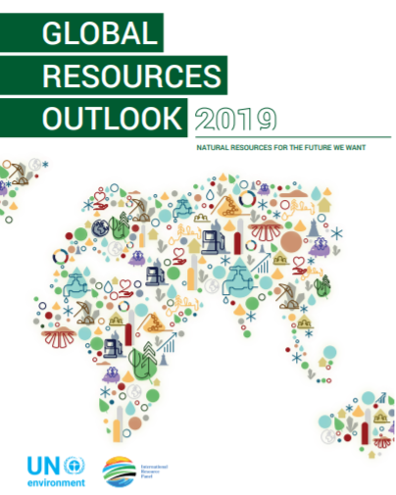
NATURAL RESOURCES FOR THE FUTURE WE WANT
Notes:
[PLACEHOLDER – TITLE SLIDE TO BE INCLUDED]

Slide 13
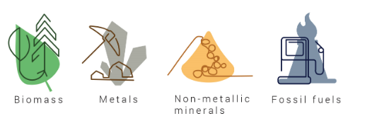
Resources:
Provide the foundation for the goods, services and infrastructure that make up our current socio-economic systems
Biomass (wood, crops, including food, fuel, feedstock and plant-based materials)
Fossil fuels (coal, gas and oil)
Non-metallic minerals (including sand, gravel and limestone)
Metals (such as iron, aluminum and cooper…)
Per capita material footprint from High-Income Countries is 13x the level of the Low-Income Countries !!!

Slide 14
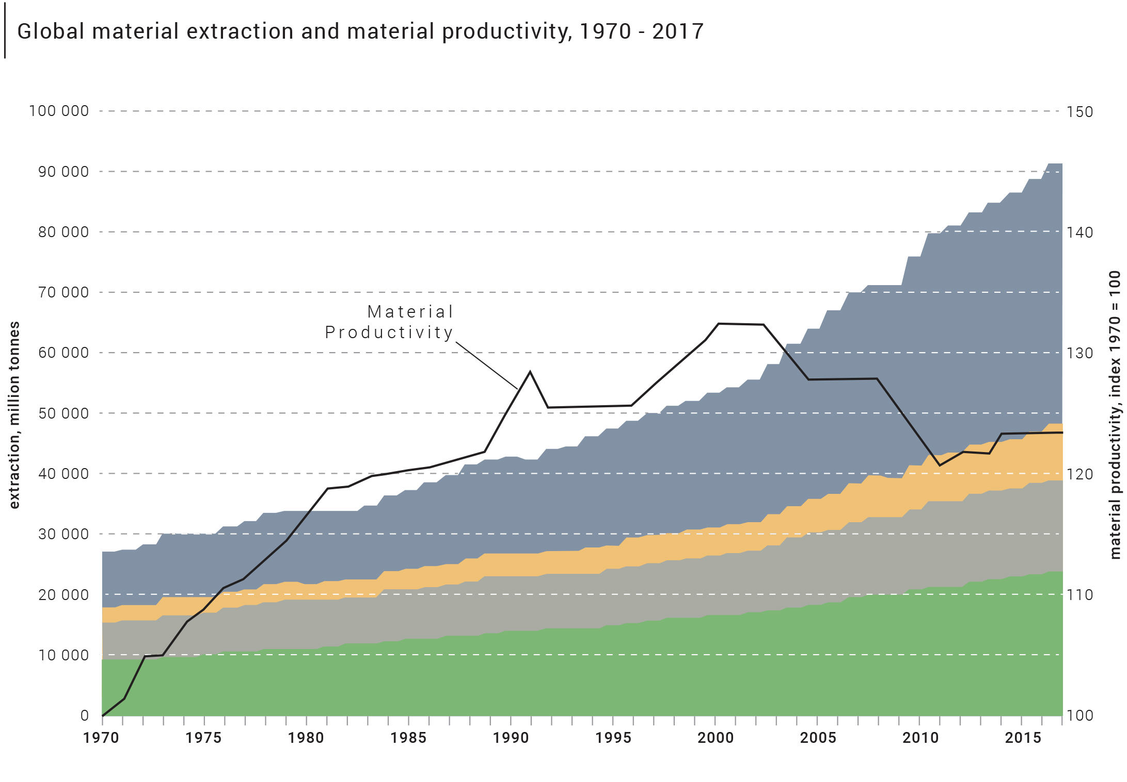
Relentless demand: Global resource use, Material demand per capita and Material productivity 1970-2017
Global resource use has more than tripled since 1970
Global material demand per capita grew from 7.4 tons in 1970 to 12.2 tons per capita in 2017
Material productivity started to decline around 2000 and has stagnated in the recent years
Non-metallic minerals
Metals
Fossil fuels
Biomass
Notes:
Common perception: The economy is growing but technology is advancing and we are becoming more efficient
The truth: Some (high-income) countries are becoming much more efficient but global productivity has not improved in almost 20 years
-> Technological progress in some countries does not automatically (fast enough) trickle down to other countries
-> Efficiency gains in some countries are not actually due to technological progress but due to outsourcing of production of final items
-> Larger shares of production have been moved to less efficient countries
-> Global production and consumption chains do not have a systematic productivity focus - let alone effective strategies - yet

Slide 15
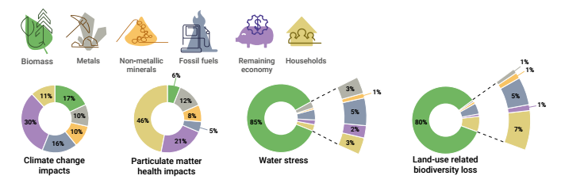

Environmental impacts in the value chain
resource extraction and processing phase
90% of global biodiversity loss and water stress
50% of global climate change impacts
1/3 of air pollution health impacts
Notes:
The extraction and processing of materials, fuels and food make up about half of total global
greenhouse gas emissions (not including climate impacts related to land use) and more than 90
per cent of biodiversity loss and water stress.
An estimated 11 per cent of global species were lost by 2010 due to global land use.
Water stress:
Biomass: 85%
Land use related biodiversity loss:
Biomass: 80%

Slide 16
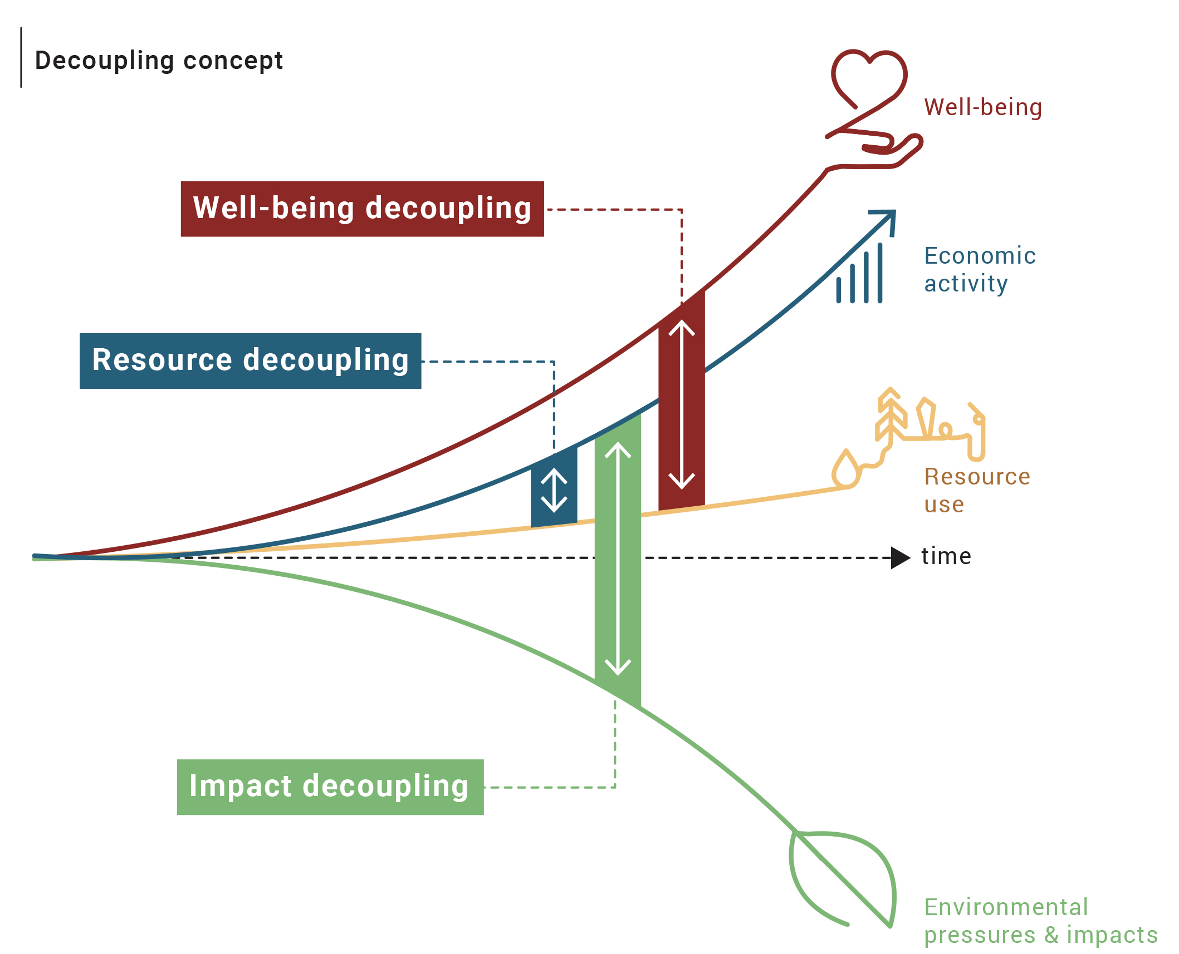

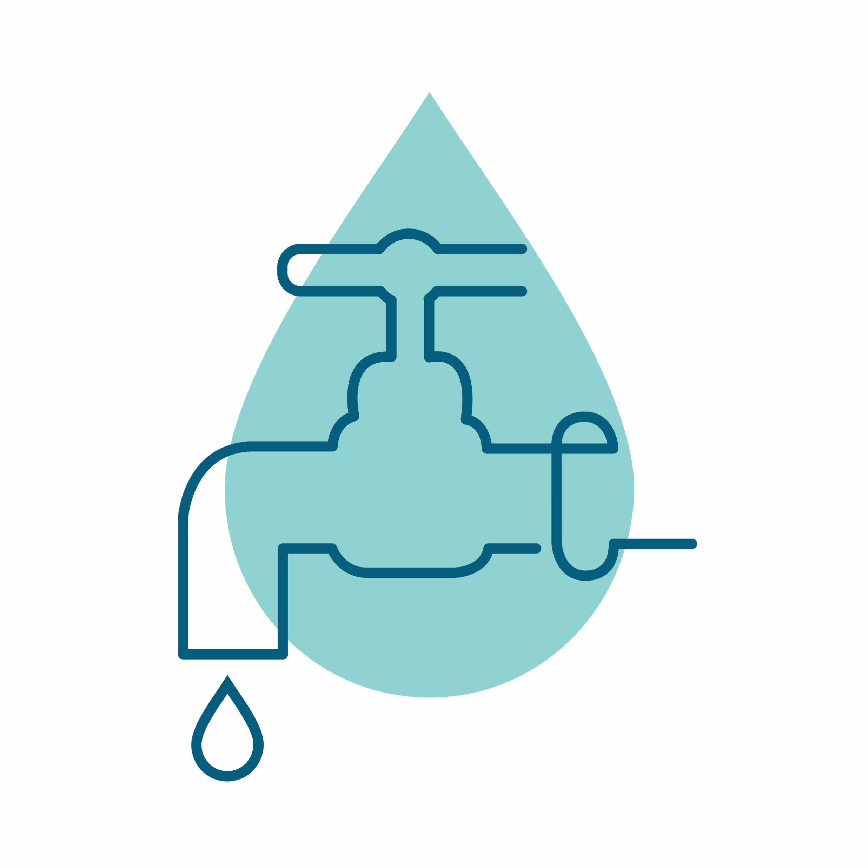


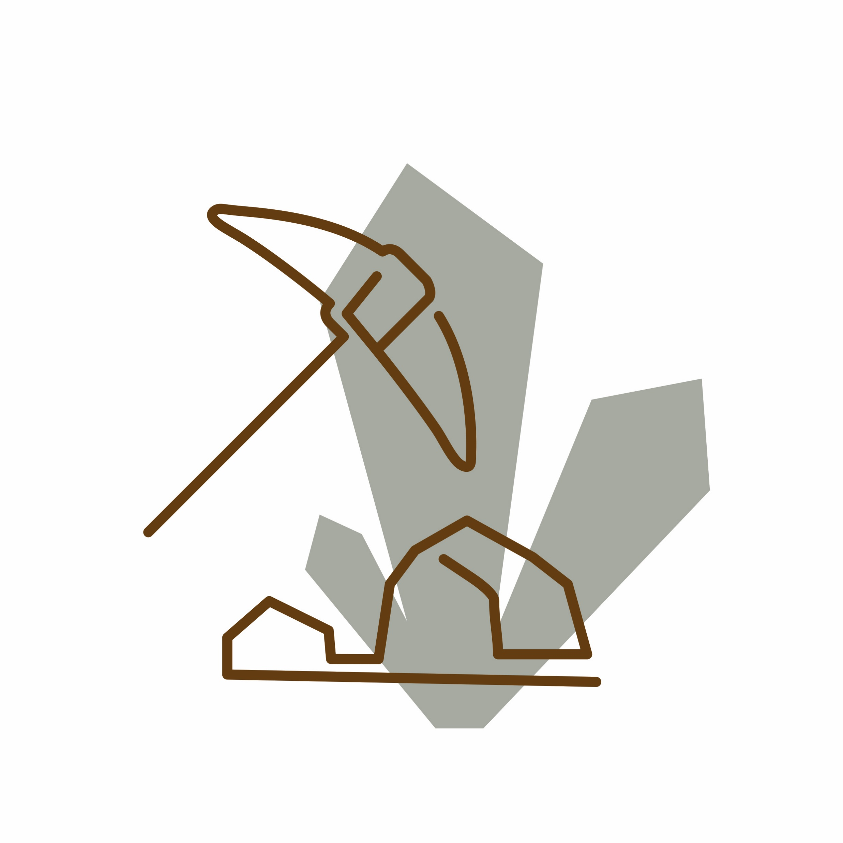
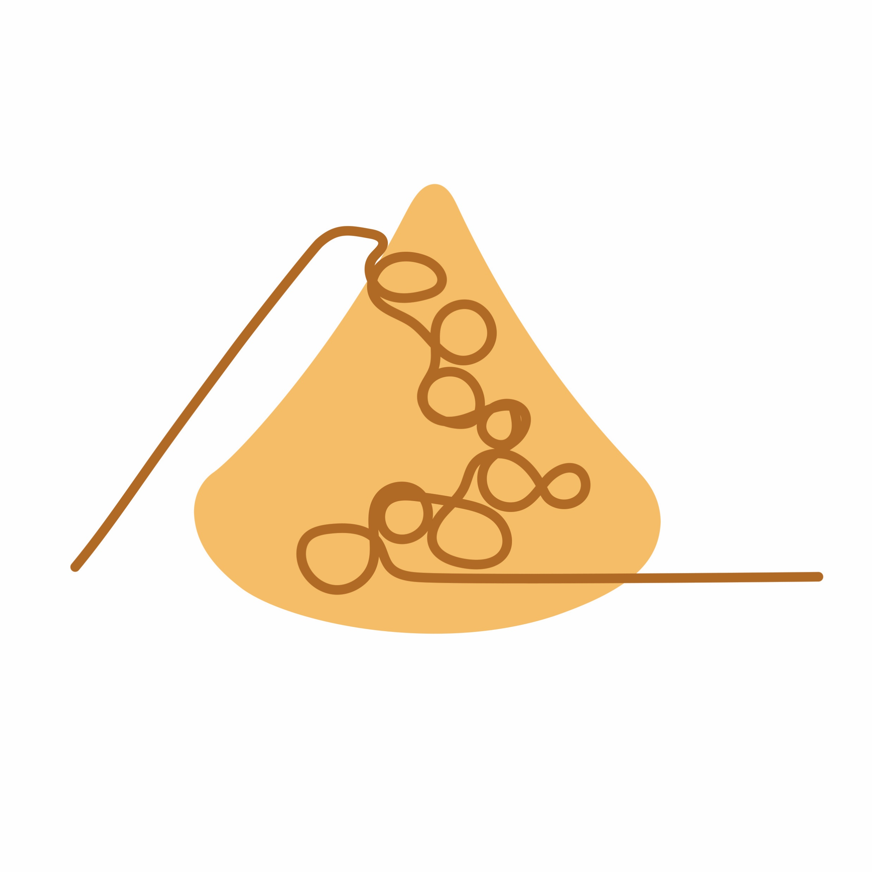

Decoupling concept

Slide 17
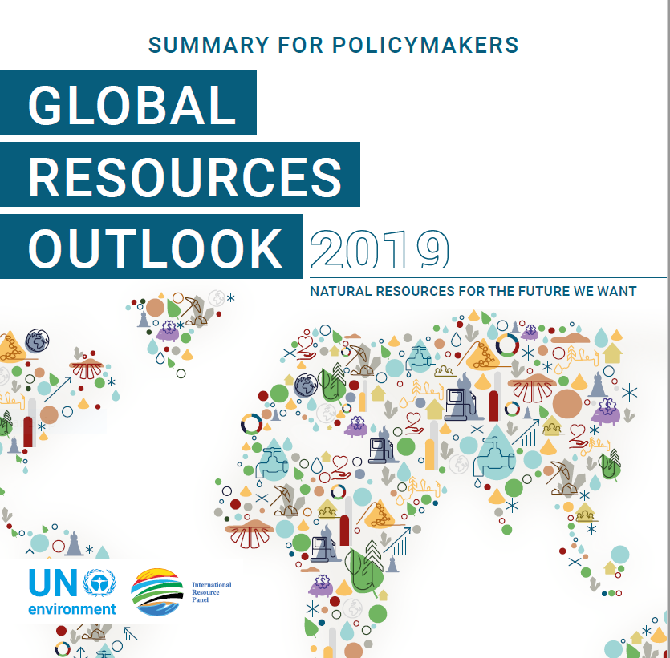
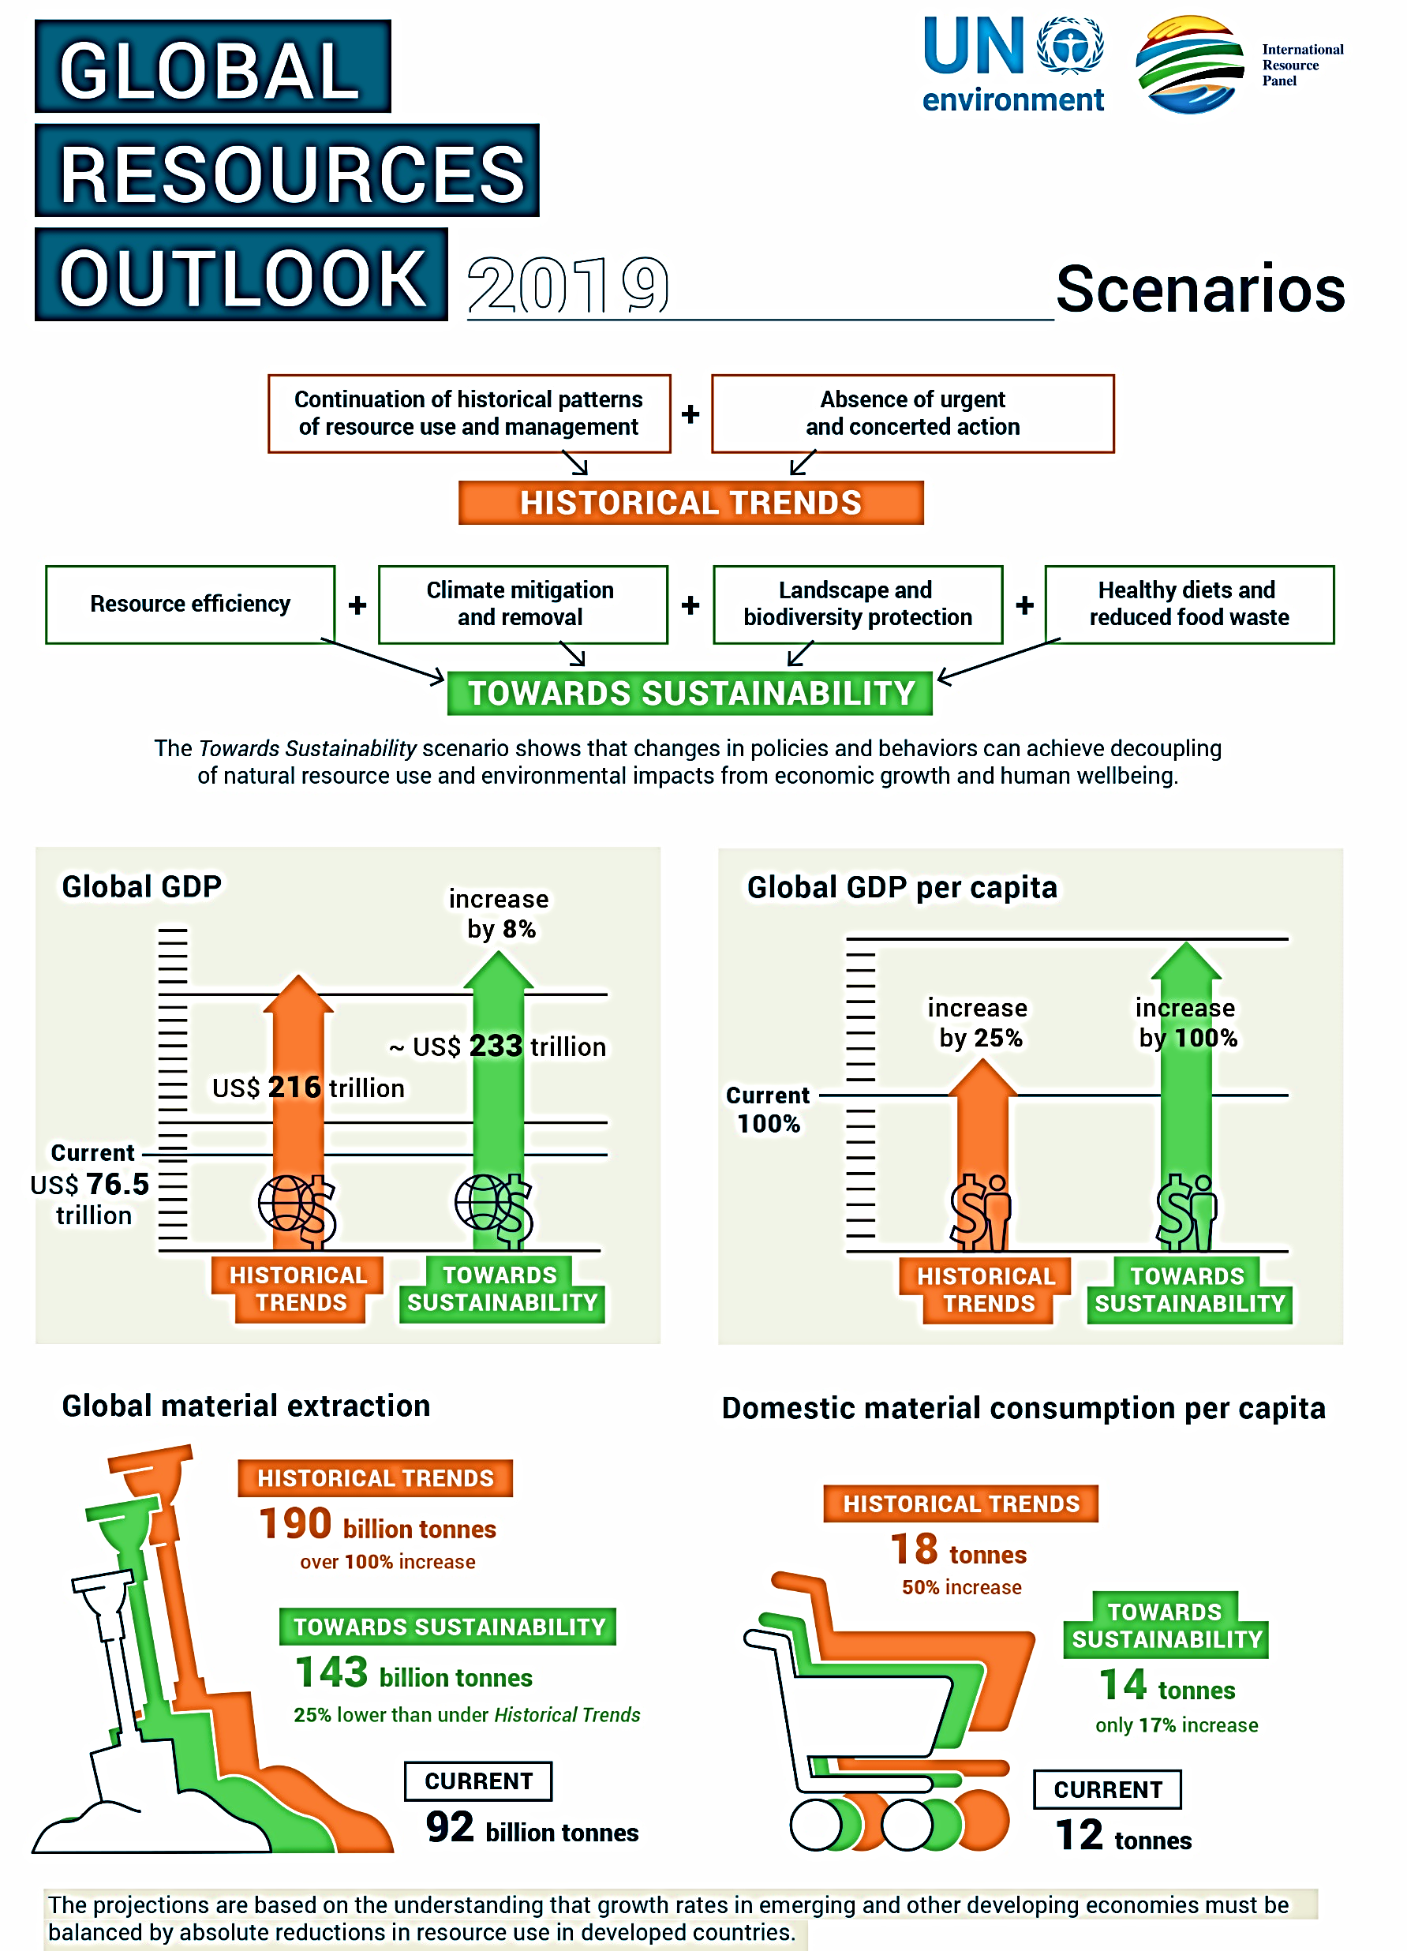
Achieving decoupling is possible and can deliver substantial social and environmental benefits, including repair of past environmental damage, while also supporting economic development and human well-being
IRP Scenario modelling
Notes:
[Resource Efficiency Policies] + [Climate mitigation and removal policies] + [Landscape and biodiversity
protection] + [Healthy diets and reduced food waste] = Towards Sustainability
1. Resource efficiency policies can lead to the reduction in resources needed per unit of output and
to an overall reduction in supply costs. Other policy measures target changes to regulations,
technical standards and procurement policies.
2. Climate mitigation policies include a carbon levy and financial support for two carbon dioxide
removal technologies – bioelectricity with carbon capture and storage and direct air capture of
carbon dioxide.
3. Landscape and life-on-land policies protect biodiversity by ensuring that climate mitigation and
energy policies are consistent with land and food system goals.
4. Shifts in societal behaviour assumes the adoption of healthier diets and the reduction of food
waste throughout the food supply chain. The healthier diets are consistent with international
dietary guidelines, and feature a 50 per cent reduction in meat consumption – replacing animal
protein with plant protein – except in regions where diets are already low in meat.

Slide 18
CIRCULAR ECONOMY
Should be seen as an instrument to deliver decoupling and as a part of the bigger picture of economic, societal and cultural transformation needed to deliver the SDGs

Slide 19
CIRCULAR ECONOMY
AND BIO-ECONOMY

Slide 20
BIOECONOMY
AND CIRCULAR ECONOMY
Notes:
Aim to decouple growth and dev from consumption of finite resources
Maximisation of asset utilisation (presupposes design + reverse logistics)
On the left side, notion of regeneration means that nutrient loops need to be addressed (currently fragmentation).

Slide 21
ALIGNING INCENTIVES WITH REGULATION
AGRICULTURE - FROM PRODUCT TO SERVICE BASED CROP PROTECTION
Digitalisation is allowing targeted approach to individual plant protection - precision farming is an already known instrument, but producers are still quantity based driven.
Instead of selling pesticides, chemical companies could sell services to protect (hectares of) plants from pests. This would incentivise them to increase profits through minimising the costs of resources used, including pesticides.

Slide 22
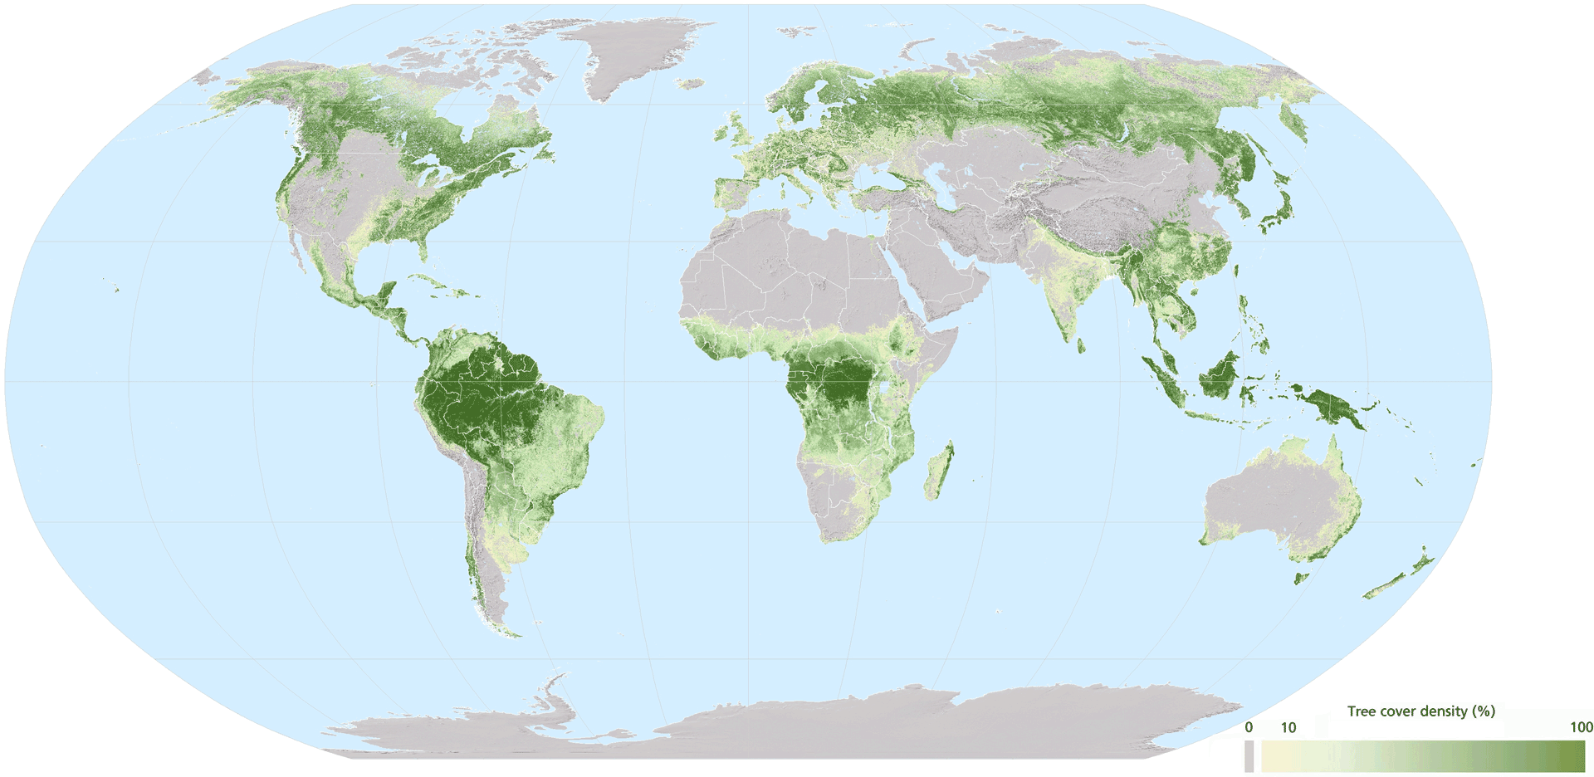
FORESTS AT THE HEART OF A CIRCULAR BIOECONOMY: COUPLING ECONOMY AND ECOLOGY
Largest terrestrial carbon sink and main source of precipitation, oxygen and biodiversity
Largest source of non-food non-feed renewable biological resources

Slide 23
CIRCULAR ECONOMY AND BIOECONOMY
Some Interesting Questions
How to improve nutrient cycles
Circular design of bio-based products
Integrating well informed consumers to better play their role
Renewable Carbon potential
Waste prevention
Better waste management
…

Slide 24
SOME OBSTACLES AND CHALLENGES
Trade-offs between biomaterials/bio energy/farming (fibre/fuel/food) and with other services provided by ecosystems (oxygen, water and temperature regulation, nutrients, biodiversity)
The definition of cascading is not universal
Supply of sustainably produced biomass and soil balance should be ensured
Mixing bio and technical materials could create difficulties for CE
Substitution of products should be dealt with care after assessing environmental impacts
Focus should not be only on products and materials, but also on systems and business models

Slide 25
BIOECONOMY
HAS A MAJOR DEVELOPMENT POTENTIAL
But it has to respect sustainability criteria
and it has to be complementary and in line with decoupling and circular economy principles

Slide 26
BUSINESS ACTORS
MORE OR LESS REGULATION?
We should continue working actively to bringing together the leading business actors. Many businesses express that they are not afraid of more regulation but of unfairness, free riders and uncertain risk. If we make policies fair, consistent and reliable – we can work together across policy and business actors for a real transition.

Slide 27
TO CONCLUDE
WHY AND HOW?

Slide 28
IMPORTANT MESSAGES TO REMEMBER
The existing global resource use trends and their environmental and health impact are extremely worrying and can/should not continue.
Circular economy based on the concept of decoupling is an essential ingredient of an economy, which would be SDG compliant.
If appropriate policies, including resource efficiency, are applied, we can reduce social differences, efficiently fight against climate change, biodiversity loss and pollution, while economic growth would be even higher than in the case that the current trends would continue.
Circular Economy and bio-economy solutions are an important part of the answers to climate change challenges (and biodiversity loss).
Bio-economy has a major role to play, but it is essential that, like the rest of the economy, respects the sustainability criteria.

Slide 29
The challenge seems to not be one of not inadequate scientific evidence anymore; rather it is one of cooperation and implementation.
Complexity and scale of these challenges requires a space that allows actors with responsibility for those environmental governance mechanisms to be able to consider and experiment with both new forms of collaboration and more „systemic“ approaches ... through promoting multi stakeholder cooperation, more agile governance (including sub-state actors, such as cities, states and provinces), the use of new technologies, and enhanced accountability and transparency.

Slide 30
We need more “Circularity ” even in the
GLOBAL GOVERNANCE
Sharing sovereignty instead of owing sovereignty

Slide 31
Europe is not only
blue with yellow starts
It is a rainbow
blue for freedom and democracy
red for social values
green for the protection of environment
yellow for the culture
We can hardly picture Europe as the center of the World,
but we should do everything that Europe remains the
center of the dreams of all the people of the World

Slide 32
Transition to a more sustainable economy and society
IS UNAVOIDABLE!
Humans are supposed to be intelligent. It is high time to prove it.
We have to fix a broken compass!

Slide 33
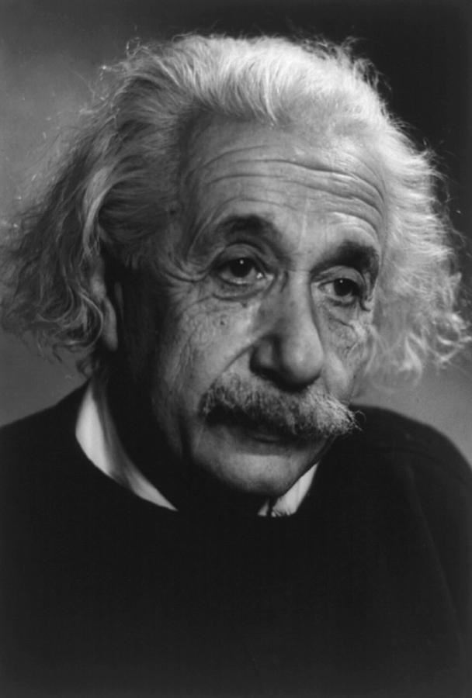
But … It will not be easy
ALBERT EINSTEIN
When asked why it is that mankind has stretched so far as to discover the structure of the atom, but we have not been able to devise the political means to keep the atom from destroying us he replied:
“That is simple, my friend. It is because politics is more difficult than physics”

Slide 34
Why the changes are so difficult in practice?
While the challenges we face require a deep systemic change and long-term rethinking of the way how we govern our societies, political cycles, public and financial institutions, to a large extent also private companies, have inbuilt short-term focus and logic. This inconsistency limits our ability for efficient and strategic action.
Production and consumption systems are based on the logic of consumerism fuelled by quantity-driven profits and growth measured by GDP. GDP could be best explained by saying, that one will not reach the goal by walking faster, if walking in the wrong direction! We have to fix a broken compass! There is a lack of strategic identification of risks and long-term, even mid-term, risk management and there is a clear lack of understanding what really matters for our wellbeing.
A transition to a more sustainable economy and society will only be possible if it is just, fair and inclusive. We have to make our societies more equitable and do more in the fight against poverty. Social unrest is growing even in high-income countries and it is high time to hear the echo of the streets and the voice of a frustrated young generation.

Slide 35
“North Star” guiding our policies and behaviour
GREEN DEAL: INTER-GENERATIONAL AGREEMENT
A Program for the Future Generations
“Sustainability First”

Slide 36
Circular Economy and Bio-economy are not a new concept
They are the oldest concepts on the earth. All nature is bio-based and organized on the principles of the circular economy. Nothing is lost and everything has its purpose. That is why it would make common sense to embrace both and finally start to behave accordingly.
In essence there is only question we have to answer:
Do we agree that we humans are part of the nature too?

Slide 37
To answer this question we probably do not need the help of the most famous Belgium detective, but his advise is always useful
HERCULE POIROT
When asked why he is speaking about himself always in a third person he replied something like that:
If one is such a genius like myself, it is very important to establish a healthy distance to himself.

Slide 38
Advise of Prof. Guy McPherson:
”If you think the economy is more important than the environment (and health), try holding your breath while counting your money".

Slide 39
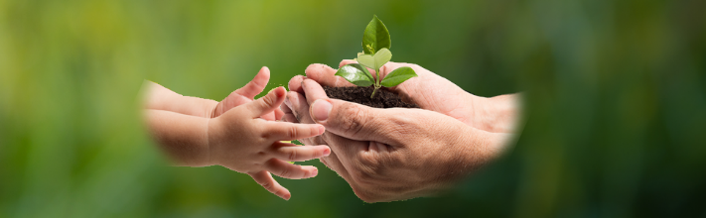
THANK YOU
For more information
Contact IRP Secretariat at resourcepanel@un.org
Visit our website at http://resourcepanel.org/

