Slide 1


EWRC 2018
CIRCULAR ECONOMY
FOR SUSTAINABLE REGIONS AND CITIES
10th October 2018
JANEZ POTOČNIK
Co-chair UNEP International Resource Panel (IRP)
Partner SYSTEMIQ

Slide 2
WE WANT CHANGES …
BUT WE DO NOT WANT TO CHANGE

Slide 3
For the first time in a human history we face the emergence of a single, tightly coupled human social-ecological system of planetary scope.
We are more interconnected and interdependent than ever.
Our individual and collective responsibility has enormously increased.

Slide 4
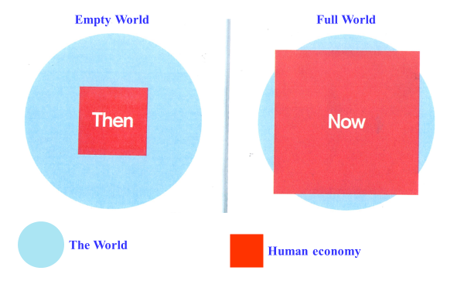
EMPTY WORLD AND THE FULL WORLD
Source: Club of Rome: Simplified after Herman Daly
Labour and Infrastructure limiting factors of human wellbeing
Natural resources and Environmental sinks limiting factors of human wellbeing

Slide 5
In the 21st Century we do not have any more the luxury of thinking and acting based on short term logic and interests

Slide 6
DPSIR FRAMEWORK

Slide 7
OUR ECONOMY …

Slide 8
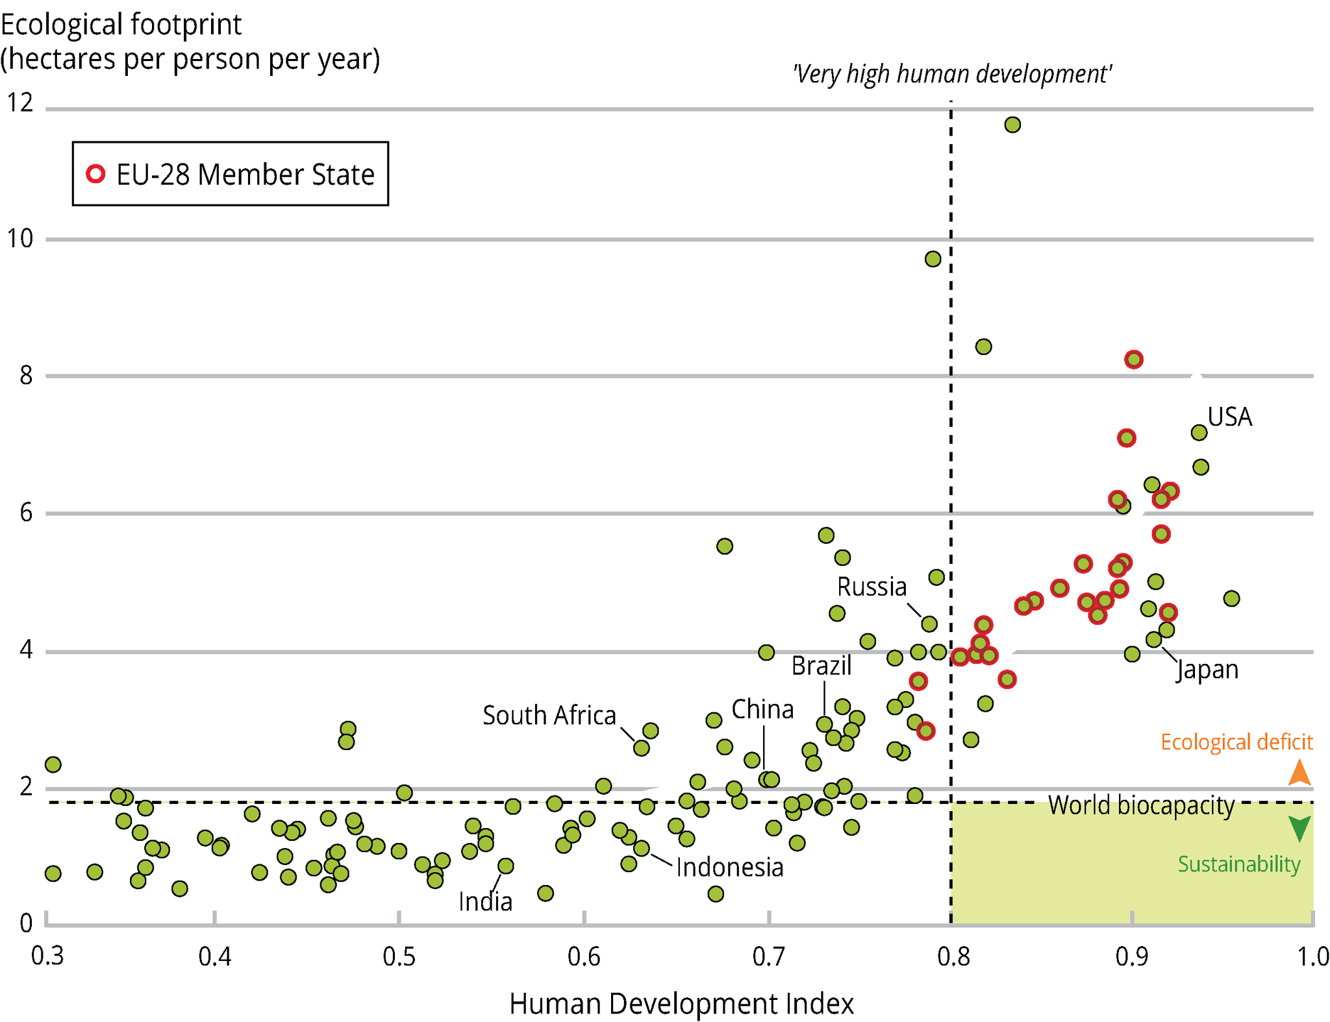
DEVELOPMENT TRAJECTORY …
Source: Global Footprint Network, 2012; UNDP, 2014a
Notes:
it was taken from the UN GEO 5 report. Page 424 of this report indicates the graph was created by plotting UNDP 20009 HDI figures against 2010 Global Footprint Network Figures. The Global Footprint Network site indicates that UK's 2010 footprint is about 5 hectares per person. The 2009 UNDP report indicates that the UK's HDO is at about 0.95. The cluster at the intersection of 5 and 0.9 is thus where the UK is.
This figure plots countries on the basis of two indicators: the Human Development Index (HDI) and the ecological footprint per person.
In order to achieve sustainability, countries must move towards the bottom right hand corner marked in green and as such decouple human development from natural resource use and environmental impacts.
The figure shows that worldwide, no country held that position in 2007.
We should also look to avoid the path the arrows take us: higher human wellbeing yet an increase in the ecological footprint followed by a realisation for the need for change, leading to a decrease in the footprint.

Slide 9
Price Signals:
Finacial Capital Overvalued
Human Capital Undervalued
Natural Capital not Valued
Market
Producers/Consumers
Rational Behaviour
Economic model
Inbuilt Economic, Social, Environmental Inbalances

Slide 10

SAFE OPERATING SPACE
ECONOMIC SYSTEM FUNCTION OF ECOSYSTEM
ECOSYSTEMS
Deposits Emissions Pollution
SOCIO-TECHNICAL SYSTEMS
providing social needs and value
Withdrawals from the ecosystems
Profits privatized
Policy
system
Industry
  Ecosystem
  services
Energy
system
Food
system
Environmental externalities
Environmental externalities
system
system
Mobility
system
Costs socialized
Values
Market
Science
Technology
Notes:
We therefore need a new model of change that will allow us to live well within planetary boundaries. This is what the green economy should be. It aims not only at efficiency, but also at ecosystem resilience and at human well-being.
We need instead to completely rethink our systems and the business models that support them, and a transition to new systems that fulfil societal needs but do so in an essentially sustainable way.
The circular economy is a fundamental part of this transition, and it is a crucial element of the 2050 vision in the 7th EAP. The upcoming communication of the European Commission on circular economy will propose some important steps towards this transition.
Transitions in our socio-technical systems will not occur all at once. Historically, changes in these systems and the business models that support them did not occur in a big bang. Instead, socio-technical systems often emerged via small ‘niche’ innovations in business and other places. Niche innovations happen all the time, but only a few of these niche innovations are successful enough to be up-scaled and distributed more widely.

Slide 11
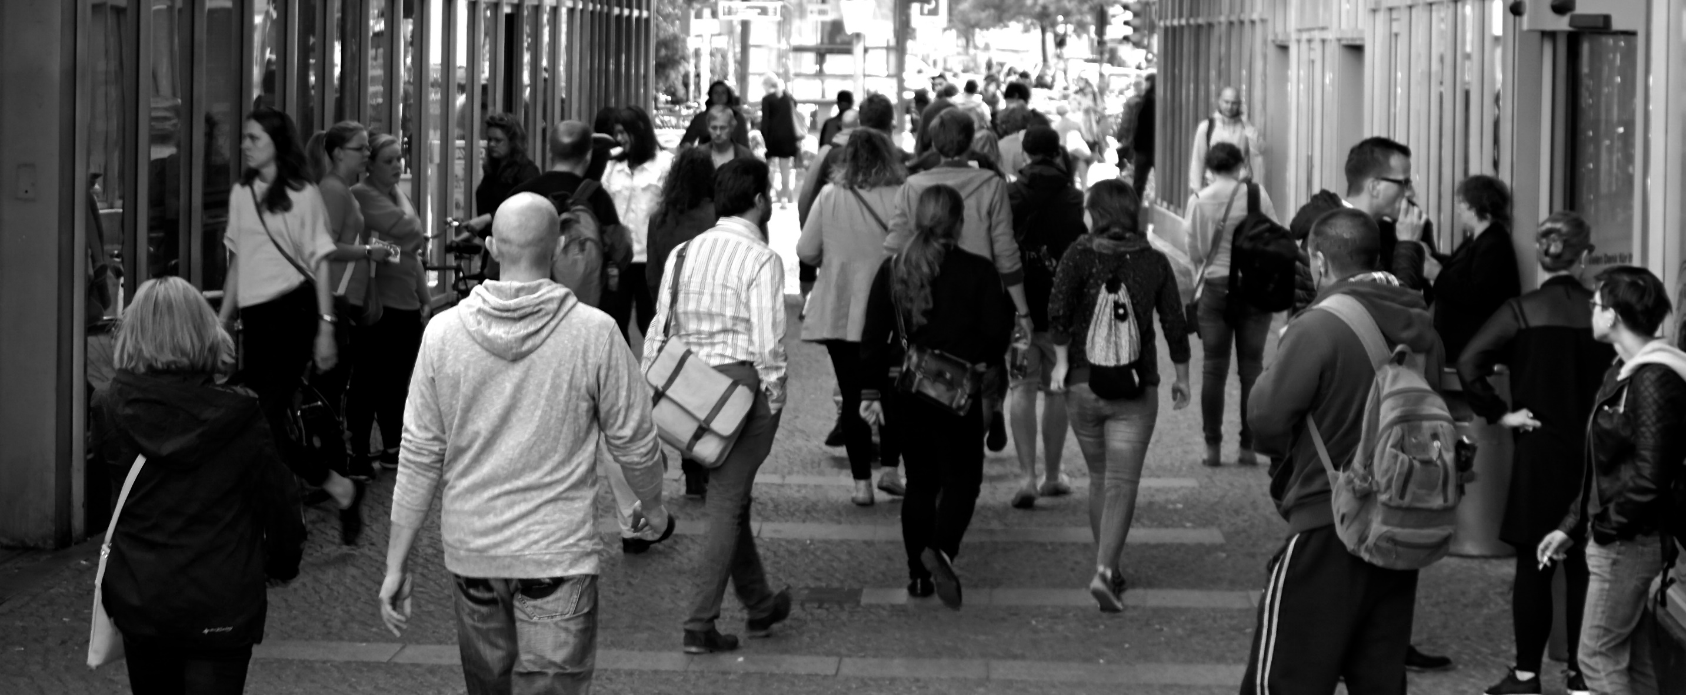
MEASURES OF SOCIETAL DEVELOPMENT THAT INCLUDE NATURAL CAPITAL DEPLETION GROW MUCH SLOWER THAN GDP
Progress per capita³, globally, 1990-2010, real terms
Considerations
C a p i t a l
Economic
Social
Natural
✓
Gross Domestic Product
2,0
Human Development Index
✓
✓
0,8
Genuine Progress Indicator¹
✓
✓
✓
-0,1
Inclusive Wealth Index²
✓
✓
✓
-0,2
1 1990-2005, as later data not available globally,
2 IWI exists in two versions, one unadjusted, and one where adjustments are made for environmental damage, oil capital gains, and total factor productivity. The adjusted version is shown here,
3 Global population growth was 1.6 percent per year during the period
SOURCE: UNEP (2014a), Kubiszewski et al. (2013)

Slide 12
It is not helping if you are walking faster,
if you are walking in the wrong direction!

Slide 13
OUR COMMITMENT
AND OUR OBLIGATION

Slide 14
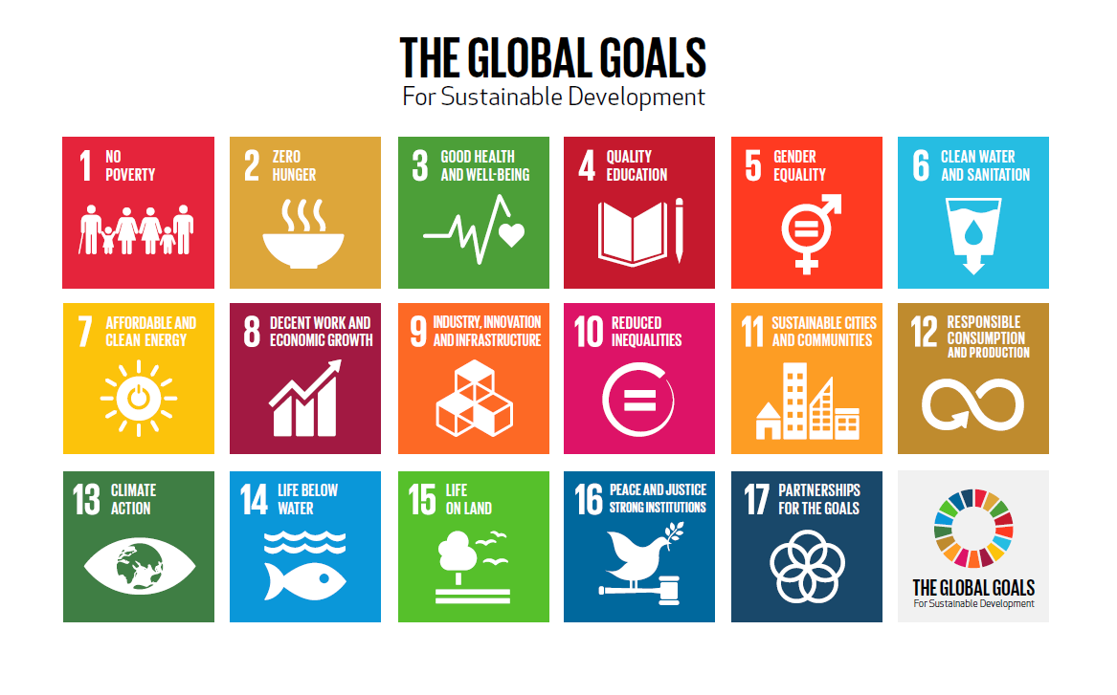

Slide 15

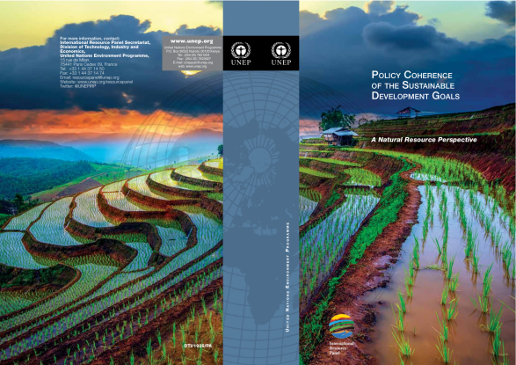
Trade-offs among various SDGs are unavoidable. Sustainable Consumption and Production is the most efficient strategy to mitigate trade-offs and create synergies to resolve the development and environmental challenges articulated in the SDGs.

Slide 16
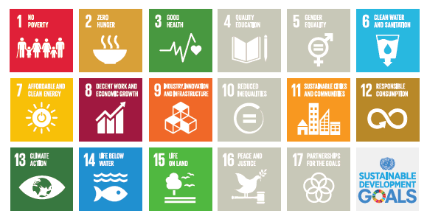
SDGs DIRECTLY DEPENDENT ON NATURAL RESOURCES

Slide 17
RESOURCES
THE MISSING LINK

Slide 18
DECOUPLING IS THE IMPERATIVE
OF MODERN ENVIRONMENTAL AND ECONOMIC POLICY

Slide 19
In the mid-term, except in specific cases, resource shortage will not be the core limiting factor of our (economic) development …
… but the environmental and health consequences caused by this excessive and irresponsible use of resources will be!

Slide 20
CIRCULAR ECONOMY
Started as an environmental initiative
In two years it was transformed to an economic based initiative with positive environmental and health consequences
In reality is should be seen as a part of the bigger picture of societal and cultural transformation needed to sustain the humanity and its prosperity.

Slide 21















OUTLINE OF A CIRCULAR ECONOMY SYSTEM
Principles
Preserve and enhance natural capital by controlling finite stocks and balancing renewable resource flows
Renewable materials
Finite materials
1
Regenerate
Renewables
Substitute materials
Virtualise
Restore
Renewables flow management
Stock management
Optimise resource yields by circulating products, components and materials in use at the highest utility at all times in both technical and biological cycles
Biological materials
Technical materials
Farming/ collection
Parts manufacturer
Soil restauration
Biochemical feedstock
Product manufacturer
Biosphere
Service provider
Recycle
2
Share
Refurbish/remanufacture
Biogas
Cascades
Reuse/redistribute
Maintain
Consumer
User
Extraction of
biochemical feedstock
Collection
Collection
Foster system effectiveness by revealing and designing out negative externalities
Minimise systematic leakage
and negative externalities
3

Slide 22
CIRCULAR ECONOMY AND CLIMATE CHANGE
Notes:
Aim to decouple growth and dev from consumption of finite resources
Maximisation of asset utilisation (presupposes design + reverse logistics)
On the left side, notion of regeneration means that nutrient loops need to be addressed (currently fragmentation).

Slide 23
CLIMATE
CARBON MANAGEMENT
LAND
WATER
ENERGY
MATERIALS
DECOUPLING
RESOURCES

Slide 24
PILLARS FOR EFFICIENT CLIMATE CHANGE POLICY
SUPPLY SIDE SOLUTIONS
DEMAND SIDE SOLUTIONS
NATURE BASED
SOLUTIONS
DEMAND SIDE SOLUTIONS
Energy,
Carbon management
Circular Economy,
Land, Water,
Materials
Management
Eco-system services
Environmental sinks
Circular Economy,
Land, Water,
Materials
Management

Slide 25
A MORE CIRCULAR ECONOMY CAN REDUCE EU EMISSIONS FROM MATERIALS BY 56%
EU emissions reductions potential from a more circular economy, 2050
Mt CO₂ per year
530
178
Steel
Plastics
-56%
Aluminium
56
Cement
62
234
2050 Baseline
Materials recirculation
Product materials efficiency
Circular business models
2050 Circular scenario

Slide 26
A SHARED MOBILITY SCENARIO IS A HIGHLY ATTRACTIVE VISION FOR PASSENGER CARS
CO₂ impact of materials
Mt CO₂ per year, Europe
Total cost of ownership
EUR per 1000 pkm
Externalities and cost to society
EUR per 1000 pkm
60
Steel
-70%
-77%
-74%
Aluminium
18
Plastics
Other
Baseline scenario, 2050
Circular scenario, 2050
Current
Circular scenario, 2050
Current
Circular scenario, 2050
pkm = passenger kilometre

Slide 27
CIRCULAR ECONOMY
REGIONS AND CITIES

Slide 28

URBANISATION
Globally, an area of the size of the UK has been converted to buildings since 1990 (OECD GG Indicators 2017)
More than 50% of urban fabric expected to exist by 2050 still needs to be constructed
In the three years period (2011-2013), China has used more cement than the USA during the entire 20th century

Slide 29
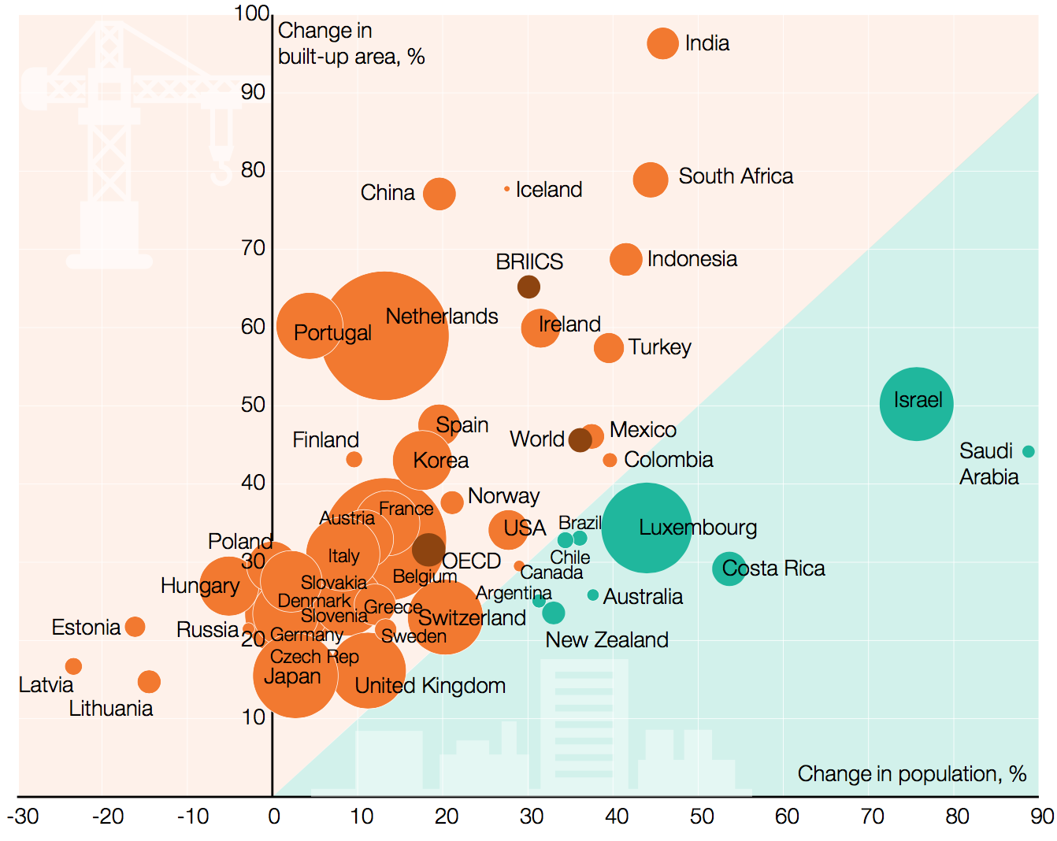
BUILT-UP AREA PER CAPITA IS INCREASING, INCLUDING IN COUNTRIES THAT ARE ALREADY VERY MUCH URBANISED, 1990-2014
Source: OECD, Green Growth Indicators 2017

Slide 30
“NEW URBAN AGENDA”
QUITO 2016
Roadmap for sustainable urbanization with its three transformative commitments
  leave no one behind
  sustainable and inclusive economies
  environmental sustainability
  and references to resource efficiency, alongside low-emission and resilience, of housing, infrastructure and basic services.

Slide 31
URBAN SYSTEMS
AND CIRCULAR ECONOMY
SHARING MODELS
MOBILITY SYSTEMS
WASTE RECYCLING
SUSTAINABLE BUILDINGS
ENERGY EFFICIENCY …
Notes:
Aim to decouple growth and dev from consumption of finite resources
Maximisation of asset utilisation (presupposes design + reverse logistics)
On the left side, notion of regeneration means that nutrient loops need to be addressed (currently fragmentation).

Slide 32

“THE WEIGHT OF THE CITIES” - RESOURCE REQUIREMENTS OF FUTURE URBANISATION 2050
Urbanization is expected to be more or less completed in 50 years.
We have a once-in-a-lifetime opportunity to shift the expected urbanization onto a more environmentally sustainable and socially just path.

Slide 33
THE EFFECT OF STRATEGIC INTENSIFICATION…
Network of high density nodes interconnected with affordable transit nodes, mixed-use and ecologically designed: energy efficiencies = 0.5 x BAU (factor 2)
Energy-efficient buildings: reductions in energy demand = 0.5 x BAU (factor 2)
Maximum use of renewable energy with integrated demand-supply management: efficiency 20% = 0.8 x BAU
Human behavior change: efficiency = 0.5 x BAU
THE CASCADING MULTIPLICATIVE IMPACT OF MEASURES APPLIED TO EACH OF THE FOUR LEVERS IS A MULTIPLICATION BY 0.5 X 0.5 X 0.8 X 0.5 = 0.1, I.E. A 10-FOLD REDUCTION IN ENERGY USE COMPARED TO BAU

Slide 34
RECOMMENDATIONS
Shift from ‘linear’ to ‘circular’ metabolisms
Urban metabolisms must be monitored to inform strategic planning
Relationships between GDP, population and land/material/energy use must be measured and targets developed by city types
Change city planning ‘defaults’ toward 5D framework
Use urban infrastructure investments as catalysts for change
Link infrastructure & land use policy (regional and neighborhood)
Promote appealing mixed-income mixed-use city cores; prevent suburbanization
Attractive business propositions to support infrastructure transformation
Leverage the power of ‘experimentation’ to re-imagine futures in practice
Foster inter-city learning networks
Support from higher levels of government
Urban Metabolism
Pathways of Change
Governance

Slide 35
Thematic Paper: Regions in Transition Towards a Circular Economy (2014)
Purpose was to explain the importance of circular economy at regional level and take a stock of the implementation of relevant instruments across European regions. It also seeks to identify patterns of regional actions which are relevant in relation to the agenda of circular economy and draw lessons based on regional practices from the actual implementation.

Slide 36
European Commission and EU member states have unique opportunity and responsibility to align all existing funding instruments and policies (CAP, FP9, Cohesion policy, Trade …) to support the transition to the CE.
Agenda for Sustainable Development 2030
Next MMF likely for the period 2021-2027
AND IF THIS WILL NOT BE DONE …

Slide 37
The time is gone, the song is over,
Thought I’d something more to say
(Pink Floyd)

Slide 38
TO CONCLUDE

Slide 39

NEW ECONOMIC MODEL BASED ON SUSTAINABLE CONSUMPTION AND PRODUCTION (SCP) INTEGRATING ALL PILLARS OF SUSTAINABILITY IS
WE HAVE TO FIX A BROKEN COMPASS
(PAVAN SUKHDEV)
NECESSARY
AND UNAVOIDABLE
SCIENCE

Slide 40
ASSESSING GLOBAL RESOURCE USE
2017 IRP Report
Recommended policy strategies
Set targets and measure progress
Act on key leverage points across all levels of governance
Take advantage of leapfrogging opportunities
Implement a policy mix that builds incentives and corrects market failures
Promote innovations toward a circular economy
Enable people to develop resource efficient solutions
Unlock the resistance to change

Slide 41
RESPONSIBILITIES OF THE BUSINESS SECTOR
Change the risk management to be aligned with the SDGs
From being a pure product or service providers managing the risks of the company through profit maximisation
To socially responsible companies managing also the risks of the society

Slide 42
SYSTEM INITIATIVE ON ENVIRONMENT AND NATURAL RESOURCE SECURITY
World Economic Forum – Annual Meeting 2018
Complexity and scale of these challenges requires a space that allows actors with responsibility for those environmental governance mechanisms to be able to consider and experiment with both new forms of collaboration and more „systemic“ approaches ... through promoting multi stakeholder cooperation, more agile governance (including sub-state actors, such as cities, states and provinces), the use of new technologies, and enhanced accountability and transparency.

Slide 43
System Initiative on Environment and Natural Resource Security
World Economic Forum – Annual Meeting 2018
The challenge seems to not be one of not inadequate scientific evidence anymore; rather it is one of cooperation and implementation.
There is a deepening perception of a lack of synchronicity between economic and environmental policy responses to global risks.

Slide 44
GOVERNANCE
REDEFINING SOVEREIGNTY

Slide 45
There is no sustainable world without sustainable and healthy regions and cities.
If we are to avoid globally extensive and inter-systemic crisis and frequent conflicts than let’s get serious about implementing what we have agreed in SDGs. Changes are unavoidable and humans are supposed to be intelligent. It is high time to prove it.
Change will not appear by waiting for the leadership of others, be the leaders on your level of governance and authority … in politics, in business, academia, civil society, cities, regions, in making your investment decisions …

Slide 46
Any global transition is a major new opportunity for the innovation, new development opportunities, new jobs
And alternative ...
I would rather not think and talk about it!

Slide 47
The CE genie is out of the bottle
(Apple, HP, Siemens, Alstom, BMW, Renault, Michelin, Veolia, Dow Chemicals, Walmart, Arup, BSF, CISCO, Caterpillar, Kingfisher, Ikea, Microsoft, Philips, DSM, Solvay, SUES, Steelcase, Unilever, Tetra Pak, Google, Danone …)
Major economic actors have moved.
CE connects competitiveness and sustainability.
CE is about transition to the SDG compliant economy.
How to overcome short termism inbuilt in our democratic political systems and institutions (public, financial…) in fundamental conflict with the system change needed?

Slide 48
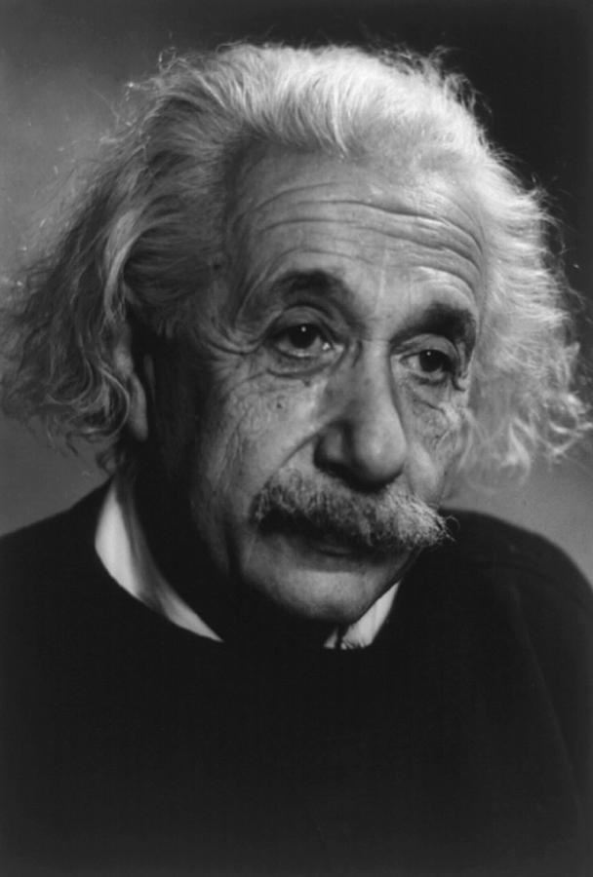
WILL IT BE EASY?
ALBERT EINSTEIN
When asked why it is that mankind has stretched so far as to discover the structure of the atom, but we have not been able to devise the political means to keep the atom from destroying us he replied:
“That is simple, my friend. It is because politics is more difficult than physics”

Slide 49
Guy McPherson:
”If you think the economy is more important than the environment (and health), try holding your breath while counting your money".

Slide 50

THANK YOU
For more information
Contact IRP Secretariat at resourcepanel@un.org
Visit our website at http://resourcepanel.org/

