Slide 1

Supporting transition to circular economy in cities and regions
EWRC 2016 Workshop
Philippe Micheaux Naudet, ACR+, Brussels, 12 October 2016

Slide 2

A word about ACR+
Since 1994
Awareness raising and communication
Operational instruments
Legal and economic instruments
Strategy and planning
Cooperation and capacity building
Services to Local and Regional Authorities
Network of cities & regions to exchange of expertise
To improve resource efficiency and circular economy policies
Multi-stakeholders approach

Slide 3






















Some of our members

Slide 4
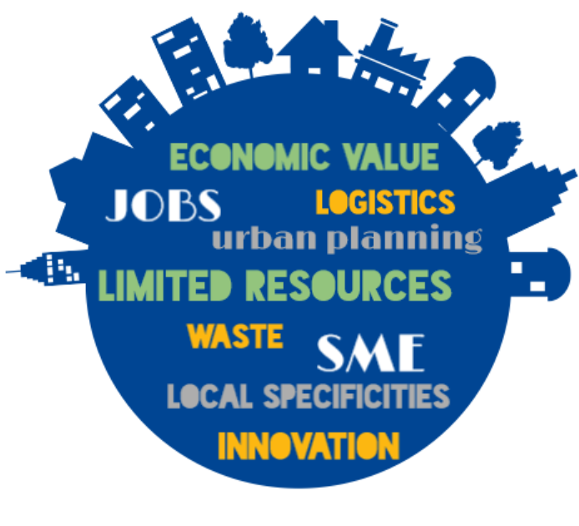
Local & Regional Authorities’ challenges

Slide 5


From waste to resources
Linear economy
Resources
Circular economy
Chain economy
Resources
Downcycling
Upcycling
Sustainable Production
Production
Production
Throw away society!!!!
Better… but not ideal!!!!
Close the loop!
Consumption
Sustainable Consumption
Consumption
Waste
Waste
From waste to resources

Slide 6
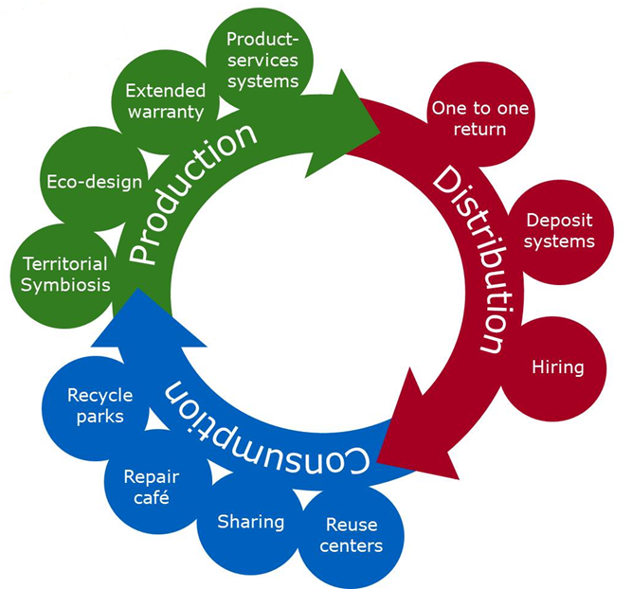
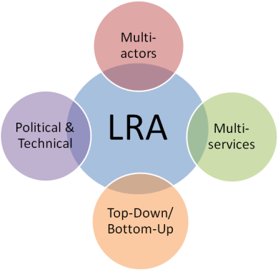
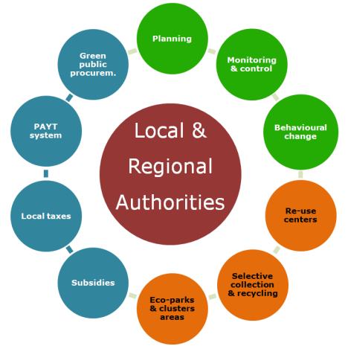
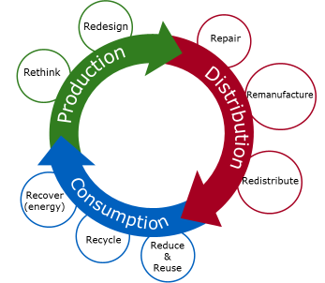
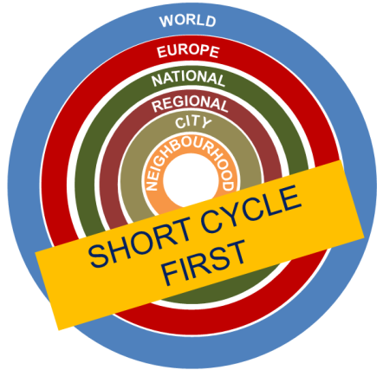
ACR+ vision: 5 pillars for circular economy
Territorial hierarchy
Multi-R approach
The role of LRAs
Shared governance
New business models
Notes:
1- Territorial hierarchy: circular economy actions should favour short cycles that will then be connected between them and with the upper levels
2- Multi-R approach in the whole production-distribution-consumption cycle: rethink, redesign, repair, remanufacture, redistribute, reduce and reuse, recycle, revocer
3- Local and regional authorities are at the core of circular economy because they are in contact with all stakeholders on the ground and can facilitate circular economy through different instruments (economic, regulatory, technical, educational and communication based)
4- Shared governance: multi-actors (public, private, research, NGOs); multi-services (economy/environment/urban planning, etc.); top-down / bottom-up; political decision makers / technical staff
5- New business models (and business models that need to be more implemented): ecodesign, territorial symbiosis, product service systems (economy of functionality), etc.

Slide 7















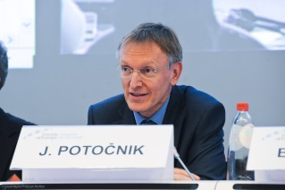



The Circular Europe Network in a nutshell
Circular economy
ACR+ Members & desk research
20 years experience
Advisory Committee
Cooperation with national networks
Related to the topic
Political support
Information // visibility
promotion // visibility
Notes:
1- created in 2014 by ACR+: the strength of the CEN is made of ACR+ members: cities and regions are invited to join!
2- cooperating with national platforms on circular economy, some of them already being ACR+ members
3- ask for cooperation and review by an advisory committee which members evolve according to the topic (including European Environmental Bureau an University College of London)
4- received some political support (including from the former EU Commissioner for environment Janez Potochnic)

Slide 8



CEN activities to help cities and regions
2- Providing tools
1- Connecting experts
3- Building capacities
Notes:
1- connect experts at EU level, organise events and thematic meetings
2- analyse and provide technical documents and tools
3- support learning, train staff (work in progress)

Slide 9
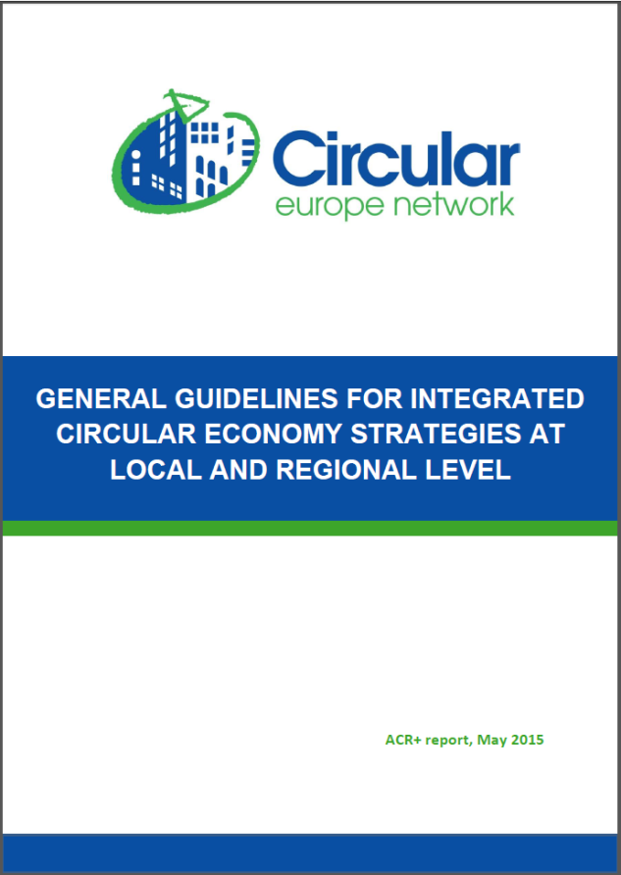
General guidelines for circular economy planning
Circular economy
Clarifying circular economy:
  Basic concepts & objectives
  Principles founding circular economy strategies (vision)
  Key areas of intervention (material resources, sustainable production & sustainable consumption)
Circular economy in practice:
  First steps for a circular economy strategy (cross-sector approach, stakeholders, parallel & other actions, metabolism, co-creation)
  Instruments, cross-sector & thematic measures
  Roadmap and monitoring
Already in EN, IT, CAT, PT & ES
Notes:
Table of content
INTRODUCTION
Part 1: CLARIFYING CIRCULAR ECONOMY
1. WHAT DOES “CIRCULAR ECONOMY” MEAN?
1.1. Basic concepts
1.2. Objectives of circular economy
2. ON WHAT PRINCIPLES SHOULD A CIRCULAR ECONOMY STRATEGY BE BASED?
2.1. The “multi-R” hierarchy
2.2. Territorial hierarchy
2.3. Shared governance
2.4. Integrated planning
3. WHAT ARE THE KEY AREAS OF INTERVENTION?
3.1. Material resources management
3.2. Sustainable consumption
3.3. Sustainable production
3.4. Priority sectors
Part 2: CIRCULAR ECONOMY PLANNING IN PRACTICE
4. WHAT (FIRST) FUNDAMENTAL INITIATIVES SHOULD LOCAL AND REGIONAL AUTHORITIES TAKE?
4.1. Develop a cross-sector approach at the political and administrative level
4.2. Identify potential stakeholders
4.3. Identify parallel policy actions in progress or planned
4.4. Establish a diagnosis of the territorial metabolism
4.5. Gather information on experiences from similar territories
4.6. Organise co-creation
5. WHAT INSTRUMENTS TO USE? WHICH TRANSVERSAL AND THEMATIC MEASURES?
5.1. Potential instruments
5.2. Cross-sector measures
5.3. Thematic measures
6. WHAT ROADMAP AND MONITORING TO ADOPT?
CONCLUSIONS

Slide 10
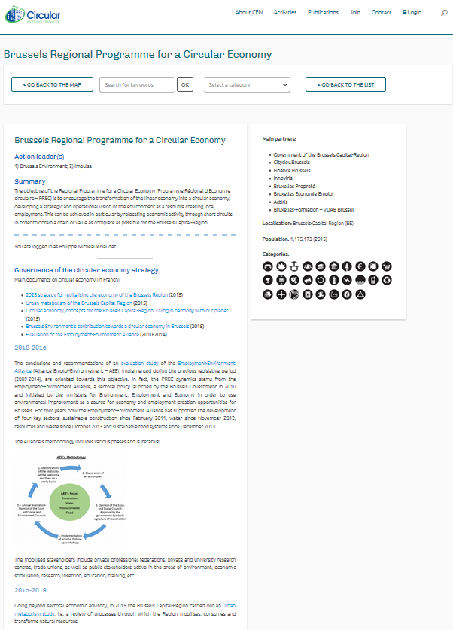
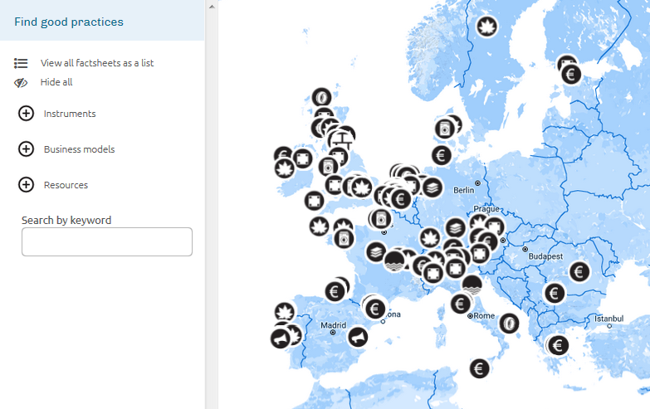
Factsheets on circular economy strategies / actions
Circular economy
150 cases already
www.circular-europe-network.eu

Slide 11
Join the network,
share the benefits!
www.circular-europe-network.eu
Contact: pmn@acrplus.org

