Slide 1


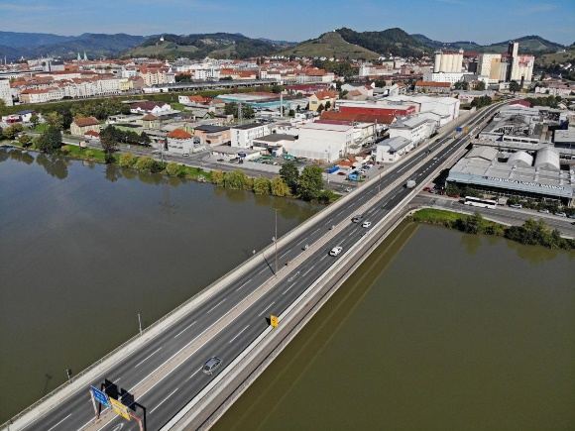
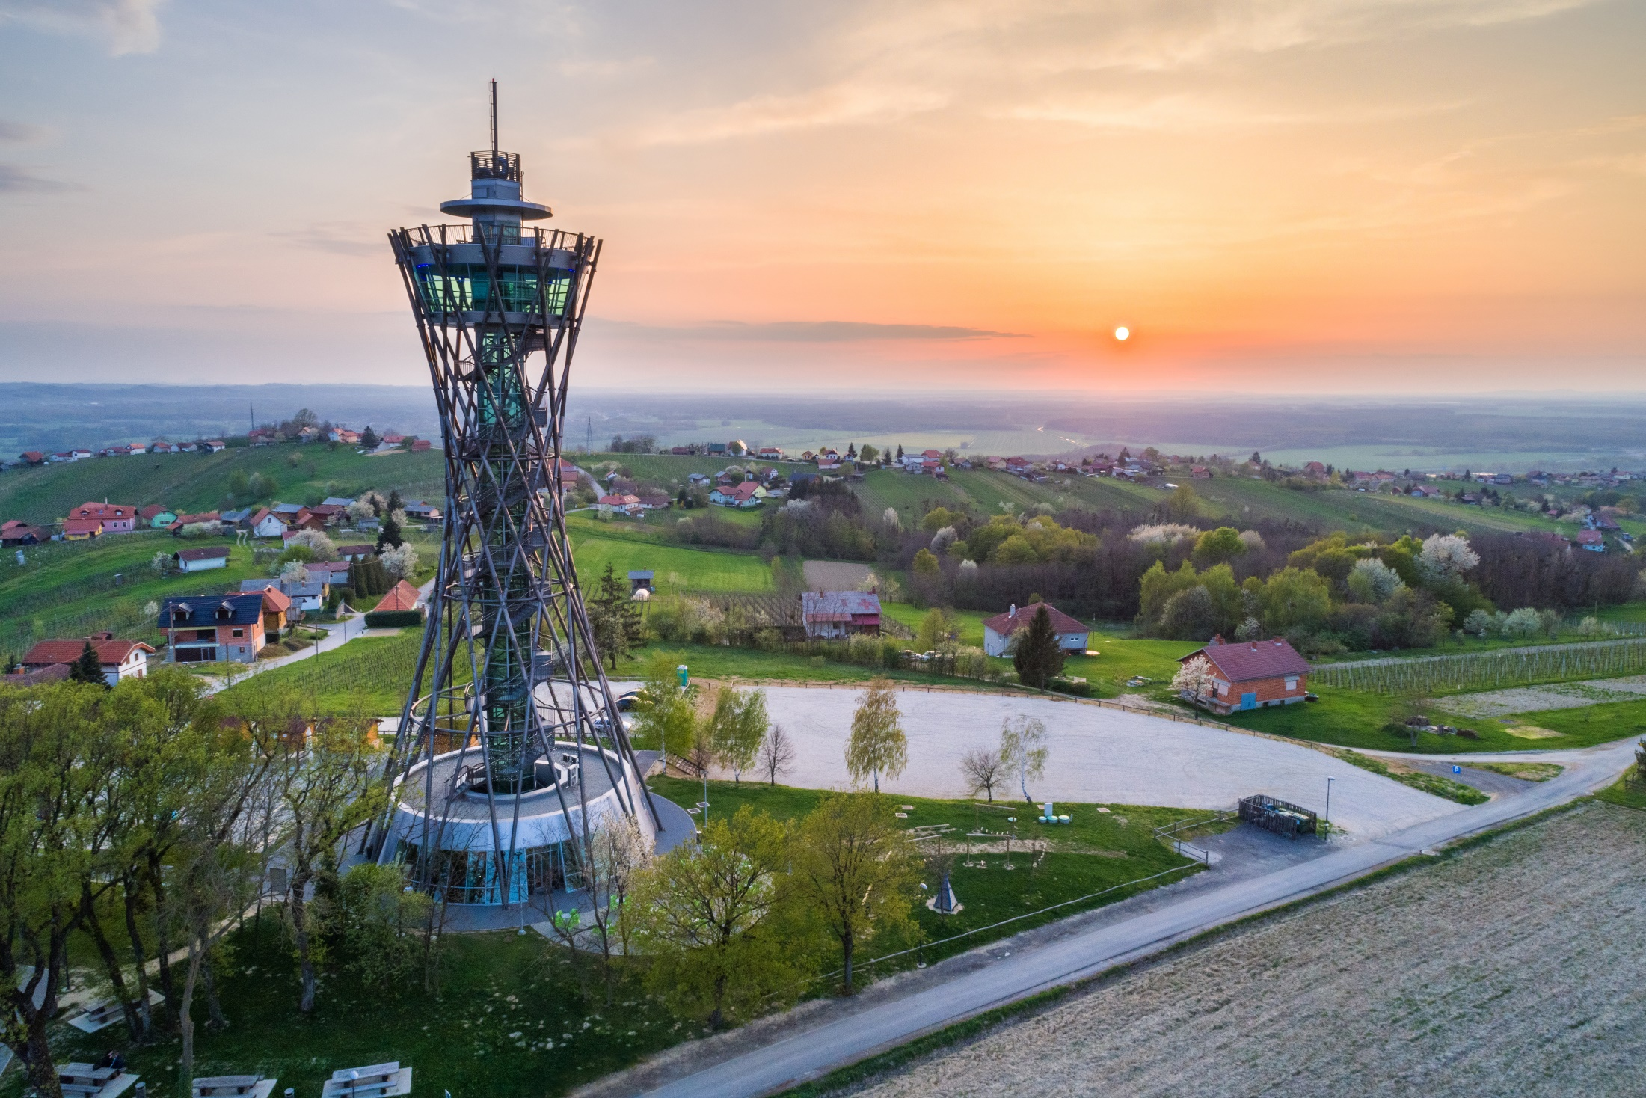

Slide 2


Workshop 09WS459
Measuring social progress in European regions and cities
Kohezijska regija Vzhodna Slovenija / Cohesion Region Eastern Slovenia
Peter Medved, Secretary of the Development Council of Cohesion Region Eastern Slovenia
Brussels, 9 October 2019

Slide 3


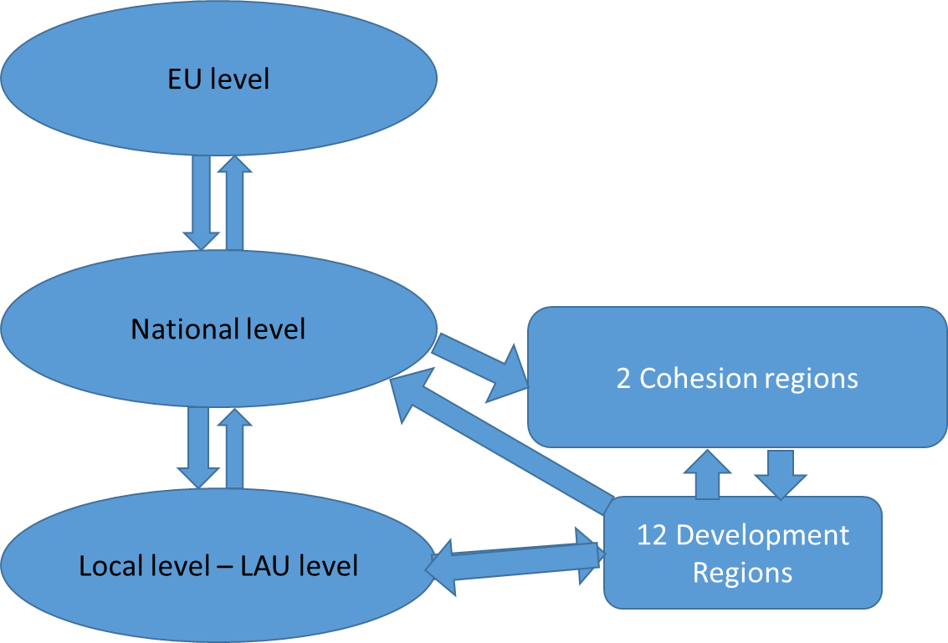

Slide 4
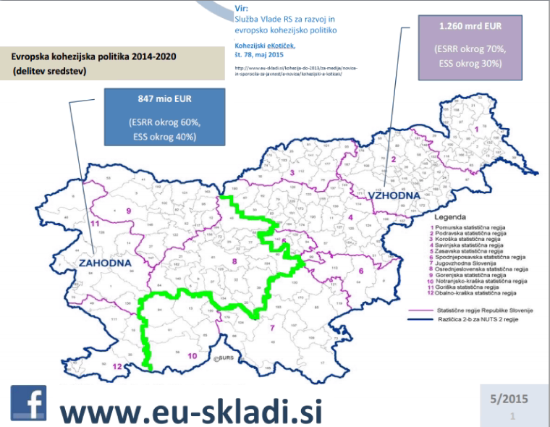

Slide 5
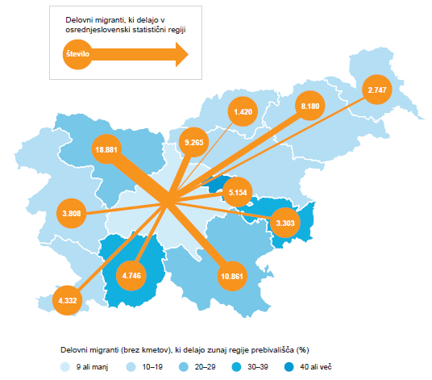
Number of daily migrants working in Centralslovenian region / % of daily migrants outside core region

Slide 6
Self-assessment with life satisfaction
Persons below powerty line in %

Slide 7
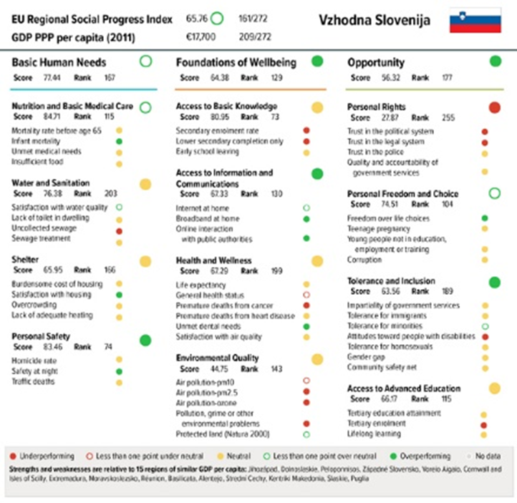

Slide 8
Pros and cons, future usefulness
Availaility of time series
Comparabiity with other regions, state and EU level
Recognition of different ways of progress measurement (not only economic indexes and data)
Measures regional output, is result of all policy leveles
a tool to co-prioritise regionaly/national social policy

Slide 9
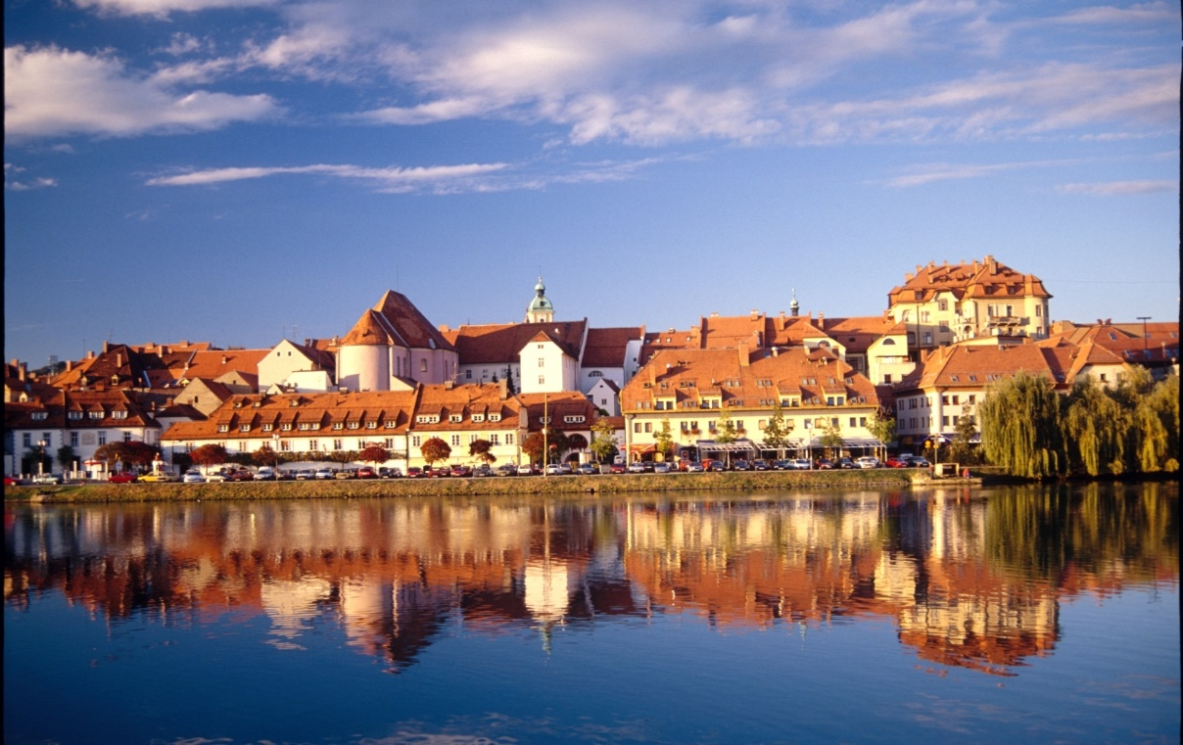
Thank you for your attention
Peter Medved
peter.medved@gov.si

