Slide 1

Slovenia, its geo-strategic position and main infrastructure investments
Peter Gašperšič Ph.D.
Minister
Brussels, March 3, 2016

Slide 2
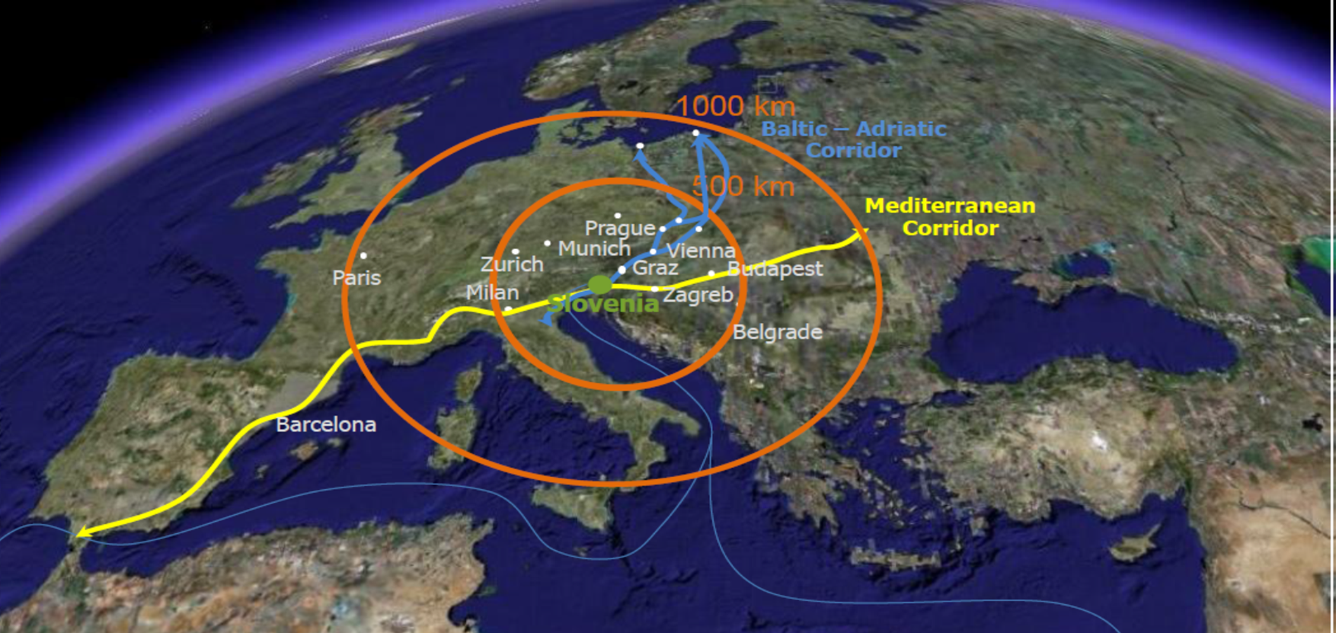
Geographical position
Baltic – Adriatic (1) and Mediterranean (3) corridor connects SI with western and eastern Europe and further on with Russia and Asia
Rotterdam
Prage
Budapest
Koper
Notes:
Slovenia kept its important position also in the last EU legislation on Trans-European Network for Transport. You can see map of TEN-T corridors where Slovenia is part of Baltic – Adriatic and Mediterranean corridors.

Slide 3
Geographical position
Pan European transport corridor X.
Rotterdam
Prage
Budapest
Koper
Corridor X.
Notes:
The only exception not included in core TEN-T network is the route from Ljubljana to Salzburg and further on to Munich which is “only” part of comprehensive TEN-T network.
To promote the connection of Corridor X to the TEN-T network, Slovenia prepared Letter of intent for the establishment Alpine – Western Balkans Corridor (AWB) linking Salzburg – Ljubljana – Zagreb – (Wels – Graz- Zagreb), which was signed by Austria, Croatia, Serbia, Bulgaria and Slovenia in 2015. The first planned step is to set up the AWB corridor as a railway freight corridor according to the Regulation 913/2010 and then to include it in the TEN-T core network.

Slide 4
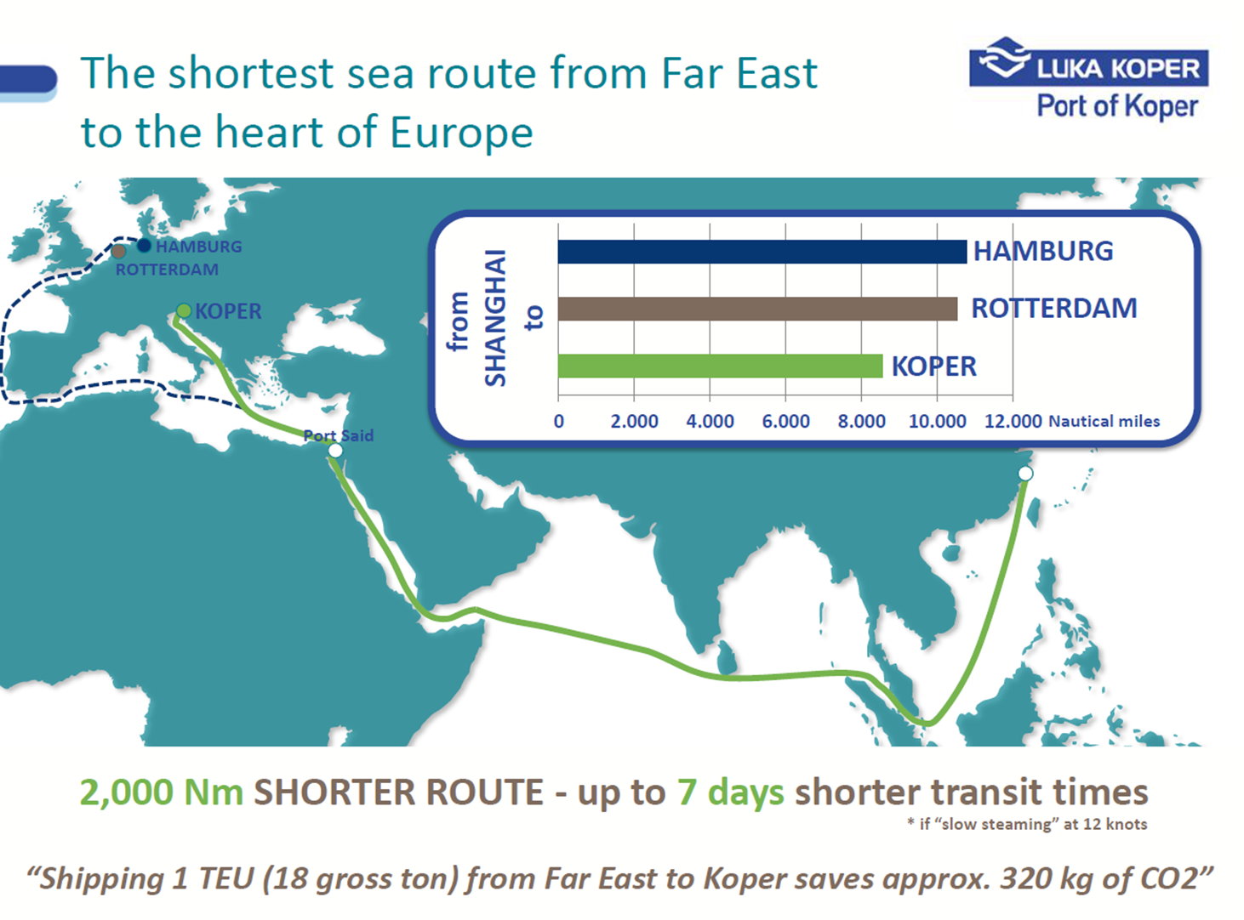
Port of Koper
Notes:
Slovenia lies in the centre of Europe, so when you arrive to Port of Koper you are indeed in the heart of Central Europe. Besides, if you come from Asia from Shanghai, you save more than 7 days of transit time. This is of great importance for economy – time is money; however, the protection of the environment is becoming increasingly important worldwide and shortening route contributes to less CO2 emissions and other GHG (green house gas) emissions and pollutants as well.
The distance by land from the Port of Koper to the Eastern European cities, Bratislava and Prague, is approximately 600 kilometres shorter than from the Port of Rotterdam.

Slide 5
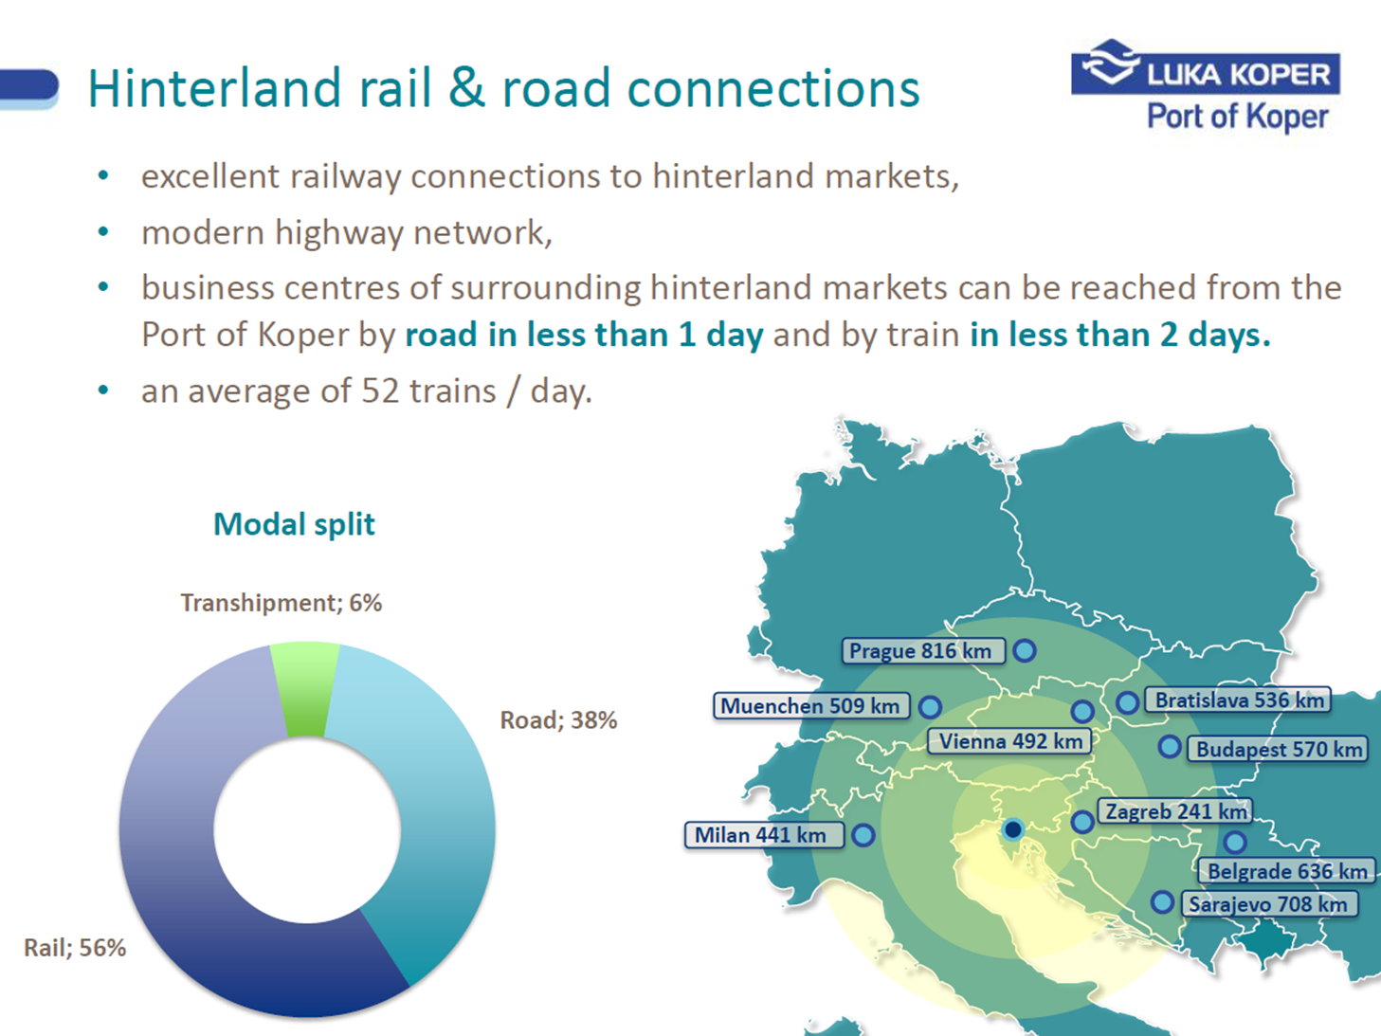
Port of Koper

Slide 6
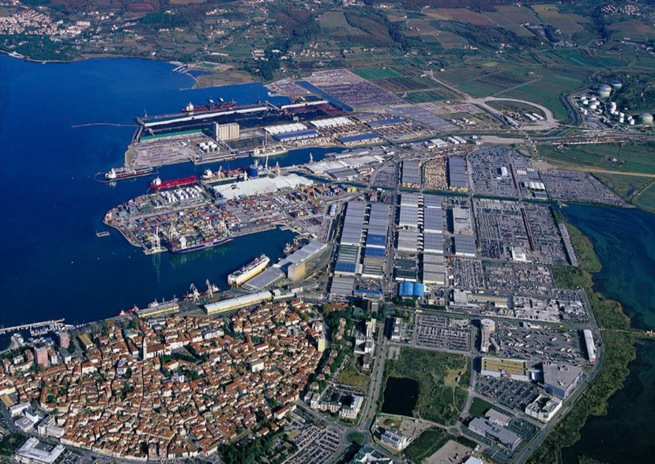
Investment needs in infrastructure
Port of Koper
Notes:
Investing in the development of an appropriate port infrastructure is an essential building block in establishing the Pan-European multimodal network in which the Mediterranean and Baltic – Adriatic corridor is connected with the sea lanes in the Adriatic-Ionian corridor.

Slide 7
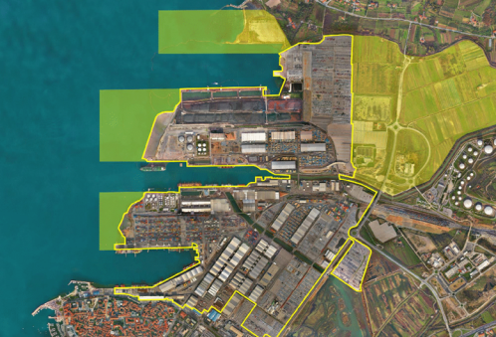
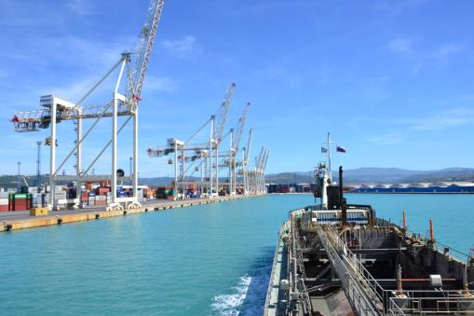
Port of Koper
Long term investments in
port infrastructure and the connecting inland infrastructure
Cargo throughput in 2015: 20,7 mio t
Plan for 2016: 21,6 mio t
Plans in 2030: 30-40 mio t
Notes:
The concessionaire Port of Koper is providing funds for investments in the development of port infrastructure in the area of the Port of Koper. The Republic of Slovenia is undertaking maintenance activities on navigable waterways outside the port areas and deepening them.
In order to increase the competitiveness of maritime transport, Slovenia needs to work on developing the international port in Koper, upgrading it and modernising its rail connections with the TEN-T network.

Slide 8
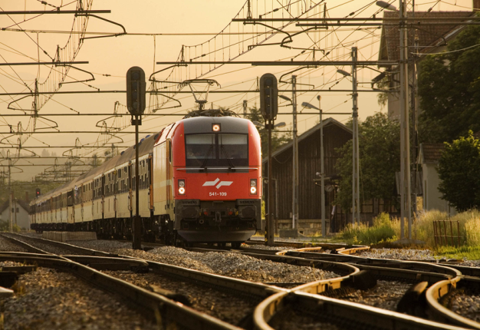
Efficient and modern public railway infrastructure
Main strategic goals of the Republic of Slovenia:
shifting of freight from roads to rails
multimodality
safe and efficient transport
TEN-T railway standards for Comprehensive and Core Network in Slovenian rail network (TEN-T Regulation (EU) No. 1315/2013) http://www.hiperdesign.eu/sz/en/Index.html
Notes:
Main strategic goals of the Republic of Slovenia are:
efficient and modern public railway infrastructure;
shifting of freight from roads to rails;
multimodality;
safe and efficient transport
Fulfilment of the TEN-T railway standards for Comprehensive and Core Network in Slovenian rail network (TEN-T Regulation (EU) No. 1315/2013)
.
The total length of the our rail network is 1,200 kilometres, of which 50% are mainlines, whereas about 42% of the lines are electrified. The railway network density in Slovenia (61 km of railway lines/1,000 m²) stands at a comparable level to the EU-27 average. The configuration of railway lines is outdated and no longer meets modern rail transport demands.
Slovenia’s investments in rail infrastructure development will pave the way to aligning the rail system with European standards and interoperability conditions and will provide for compliance with TEN-T standards. Investments in the rail system support development priorities set out in the Transport development Strategy In the Republic of Slovenia ,
remove bottlenecks in the TEN-T network, improve cross-border connections, increase throughput and performance on existing lines, enhance the safety and competitiveness of rail transport, and facilitate the shift of traffic from overburdened road networks to railways, which all leads to reducing negative environmental impacts caused by traffic.
In 2016 all main investments and upgrading will be finished on the Mediterranean Corridor - intersection Pragersko – Hodoš.
Main Investments for the next financial perspective are:
Second track of railway line Divača Koper
Upgrading railway connection Zidani most – Celje, Note Pragersko and
Second track of railway line Maribor Šentilj.

Slide 9
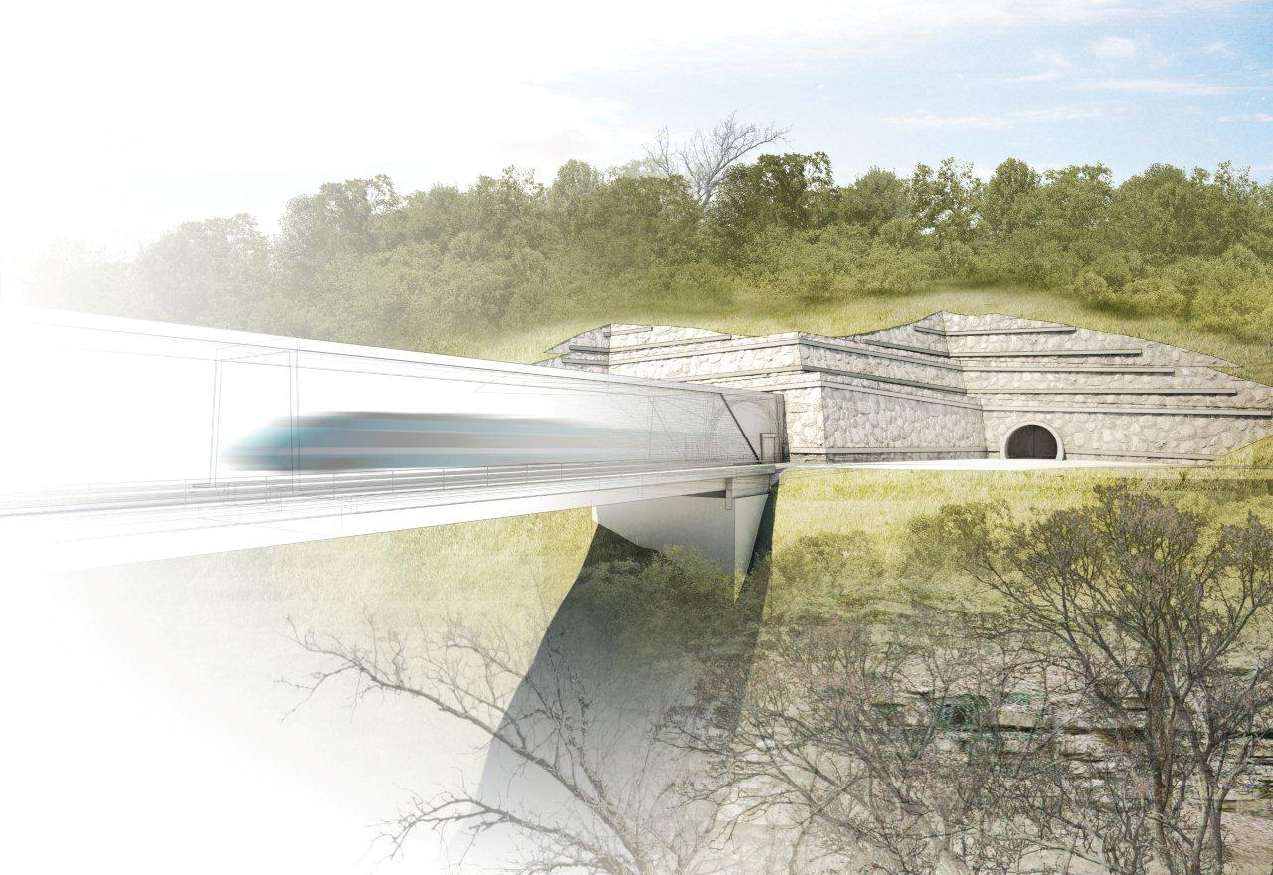
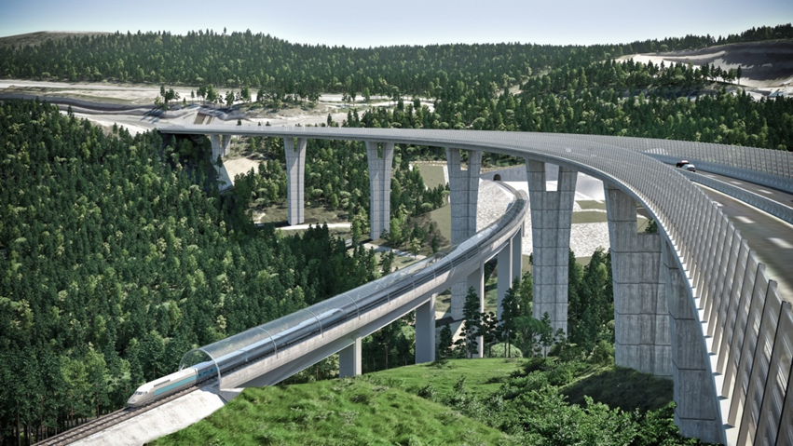
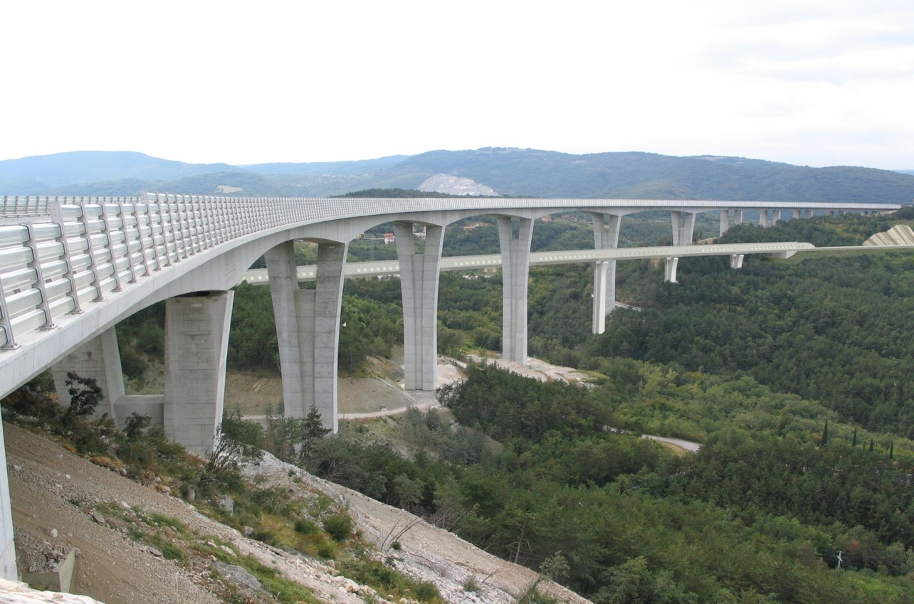
Second track of the Divača–Koper railway
Notes:
The total length of the rail network is 1,200 kilometres, of which 50% are mainlines, whereas about 42% of the lines are electrified.
The railway network density in Slovenia (61 km of railway lines/1,000 m²) stands at a comparable level to the EU-27 average.
The configuration of railway lines is outdated and no longer meets modern rail transport demands.
Slovenia’s investments in rail infrastructure development will pave the way to aligning the rail system with European standards and interoperability conditions and will provide for compliance with TEN-T standards.
Investments in the rail system support development priorities set out in the Transport development Strategy In the Republic of Slovenia ,
remove bottlenecks in the TEN-T network, improve cross-border connections, increase throughput and performance on existing lines, enhance the safety and competitiveness of rail transport, and facilitate the shift of traffic from overburdened road networks to railways, which all leads to reducing negative environmental impacts caused by traffic.
In 2015 all main investments and upgrading will be finished on the Mediterranean Corridor - intersection Pragersko – Hodoš.
Main Investments for the next finnancial perspective are:
Second track of railway line Divača Koper
Upgrading railway connection Zidani most – Celje, Note Pragersko and
Second track of railway line Maribor Šentilj
Project value:
The estimated value of the project on the basis of the latest projections for the acquisition of building permits and other studies and documentation prepared amounts to EUR 1,4 billion (incl. VAT) in current prices.
Activity situation:
Decree on the national spatial plan adopted in 2005, amending is being adopted in 2014;
Public presentation of environmental impact assessment in Slovenia has ended;
Environmental consent was issued on October 2014;
Projects for the acquisition of building permit – compiled and reviewed;
Investment programme: compiled and sent to be coordinated at the ministry
Sidetrack from the Port of Koper
Preparation of the Act for the Investing company
Application for EU funds: necessary studies and analyses are being prepared
Considering the activity situation, it will be possible to get the all permits in mid-2016 and start of main works in I. half of 2017.
Deadline for project completion: 2021-2022.

Slide 10
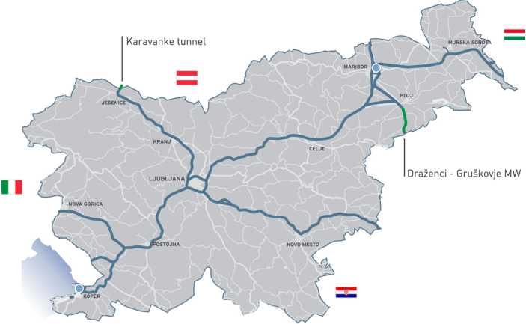
Motorways
Density
(30 km/1,000 m2)
Twice the
EU-27 avarage
Notes:
Thanks to its extensive investments in motorways, Slovenia’s density of motorways is almost twice (30 km/1,000 m²) the EU-27 average.
The Slovenian motorway system has been nearly completed with the help of generous investments in the current financial perspective, but the missing sections of the TEN-T network represent bottlenecks which will require additional investments. They will improve cross-border transport connections with neighbouring countries (Croatia, Hungary, Italy and Austria) and, consequently, reduce the time required to cross the border.

Slide 11

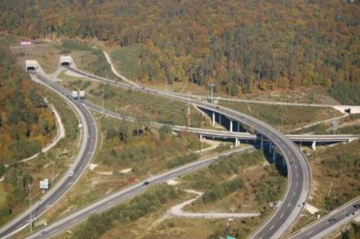
Motorways
Since 1994, the management of all existing motorways & relevant road infrastructure transferred to DARS d.d.
At the moment DARS manages and maintains a total of 606 km of motorways and expressways, 161 km of access roads and 27 km of rest areas
Notes:
By way of contract on 1st January 1994, the Republic of Slovenia transferred the management of all existing motorways, as well as relevant infrastructure and plant, to DARS d.d.
DARS, Motorway Company in the Republic of Slovenia is a joint-stock company
At the moment DARS manages and maintains a total of 606 km of motorways and expressways, 161 km of access roads and 27 km of rest areas

Slide 12
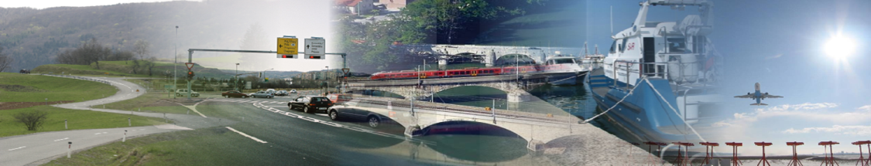
Investment needs in infrastructure
Development of road infrastructure
Missing links on the TEN-T network
(Draženci – Gruškovje, Karavanke tunnel)
New connections between North and South Slovenia
(parts of the 3rd development axis)

Slide 13
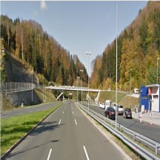
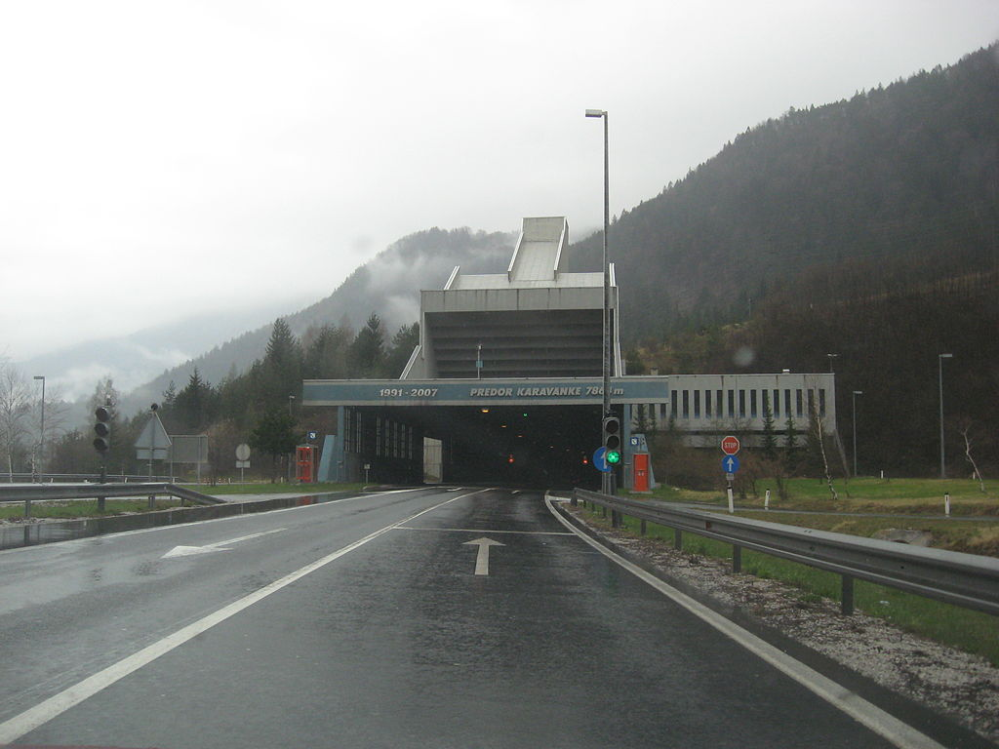
Investment needs in infrastructure
Motorway A4 Draženci – Gruškovje, 247,6 mio
Karavanke tunnel, 117,5 mio
Notes:
The Slovene motorway cross has been nearly completed, but the missing links along the TEN-T network represent bottlenecks. Major congestion hot spots are the A4 motorway Šentilj – Gruškovje, section Draženci – Gruškovje which is in fact the last missing section along the entire network (so-called Pyhrn motorway), and the single-tube tunnel on the A2 motorway section state border Karavanke – Obrežje.
The project Draženci-Gruškovje section in the total length of 13 kilometres closes the missing link on the A4 motorway, thus completing it and addressing the only identified bottleneck on the motorway as part of the TEN-T network. The project will ensure a complete motorway connection with the neighbouring countries in this part of Europe and will act as one of the key links in the direction NW-SE. Removal of this bottleneck will play a major role in addressing the congestion issues that, particularly throughout the summertime and before major holidays, bring the traffic to a standstill in the wider region from Maribor to Ptuj, practically paralysing any activity of local population.
The Karavanke Tunnel section is part of the comprehensive TEN-T network. The current problem in terms of traffic flow relates to peak hours; congestion occurs;
there are also traffic jams of a few kilometres on certain days; the traffic of trucks before the tunnel is limited or controlled due to safety reasons. Traffic flows are also increasing annually, potentially also causing a higher number of days and scope with heavy congestions, which is problematic for users (congestions, environmental burdens) and tunnel operator (provision of safety). There is no alternative to upgrading the single-tube corridor with a second tube to reach the full profile of a four-lane road. Traffic safety will be improved, which is pursuant to the provisions of the tunnel safety directive (Directive 2004/54).
The project on the construction of the second tube of the Karavanke tunnel is planned to apply for support under the CEF. It is included in so called Juncker‘s programme.

Slide 14
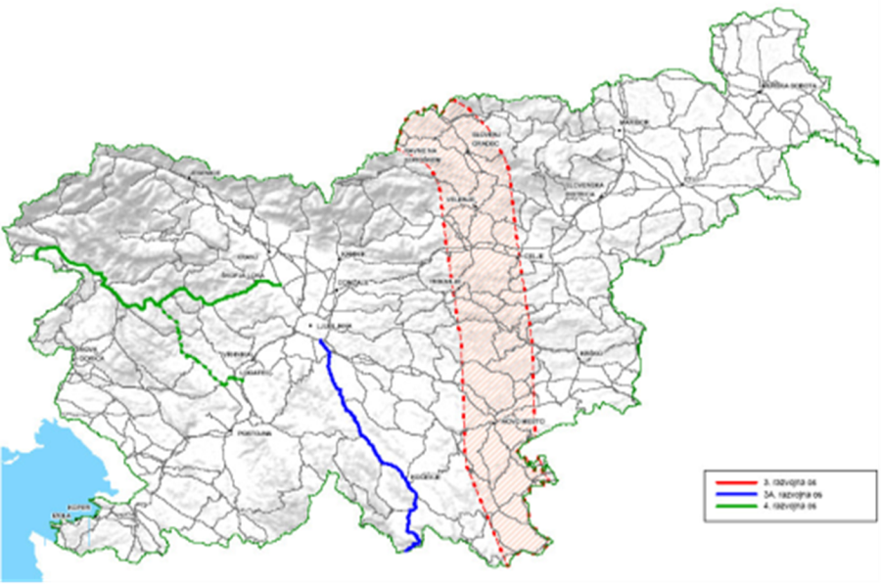
Investment needs in infrastructure
3rd development axis
Notes:
With a view to strengthening regional development potential, Slovenia seeks to improve accessibility to the existing TEN-T network and the quality of life, as well as to sustain the development of the economy in all regions of Slovenia by carrying on projects of road transport infrastructure on the so-called development axes.
The third development axis is a structural project which establishes transport connections between the urban centres of Koroška, the region Savinjska regija, Zasavje, Spodnje-Posavje and South Eastern Slovenia, and is connected to the regional centres and roads of the Austrian side of Koroška the Karlovac county in Croatia.

Slide 15
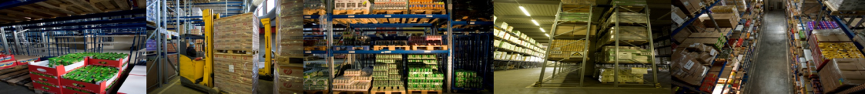
Investment opportunities
Intermodal Logistics Terminal Ljubljana – ILT
Total ILT surface area = 47,4 ha
Current covered warehouses: 79,000 m²
Planned new covered warehouses: 82,000 m²
New ILT
total planned covered warehouse space:
161,000 m²
Investors: SŽ d.o.o. and BTC Ltd.
Notes:
Ljubljana is one of the urban nodes on the Baltic-Adriatic Corridor. Therefore a modern Inter Logistic Terminal is planned. Intermodal Logistics Terminal Ljubljana in joint venture of the BTC d.d. and Slovenske železnice - Slovenian Raiways Ltd.

Slide 16
For more information…
Slovenia will build infrastructure through the cohesion funds, through public private partnerships and joint ventures with interested partners
Selection of the best performers is planned for all tenders
In the field of transport infrastructure Slovenia sees an opportunity for good cooperation between the countries in the region
Notes:
Slovenia will build infrastructure through the cohesion funds, through public private partnerships and joint ventures with interested partners.
The invitation to the Tender for the selection of partners are planned for the selection of public and private partners that are best performers.
In the field of transport infrastructure Slovenia sees an opportunity for good cooperation between the two countries.

