Slide 1
Overview of EU defence policy and funding opportunities for defence sector
PermRep of Republic of Slovenia
EU Funding for Defence and Security
Brussels – 8 March 2018
Paul Anciaux
European Commission, DG GROW
GROW i.4

Slide 2
Structure
EU Funding instruments
  European Defence Fund
  ESIF, COSME
Networks in support of SMEs, clusters and regions
  European Strategic Custer Partnerships
  European Network of Defence-related Regions
  Enterprise Europe Network
Awareness-campaign

Slide 3
Launching the European Defence Fund
European Defence Action Plan of 30 November 2016 announced the creation of a European Defence Fund
European Commission adopted on 7 June the Defence Package:
  Reflection Paper on the Future of European Defence
  Communication on Launching the European Defence Fund
  Proposal for a Regulation of the European Parliament and of the Council establishing the European Defence Industrial Development Programme (EDIDP)
Proposal for a Regulation establishing the EDIDP is currently being discussed at the Council and at the Parliament – final agreement to be reached during the Bulgarian Presidency of the Council of the European Union

Slide 4
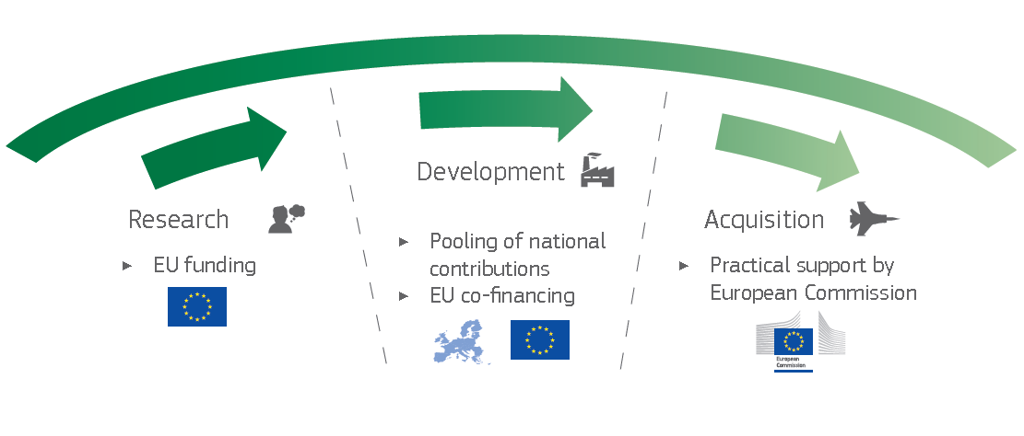
EDF - COMPLETE CAPABILITY DEVELOPMENT CYCLE
Research Window
Capability Window
Preparatory Action on Defence Research
European Defence Research Programme
European Defence
Industrial Development
Programme
Financial Toolbox

Slide 5
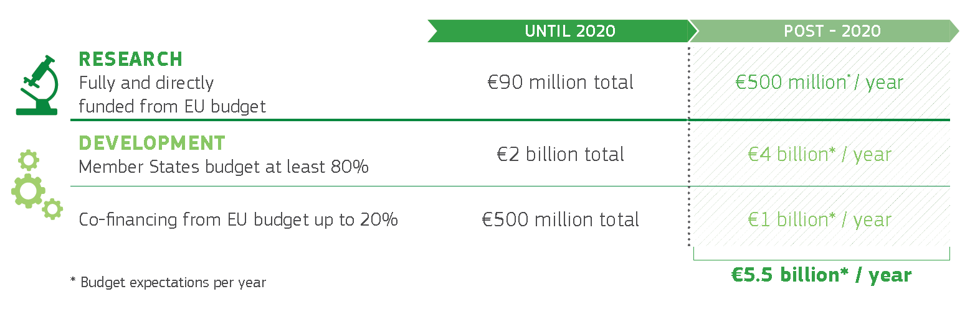
Proposed budgets

Slide 6
capability window

Slide 7
EUROPEAN DEFENCE INDUSTRIAL DEVELOPMENT PROGRAMME
  Proposal for Regulation adopted on 7 June 2017 – procedure in front of the European Parliament and of the Council of the EU forthcoming
  First proposal for EU budget support for collaborative defence capability development projects
  Objectives:
    Foster the competitiveness and innovation capacity of the EU defence Industry
    Leverage cross-border cooperation between undertakings, including SMEs, in the development of defence technologies or products
    Foster better exploitation of the results of defence R&T

Slide 8
EUROPEAN DEFENCE INDUSTRIAL DEVELOPMENT PROGRAMME
  Legal base: Article 173 TFEU
  Duration: 2 years → 2019-2020
  Budget: EUR 500 million for the period 2019-2020
  Areas of intervention: design, prototyping, testing qualification or certification of a product or technology, or studies
  Beneficiaries: at least 3 undertakings from at least 2 different Member States must establish a cooperation (consortium)
  Involvement of SMEs: a credible proportion of the budget will benefit actions enabling cross-border participation of SMEs

Slide 9
EUROPEAN DEFENCE INDUSTRIAL DEVELOPMENT PROGRAMME
  Amount of support: up to 20 % of total cost for prototyping (for other actions it may cover up to 100%). Higher percentage of an additional 10 percentage points is provided for projects under PESCO
  Support instruments: grants, financial instruments or public procurement
  Implementation through a multiannual work programme
  Actions should be based on common technical specifications
  Ownership and Intellectual Property rights: the Commission will not own the products or technologies resulting from supported actions

Slide 10
EUROPEAN DEFENCE INDUSTRIAL DEVELOPMENT PROGRAMME
  Next steps
  Preparation Draft Work Programme
  Companies should identify possible projects
  Cooperation is a priority: not only between large and SME, also between SME

Slide 11
ESIF & COSME

Slide 12
ESIF
European Structural & Investment Funds
  ESIF may be used in defence sector as long as they contribute to objectives of the fund
  ERDF may fund defence activities and dual-use activities in research and innovation, as part of a smart specialisation strategy
  Commission is promoting funding opportunities through ESIF to the benefit of defence stakeholders

Slide 13
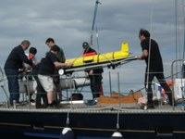
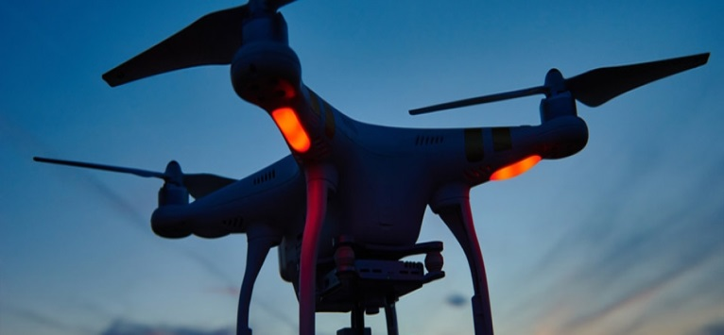



Intruder detection & avoid system for drones (Poland)
Radio-wave technology for drones (Poland)
Energy efficient robotics for deep sea
(Portugal)
ESIF 2014-2017
Projects in dual use areas
SMEs in the lead
Cyber security (Estonia)
Circular economy -waste (Greece)
Advanced lightweight impact materials (Portugal)

Slide 14
COSME
COSME: Programme for the Competitiveness of Enterprises and SMEs
First EU programme targeted to SMEs
    Facilitating access to finance
    Supporting internationalisation and access to markets
    Improve the conditions for businesses
    Foster entrepreneurship and entrepreneurial culture
    Budget: €2.3 billion for 2014 – 2020

Slide 15
Networks

Slide 16
COSME
  ESCP-4i
European Strategic Cluster Partnerships
Support to clusters in the Defence & Security sector
  More info: https://ec.europa.eu/easme/en/cos-clusint-2017-03-6-clusters-go-international-defence-and-security-sector
Call open until 13 December 2017
Signature contracts expected for 1 June 2018
Notes:
Aim: (connect with non defence-related clusters) photonics, medical, energy, health, maritime, ICT, textiles, ….
Budget
Only entities established in EU can take part

Slide 17

COSME
ENDR
Forum for regional organisations & clusters to exchange information and share best practices
Info on access to funding at EU level
Organisation of events
Notes:
Dual use Cyber security strategies symposium Rennes, Nov 2016
EDAP's new opportunities for regions workshop Brussels, March 2017
Maritime and Defence Dual-use conference Southampton, April 2017
Dual-Use Conference 2017 – Drones & Space Aarhus, May 2017
ENDR Member workshop Brussels, 26 Oct 2017

Slide 18
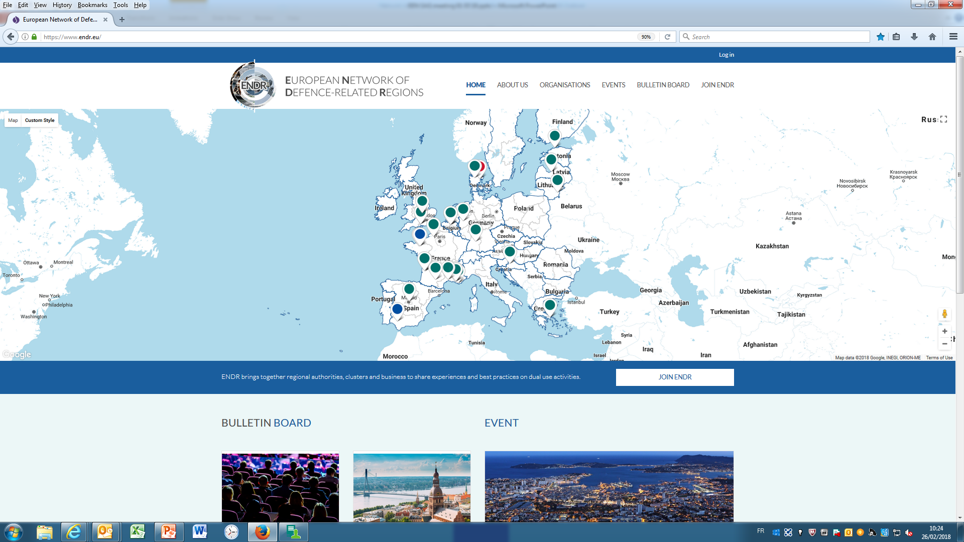
www.endr.eu

Slide 19
2018-2019
ENDR
Expand membership
Increase availability of info
  Access to EU funding section on www.endr.eu (Q1 '18)
  EDF leaflets (Q1 '18) & brochures (Q3 '18)
Organise events

Slide 20
Events 2018
Drone Days EEN Brokerage Event
  Brussels, 9-11 March
European Forum of defence and dual use technologies for the protection of the maritime domain (ENDR)
  Toulon, 24-25 May
EUROSATORY – Defence & Security International Exhibition
  Paris, 11-15 June
Seminar Synergies of EU funding in the area of dual use & defence (ENDR)
  Seville, 3-4 October
Conference Cyber (ENDR)
Tallinn, 28-29 November (tbc)

Slide 21

EEN
SMEs can turn to EEN for free-of-charge advice on EU legislation, funding and B2B
Examples show potential for EEN to be involved in supporting SMEs in area of dual use
Defence as an optional activity for EEN partners in host organisations where service-provision to this sector is allowed
  DG GROW will provide support and on-demand-training to EEN Partners and SG

Slide 22

Awareness campaign
  Brochure
  successful cases of SMEs using EU funding
  in DE, EN, ES, FR, IT, PL, SE
  hard copies via EEN and on-line
  Videos
http://ec.europa.eu/growth/content/dual-use-technology-eu-%E2%80%93-sme-success-stories-eu-funding_en
https://www.endr.eu/about-us

Slide 23
Thank you for your attention!

Slide 24
USEFUL LINKS
Commission‘s Communication on European Defence Fund: http://eur-lex.europa.eu/legal-content/en/TXT/?uri=CELEX%3A52017DC0295
Communication from the Commission on European Defence Action Plan:
http://eur-lex.europa.eu/legal-content/EN/TXT/?uri=COM:2016:950:FIN
Proposal for a Regulation establishing the European Defence Industrial Development Programme:
http://eur-lex.europa.eu/legal-content/EN/TXT/?uri=CELEX%3A52017PC0294
Commission policy in support of Defence SMEs: http://ec.europa.eu/growth/sectors/defence/industrial-policy/smes/index_en.htm

