Slide 1




Strategic research and innovation partnership (SRIP) –
Networks for the transition to circular economy
Bio-Raw materials for coatings in Helios
Dr. Martin Ocepek, Helios TBLUS d.o.o.
Head R&D Synthetic Resins
23 September 2019 I Brussels
Investment is co-financed by the Republic Slovenia and the EU under the European Regional Development Fund.

Slide 2

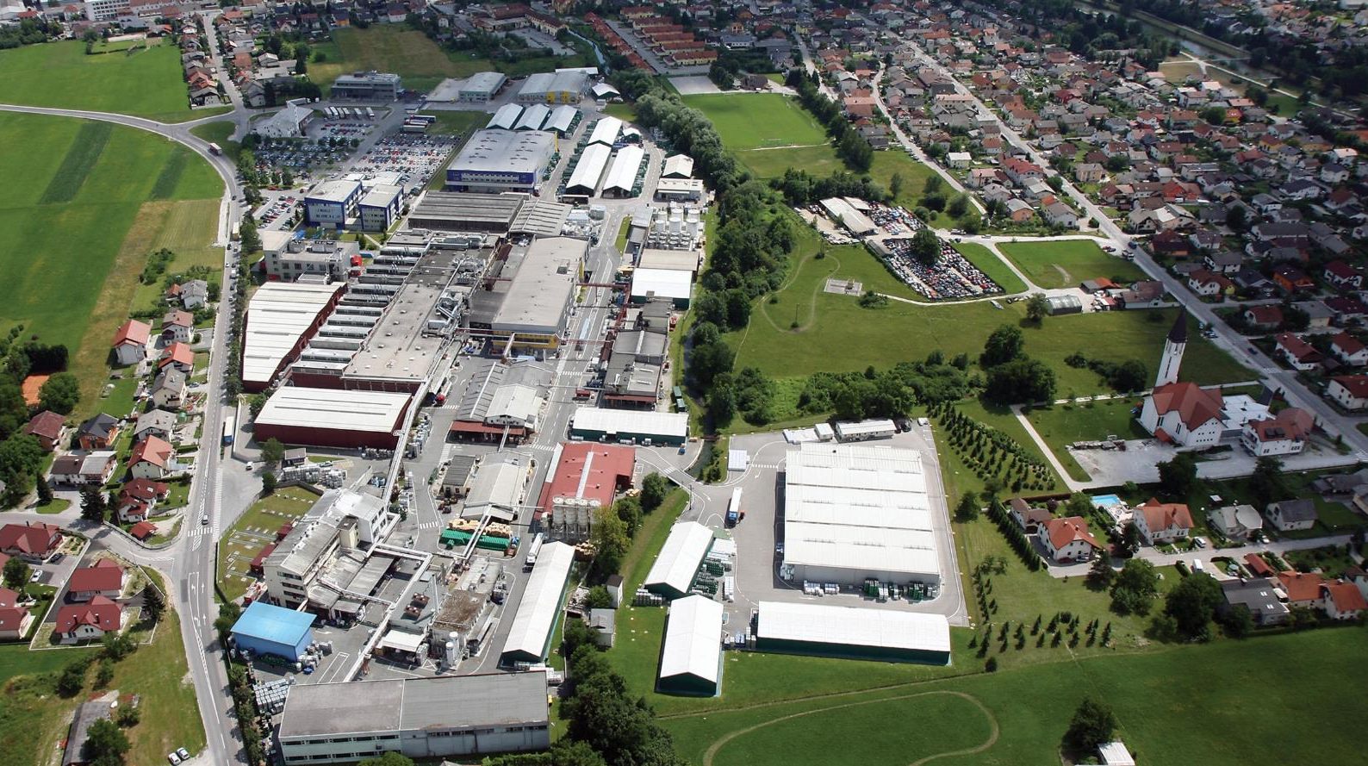
AMONG THE TOP COATING COMPANIES IN THE EUROPEAN MARKET
Sales 2018: €400m
Employees: approx. 2,000
Production sites in: Austria, Germany, Italy, Slovenia, Croatia, Russia, Serbia and Ukraine
Production: 80,000 tons liquid coatings, 16,000 tons powder coatings, 29,000 tons chemicals, 54,000 tons resins

Slide 3
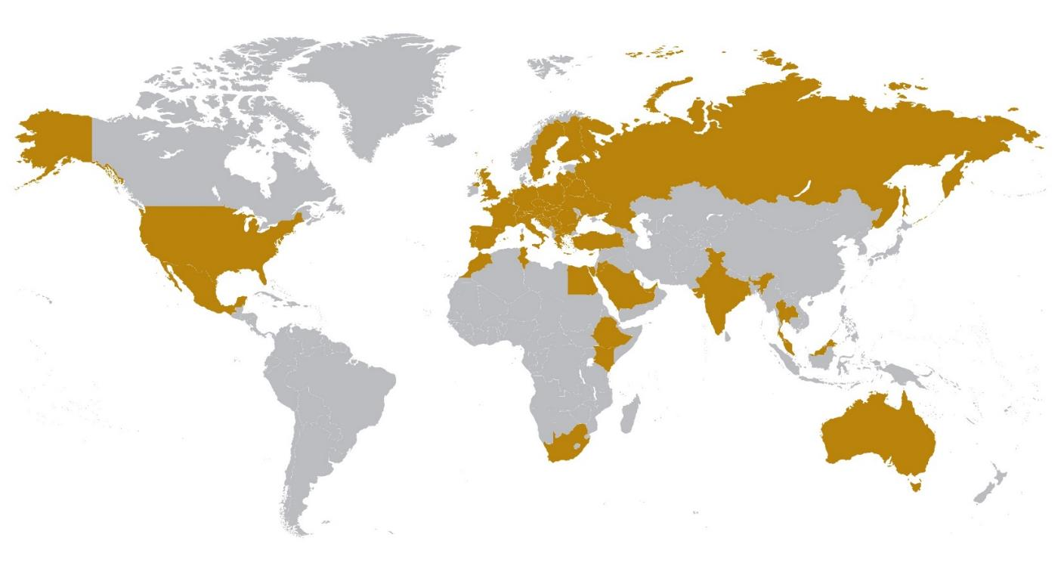
Production 54,000 tons
Turnover over €100m
Sales to over 50 countries worldwide
81% external sales
75% of sales in Germany, Italy and France
RESINS SUPPLIER SINCE 1908

Slide 4
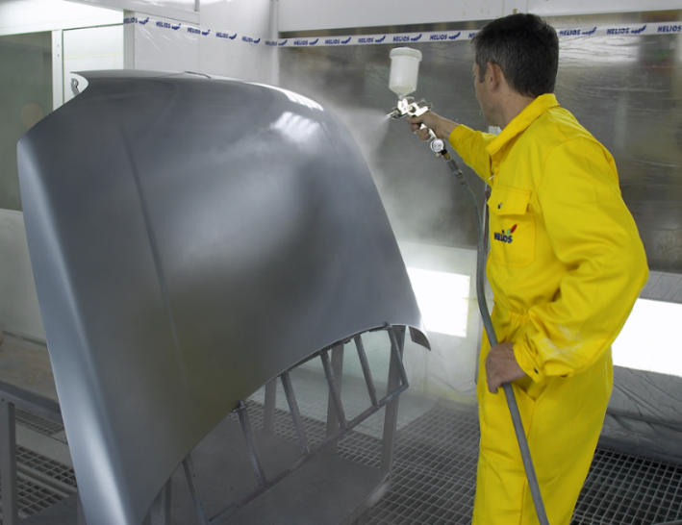
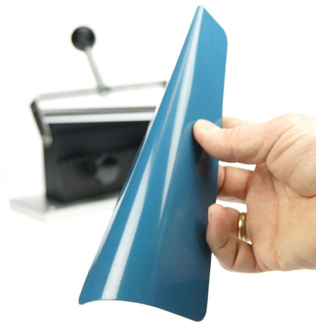

Circular economy in Paints / Coatings
Coating:
Resin(s) / binder(s)
Solvent(s)
Aditive(s)
Pigment(s)

Slide 5

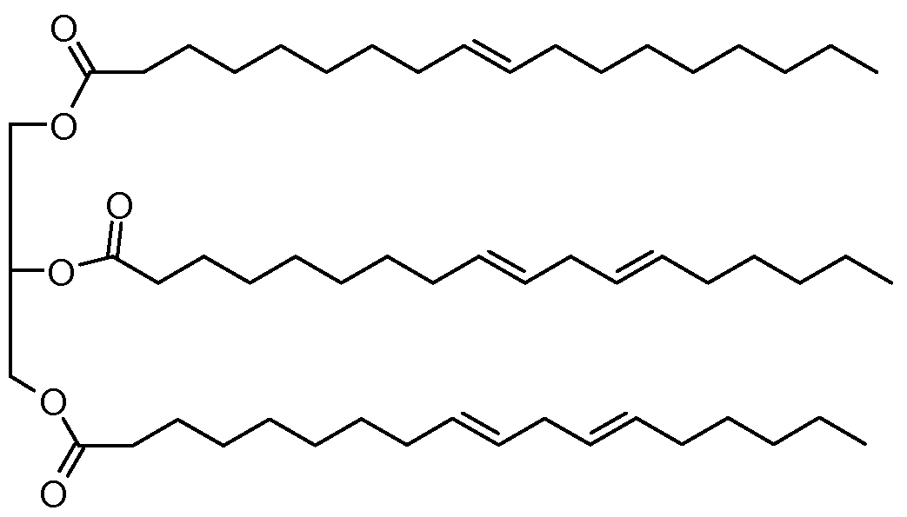

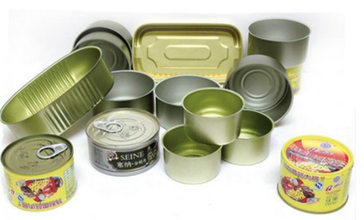
Curent status in Helios regarding Circular economy
Process:
Waste-water treatment
Regenerative thermal oxidizer (RTO)
…
Materials:
Alkyds
Water-based materials
Partly Bio-based (Meth)Acrylates
BPA-free resins for food-contact coatings
…

Slide 6


Finished projects
Novel high performance, water-based “high solids” and bio-based industrial wood coating

Slide 7

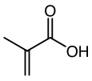



    Increasing Bio-based content
      Bio-based methacrylic acid
      Cooperation with National Institute of Chemistry Slovenia
      EU patent application
-CO₂
BIO-Hydroxyethyl Methacrylate
Catalyst
BIO-based Itaconic acid
(from Citric Acid)
BIO-Methacrylic acid
BIO-Methyl Methacrylate

Slide 8
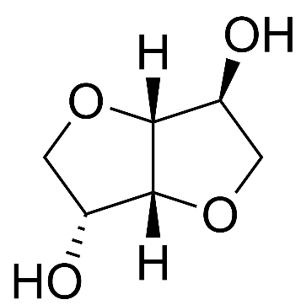

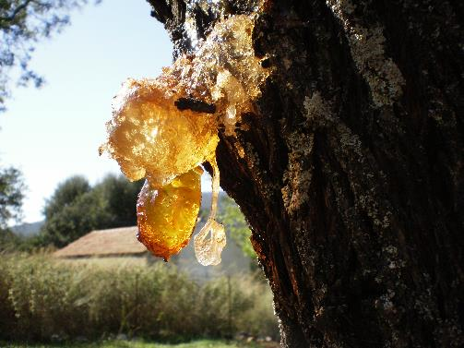

    Increasing Bio-based content
      Bio alternative polyols (Isosorbide) and diacids for polyesters (Furandicarboxylic acid instead Terephthalic acid)
      COST Action:
      European network of furan based chemicals and materials for a sustainable development (FUR4Sustain)
      September 2019: 2 BBI (Bio-based Industries) proposals

Slide 9
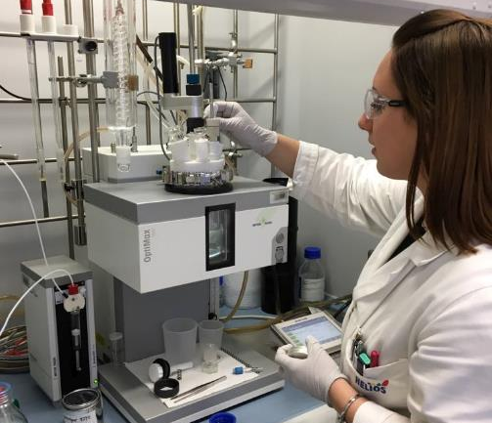

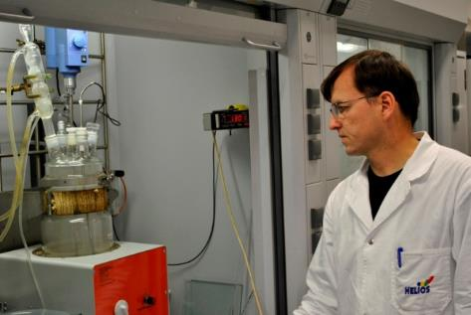
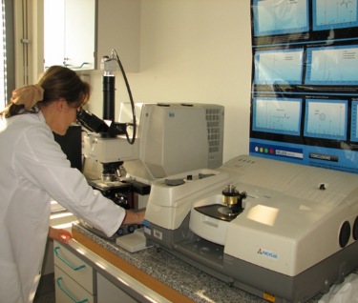




    SUSTAINABILITY
    vs.
    PERFORMANCE
    &
    PRICE

Slide 10
Thank you for your attention!
Contact:
Dr. Martin Ocepek
e: martin.ocepek@resinshelios.com
T: +386 1 722 4256
Investment is co-financed by the Republic Slovenia and the EU under the European Regional Development Fund

