Slide 1

Committed to research excellence
Advanced and high-performing materials
Cooperation opportunities
Dr. Barbara Tišler
Head of project management office
Brussels, 8th March 2018

Slide 2
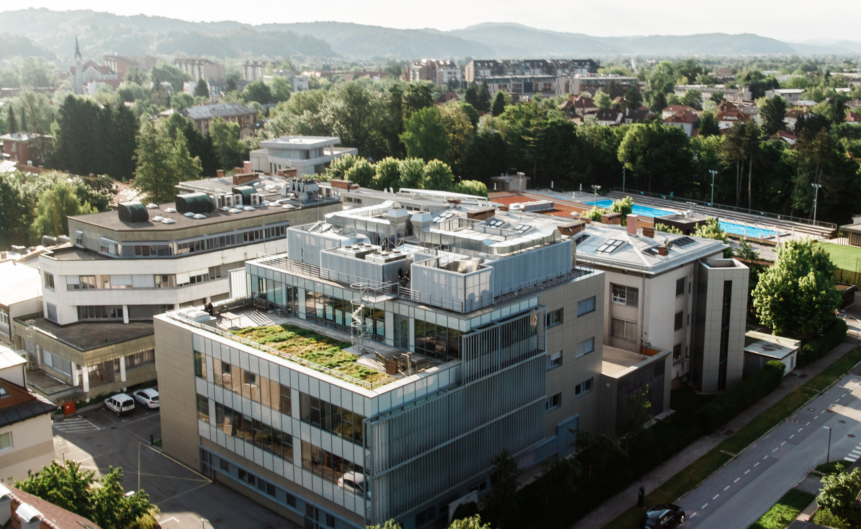
12 Departments
300 Employees
130 Researchers with PhD
66 PhD students
In expanding knowledge of chemistry and associated studies
In transferring knowledge to younger generations
In applying newly acquired knowledge to industry

Slide 3
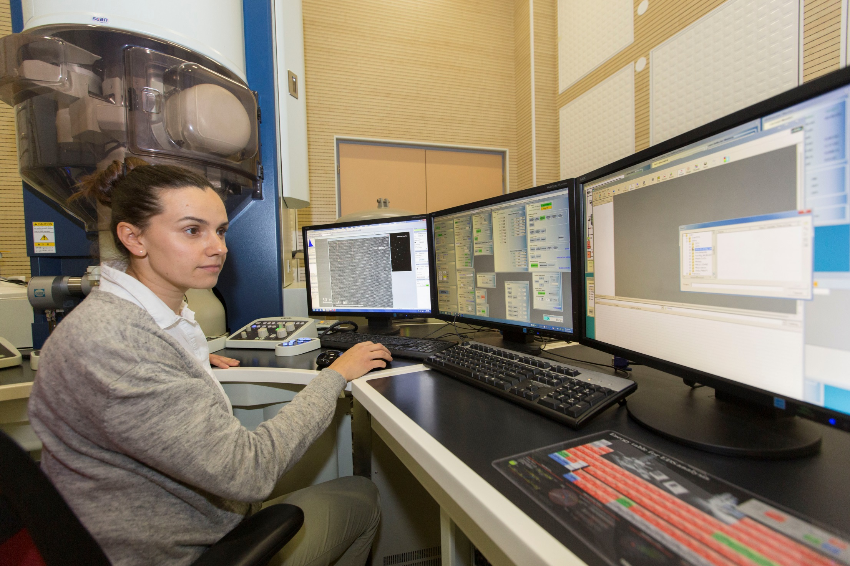
800 MHz NMR spectrometer National NMR Centre (CERIC/ERIC)
AR-STEM (Jeol, ARM 200 CF)
Supra 35 VP EM with EDX analysis
Confocal microscopy (Leica TCS WLL SMD platform)
High performance computing cluster

Slide 4
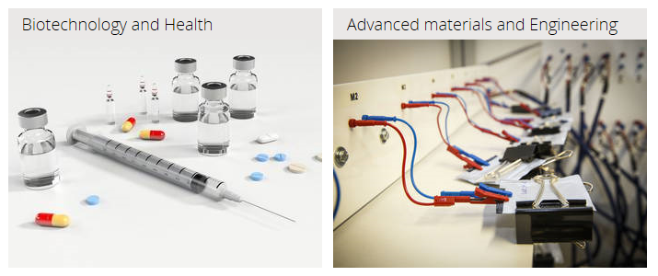
Two main research areas

Slide 5
























Projects
25 EU projects
13
H2020
4
Interreg
50 slovene funding
4
ERA NET
2
NATO
1 CRP ICGEB
1 EDA

Slide 6
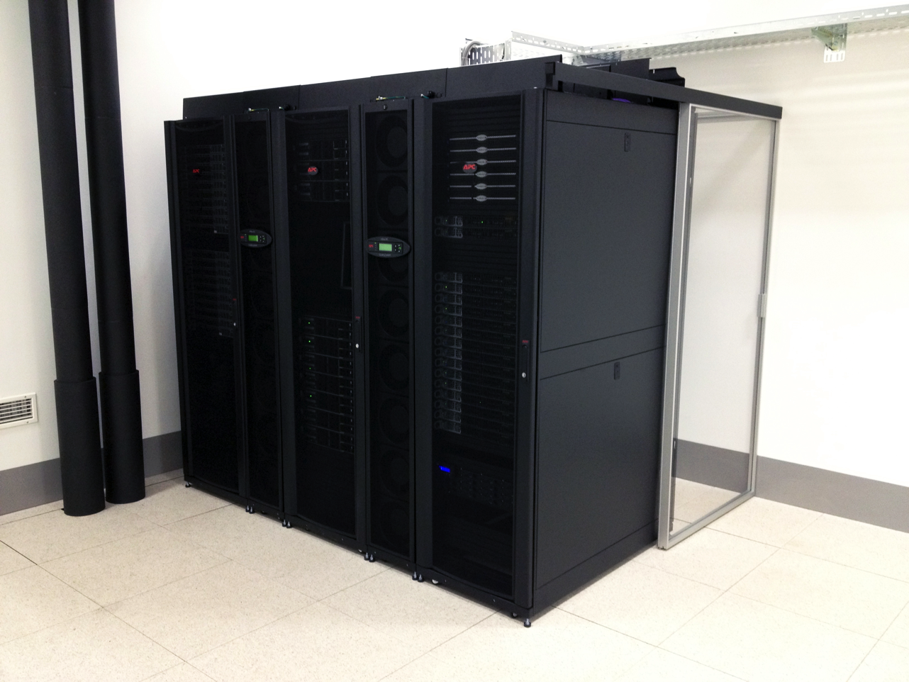
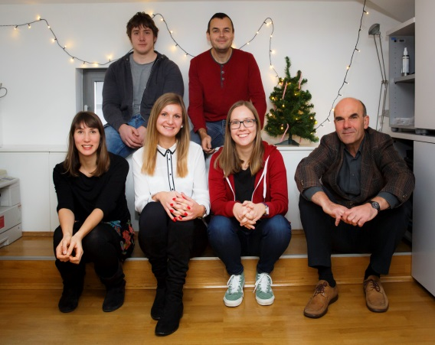


Defence and security proposal for call:
SU-DRS04-2019-2020: Chemical, biological, radiological and nuclear (CBRN) cluster
Multiscale Molecular Simulation of chemical reactivity on the QM/MM
level
Organophosphates irreversibly phosphorylate serine, one of three amino acid residues in the catalytic site of the enzyme acetylcholinesterase.
Design of novel antidotes for cleavage of organophosphate complex with acetylcholinesterase.
Application to tabun poisoned patients.
Laboratory for Computational Biochemistry and Drug Design
Prof. dr. Janez Mavri, Head, e-mail: janez.mavri@ki.si

Slide 7
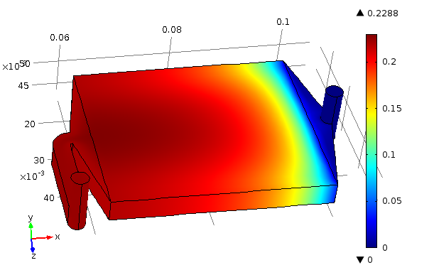
Defence and security proposal for call:
SU-DRS02-2018-2019-2020: Technologies for first responders
Electrocatalytic Carbon Dioxide Activation and Reduction, Electrolysis and Fuel Cells
- miniaturized PEM FC system (membrane electrode assembly (MEA) of c. 1 cm2)
- in-depth microscopy durability studies and method development
- new electrochemical processes for platinum-group metals (PGM) recycling
- in-situ electrochemical transmission electron microscopy (TEM)
- CO2 reduction in water and organic solvents (CO, methanol and ethylene)
CO2
Department for Catalysis and Chemical reaction Engineering
Prof. dr. Blaž Likozar, Head, e-mail: blaz.likozar@ki.si

Slide 8
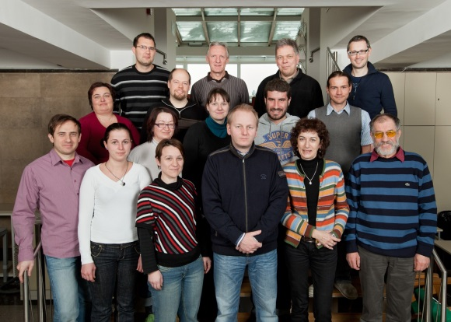
Defence and security proposal for call:
SU-FCT02-2018-2019-2020: Technologies to enhance the fight against crime and terrorism
Gas sensors for preventing terrorism
-detection systems that would provide early warning and possibly prevent future attacks,
-Suitable for highly explosive organic peroxo compounds
(2015 Paris, 2016 Brussels , 2017 Manchester)
Development of:
a) environmental-atmospheric chemistry
b) chemical characterization and (elemental) speciation/imaging
  c) electroanalytical chemistry and development of electrochemical
  (micro)sensors and biosensors
Department for Analytical Chemistry
dr. Samo Hočevar, Head, e-mail: samo.hocevar@ki.si

Slide 9
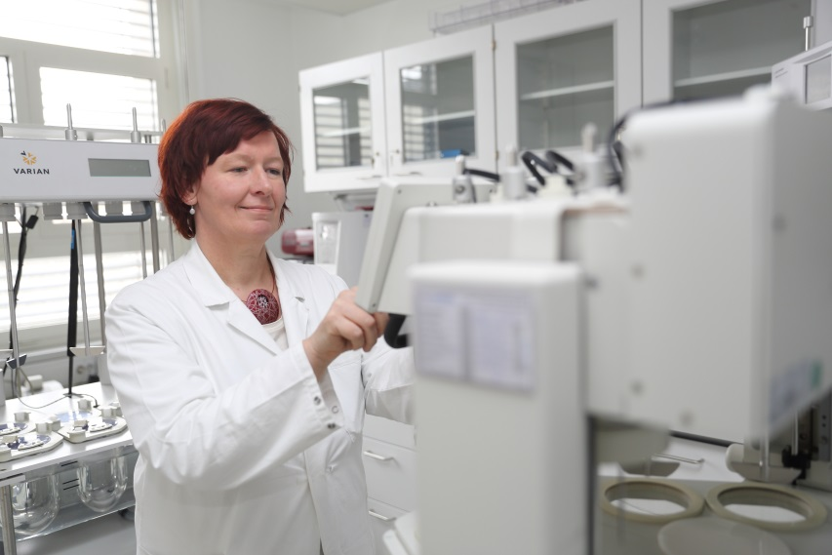
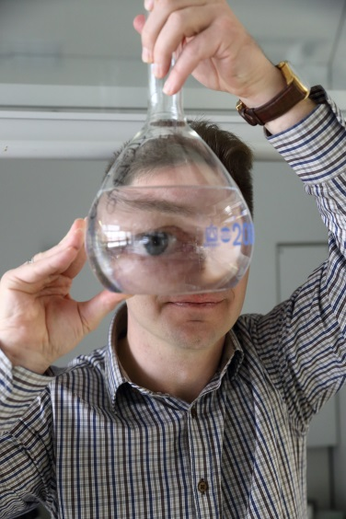
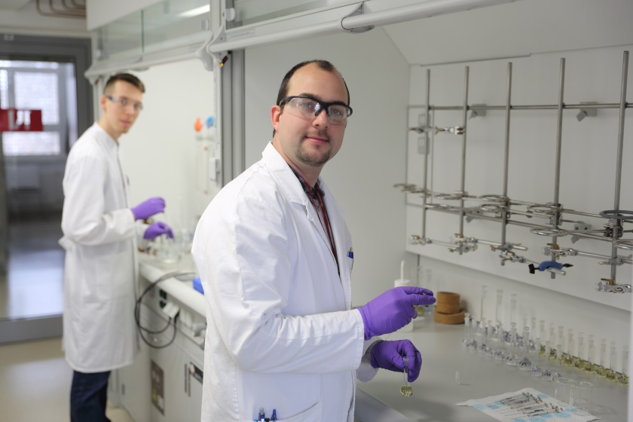
Other cooperation opportunities
all equipment is GMP qualified
Inspections:
FDA: 1996, 1997 and 2007; without any major observations – GLP inspection for bioequivalence studies.
SIQ: 2009, 2013, 2015
IQ NET: 2009, 2013, 2015
JAZMP: 2012, 2014, 2017; Certificate of European GMP compliance for manufacturing the medicinal products and equipment
-
Centre for validation technologies and analytics
dr. Samo Andrenšek, Head, e-mail: samo.andrensek@ki.si

Slide 10
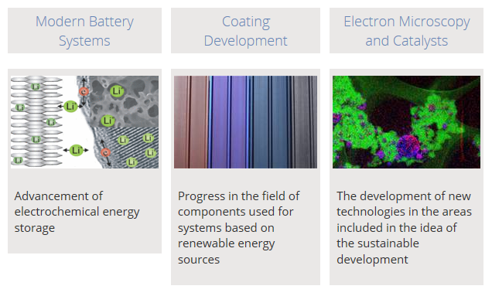
Advanced material development
-synthesis, characterization and development of advanced materials for sustainable, low carbon energy solutions.
The main research areas comprise
(i) advanced battery materials,
(ii) coating development and
(iii) synthesis and characterization of electrocatalysts.
In order to better understand the properties and functioning of these materials, we also develop our own spectroscopic, microscopic and electrochemical methods.
Department for Materials Chemistry
Prof.dr. Miran Gaberšček, Head, e-mail: miran.gaberscek@ki.si

Slide 11
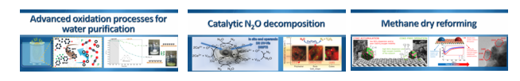
Water purification technologies
-development of modern processes for water treatment along with: (i) catalytic
(ii) microbial and enzymatic processes in energy and production of high added-value compounds
Department for Environmental Sciences and Engineering
Prof.dr. Albin Pintar, Head, e-mail: albin.pintar@ki.si

Slide 12




National Institute of Chemistry
Hajdrihova 19
1001 Ljubljana, Slovenia
Webpage: www.ki.si
e-mail: project.office@ki.si
Phone: 00386 (1) 476 0498
Fax: 00386 (1) 476 03 00

