Slide 1
Navarra & circular economy
A bottom-up approach

Slide 2
GROUP FOR THE CIRCULAR ECONOMY IN NAVARRE REGION
Creation date: Oct-Nov 2015
Supported by the Confederation of Navarrese Entrepreneurs under its environmental action framework.
Aim: social leadership influencing the government to accelerate the transition to a circular economy in the region.
Entities invited to take part: People/Entities/Companies that attended the early actions developed in 2014.
Participation of more than 30 people of 23 entities: multidisciplinary
DECLARATION OF INTENT AND COMMITMENT TO BOOST THE CIRCULAR ECONOMY IN NAVARRE PRESENTED TO THE VICEPRESIDENT OF NAVARRA (NOV 25, 2015)
ACTION
Offering support and collaboration to public institutions
Requesting a review of the S3 based on the Circular Economy principles and a meeting with the Vice President of Navarre
Notes:
Explaining when: it was organised a workshop for the presentation of the results achieved by the business associations with different companies in for the indentification of business oportunities WITHIN THE CIRCULARITY. Our representative of navarra in brussels and the vicepresident were taking part of the workshop, in the final part, without any previous information, 4 representatives of the group read the declaration to the vicepresident.
OFFERING OUR SUPPORT AND COLLABORATION TO PUBLIC INSTITUTIONS IN CREATING A FAVOURABLE ENVIRONMENT FOR OUR REGIONAL CIRCULARITY.
2 DEMANDS:
THE REVIEW OF THE REGIONAL SMART SPECIALISATION STRATEGY BASED ON THE CIRCULAR ECONOMY PRINCIPLES
ASK FOR A MEETING WITH THE VICEPRESIDENT OF ECONOMIC DEVELOPMENT.
It was the first opportunities we had to give the message and we just did it, it was NO official action, neither within the protocol of such an event, but it was welcome.

Slide 3
GROUP FOR THE CIRCULAR ECONOMY IN NAVARRE REGION
RESULTS
1
Participation of group in the review process of the S3 development.
Inclusion of the Bioeconomy and the Circular Economy in the strategy.
2
Participation of the regional Government in a H2020 project (CIRC-03-2016: Smart specialisation for systemic Eco-innovation/Circular Economy)
3
Meeting of representative of the group with the regional GD of Economic Development and Environmental and Territorial Planning (June, 1 2016)
CHALLENGES
Cross-cutting: implementation of the circular economy in all the policies and plans currently under definition: Social Economy, Climate Change, Science, Technology and Innovation, Industrialisation, etc.
1
2
Development of a Regional Circular Economy Strategy with an effective public participation process.
3
Using fiscal/financial instruments to stimulate circular business models.
Notes:
CHALLENGES: STILL A LOT OF WORK TO DO, “the ball is in the government´s court”:
The group has not been constituted with a legal entity.
Our aim was achieved
Now each entity has the commitment to introduce the circular economy principles in every working group, policy or strategy in which the entity can take part.
In the meantime each entity is working to develop actions, projects, products and service include in a more circular economy.

Slide 4
























GROUP FOR THE CIRCULAR ECONOMY IN NAVARRE REGION
4 COMPANIES
8 CLUSTERS & BUSINESS ASSOCIATIONS
1 FOUNDATION
2 PUBLIC ENTITIES/AGENCIES
5 CONSULTANCIES
2 TECHNOLOGICAL CENTERS
2 UNIVERSITIES

Slide 5



Plastic Repair System
CIRCULAR ECONOMY
REPAIR
REUSE
a solution to environmental and economic issues
Notes:
Plastic Repair System was founded in 2011 to provide a solution to the growing environmental and economic problems. After carefully studying the business and logistic strategies of Spanish companies, we noticed that a lot of industries discard their plastic crates and containers when they are damaged, and replace them with new ones. This is not only costly for the company but also results in a high percentage of plastic waste. We believed there had to be a different way.
The idea behind Plastic Repair System is simple: to repair instead of discard. To reuse instead of replace. Plastic Repair System offers an alternative to the (over)consumption of plastics within industries.
In doing so, Plastic Repair System embraces the philosophy of Circular Economy. We don’t consider broken plastic objects as a loss, but rather as a possibility. By repairing, we give plastic objects a second life and help companies contribute to take action to defend the environment.
We are proud to announce to have obtained the necessary patents to expand our philosophy and our business to Europe.

Slide 6
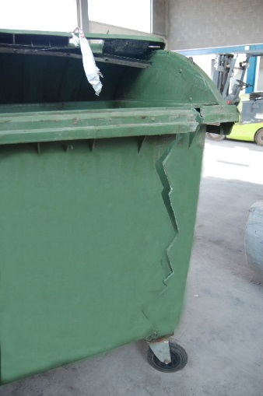
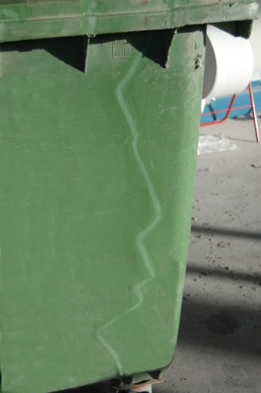
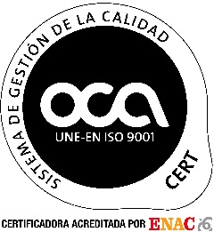



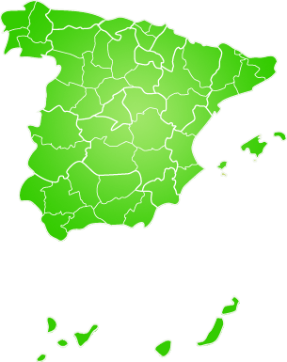

PRS - method
The PRS-method
Functionality
100%
Strength
at least 98%
Before
After
PRS is active in:
Industrial sector
Food industry
Waste collection
Sport and Leisure
Current situation
our goal:
26 workshops
Notes:
How do we do business?
We have developed our own system to repair plastic: the PRS-method. It is patented and certified. This system is based on a welding technique with virgin material. Through this method, we can completely restore the object to its original state.
Our clients are situated within the industrial sector, the alimentary sector, waste collection and sport and leisure. We focus mainly on plastic crates, containers, tanks, etc. used in the logistical process, but in reality, we can repair any object made of plastic.
At this moment we have 26 operational workshops throughout Spain to distribute our repair-services close to the client. With our newly obtained patents, we are setting our goal for the future: to go international.

