Slide 1
Bioeconomy in Navarra Region: the example of CENER BIO2C Research Centre
Conference on “Sustainable Business Models in Circular Bioeconomy”
Jorge Molina Villanueva (ADItech) – 23rd of September, 2019 - Brussels
Permanent Representation of Slovenia to the EU

Slide 2
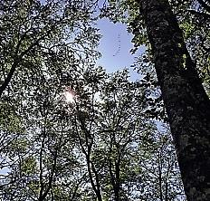
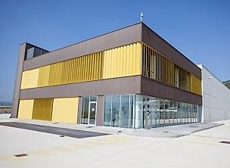
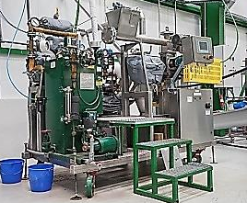
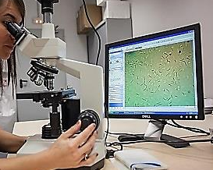
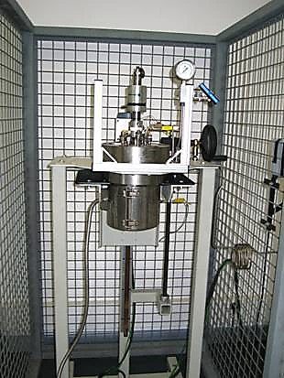
TECHNOLOGY TOWARDS CIRCULAR BIOECONOMY
BIORESIDUE & RESIDUAL BIOMASS
BIOREFINERY
concepts
OFMSW
Park and garden waste
HORECA
Sewage sludge
Other residual biomass
CIRCULAR BIOECONOMY
  Sugar platform
  Lipid platform
  Protein platform
  Others: minerals, inerts
  Integral
  Flexible
  Cascade
  Zero waste
BIOBASED PRODUCTS
BIOENERGY
  Biodegradable plastics
  Biobased chemiclas
  Biostimulants
  Biopesticides
  Biofertilizers
  Advanced biofuels
  Solid biofuels

Slide 3
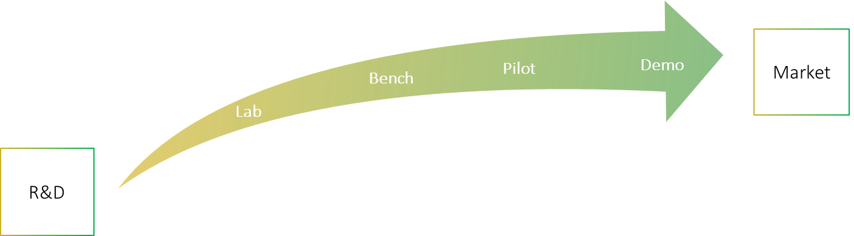
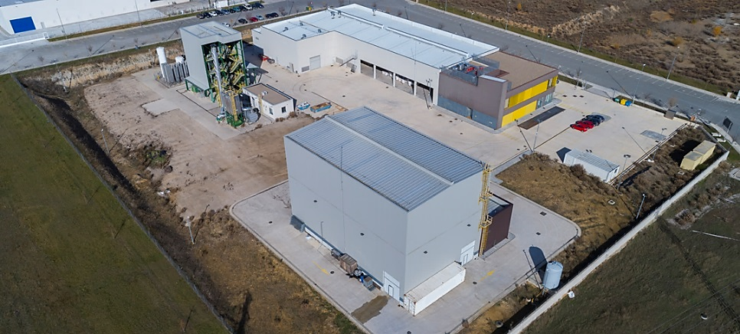
BIO2C – Biorefinery and Bioenergy Centre
CENER’s Industrial research infrastructure for bioprocesses
The Biorefinery and Bioenergy Centre (BIO2C) is a semi-industrial demonstration-scale testing facility with different Process Development Units capable of developing and validating processes for the production of bioproducts, solid biofuels, advanced liquid and gaseous biofuels, as well as biorefinery concepts by integrating different routes of valorisation, as an intermediate stage between the laboratory and the commercialization trough the industrial scale-up of these technologies.
Integrated trial and demonstration platform designed to develop:
processes,
equipment and specific components,
new bioproducts and biofuels,
bio-refinery concepts.

Slide 4
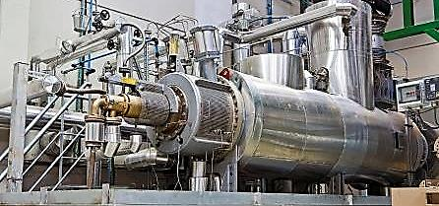
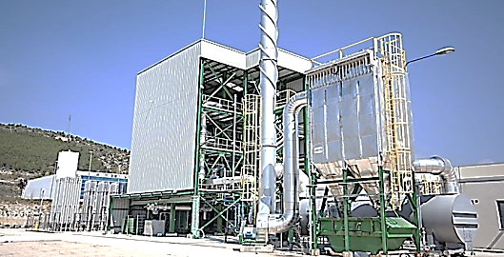
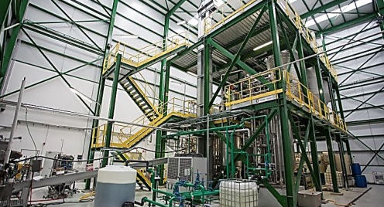
BIO2C Proccess Units
From lab scale up to TRL 6-7
Pretreatment Unit
Gasification Unit
Biochemical Unit
Since 2008
Since 2012
Since 2013
2MWt-500kg biomass/h
2MWt-500kg biomass/h
1,5t biomass/week
Chipping and choping
Gasification Island
Pretreatment
Drying
Thermal Oxidizer
Solid / Liquid Fractionation
Torrefaction
Flue gases treatment
Biological Processes (Enzymatic Hydrolysis & fermentation)
Milling
Pelletizing

Slide 5
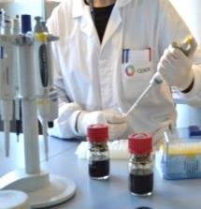
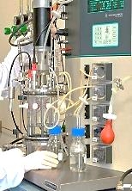
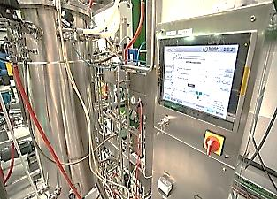
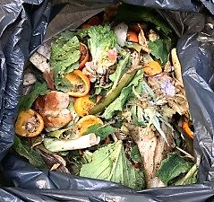
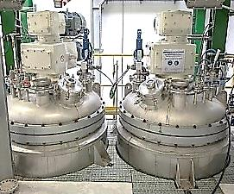

Background
BIOREFINERY – BIOENERGY-BIOPRODUCTS – BIOFUELS – CIRCULAR ECONOMY
LAB
PILOT
DEMO
RAW MATERIALS
TO
PRODUCTS
LIGNOCELLULOSIC BIOMASS
BIOFUELS - BIOENERGY
Cereal straw
Energy crops
.…..
Forest residues
……
Food industry residues
Compost
……
Black liquor
Spent mushroom substrate
Organic fraction MSW
Sugar cane trash
Sewage sludge
Bioethanol
Biodiesel
Bio-Power
……
Pellets
…..
Biobuthanol
……
Biopesticides
Bioplastics
Biosurfactants
Biofertilizers
2002-2019
BIOWASTE
BIOFUELS- BIOENERGY-BIOPRODUCTS

Slide 6
THANK YOU VERY MUCH!

