Slide 1
Strategic research and innovation partnership (SRIP) –
Networks for the transition to circular economy
Sustainable Business Models in Circular Bioeconomy
Dragica Marinic /
Chamber of Commerce and Industry of Štajerska
23 September 2019 I Brussels
Investment is co-financed by the Republic Slovenia and the EU under the European Regional Development Fund.

Slide 2
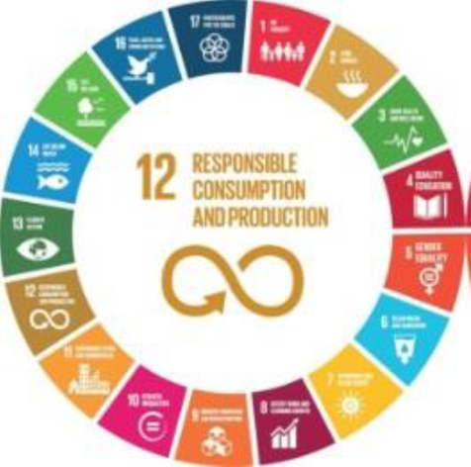
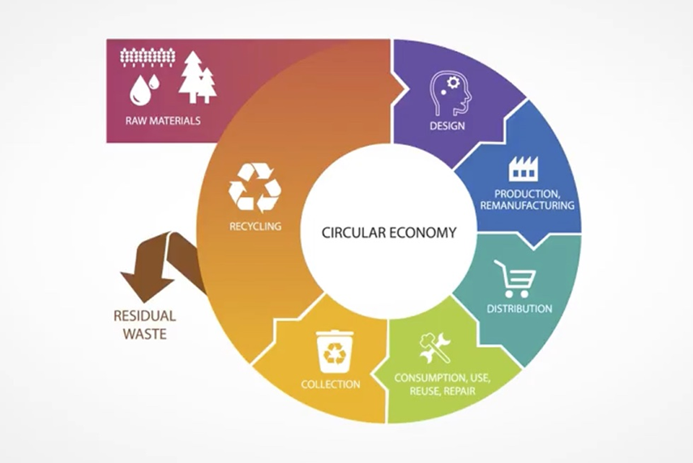
The circular model builds a capital on:
Economic / Natural / Social level (clossing the loop).
Principles: design out of waste and of pollution, keep products and materials in use, regenerate natural / eco systems (Source: EMA 2012)

Slide 3
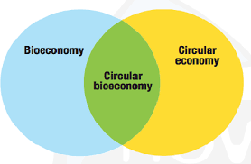
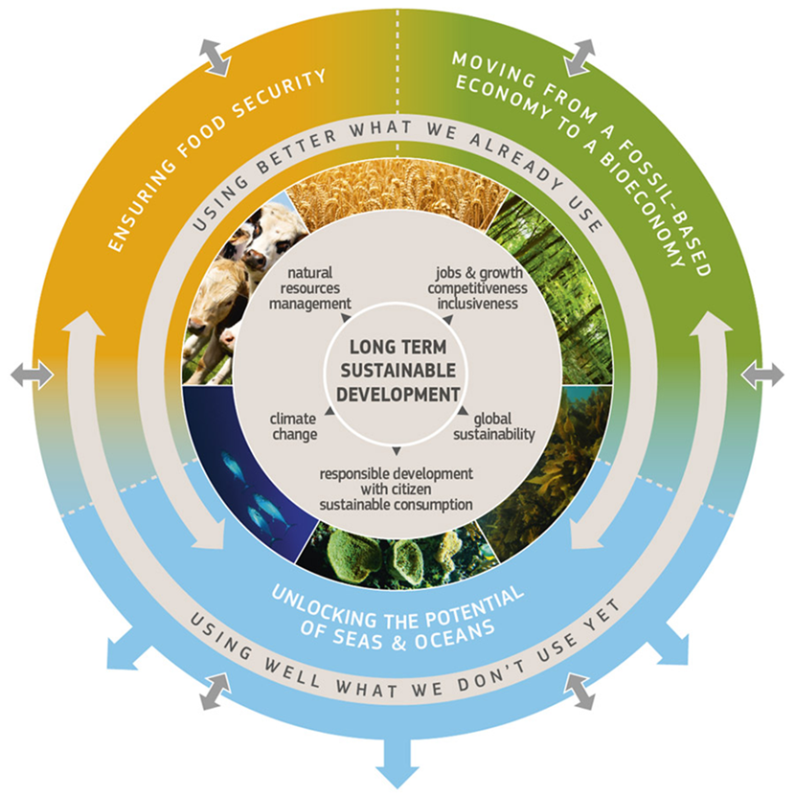
.

Slide 4
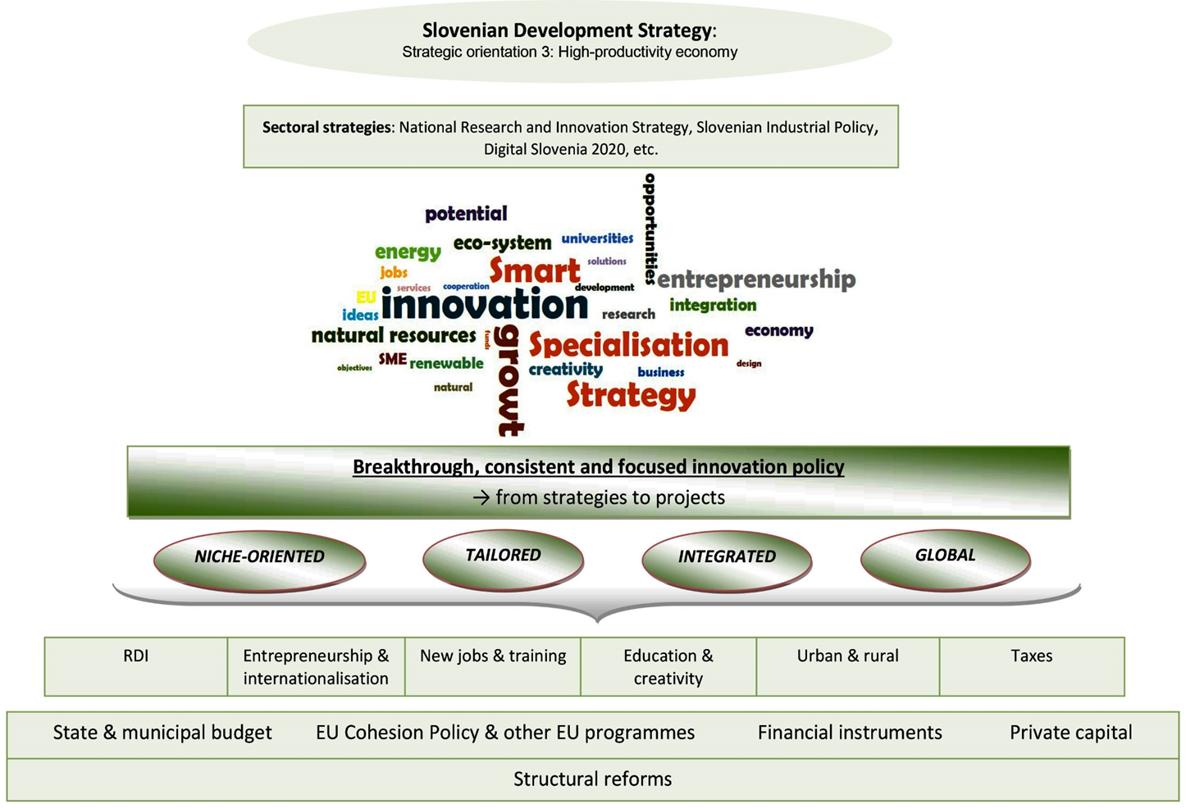
.
(Source: Wostner 2018)

Slide 5
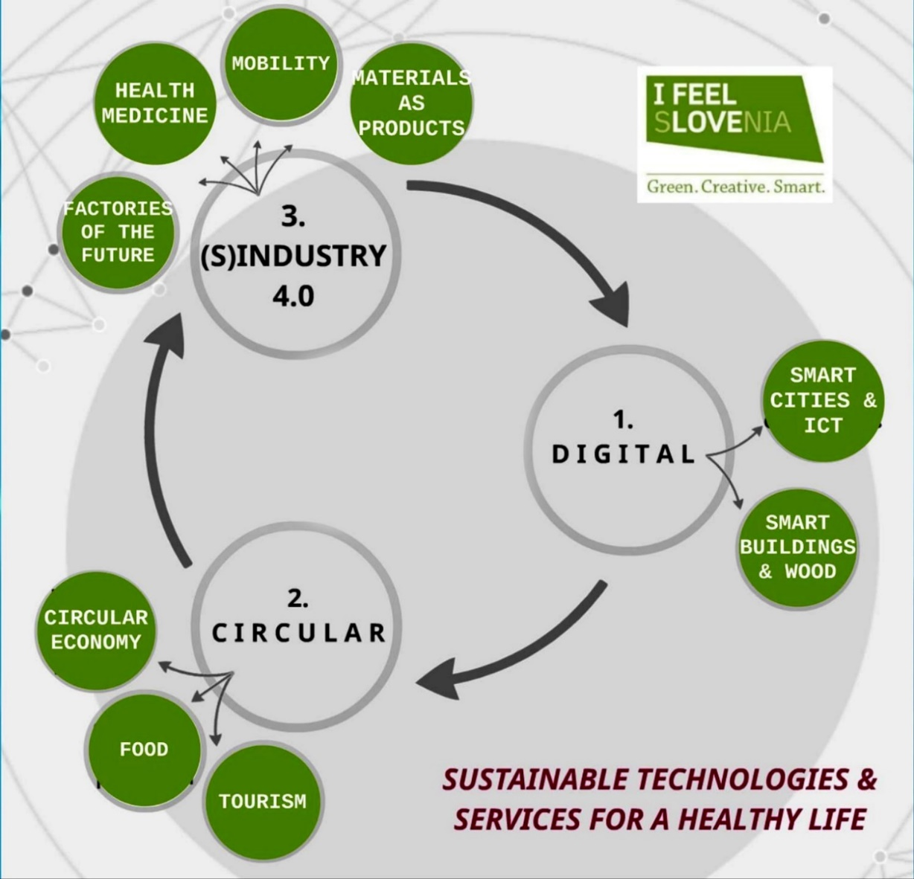
Smart Specialisation Strategy, S4: Strategic Research and Innovation Partnerships (SRIPs)
.

Slide 6
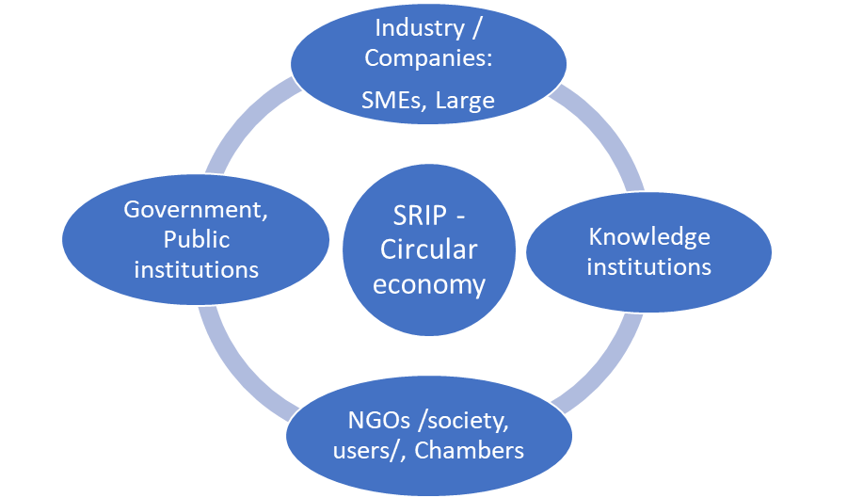
Strategic research and innovation partnership–
Networks for the transition to circular economy /SRIP-Circular economy:
- a long term, sustainable public - private partnership,
- innovation - ecosystem,
- intellectual potentials for an entering to global market among:
Quadruple helix model of open innovation in
knowledge-based development ((Source: Boyes 2018)
.

Slide 7
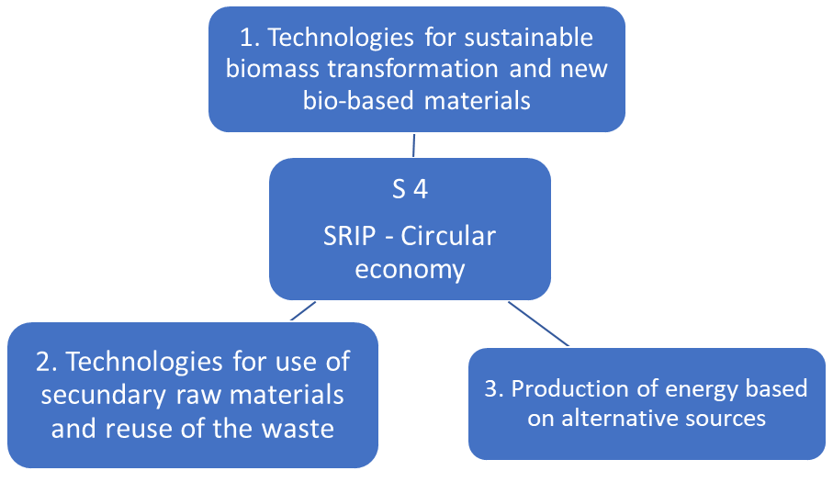
Smart Specialisation Strategy, S4:

Slide 8
SRIP – Circular economy /a new business model/
WHO?
Government of Slovenia / financial support - collaboration
Business entities,
Knowledge institutions,
NGOs,
Chambers
WHY?
* Support, connection,
collaboration
* Establishing:
1. long term public-private partnership
2. value chains
3. new hi tech products, services
4. new business models
.

Slide 9
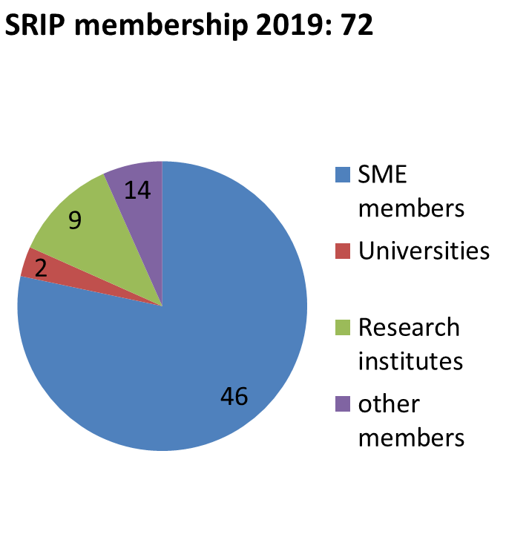
Start-up year of SRIP: November 2016
Structure of SRIP

Slide 11
SRIP – Circular economy / Focus areas:
Focus area 1: Sustainable energy
1.
Waste to Energy (WtE):
the process of generating energy in the form of electricity and/or heat from the primary treatment of waste
2.
Energy optimization and materials efficiency / the reduction of energy consumption and its efficient use
3.
External energy sources – low carbon footprint / renewable energy resources: production of energy from water, wind, sun, radiation sources, fusion.

Slide 12
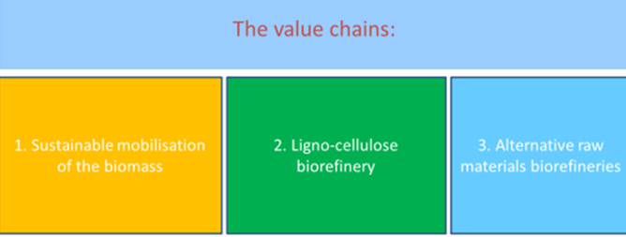
Focus area 2: Biomass and alternative materials
Biomass ligno-cellulose biomass (inferior quality of the wood only),
Alternative raw materials:
- other sources of organic raw materials (whey, algae,…)
- paper silt, etc.

Slide 15
SRIP – Circular economy: Action Plan – Business Strategy: / Sustainability / Research and Career Platform / Entrepreneurship / Investment / Internationalisation
Action plan of SRIP:
- Joint development activities
- Internationalisation
- Human resources development
- Entrepreneurship and joint
services
- The optimization of regulatory
framework
1. Career Platform:
- Profession of future
- Individual career plan
- Training, Education,
- Competences
2. Innovation
3. Digitalization
4. Ecodesign
1. Public – Private Investment
2. Public calls /joint projects/:
- Slovenia,
- EU countries,
- Others

Slide 16
SRIP – Circular economy: Activities of the members in the field of circular (bio)economy
ACIES BIO, Ljubljana
Innovative Whey2Value technology, which enables the processing of waste acid whey, which only means the cost for the dairy industry, into vitamin B12. / www.aciesbio.com
Tekstina, Ajdovščina: the project TRASH-2-CASH: chemical recycling of cellulose and polyester textile waste to new fibres and new products. / www.tekstina.si | www.tekstina-tech.si
Algen, algal technology centre, Ljubljana
Algal waste water treatment technologies in circular economy. / www.algen.eu
Predilnica Litija: potential of biomass for the development of advanced materials and bio-based products: new value chains. / www.litija.com

Slide 17
SRIP – Circular economy: Activities of the members in the field of circular (bio)economy
Pulp and Paper Institute nad consortium partners:
Potential of biomass for development of advanced materials and bio-based products http://celkrog.si/?lang=en
Melamin Kocevje:
one of the most important producers of modified melamine resins and decorative melamine films for chipboards in central Europe /different industry divisions: Chemical, Wood, Footwear
http://www.melamin.si/en/

Slide 18
SRIP – Circular economy Proposals of the collaboration:
- Research projects: SMEs, research
institutions,
Pilot / Demo projects / Vanguard iniciative
Exhange knowledge,
Learning (workshops, conferences),
B2B meetings,
Study visit
Trade fair participation,
Networking,
Collaboration in the
(global) value chains.

Slide 19
Thank you! Contact: Stajerska gospodarska zbornica / SGZ Chamber of Commerce and Industry of Stajerska Ulica talcev 24, SI-2000 Maribor www.srip-circular-economy.eu Tel.: 00386 (0)2 220 87 00 Dragica Marinič, PhD dragica.marinic@stajerskagz.si srip@stajerskagz.si

