Slide 1
Secure Societies H2020 Opportunities
Dr. Marina Martínez García
Programme Officer H2020
Spanish Officer for Science and Technology, SOST-CDTI

Slide 2
The context…

Slide 3
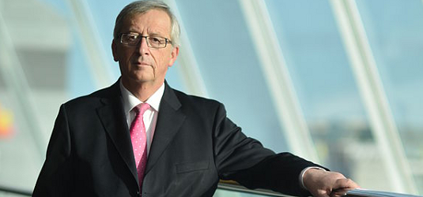
Junker’s Commission orientation…

Slide 4
Junker’s Commission orientation…

Slide 5
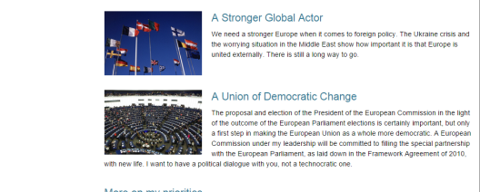
Junker’s Commission orientation…

Slide 6
The focus areas in the WPs 2018-2020…
Personalising health and care
Sustainable food security
Blue growth: unlocking the potential of seas and oceans
Smart cities and communities
Competitive low-carbon energy
Energy Efficiency
Mobility for growth
Waste: a resource to recycle, reuse and recover raw materials
Water innovation: boosting its value for Europe
Overcoming the crisis:
Disaster-resilience
Digital security
Industry 2020 in the Circular Economy
Internet of Things
Smart and Sustainable Cities
Sustainable Food Security – Resilient and resource-efficient value chains
Energy Efficiency
Digital Security
Blue Growth - Demonstrating an ocean of opportunities
Competitive Low-carbon Energy
Automated Road Transport – The New Frontier
9 focus areas in WP 16-17
Building a low-carbon, climate resilient future
Connecting economic and environmental gains – the Circular Economy
Digitising and transforming European industry and services
Boosting the effectiveness of the Security Union
12 focus areas in WP 14-15
4 focus areas in WP 18-20

Slide 7
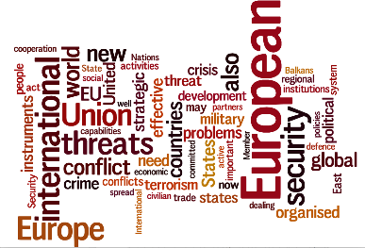
Focus Area: Boosting the effectiveness of the Security Union
4
Budget: ca. €1,000m
Mission
Component
Source
New technologies and processes to meet needs of security practitioners, including for fighting and preventing crime
Reduced loss of life and damage from natural and man-made disasters
Key infrastructure better protected
EU borders better secured
Secure and trusted digital environment
Better match R&D objectives with Security Union policy needs.
Strengthen impact of security-related research: involving practitioners and stimulating new markets.
Identify security-related research in other H2020 societal challenges, and contribute to other policies (Digital, Space, Health, etc.)
LEIT-ICT
LEIT-Space
SC - Health
SC - Energy
SC – Reflective Societies
SC – Secure Societies

Slide 8
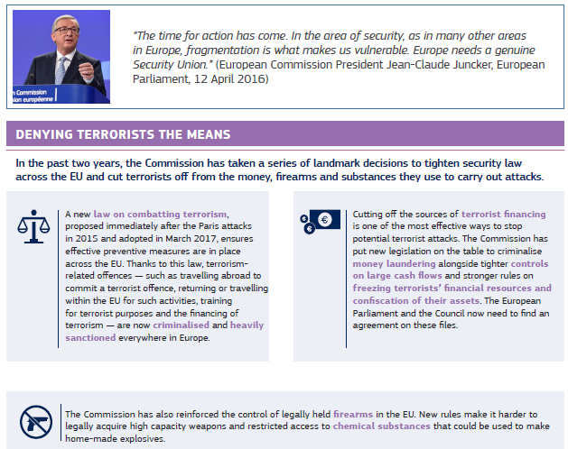
About the Security Union…

Slide 9
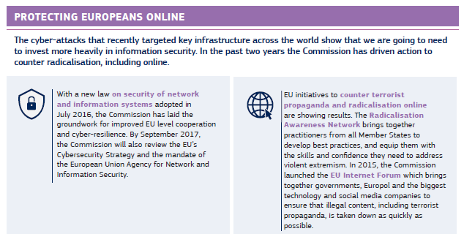
About the Security Union…

Slide 10
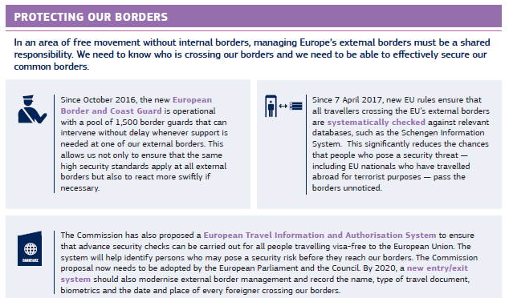
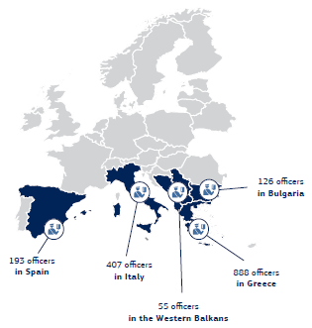
About the Security Union…

Slide 11
WP 2018-2020
2014 | 2015 | 2016 | 2017 | 2018 | 2019 | 2020
Scoping paper 1
Workprogramme 2014-2015
 | Scoping paper 2
 |  | Workprogramme 2016-2017
 |  |  | Scoping paper 3
 |  |  |  | Workprogramme 2018-2020
422 M€
340 M€
704 M€

Slide 12
Timming for call-2018…
Foresight and stakeholder consultation (Advisory Groups)
Consultation Member States
Strategic Priorities
&
Budget
Elaboration of work programme
(Draft)
Q2-2017 → Q3-2017
Q1-2016 → Q3-2016
Q3-2016 → Q1-2017
Jan → Mar
2018
Oct - 2017
27-Oct
Adoption of WP 2018-2019
(orientation for 2020)
FIC-2018
SMIIgs-2018
Infoday
Nacional
2018
About 18 months
Draft version
consolidated
WP Published
07-Nov
Call OPENs
15-Mar-2018
DEADLINE
23-Ago-2018

Slide 13
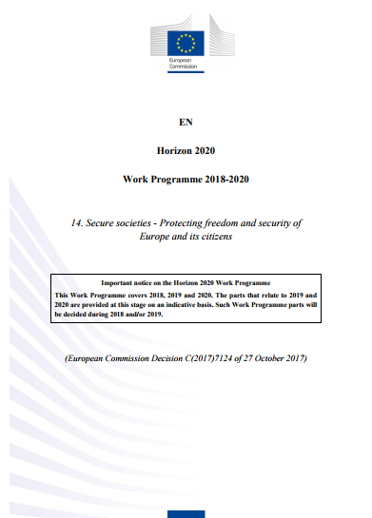
Where can we find the details?
http://ec.europa.eu/research/participants/data/ref/h2020/wp/2018-2020/main/h2020-wp1820-security_en.pdf
Timeline CALL-2018
OPENING = 15 Mar 2018
DEADLINE = 23 Aug 2018
Funded projects in the call-2018 would start by Apr-May 2019

Slide 14
Secure Societies topics…

Slide 15
OVERVIEW Structure for 2018-2020
Protecting the infrastructure of Europe and the people in the European smart cities
Disaster Management - Resilient Societies
Fight Against Crime & Terrorism
Border & External Security
General Matters
Digital Security - Cybersecurity

Slide 16
Protecting the infrastructure of Europe and the people in the European smart cities
Projects of 2 years max.
Industry participation is a MUST!!!!

Slide 17
Protecting the Infrastructure in Europe
SU-INFRA01-2018-2019-2020: Prevention, detection, response and mitigation of combined physical and cyber threats to critical infrastructure in Europe
IAs of bout 8 M€ and TRL 7 for deploying solutions that allow forecast, prevention, detection, response, and in case of failure, mitigation of consequences (including novel installation designs) over the life span of the infrastructure and also the neighbouring populations and the environment.
Interdependent physical (e.g. bombing, plane or drone overflights & crashes, spreading of fires, floods, seismic activity, space radiations, etc.) and cyber threats and incidents (e.g. malfunction of SCADA system, non-authorised access of server) and consider the cascading risks.
Scenarios of real life in real-time and tackling physical and cyber threats.
SECTORS: Water systems, energy infrastructure (power plants and distribution), transport infrastructure, communication infrastructures, health services, e-commerce and the postal infrastructure, and financial services.
At least 2 operators (not necessary to be coordinators) of the chosen type of critical infrastructure operating in 3 Member States or Associated Countries.
24 M€ for the call-2018 → About 3 projects!

Slide 18
Protecting the Infrastructure in Europe
SU-INFRA02-2019: Security for Smart Cities and "soft" targets in Smart Cities
IAs of bout 8 M€ and TRL 7 for deploying pilots in at least 2 cities (or metropolitan áreas) that cover at least one of the next aspects:
Simulation, detection and analysis of the additional security threats and risks created through the interconnection of smart systems (e.g. IoTs, in particular those IoT objects used by security practitioners) and smart infrastructures (e.g. smart (government) buildings, smart railways, smart ports, smart factories, smart bridges, smart hospitals, large gathering of people in smart infrastructure) within a smart city;
Delivery of a cyber-security framework to make easy the collaboration across all smart cities stakeholders (urban planners, infrastructure operators, security practitioners, IT supervisors and providers) across smart organizations within the city;
Support and implementation of a common approach to securing and managing the data from all the smart infrastructures and systems hosted in a smart city supporting the citizens, the public authorities, the security practitioners, and the urban economy.
16 M€ in the call-2019 → About 2 projects!
It is not necessary that the city has aprevious “Smart Cities Lighhouse” Project neither to be coordinator!

Slide 19
Conditions….
Protecting the Infrastructure in Europe
At least 2 opperators of CI from at least 2 EEMM or Associated Countries (INFRA01) or at least 2 cities or Aglomerations from 2 EEMM or Associated Countries (INFRA02) as FULL PARTNERS.
Involvement of industry COMPULSORY
OPTIONAL other type of users…
Max 2 years project

Slide 20
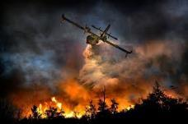
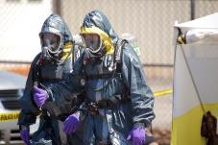
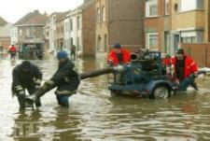
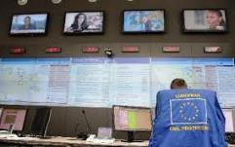
Disaster - Resilient Societies
SOME TOPICS HAVE DIFFERENT SUB-TOPICS
depending on the year!!!!!!!

Slide 21
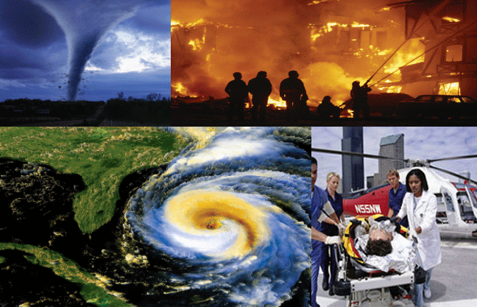
Disaster - Resilient Societies
SU-DRS01-2018-2019-2020: Human factors, and social, societal, and organisational aspects for disaster-resilient societies
RIA of 5 M€ (ONLY 1 Project in 2018) → Deploying tools for national, regional and local authorities to address recent dramatic events either related to natural causes (flash floods, earthquakes, avalanches) or terrorist attacks have alas illustrated that European society is not well prepared to react to disasters or industrial dissasters.
Involvement of first responders (at least 3), city authorities and citizens.
International collaboration encouraged (not mandatory) with Japan (funded by Japan Science and Technology Agency).

Slide 22
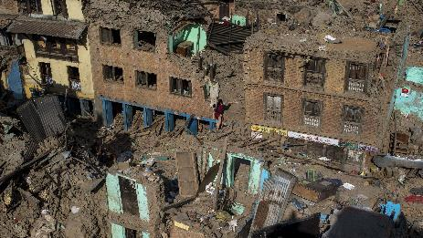
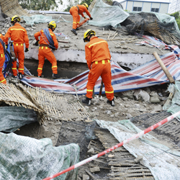
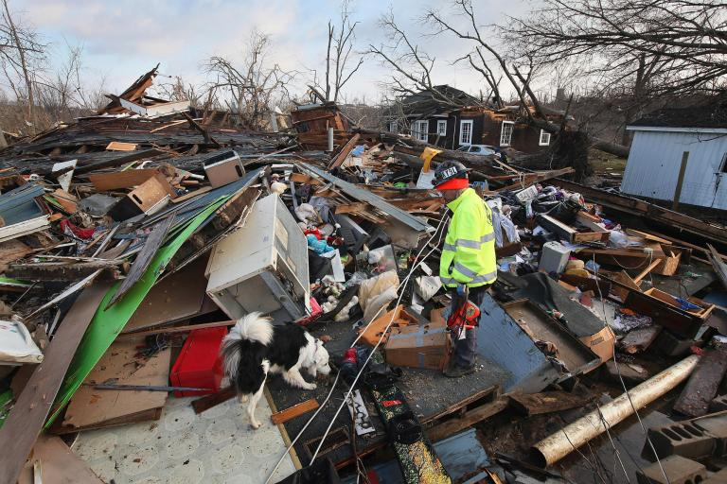
Disaster - Resilient Societies
SU-DRS02-2018-2019-2020: Technologies for first responders
RIA of 7 M€ & TRL 4-6 (about 4 Projects in 2018) en:
OR well, Victim-detection technologies , 2018
OR well, Innovation for rapid and accurate pathogens detection, 2019
OR well, Methods and guidelines for pre-hospital life support, 2020
OR well, “Other technologies” including UAVs, robots, etc…, 2018-2019-2020
In all at least 3 first responders, but 5 for “Other”.

Slide 23
Disaster - Resilient Societies
SU-DRS03-2018-2019-2020: Pre-normative research and demonstration for disaster-resilient societies
IAs of 6 M€ & TRL 6-7 (ONLY 1 Project in 2018) for issues related to pre-standardisation in:
OR well, Pre-standardisation for the security of water supply, 2018 → Uptake results from previous FP7 projects but also to integrate current technologies in the existing water safety network.
OR well, Pre-standardisation in CBRN-E crisis management & Natural hazards, 2019
OR well, First aids vehicles deployment, training, maintenance, logistic and remote centralized coordination means, 2020
In all at least 3 first responders or agencies or operators…

Slide 24
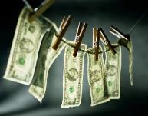
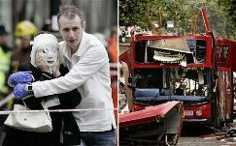
Fight Against Crime & Terrorism
SOME TOPICS HAVE DIFFERENT SUB-TOPICS
depending on the year!!!!!!!

Slide 25
Fight Against Crime & Terrorism
SU-FCT01-2018-2019-2020: Human factors, and social, societal, and organisational aspects to solve issues in fighting against crime and terrorism
RIAs of 5 M€ (about 2 Projects in 2018) → Developing new approaches for:
OR well, New methods to prevent, investigate and mitigate trafficking of human beings and child sexual exploitation, 2018
OR well, Understanding the drivers of cybercriminality, and new methods to prevent, investigate and mitigate cybercriminal behaviour, 2019
OR well, Developing comprehensive multi-disciplinary and multi-agency approaches to prevent and counter violent radicalisation in the EU, 2020
OR well, “OPEN”, 2018-2019-2020 → Other way to solve issues in fighting against crime and terrorism, but supported by a larger number of LEAs.
At least 3 LEAs, but 5 for “OPEN”.

Slide 26
Fight Against Crime & Terrorism
SU-FCT02-2018-2019-2020: Technologies to enhance the fight against crime and terrorism
RIAs de 7 M€ & TRL 4-6 (unos 3 Proyectos para 2018) for new knowledge and targeted technologies for fighting against crime and terrorist organisations:
OR well, Trace qualification, 2019
OR well, Digital forensics in the context of criminal investigations, 2018 → New forensic tools and methodologies, while fully respecting fundamental rights and privacy.
OR well, Money flows tracking, 2020
OR well, “OPEN”, 2018-2019-2020 → Other ways and technologies including augmented reality, autonomous systems, technologies to support better protection of public figures, etc…, but supported by large numbers of practitioners.
For all the sub-topics, LEAs training and (joint) exercises, and of information packages for the wider public and civil society organisations is mandatory.
At least 3 LEAs, but 5 for “OPEN”.

Slide 27
Fight Against Crime & Terrorism
SU-FCT03-2018-2019-2020: Information and data stream management to fight against (cyber)crime and terrorism
IAs of 8 M€ & TRL 5-7 (ONLY 1 Project) → Developing solutions (in compliance with EU societal values, including privacy and fundamental rights) that allows the LEAs to manage voluminous and heterogeneous data (images, videos, geospatial intelligence, communication data, traffic data, financial transactions related date, etc.) and turn it into actionable intelligence.
Trend analysis of emerging cybercrime activities based on past of (cyber)criminal activities, on technological developments, and on trends in the society.
Behavioural/anomaly detection systems (using dif. sensors) and methodologies .
At least 3 LEAs
Balance of IT specialists, psychologists, sociologists, linguists, etc. exploiting big data and predictive analytics: a) to caracterize trends in cybercrime and in cybercriminal organizations and b) to enhance citizens' security against terrorist attacks in places considered as soft targets, including crowded areas (shopping malls, entertainment venues, etc.).
Societal aspects (e.g. perception of security, possible side effects of technological solutions, societal resilience) have to be addressed.

Slide 28
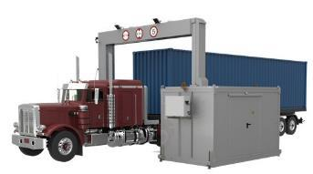
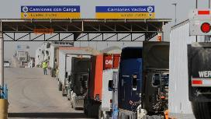
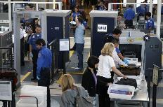
Border & External Security
SOME TOPICS HAVE DIFFERENT SUB-TOPICS
depending on the year!!!!!!!

Slide 29
Border & External Security
SU-BES01-2018-2019-2020 → RIA of 5 M€ (About 2 Projects in 2018):
Sub-topic 1 (2018): Detecting security threats possibly resulting from certain perceptions abroad, that deviate from the reality of the EU
Sub-topic 2(2019): Modelling, predicting and dealing with migration flows to avoid tensions and violence
Sub-topic 3(2020): Developing indicators of threats at the EU external borders on the basis of sound risk and vulnerability assessment methodologies
Sub-topic 4(2018-2019-2020): Open (max 18 months)
SU-BES02-2018-2019-2020 → RIA of 7 M€ & TRL 4-6 (About 3 projects in 2018)
Sub-topic 1 (2018): Providing integrated situational awareness and applying augmented reality to border security
Sub-topic 2 (2018): Detecting fraud, verifying document validity and alternative technologies to identifying people
Sub-topic 3 (2019): Security on-board passenger ships
Sub-topic 4 (2019): Detecting threats in the stream of commerce without disrupting business
Sub-topic 5 (2020): Disruptive sensor technologies for border surveillance
Sub-topic 6 (2018-2019-2020): Open (max 18 months)
SU-BES03-2018-2019-2020 → IA of 5M€ (About 2 Projects in 2018)
Sub-topic 1 (2018): Remotely piloted aircrafts and underwater autonomous platforms for off-shore patrol vessels
Sub-topic 2 (2019): New concepts for decision support and information systems
Sub-topic 3(2020): Improved systems for the detection, identification and tracking of small boats
Sub-topic 4(2018-2019-2020): Open (max 18 months)
At least 3 authorities/end-users, but 5 for “OPEN”.

Slide 30
General Matters

Slide 31
General Matters
SU-GM01-2018-2019-2020 → 4 sub-topics and at least 8 users:
Sub-topic 1 (2019-2020): Practitioners in the same discipline and from across Europe
Sub-topic 2(2018): Innovation clusters from around Europe and training facilities
Sub-topic 3(2018): Procurement agencies
Sub-topic 4(2019): Border and coast guard organizations
SU-GM02-2018-2020 → 2 sub-topics and at least 6 users:
Sub-topic 1 (2018): Common requirements specifications for innovative, advanced systems to support security
Sub-topic 2 (2020): Procurement of prototype systems among those specified as a result of sub-topic 1
Topic | Instrument | Deadline | M€
SU-GM01-2018-2019-2020 | CSA; 1,5 – 3,5 M€ | 8/2018 8/2019 | 5 10,5
SU-GM02-2018-2020 | CSA; 1 M€ | 8/2018 | 6
SU-GM03-2018-2019-2020 | PCP CO-FUND; 2-12 M€ | 8/2018 8/2019 | 8,2 7

Slide 32
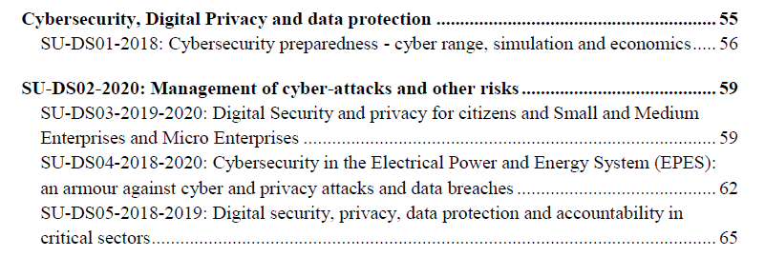
Digital Security - Cybersecurity

Slide 33
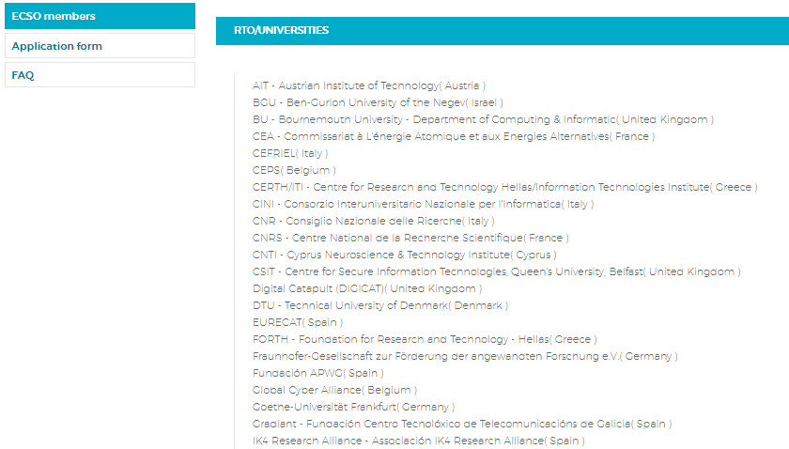
Relevant Stakeholders…

Slide 34
Digital Security - Cybersecurity
SU-DS01-2018: Cybersecurity preparedness - cyber range and economics → IAs of 5-6 M€ of TRL 7 (About 2 Projects)
SU-DS04-2018-2020: Cybersecurity in the Electrical Power and Energy System (EPES): an armour against cyber and privacy attacks
IA of 6-8 M€ and TRL 7 (20M€ for 2018) for developing solutions for protection, early detection and recovery of power plants from cyber-attacks.
Protection to the consumers (Smart-metters at home) and the grid as well.
SU-DS05-2018-2019-2020: Digital security, privacy and accountability in critical sectors
IAs of 3-4 M€ and TRL 7 (8,5 M€ for 2018) for developing cyber-protection solutions for:
OR well, In multimodal transport systems, 2019
OR well, In the healthcare ecosystem, 2019
OR well, In the finance sector, 2018

Slide 35
Events that you cannot miss…

Slide 36
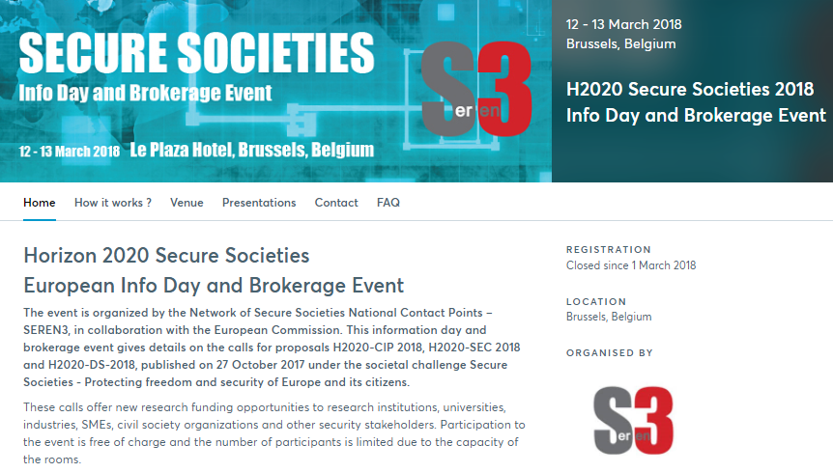

Slide 37
Many thanks…
Dr Martínez-Garcia
H2020 Programme at SOST-CDTI office
marina.cdti@sost.be

