Slide 1
Project WCYCLE Model of Urban Circular Economy for Municipality of Maribor, Slovenia Brussels, October 2018
Igor Kos, WCYCLE Institute Maribor igor.kos@wcycle.com https://wcycle.com/

Slide 2
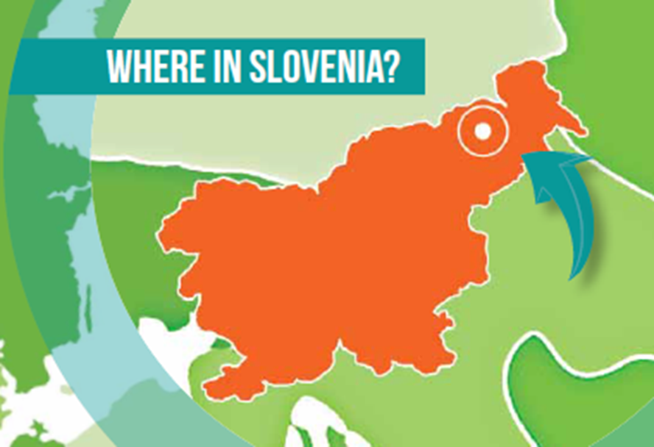
Maribor is the capital of the province of Styria and the second largest city in the country with 115.000 inhabitants
It is a pleasant small 850 year old university town set in the beautiful surroundings of Pohorje hills on one side and the wine hills on the other, divided by the river Drava
It is the economic and cultural center of northeastern Slovenia with rich industrial history
It offers a diverse and high-quality tourist services, a clean environment and the highest quality of natural water

Slide 4
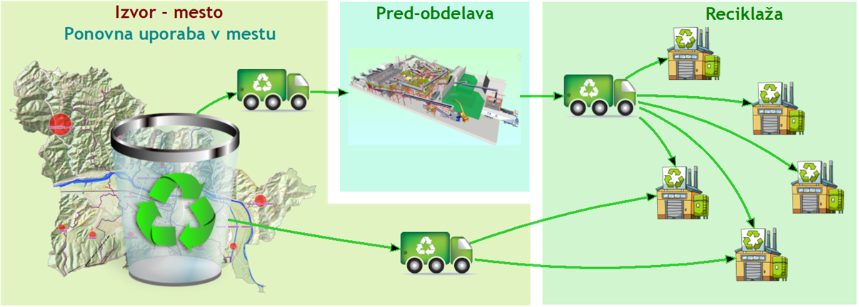
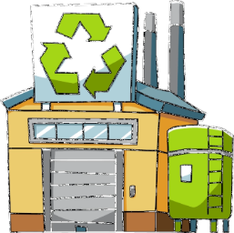
Material circles

Slide 5
Maribor Project starting points
The city has no landfill and does not want to have it, nor does it want to dispose of waste with incineration
In the process of processing, with the goal of maximizing re-use, everyone in the urban area of the city will get output sources, preferably from the population, utilities, construction, industry, agriculture, water management and service activities
The advantage of recovering source materials is recycling materials and water, and the production of new composite materials, followed by energy use
The holders of the processing of output sources for each strategic project area are enterprises in predominantly municipal public ownership, which are already being implemented as a public service point, while the holder of soft contents of the social environment is the city administration
New processing and service capacities for the management of output sources are planned as priority areas for urban degraded areas with the aim of their regulation and revitalization
Only close cooperation between public companies, citizens, industry and local government leads to a successful interconnected system that optimizes resources and economic, environmental and social results

Slide 6
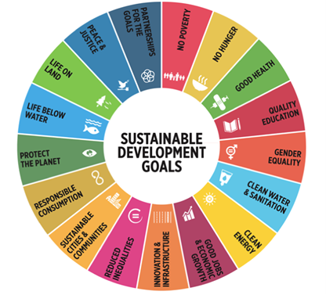
EU LEVEL
Closing the loop - An EU action plan for the Circular Economy to develop a sustainable, low carbon, resource efficient and competitive economy, dec. 2015
NATIONAL LEVEL
Smart Specialization Strategy, July 2015
Framework program for the transition to a green economy, Oktober 2015
Waste management program and waste prevention program of Republic of Slovenia, June 2016
Roadmap towards Circular economy in Slovenia May 2018
LOCAL LEVEL
Waste management strategy in MO Maribor, mar. 2015
Sustainable Urban Strategy of the Municipality of Maribor, feb. 2016
Strategy for transition of Maribor to Circular Economy - June 2018

Slide 7
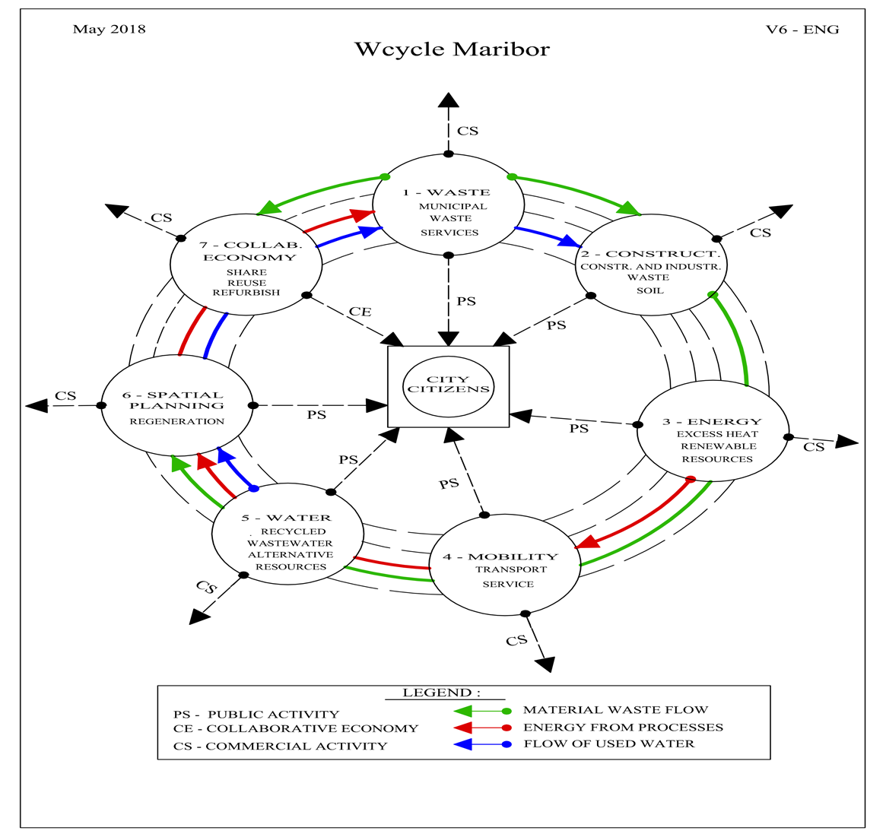
HORIZONTAL MODEL
The priority is material flow
The priority is the flow of energy and water
Unified flow of ideas
Economically and with nature
People for People
For citizens, the market, for tomorrow
…….

Slide 8
Vertical organizational model and role of IWM
The Wcycle Institute will, as a priority, support the development of Wcycle's processes as a model of efficient sectoral resource management in the urban environment of the City of Maribor through the implementation of technology, research and development optimization Recognition and mapping of waste resources in the city
Circular planning and resource management policies
City agenda for the circular economy
Requirements for the use of secondary resources
Circular Procurement
Sustainable use of space
Sustainable food consumption
Circular knowledge management
Circular funding
Environmental signs and other information for consumers and subscribers

Slide 9
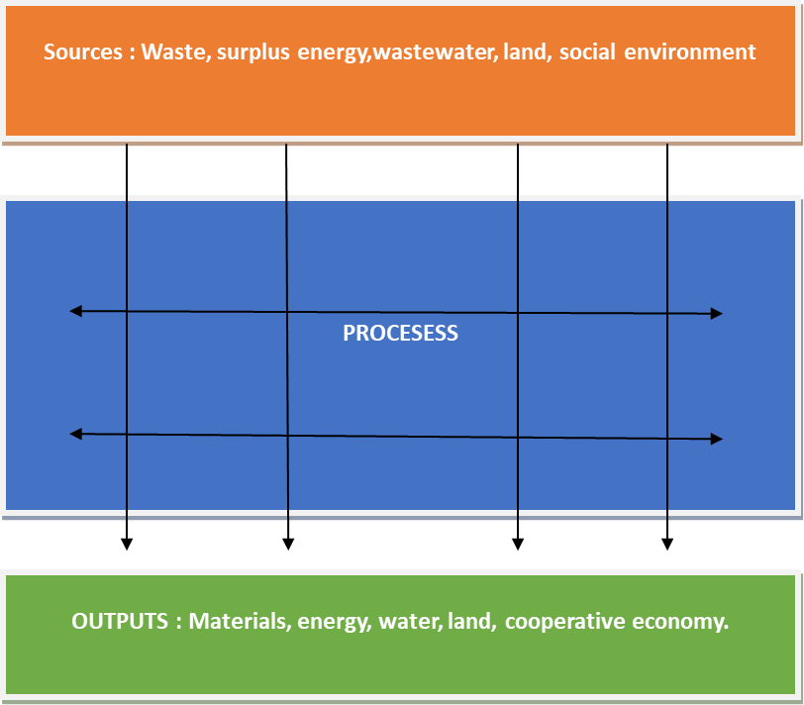
Strategic project areas
1. Treatment of municipal waste and associated services
2. Use of processed construction and demolitionl waste and soil in urban construction
3. Managing supluss heat and renewable energy
4. Sustainable mobility - Urban transport and joint service
5. Reuse of recycled water and alternative water resources
6. Sustainable management of land and regeneration of degraded areas
7. Cooperating economy network

Slide 11
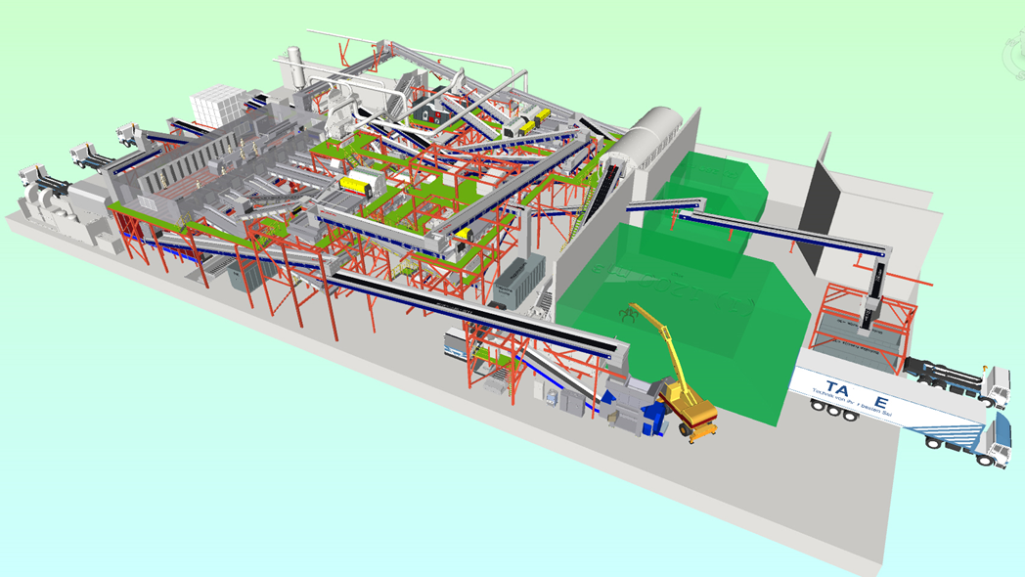
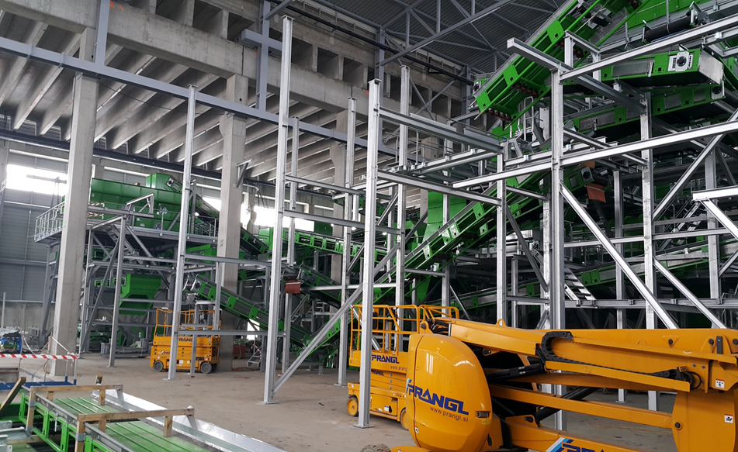
NEW AUTOMATED SORTATION PLANT FOR MUNICIPAL WASTE IN
MARIBOR, MAY 2018

Slide 12
URBAN SOIL 4 FOOD
WINPOL
CINDERELA

Slide 13
we connect 1+1+1>3…
Thank you for attention

