Slide 1
Working with EBRD EBRD financing for Transport & Logistics Brussels 3 March 2016

Slide 2
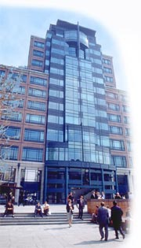
EBRD in a snapshot
IFI to promote transition to market economies in 36 countries;
Over € 86.6 bln invested in 3,700+ projects since 1991;
Owned by 64 countries and two intergovernmental institutions (AAA rated);
HQ in London, it has 36 regional offices;
Across all business sectors (Infrastructure, Energy, Industry & Agri, Financial Institutions, etc.)
Private sector oriented (80%)

Slide 3
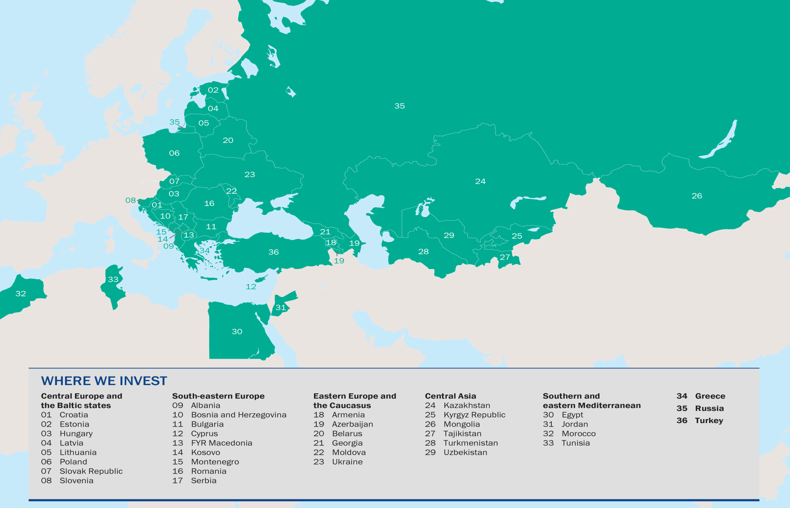
Where the EBRD invests
Geographic Split
(in % ABV, Transport)

Slide 4
Our principles of operations
Transition Impact
Sound Banking
EBRD
Addition-ality
Every investment must help a country to move closer to a full market economy
EBRD has higher risk appetite, but does not crowd other investors out: Terms are market-based
The project has to be feasible, well-structured and financially robust

Slide 5
Tailored financial options …
… matching client capacity and transition gaps
Sovereign debt
Platform for project-led policy dialogue and sector reform where significant transition gaps and state-ownership continues to dominate.
Donor funded TC to overcome transition challenges
Non sovereign debt with State Owned Entities
Self-financing independence
Debt on commercial terms, entirely based on company creditworthiness
Private Sector
Senior debt
Quasi-equity and equity
Capital markets (bonds, IPOs)
PPPs
Long tenor, local currency
Co-financing (with commercial banks and IFIs)
24 February, 2016

Slide 6
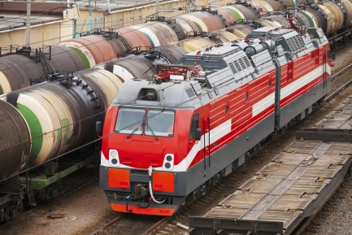
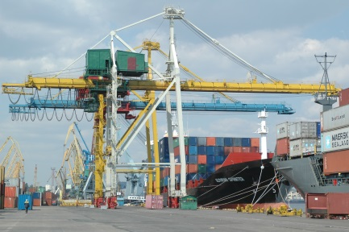
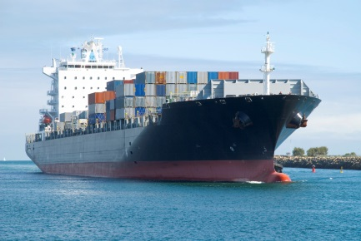
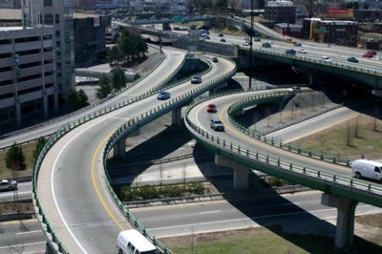
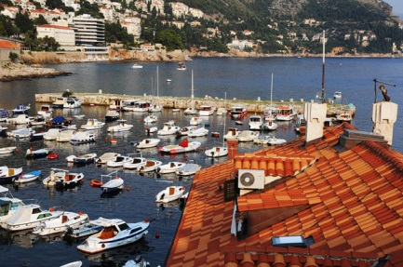
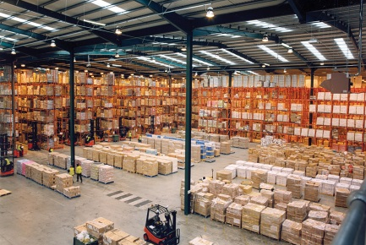
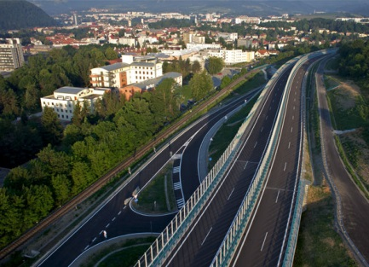
EBRD in the Transport Sector
Over EUR 13 billion invested in 270+ projects

Slide 7
Why Transport?
Safe and efficient transport networks fundamental to economic growth and well-functioning markets
Infrastructure gap
Severe constraints on public budgets: Private sector participation is key
Emphasis on regional integration: Increased risk of cross-border projects
Sector reforms needed
Innovation and multimodality are crucial for sustainable development
Transport is fundamental to deliver climate policies (COP-21): only major sector in the EU where GHG missions are still rising.

Slide 8
Some recent projects
Deep water Container Terminal Gdansk
IPO Inpost Expansion of e-locker network
Equity M6 Secondary equity market for PPPs
PKP Cargo,
Restructuring, IPO, Acquisition of Czech Rail Company
CFR Financial Restructuring
Corridor X Modernization Rail corridors (public)
Port Dubrovnik Extension berth cruise terminal
PIMK Launch of rail intermodal services

Slide 9
Our vision in the Transport Sector
“EBRD promotes and finances safe, secure and sustainable transport systems across the region which embody market principles” (Transport Strategy)
Traditional strategic approach:
Transition gaps: Sector reform and Private Sector Participation, Market Orientation, Commercialisation, Financial Sustainability, Corporate Governance
Bridging infrastructure gap: regional integration and trade facilitation
Areas of increasing focus:
Sustainable Transport: Energy Efficiency, Gender Inclusion, Road Safety
Logistic Development & Intermodal Transport
Small Business Initiative
+

Slide 10
Logistics: Area of increasing focus
Over the last 5 years the EBRD has invested €2billion in 35 Projects about Intermodal Transport & Logistics
The demand for freight transport is growing and the Bank aims to bridge the infrastructure gap and facilitate the sustainable development of the sector:
Logistics Centres
Intermodal Terminals
Road Fleet modernization
Port Development
Rolling stock and railcars
Short-Sea Shipping & Inland River Transport
Capital markets and financial restructuring (IPO, private placement, etc)
Modernization and Green Logistics

Slide 11
How to deliver Sustainable Transport?
Projects & Investments
Technical Cooperation
Policy Dialogue
Improve business environment and regulatory framework
Stakeholder engagement (eg. IFIs, CAREC, TRACECA, etc.)
Over EUR 18 mln p.a. mobilized to support sector reforms and challenges
TCs for project identification (eg. Energy Audits) and preparation (IPPF)
Wide range of financing instruments for public and private clients
Risk mitigation – catalyst (IFI status)
Mobilize EU and climate funds
24 February, 2016

Slide 12
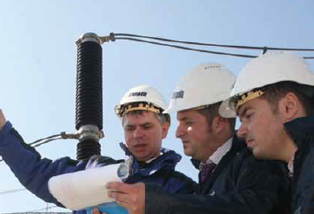
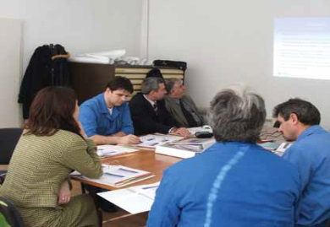
Examples of tools available: Donor funded TC available
Over EUR 20 mln mobilized from our donors to support our clients.
Some examples:
Detailed energy audit to identify opportunities for EE (terminal modernization, handling equipment, etc.);
Feasibility Studies of new products and services
Sector reform
Capacity Development, training, etc.
Environmental Management Systems,
Road Safety Management,
(etc.)
24 February, 2016
12
12

Slide 13
Examples of tools available: IPPF (Infra Project Preparation Facility)
Available
Infrastructure gap mostly explained by lack of proper project preparation and enabling environment issues
EBRD created special fund (up to EUR 40 million) to:
Promote more efficient delivery of projects
Improve quality of service offered to clients
Deepen focus on commercialised approaches
Strengthen institutional capacity
Facilitate the integration of project preparation with higher level policy dialogue
Two windows: Sustainable Infrastructure Window & PPP Window (reimbursable)
Framework agreement with up to 8 consultancy firms. Average projected size of support = EUR 1.5 mln
Example: Framework for PPP development of Dry Port Network (Egypt)

Slide 14
Examples of tools available: Green Logistics Programme
Coming soon
Funded by EBRD and Global Environment Facility (GEF)
Programme to facilitate implementation of Green Logistics and best practices in the region (non-EU countries).
Under consultation with GEF and stakeholders. Approval expected by Q1 2016
Three components:
Concessional finance available for investments in Green Solutions (15 mln USD)
Capacity building activities (Contribution to MRV methodologies and preparation of certified training)
Technical Assistance to prepare and implement green solutions
24 February, 2016
14
14

Slide 15
Examples of tools available: H2020 (Innovation in SMEs)
Under consultation
Proposal for H2020 prepared by EBRD
Programme to support innovation in SMEs and mid-caps
Innovation is not only “frontier” innovation; innovation is also product and process innovation through the adoption of practices with low level of penetration in the region
Available in Bulgaria, Latvia, Romania (modest innovators as per EU Scorecard)
Three components:
Finance for Small Business via Financial Institutions (10.0 mln EUR)
Direct finance for Small Business (6.5 mln EUR)
Climate technology innovation support (3.5 mln EUR) – TC suppport to companies developing innovative products and processes across several sectors, including Green logistics.
24 February, 2016
15

Slide 16
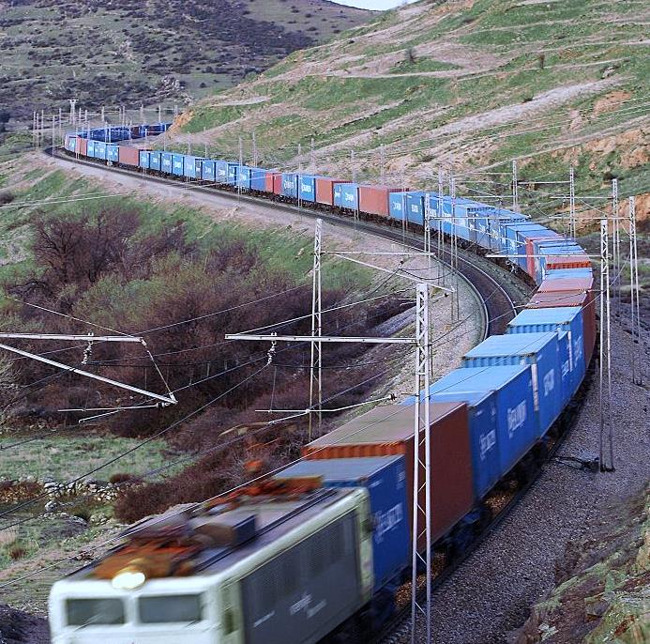
The EBRD
EBRD Solutions for Green Logistics
Case Studies

Slide 17
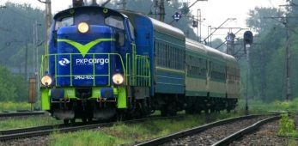
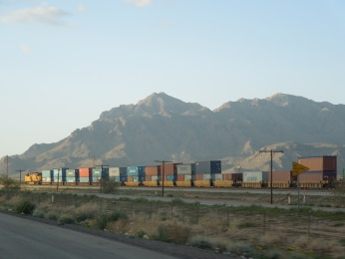
PKP Cargo, Poland
a
a
Client: | PKP Cargo S.A
EBRD finance: | EUR 100 million
Type | Senior Loan
Year: | 2015
Project description: | Financing of PKP Cargo’s acquisition of Advanced World Transport B.V., the second-largest rail freight operator in the Czech Republic
Impact: | Commercial viability of the private model to other state-owned railway operators in the region. Operation of PKP Cargo cross-border services and geographic expansion. Significantly increasing capacity of PKP Cargo to service the Baltic-Adriatic-North Sea corridor. Previously several loans, including participation at the IPO, with the use of proceeds oriented towards fleet modernization

Slide 18
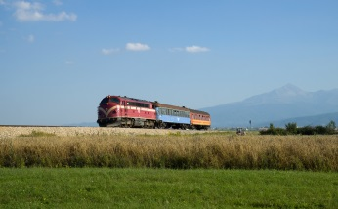
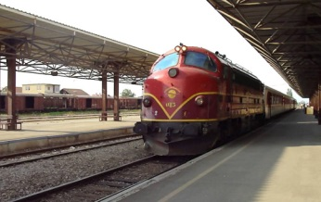
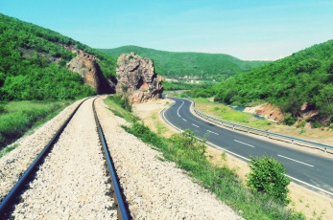
Railway Rehabilitation, Kosovo
a
a
Client: | Infrakos (Rail Infra manager, 100% publicly owned)
EBRD finance: | EUR 39.9 million
Type of finance: | Senior Loan
Year: | 2015
Project description: | Rehabilitation and upgrade of Corridor 10
Impact: | Regional integration of Kosovo by connecting to the European network through Corridors VIII and X in FYR Macedonia. Aligning the track access charging methodology with the regional standards Strengthening standards of business conduct of Infrakos by imparting a long-term approach to maintaining its assets, enhancing its accounting systems and promoting good international HR practices regarding equal opportunities

Slide 19
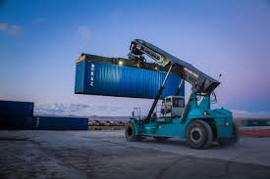
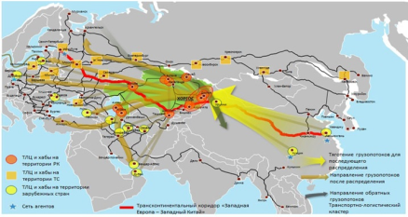
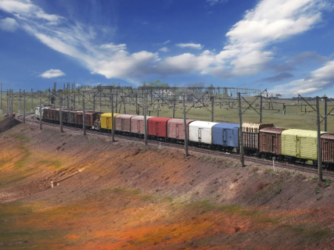
KTZ Dry Ports, Kazakhstan
a
a
Client: | Kazakhstan Temir Zholy, National Railways Company (KTZ)
EBRD finance: | Eurobond issue
Total Project cost: | CHF 285 million
Year: | 2014
Project description: | Development of a logistic hub to attract additional transit cargo traffic to the country (China-EU route)
Impact: | Development of vital infrastructure to facilitate Eurasian connectivity by rail TC support to improve corporate governance and management practices of KTZ’s logistics operator JSC KTZ Express, TC to help KTZ Express to structure a pilot logistic hub with the private sector participation

Slide 20
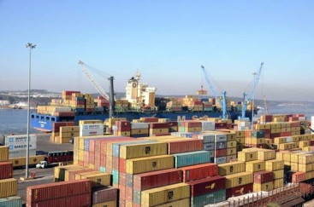
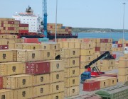
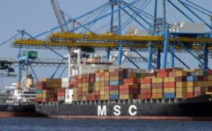
Klaipeda Transhipment hub, Lithuania
a
a
Client: | LK AB Klaipedos Smelte, subsidiary of TIL
EBRD finance: | Senior loan EUR 32.5 million
Total Project cost: | EUR 65 million
Year: | 2012
Project description: | Expansion of the container handling operations at Klaipeda Port: Transhipment hub
Impact: | Reduction of transport costs, trade facilitation and lower carbon emissions (about 50 kton CO2 p.a.) TC support for identification of new products and EE technologies Carbon footprint reporting and stronger energy management standards (ISO)

Slide 21
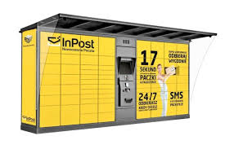
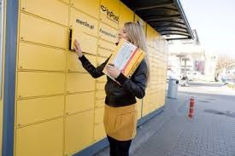
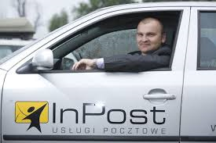
Case Study InPost, Poland
a
a
Client: | Inpost
EBRD finance: | EUR 10 mln
Total Project cost: | EUR 82 million
Year: | 2014
Project description: | Participation in IPO. Expansion of Automated Parcel Collection Network (4,000 lockers)
Approach: | Significant environmental benefits: 30 ktonnes CO2 p.a. compared to traditional delivery to door. With EBRD support, the company will also: Develop carbon neutral courier services Develop of carbon reporting system in line with EN 16258 principles and GHG Protocol. Implement Road Safety System (ISO 39001) and Environmental Management System (ISO 14001) Increase gender diversity at senior positions

Slide 22
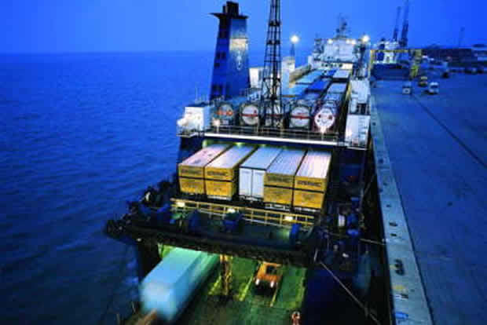
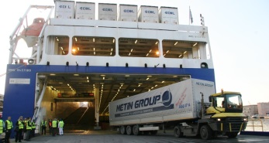
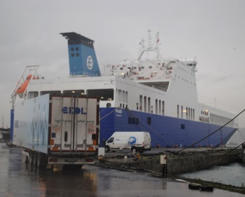
Ekol Ro-Ro services, Turkey
a
a
Client: | EKOL Lojistik, A.S.
EBRD finance: | Senior loan EUR 12 million
Total Project cost: | EUR 30.0 million
Year: | 2012
Project description: | Acquisition of three Ro-Ro Vessels to provide Short Sea Shipping between Haydarpasa (Turkey) and Trieste (Italy)
Impact: | 50,000 + trucks shifted from road to sea per annum (thus saving 19,000 ktonnes CO2) Adoption of best practices to raise the standards of the Turkish shipping industry: ISO 50000, ISO 14000, and Safety & Disaster Response Plan

Slide 23
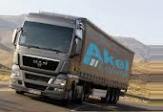
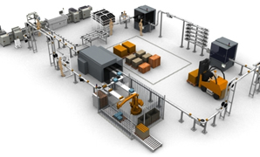
Akel Logistics, Turkey
a
a
Client: | Akel Logistics: Provider of point-to-point transport services throughout Turkey primarily in food & beverage and related sectors
EBRD finance: | Senior Loan EUR 4.4 million
Total Project cost: | EUR 4.4 million
Year: | 2013
Project description: | Working capital financing and development of two logistics centres
Impact: | Provision of integrated logistics solutions combining warehousing services with point to point logistics and transportation solutions Improving corporate governance, including simplification of ownership structures, adoption of IFRS accounts, and first time audit It was structured through Local Enterprise Facility, a vehicle for investments in small and medium-sized enterprises (SMEs);

Slide 24
Contacts
For all further enquiries, please contact:
Marcial Bustinduy Principal Sustainable Transport Specialist Transport email: bustindm@ebrd.com
Sue Barrett Director Transport email: barretts@ebrd.com
EBRD One Exchange Square London EC2A 2JN, United Kingdom

