Slide 1
Slovenian Presidency of the Council of the EU
Education, Higher Education and synergies with Research

Slide 2
KEY ORIENTATIONS
Trio roadmap: skills and competences, digitalisation, and inclusion and equity
The European vision of knowledge, education and research for a green and digital future.

Slide 3
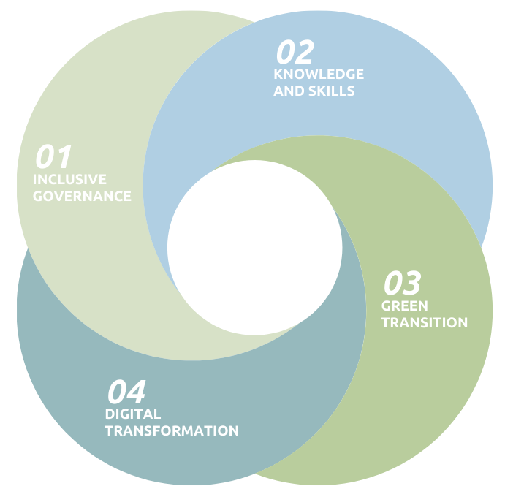
OVERARCHING PRIORITIES
4 priorities/areas:
  INCLUSIVE GOVERNANCE
  KNOWLEDGE AND SKILLS
  GREEN TRANSITION
  DIGITAL TRANSFORMATION

Slide 4
THEMATIC PRIORITIES
EDUCATION AND TRAINING
Synergies between higher education and research
Digitalization, artificial intelligence and ethics
European Agenda on Adult Learning
Governance of the Strategic Framework of European Cooperation in Education and Training (2021-2030)

Slide 5
THEMATIC PRIORITIES
Synergies between higher education and research
Joint Meeting of Directors-General for Higher Education and ERAC, 30 September
Governance of European Education Area and European Research area
Continuation of joint meetings and reflection about possible joint structure in the future
Bologna Follow-up Group

Slide 6
MAIN EVENTS AND MEETINGS
Meeting of the High Level Group on Education and Training, 6 July
Conference on Adult Learning, 8 – 9 September
Meeting of the Directors-General for Higher Education, 29 – 30 September (including jointly with European Research Area and Innovation Committee-ERAC)
Meeting of the Directors-General for VET, 3 – 5 October
Meeting of the Directors-General for Schools, 12 – 14 October
Ministerial Conference »Resetting education and training for the digital age«,
9 – 10 November
EYCS Council (Education), 29 November
Meeting of the Bologna Follow up Group, 1 – 2 December

Slide 7
Thank you for listening!

