Slide 1



Strategic research and innovation partnership (SRIP) –
Networks for the transition to circular economy
Sustainable Business Models in Circular Bioeconomy
Prof. dr. Aleksandra LOBNIK, CEO /IOS Ltd
23 September 2019 I Brussels
Investment is co-financed by the Republic Slovenia and the EU under the European Regional Development Fund.

Slide 2
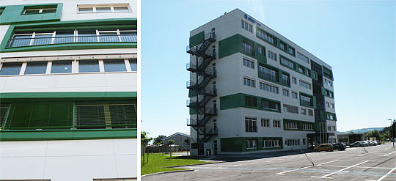

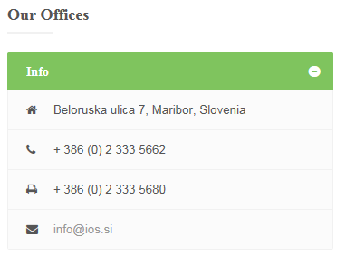
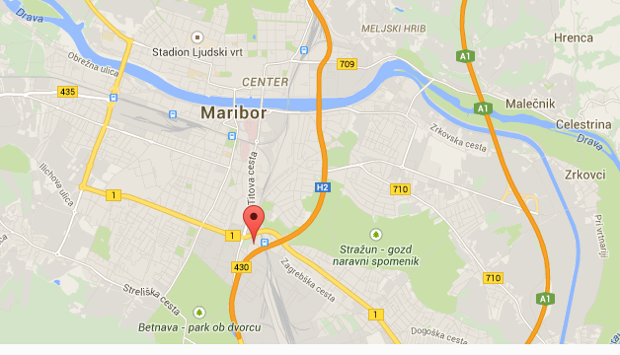
info@ios.si http://www.ios.si
2

Slide 3
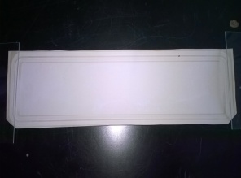
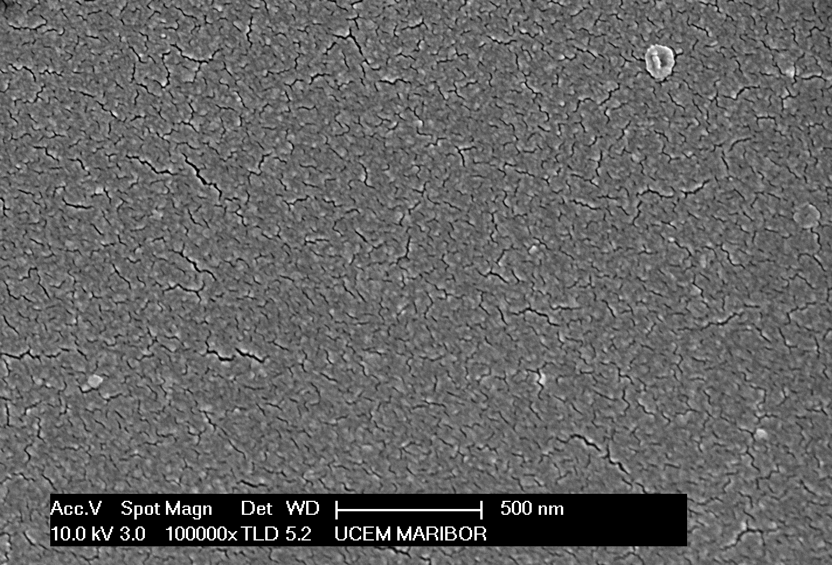
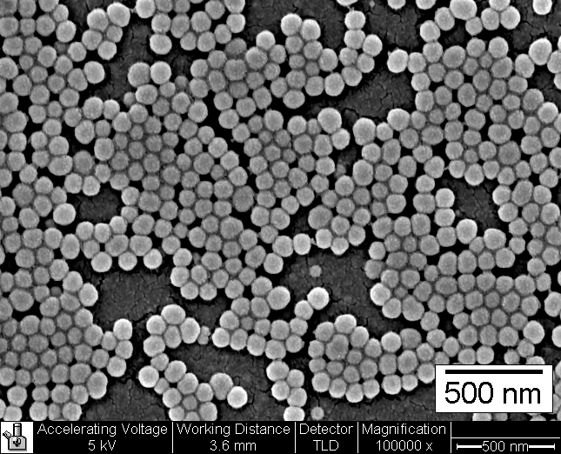
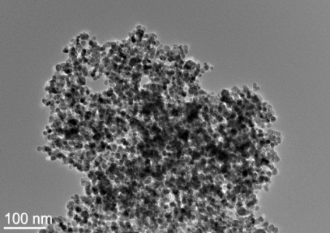
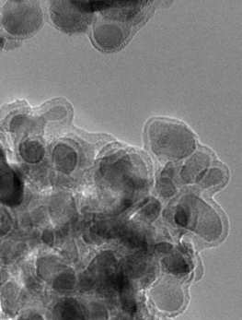
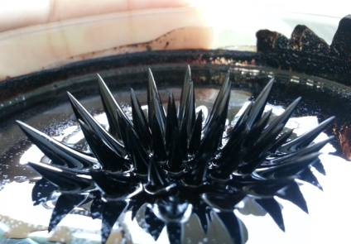
IOS, Institute of Environmental Protection and Sensors, Ltd
PATENT: NM “20 patent applications” 10 EU and 2 USA
KOŠAK Aljoša, BAUMAN Maja, LOBNIK Aleksandra “A method of surface treatment of thin film composite (TFC) membranes with tetraalkoxysilanes for retention of heavy metal ions in the membrane filtration processes of waste waters”, Patent No. SI 23535 A, 2012, The Slovenian Intellectual Property Office, Ljubljana
TFC membrane
uncoated membrane
WATER, WASTES
RECYCLING PROCESSES
coated membrane
Uncoated magnetic nanoparticles
OPTICAL CHEMICAL, BIO- SENSORS
NANOTECHNOLOGY & NANOMATERIALS
PATENT:
LOBNIK Aleksandra, KORENT UREK Špela.
“A method and an optical chemical sensor with a sol-gel membrane for the detection of organophosphates”,
EP 2 678 673 (B1), 2016-06-08. Berlin, Germany: European Patent Office, 2016.
coated magnetic
nanoparticles
magnetic fluids
PATENT:
LOBNIK, Aleksandra “Sol-gel based optical chemical sensor for detection of organophosphates and method for preparation thereof”:
RU2013129043 (A), 2015-01-10; RS55040 (B1), 2016-12-30;
RS55040 (B1), 2016-12-30. Beograd. USA patent under considaration.
PATENT:
KOŠAK Aljoša, LAKIĆ Marijana, LOBNIK Aleksandra, “Process for the preparation of superparamagnetic hollow spherical nanostructures”, GB2526659 (A), 2015-12-02. London: Intellectual property office, 2015.

Slide 4
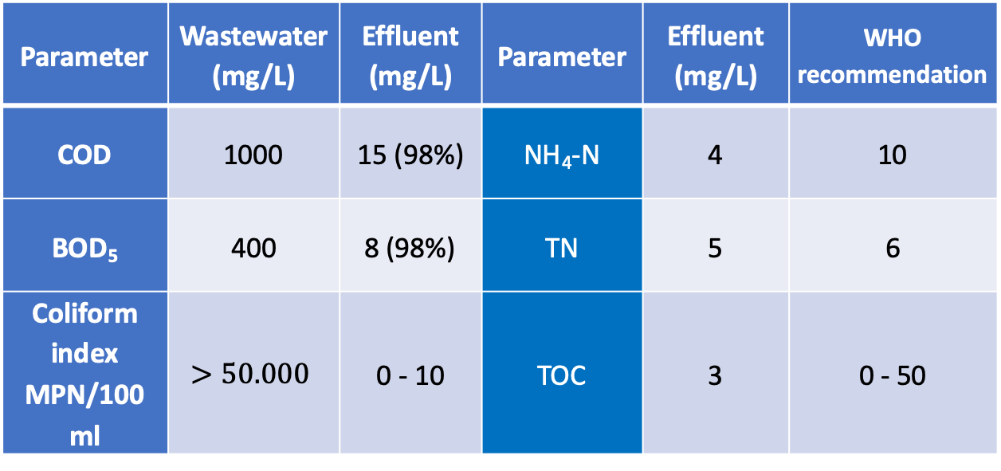
IOS PRODUCTS: Water Innovative solutions
Wate(R)euse & Water(4)Future
Based on Membrane Biological Reactor (MBR)
TREATMENT EFFICIENCY:
Parameter | Wastewater (mg/L) | Effluent (mg/L) | Parameter | Effluent (mg/L) | WHO recommendation
COD | 1000 | 15 (98%) | NH₄-N | 4 | 10
BOD₅ | 400 | 8 (98%) | TN | 5 | 6
Coliform index MPN/100 ml | $$>50.000$$ | 0 - 10 | TOC | 3 | 0 - 50

Slide 5
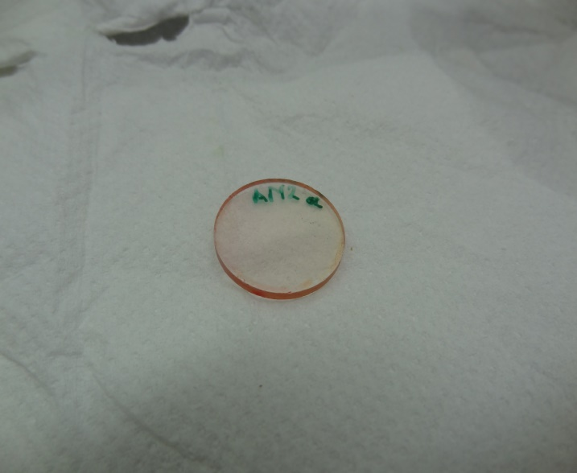
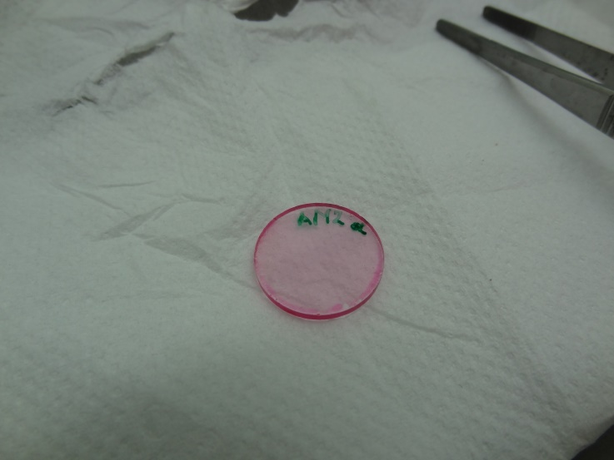

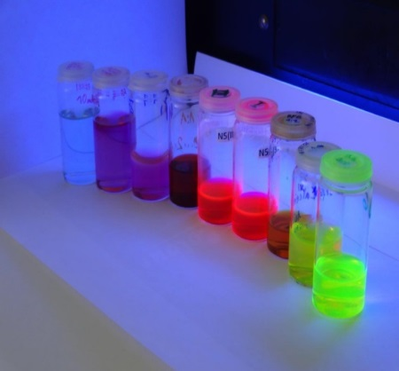
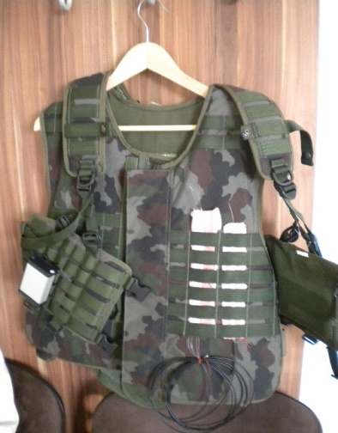
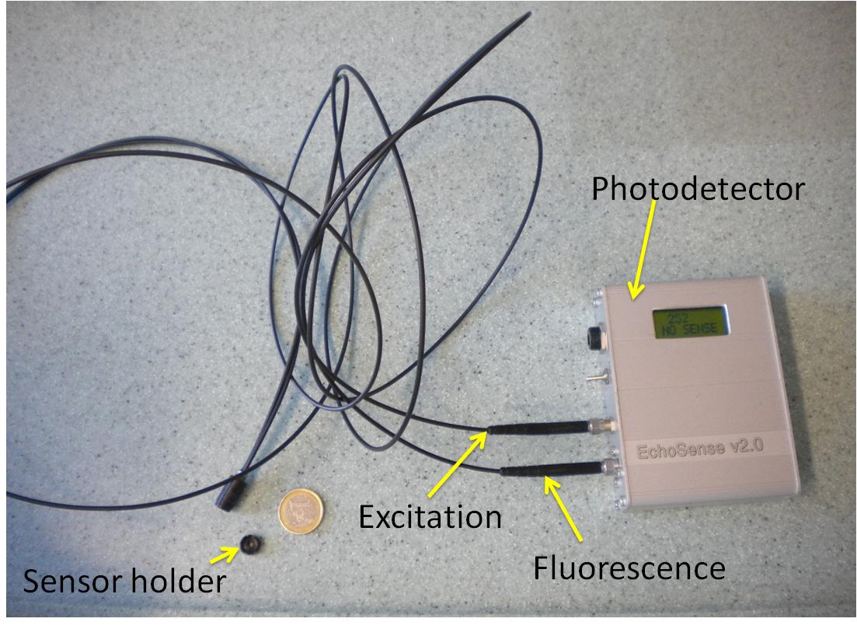
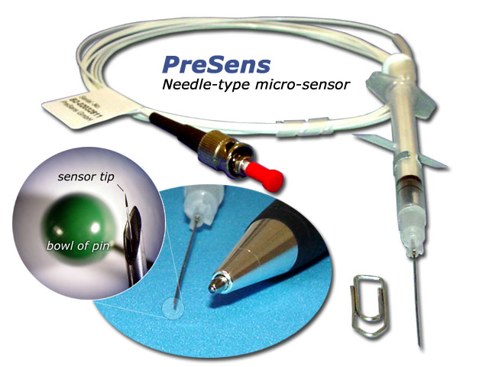
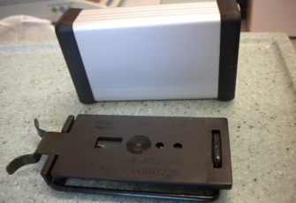
IOS PRODUCTS/PROTOTYPES SENSORS
FRESHSENS for detection of meat freshness
WATER MONITORING: NH₃, O₂, phosphates, pesticides
AIR MONITORING: O₂, CO₂, NH₃, humidity, T, pesticides,
PROTECTION/SECURITY: Optisens (prototype)
PHOTONIC NANOMATERIALS for Authenticity
WEARABLE SENSORS (incorporated into textiles, watches, mobile phones) to detect environment/body

Slide 6
IOS PRODUCTS/PROTOTYPES NANOMATERIALS
Magnetic Nanomaterials & Magnetic Fluids
Zinc Oxide (ZnO) Nanoparticles
Silica (SiO₂) Nanoparticles
Doped and/or Grafted Silica (SiO₂) Particles
Superparamagnetic Iron‐oxide based
Hollow Nanostructures

Slide 7
IOS, Ltd and Projects (not all listed)
Predstojnica: Prof.dr. Aleksandra Lobnik
Kontakt: aleksandra.lobnik@um.si
MinEra Net project (IOS, project coordinator)
MetRecycle Recycling of Rare Earth Metals using functionalized magnetic nanomaterials
Partners from Countries: Slovenia, IOS, Ltd, Sweden, Argentina, France
Duration: 2018-2021
TFC membrane
WATER
ECOLOGY
OPTICAL CHEMICAL SENSORS
NANOTECHNOLOGY & NANOMATERIALS

Slide 8
IOS, Ltd and Projects (not all listed)
Predstojnica: Prof.dr. Aleksandra Lobnik
Kontakt: aleksandra.lobnik@um.si
Eurostars (IOS, project coordinator)
Recycling of Heavy Metals using functionalized magnetic nanomaterials
Partners from Countries: Slovenia, IOS, Ltd, Roto Croatia
Duration: 2019-2022
TFC membrane
WATER
ECOLOGY
OPTICAL CHEMICAL SENSORS
NANOTECHNOLOGY & NANOMATERIALS

Slide 9
IOS, Ltd and Projects (not all listed)
Predstojnica: Prof.dr. Aleksandra Lobnik
Kontakt: aleksandra.lobnik@um.si
DEMO Project POLY CIRCULARITY
(Leader: Gorenje Surovina; Partners: IOS, Mikropolo, roto, messer, Omega, EKTC, Snaga, Tekstina)
Deals with the recycling of packaging materials and plastics to gain new secondary raw materials.
Duration: Septembre 2019- August 2022
TFC membrane
WATER
ECOLOGY
OPTICAL CHEMICAL SENSORS
NANOTECHNOLOGY & NANOMATERIALS

Slide 10
IOS, Ltd and Projects (not all listed)
Predstojnica: Prof.dr. Aleksandra Lobnik
Kontakt: aleksandra.lobnik@um.si
EU Horizont 2020 project (IOS, project co-coordinator)
RESYNTEX project - A new circular economy concept: from textile waste towards chemical and textile industries feedstock
Topic: WASTE-1-2014:
Moving towards a circular economy through industrial symbiosis
Type of action: Innovation;
Duration of the project: 42 months;
20 partners
TFC membrane
WATER
ECOLOGY
OPTICAL CHEMICAL SENSORS
NANOTECHNOLOGY & NANOMATERIALS

Slide 11
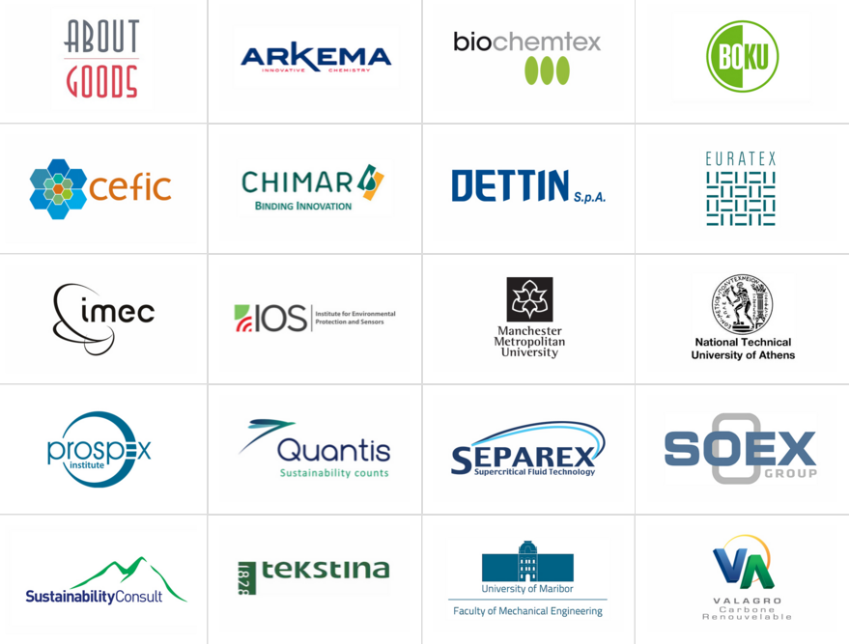
Partners
COORDINATOR: SOEX
CO-COORDINATOR: IOS
RESYNTEX has 20 project partners from across 10 different EU member states.
Partners include industrial associations, businesses, SMEs and research institutes.
Working together, the group creates an effective model for the whole value chain.

Slide 12
Recovered Textile Waste
100%
Re-Wear
60%
well preserved
10%
moderate wearability
50%
Sales in over 90 countries around the globe
Re-Use/
Re-Cycle
40%
wipers
15%
For utilization in the industry
fibre-pulling 14%
other recycling & re-use 8%
waste 3%
Incineration
Material Reutilisation
75 million tons of textile are used,
Only a few per cent of the overall textile waste ﬂow is recycled,
Currently around 60 million tons of textiles annually are sent to landfills or burned
Notes:
First of all I would like you to look at the Material Reutilisation scheme.
According to the World Apparel Fibre Consumption Survey from 2013 (FOOD AND AGRICULTURE ORGANIZATION OF THE UNITED NATIONS AND INTERNATIONAL COTTON ADVISORY) https://www.icac.org/cotton_info/publications/statistics/world-apparel-survey/FAO-ICAC-Survey-2013-Update-and-2011-Text.pdf
world consumption of all textile fibres peaked in 2007, Mankind used around 75 million tons of fibres per year.
Per capita consumption of fiber in developed country is up to 40 kg (in average 11 kg/capita);
Currently around than 60 million tons of textiles annually are sent to landfills or burned.
Textile recycling industry is able to process 93% of the waste without the production of any new hazardous waste or harmful by-products.
EU is the largest consumer market (Van Tot, 2014). In 2014 only, European consumers purchased an estimated 484 billion euros worth of clothing and textiles (Statista, 2016). On the other hand, Europeans discard 5.8 million tonnes of textiles annually (Zacune, 2013).
According to the report released by the Friends of the Earth Europe network, only about 25% of post-consumer textiles are being recycled by charities and industrial enterprises in Europe (Zacune, 2013). In the UK only 14% of end-of-life clothing goes to recycling (WRAP, 2012).
Following the Nordic Council of Ministers report, in the Nordic countries, roughly 9 kg per capita of textiles out of 14 kg consumed goes to waste treatment in the mixed waste every year, most of which could have been reused or recycled (Palm et al., 2014a).
The results of the studies conducted in Finland indicate that only a few per cent of the overall textile waste ﬂow is recycled. The majority is collected in municipal solid waste and incinerated with energy recovery (Dahlbo et al., 2016).
France went a step further. Since 2006 French producers and importers of clothing, linen and footwear are responsible by law for ensuring reuse and recycling in the post-consumer phase. Companies can either organise their own recycling programme or contribute financially to an accredited collectively responsible organisation. Those companies that use a minimum of 15 % recycled fibres in their new textile products pay a reduced membership fee of 50 %. Membership fees are among others used to support research to improved recycling of non-reusable textiles, including projects aimed at educating and assisting product designers to design with reuse and recycling in mind (Dahlbo et al., 2016).
Germany has significantly increased the amounts of the recycled household textile between years 2007 – 2013. According to the German Federal Association for Secondary Raw Materials and Waste Management, total textile recycling increased from 750,000 to 1.01 million tonnes out of which 54% has been reused (clothing), 21% used for production of rags, 17% - in the garment Industry, 6% - for energy recovery and 2% has been considered as waste (Korolkow, 2015).

Slide 13
RESYNTEX DEMO PILOT PLANT Maribor, Slovenia
100t TEXTILE/YEAR

Slide 14
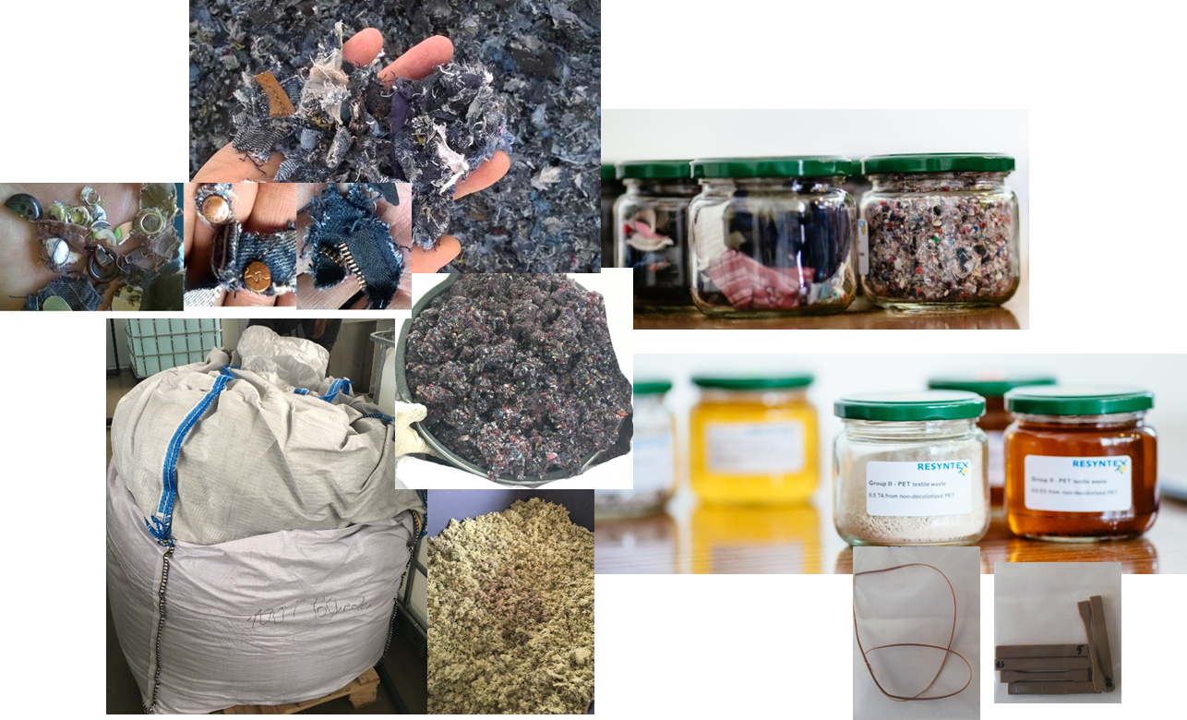
RESYNTEX DEMO PILOT PLANT is dealing with
100 t of textile-plastic wastes/per year.
Part of this DEMO is also water purification which enables more than 90% of water to be recycled and used again.
In the same matter all other chemicals as well enzymes are recycled and reused.
Inputs, intermediates and end products from RESYNTEX process

Slide 15
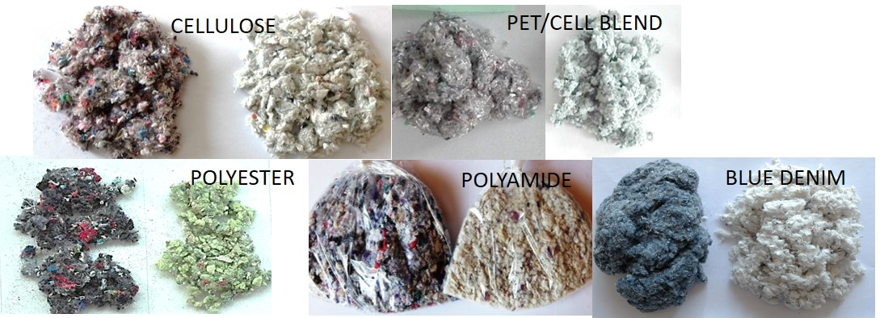
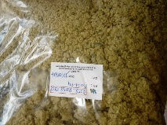
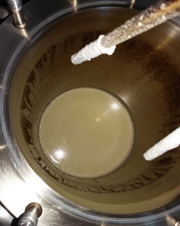
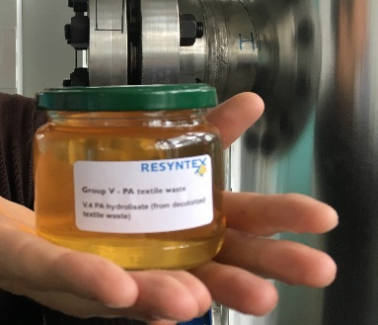
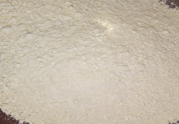
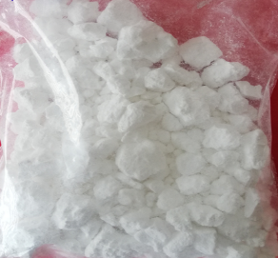
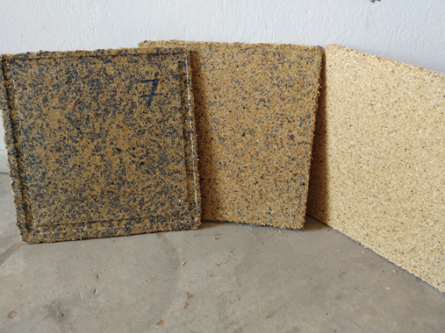
What RESYNTEX Demo pilot can offer

Slide 16

5th NANOAPP 2021
3rd Nano4Circularity
Conference Bridging Research and Industry
nanoapp.ios.si
Nanomaterials & Applications
June / 2021, Portorož / Slovenia

Slide 17
Thank you for your attention!
Contact: aleksandra.lobnik@ios.si
Investment is co-financed by the Republic Slovenia and the EU under the European Regional Development Fund

