Slide 1

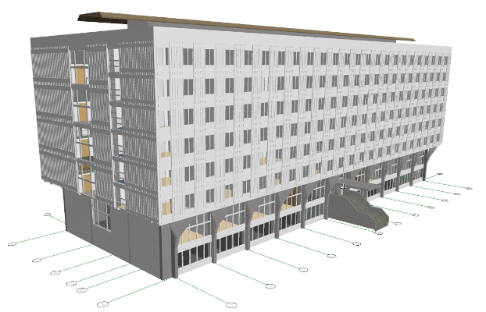
EU widening instruments - our experiences …
Anka LISEC
University of Ljubljana, Faculty of Civil and Geodetic Engineering
E-mail: anka.lisec@fgg.uni-lj.si
Brussels, September 4, 2018
The project SLICE3D has received funding from the European Union’s Horizon 2020 research and innovation programme under grant agreement No 763641.

Slide 2
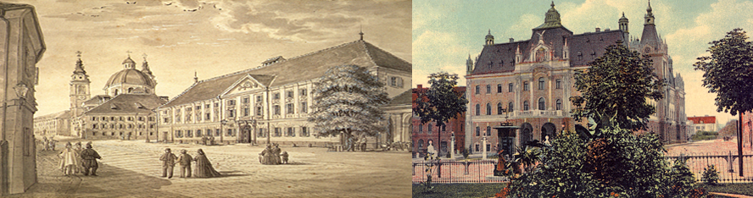
About the University
Established in 1919 with 5 member schools
At present the University of Ljubljana consists of:
  23 faculties and
  3 arts academies
  with
  40,109 students
  5,730 employees
  an annual budget of 304.7 mio €

Slide 3
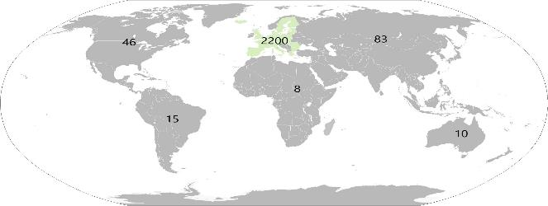
International partnership
Agreements:
  8 strategic partnerships
  88 central agreements
  2266 agreements of faculties/departments
  (84% Erasmus)
Areas of cooperation:
  Exchange of students, academic and administrative staff
  Joint research activities/projects
  Joint conferences, seminars, workshops, symposia, etc.
  Joint courses and/or curricula

Slide 4
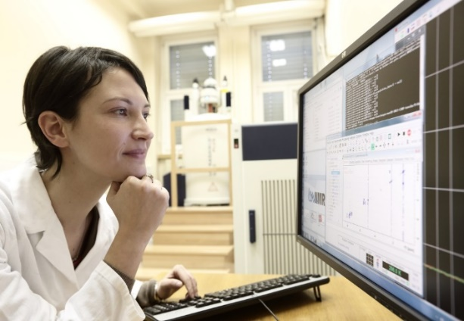
Research at UL
Three pillars of core business & two strategic orientations
  Research
  Education
  Knowledge transfer
  Quality
  Internationalization
  Research:
  4105 registered researchers
  308 young researchers + 12 post-docs
  331 national research projects
  444 EU projects
University of Ljubljana contributes almost half of the research results in Slovenia

Slide 5
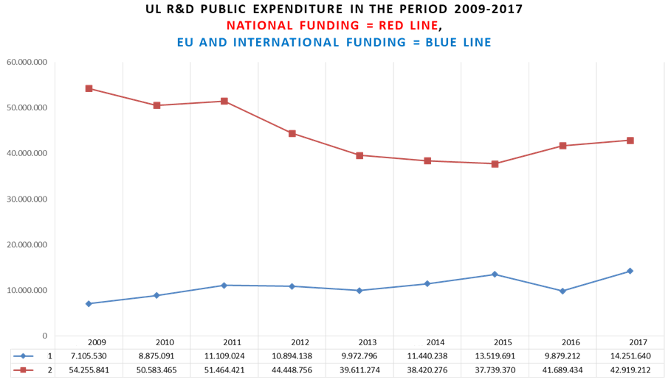
Research funding at UL
Regular national funding only for educational activities.
Research funding from public sources based on open calls:
  National research funding from Slovenian Research Agency (ARRS)
  European and international funding
  Research & services for industry and market

Slide 6
EU projects at UL
  163 projects within 7th Framework Programme (nearly 30 mio € for UL)
  96 H2020 projects as beneficiary or third party
  4 ERC Grants (5 ERC granted in 2009-2018 out of only 7 in Slovenia):
    1 ERC Starting Grant,
    2 ERC Advanced Grants, and
    1 ERC Consolidated Grant
  1 ERA Chair
  111 ERASMUS+ projects
  More than 900 projects financed by other EU programmes: COST, EUREKA, LLP, LIFE+, Health, Safer Internet Plus, etc.
  BUT
  In Horizon 2020 UL is, almost in all cases, only a project partner!

Slide 7
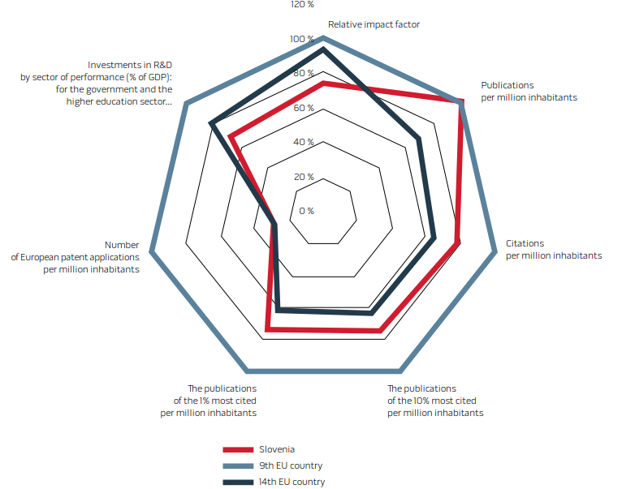
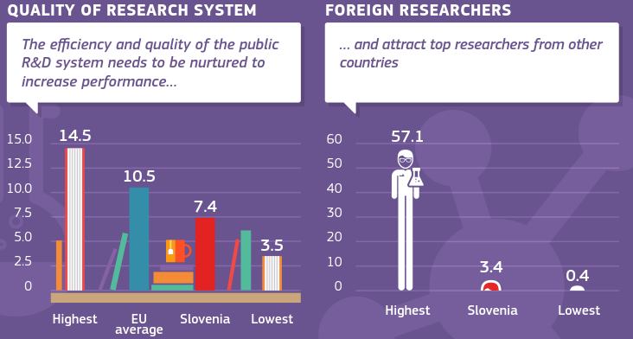
R&D challenges at the national level
Low R&I performance
Low participation in EU programs
Low national R&D investments
Limited attractions for foreign researchers
…
Source (left): https://rio.jrc.ec.europa.eu/en/library/slovenia-research-and-innovation-performance-0
Source (right): http://www.arrs.gov.si/en/index.asp

Slide 8
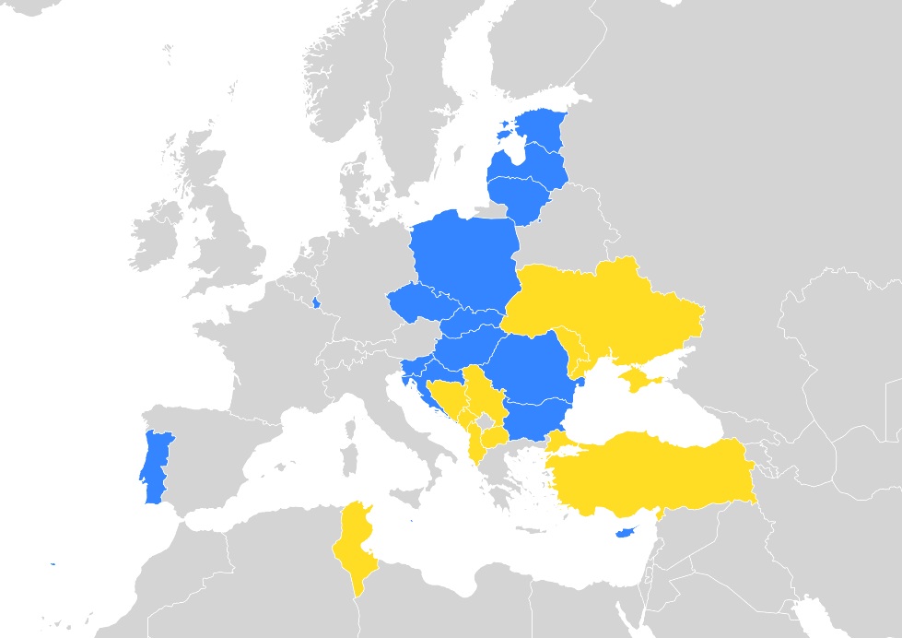
Widening actions
Low participation rates in FP7 projects in some member states:
  >> widening actions under the Spreading Excellence and Widening Participation part of Horizon 2020
The Widening Package in Horizon 2020 under Spreading Excellence and Widening Participation:
  ERA Chairs (bringing excellence to institutions)
  Teaming (institution building)
  Twinning (institutional networking)
  MSCA (Marie Skłodowska-Curie Actions) Widening Fellowships
  …

Slide 9

Widening calls – our experiences
ERA chairs:
    In Slovenia (host institution): 1 Horizon 2020 (and also 1 pilot in FP7)
  ERA chair seal of excellence (national funding);
  The problem of R&I infrastructure, equipment for granted ERA chairs;
  Limited attraction for foreign researchers due to low salaries.
Teaming: a very limited number of projects:
    In Slovenia: 4 projects (Phase 1), 1 Project (Phase 2)
  An important aspect is the required investment in the R&I infrastructure
  Autonomy, attraction for foreign researchers …
  Many "open questions" …
Source: https://innorenew.eu/about/institute/

Slide 10
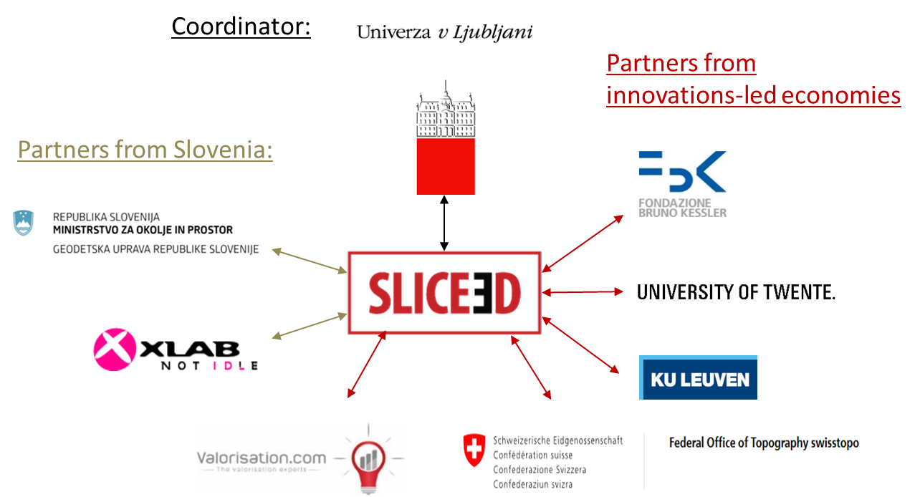

UL Teaming project - SLICE3D
The idea of Teaming projects:
  benefits of innovation-led economies are both maximised and widely distributed across the European Union.
Objective:
  Creation of new (or significant upgrade of existing) Centres of Excellence (CoE) in
  low R&I performing
  (or "widening") countries

Slide 11
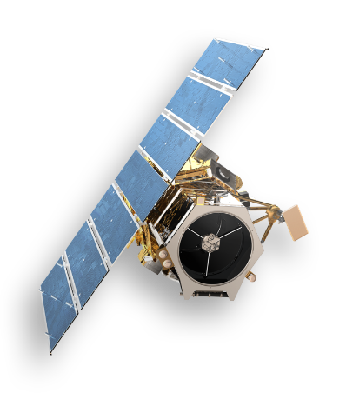
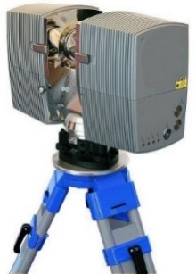
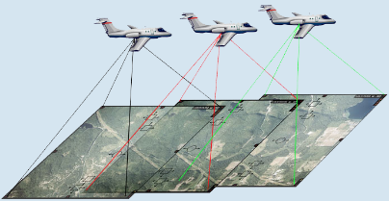
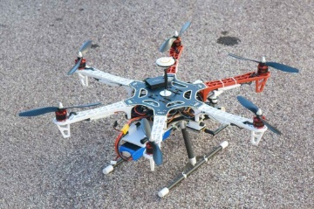
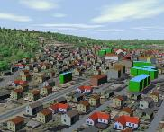
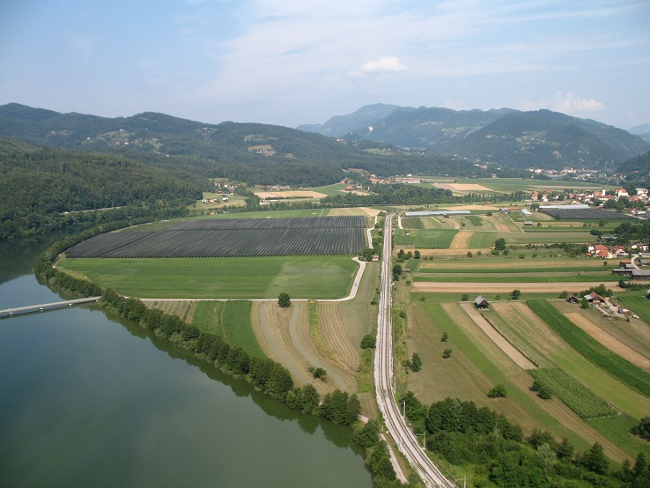
Why geospatial domain?
Challenges in geospatial domain:
  Fast technological development;
  Complexity of built and natural environments (3D/4D);
  Increasing market demand;
  Societal and environmental requirements;
  Unused potential of benefits of open (geospatial) data;
  Unused potential of EU infrastructure (Galileo, Sentinel …)!
Particularities for Slovenia:
  Limited R&I activities:
    limited human resources
    expensive research infrastructure but low budget for R&I
  Geospatial data/geospatial
  information in development
  strategies of the
  country/macro regions.
    The majority of human decisions are directly or indirectly related to a geo-location!

Slide 12

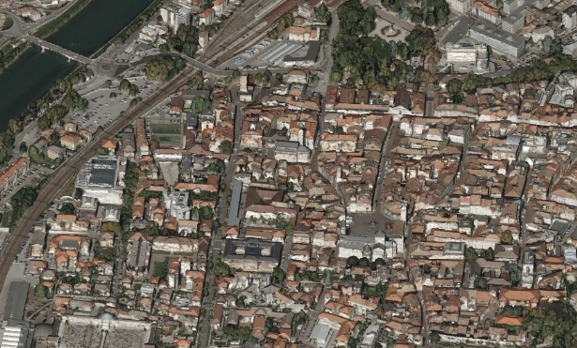
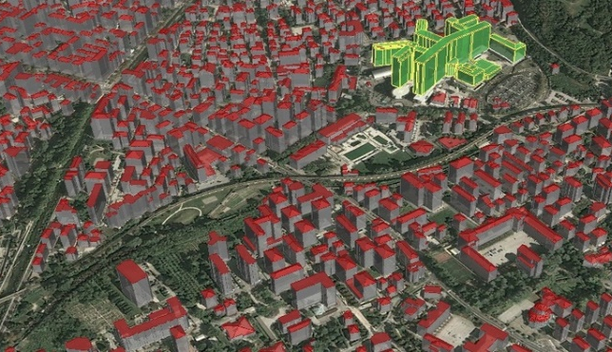
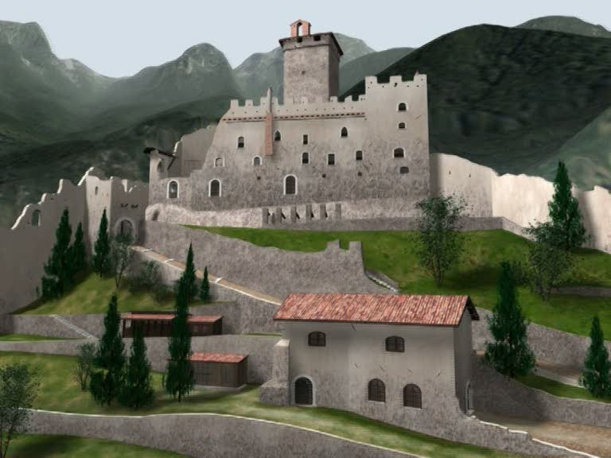
R&I domain, valorisation
    Geospatial data acquisition and processing
    Geospatial data modelling
    Data integration, publication and exploitation
SCIENTIFIC RESEARCH
PROJECTS
APPLIED PROJECTS,
SOLUTIONS FOR INDUSTRY
VALORISATION,
DISSEMINATION
INTERNATIONAL FORUMS,
NETWORKING
EDUCATION AND
TRAINING PROGRAM
    Environmental studies
    Logistics, location-based services
    Territorial management
    Tourism,
    Cultural heritage
    Disaster and risk management
    Agronomy, Forestry
    Construction, Spatial planning
Source of 3D-models: FBK 3DOM (provided by Fabio Remondino)

Slide 13
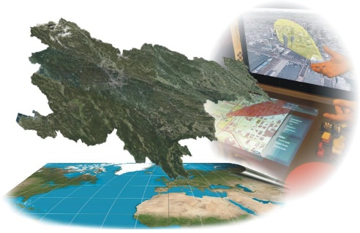
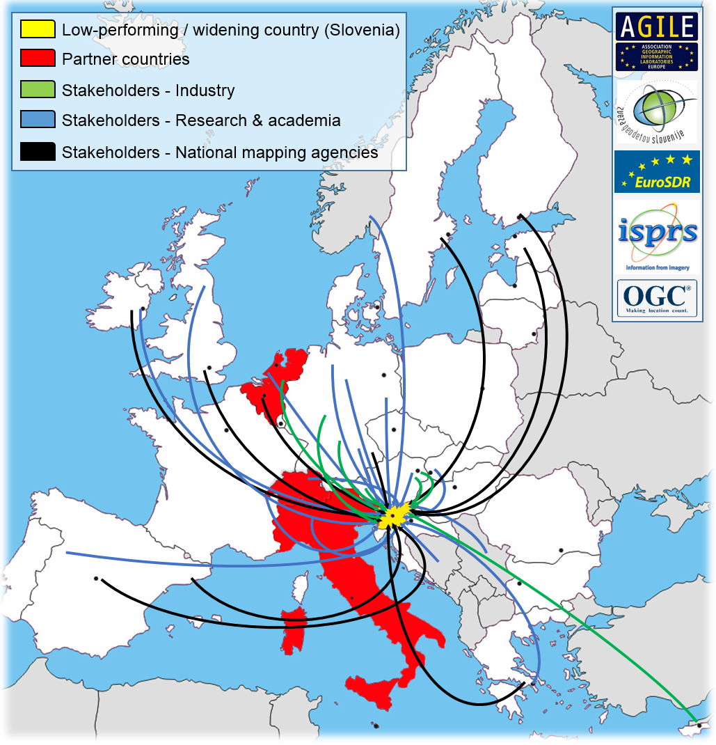
How it comes?
Networking is crucial!
  National partnerships and projects:
    Governmental institutions
    Local communities
    SMEs
  Regional networks
  International networks:
    EuroSDR, ISPRS, FIG …
    ISPRS congress in Prague (July 2016)
    November 2016: Proposal for Phase 1 project + LoS
    March 2017: Notification that project was selected for funding
    May 15, 2018: Open call for Phase 2
    September 1, 2017-August 31, 2018: SLICE3D Project Phase 1
    November 15, 2018: Deadline for Phase 2 proposal submission

Slide 14
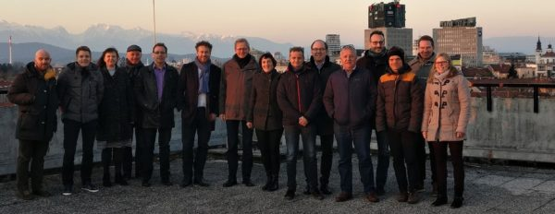
EU widening instruments - our experiences …
Anka LISEC
University of Ljubljana
Faculty of Civil and Geodetic Engineering
E-mail: anka.lisec@fgg.uni-lj.si
www.slice3D.si
Brussels, September 4, 2018
www.uni-lj.si
The SLICE3D project has received funding from the European Union’s Horizon 2020 research and innovation programme under grant agreement No 763641.

