Slide 1
Transport & Logistics Conference 2016
Brussels, 3 March 2016
Libor Lochman – CER Executive Director

Slide 2


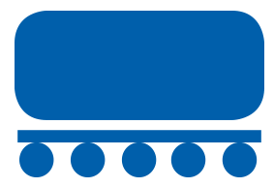

CER membership
CER represents more than 70 members and partners.
73%
of the European rail network length
80%
of the European rail freight business
96%
of rail passenger operations in Europe

Slide 3

Who we work with
^{European institutions}
More than
70
Members and
partners
Council of the EU, European Commission, European Parliament, European Railway Agency (ERA)
^{Other organisations:}
ASECAP, CEEP, CIT, EBRD, EIB, EFRTC, EIM, EPF, ERFA, ETF, IRU, OTIF, OSJD, RNE, SEETO, T&E, UIC, UNIFE, UIP, UIRR, UITP, and World Bank

Slide 4
For South East European area, three principles for urgent action
More investments on infrastructure quality and size
Enhanced, committed regional cooperation
Intelligent, pragmatic approach to implementation of the EU rail acquis

Slide 5
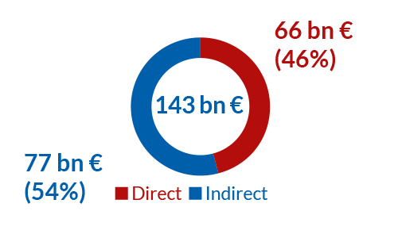
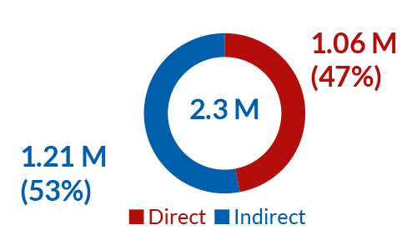
Rail investments bring positive effects on the economy at large...
Economic size of Europe´s rail sector (GVA)
Millions of persons employed
ONE in railway transport creates more than ONE other job in indirectly dependent economic activities.

Slide 6

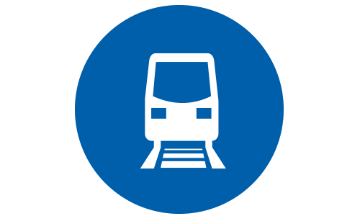

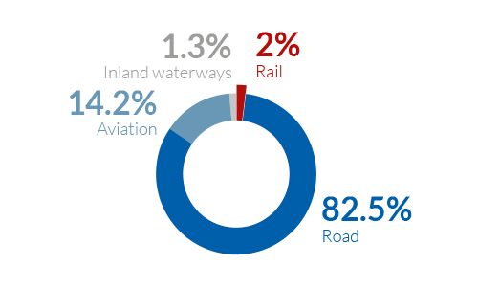

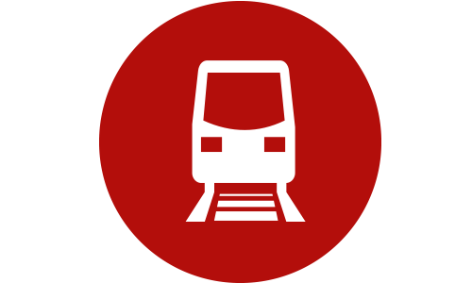

... and guarantees a sustainable development
Specific CO2 emissions per transport mode
Rail only accounts for 2% of total energy consumption in transport although it carries 17.2% of inland freight and 7.4% of passengers in Europe.
Passenger
Rail
41 gCO₂/pkm
Road
(110 gCO₂/pkm
Air
(112 gCO₂/pkm
Freight
Rail
21 gCO₂/pkm
Inland waterways
(61 gCO₂/pkm
Road
(75 gCO₂/pkm

Slide 7
Financing positively impacts rail freight modal share
Rail freight
modal share growth
(2002 – 2012)
Rail FINANCING
(1000€/line.km/yr
2002-2012)
Integrated / Unbundled
Data Source: European Commission’s RMMS 2007-2014 (excluding HR & LU)

Slide 8
SEE Rail freight
The extension of TEN-T core network to the region: a huge opportunity for the SEE area
A new Rail Freight Corridor AT-SI-HR-SRB-BG will foreseeably be established in 2016/2017

Slide 9
Container traffic in Koper grew fast in the last decade
ITF data 2015

Slide 10
Existing railway line is approaching full capacity
Saturation could occur btw 2018 and 2028, depending on traffic growth rate and operational capacity.
If Koper experiences rail capacity crunch, up to 15% of additional traffic could remain for Koper but shift to road. The remaining 85% will move to Rijeka/Trieste.
ITF data 2015
The 2nd track construction: If rail charges are raised to recover the cost of it, then for each 1% of additional TAC the rail cargo volume would decrease by the same percentage!!!

Slide 11
SEE Regional cooperation and coordination are needed
Rail is vital for ensuring proper regional integration and trigger the potential for regional traffic. This is true for both passenger and freight
Most of the SEE area is a potentially single job market: commuter traffic can and will grow
Coordination of national economies and the interplay of the comparative advantages should and eventually will restructure subregional economies along a coherent value chain
Administrative cooperation from different governmental branches is also needed (i.e. to speed up Border Crossing Procedures!)

Slide 12
Thank You
Libor LOCHMAN

