Slide 1
Railway performance, sustainability and safety in South-East Europe
Brussels, 22 March 2018
Dr Libor Lochman
CER Executive Director

Slide 2


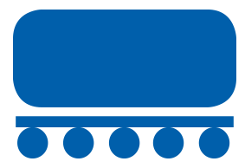
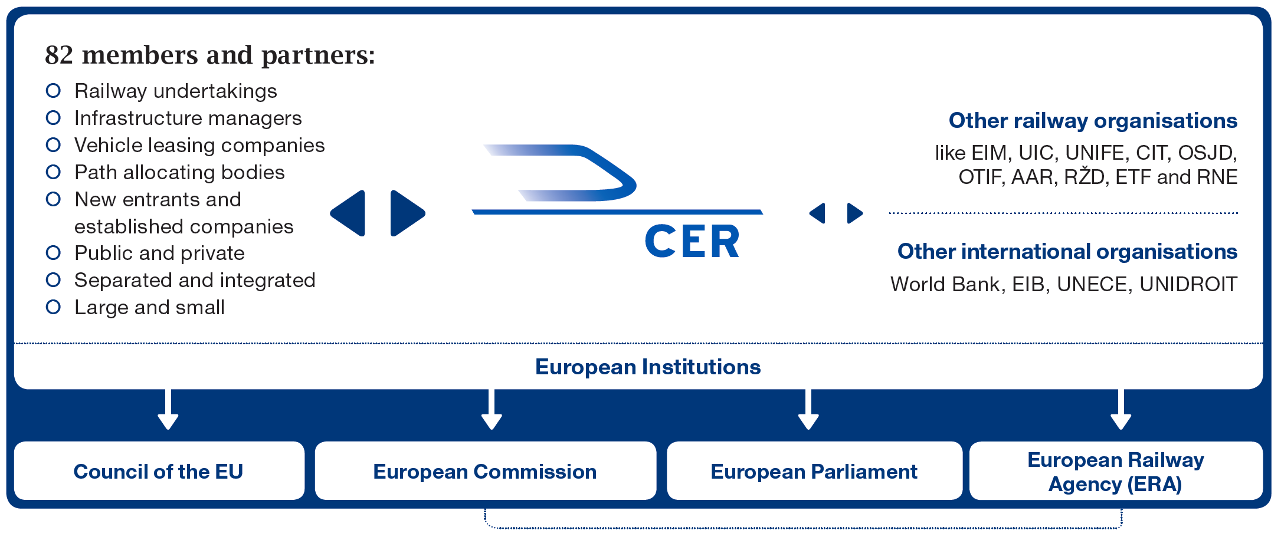

CER – The major rail lobby association
73%
80%
96%

Slide 3
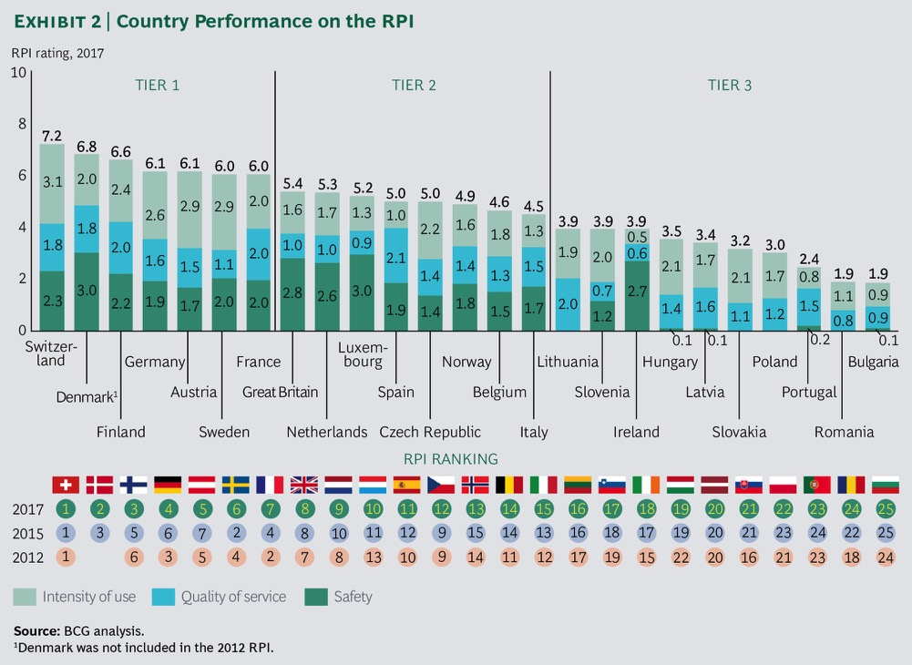
Performance of railways in the region – where do we stand?

Slide 4
Why that? Major reason:
Infra financing insufficient!
Source: ITF 2017

Slide 5
And still: the rail is the safest land transportation mode!
Source: EU Rail Agency 2017

Slide 6
On top of that: Rail is the energy efficient mode of transport
Rail uses only 1.7% of total energy in transport although it carries 17.4% of inland freight and 7.6% of passengers in EU28
Source: Eurostat

Slide 7
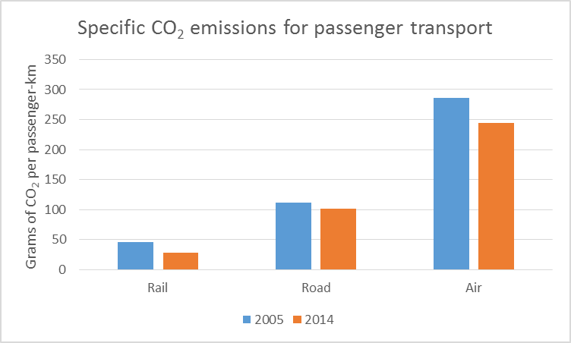
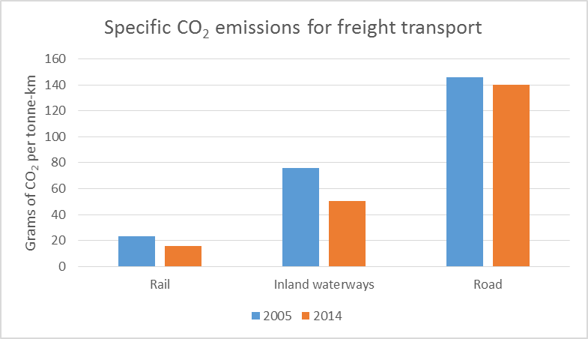
Rail is sustainable: less CO₂ intensive compared to other modes
Source: European Environment Agency

Slide 8
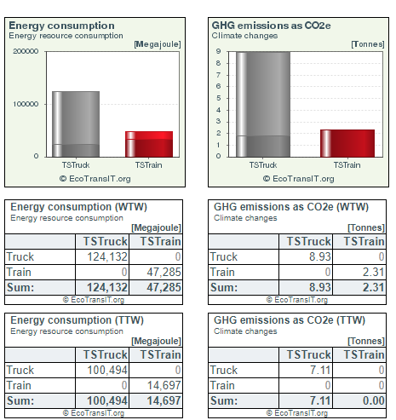
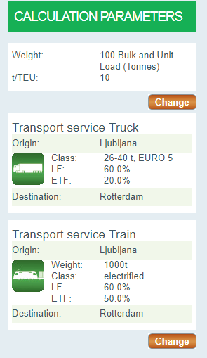
Case study: 1000 t of cargo from Ljubljana to Rotterdam
http://www.ecotransit.org

Slide 9
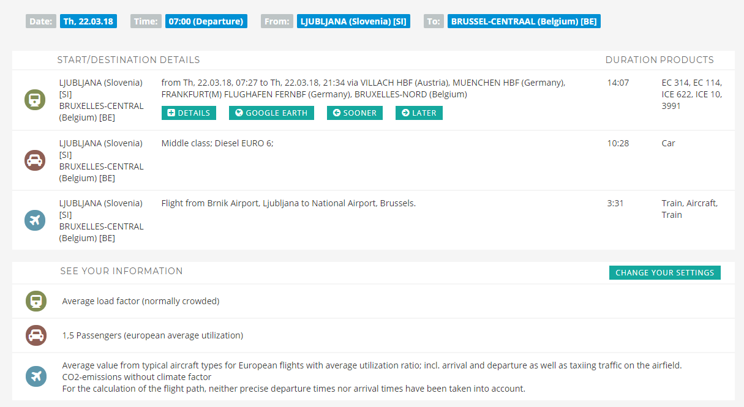
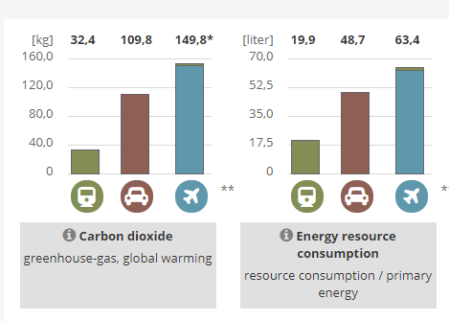
Let’s take passengers onboard:
Ljubljana – Brussels
http://www.ecopassenger.org/

Slide 10
Anything more?
Yes, let’s electrify!
More than 50% of railway lines in Europe are electrified and these lines carry 80% of the traffic
Where carbon savings and the economic case of a project are positive, rail network should be further electrified
Slovenia: 41% of 1209km electrified
Source: EC Transport pocketbook 2017

Slide 11
…and build the rail for customers on three solid pillars
Back in the 2001 White Paper,
the European railway policy
rested on 3 ‘pillars’ to
support the railways
own innovative efforts in
Productivity
Efficiency
Quality
INNOVATION
QUALITY
PRODUCTIVITY
EFFICIENCY
Market Opening Competition
Fair Competition between modes
Rail
Financing
Notes:
There have been good reasons that modal shift is a major point in the White Paper of 2001
Successful modal shift needs 3 policy elements : market opening within the rail sector; removing distortions in competition between the modes; and supplying modern rail infrastructure. Rail can gain substantially in market share, but only if all three conditions are met.
Switzerland is the classic example to show that modal shift is a realistic option. One of the contradictions of European transport policy is that everybody is applauding the Swiss model (priority for freight on rail!), but at the same time EU legislation does not allow any member state to introduce the corresponding political framework conditions!
Conclusion
We look forward to full market opening in EU in 2007 – this will undoubtedly raise productivity further; but perspectives on other two pillars remains unclear.

Slide 12
Dr Libor Lochman
Executive Director
libor.lochman@cer.be

