Slide 1


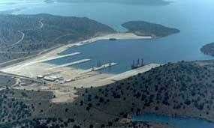
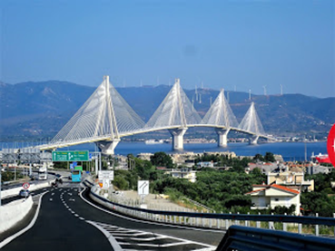


Presentation of selected results of the EU-SPI case study
Western Greece
Measuring social progress in European regions and cities
Brussels, 9 October 2019
Prof. Lena J. Tsipouri

Slide 2
A few reminders about the RWG before responding to the questions to be addressed
Among the poorest European regions
Suffered from long-term decline (relative to the nation)
A vibrant HEI/RTO community
Social situation strongly influenced by illegal migration, Roma population, temporary legal immigration in the agricultural sector

Slide 3
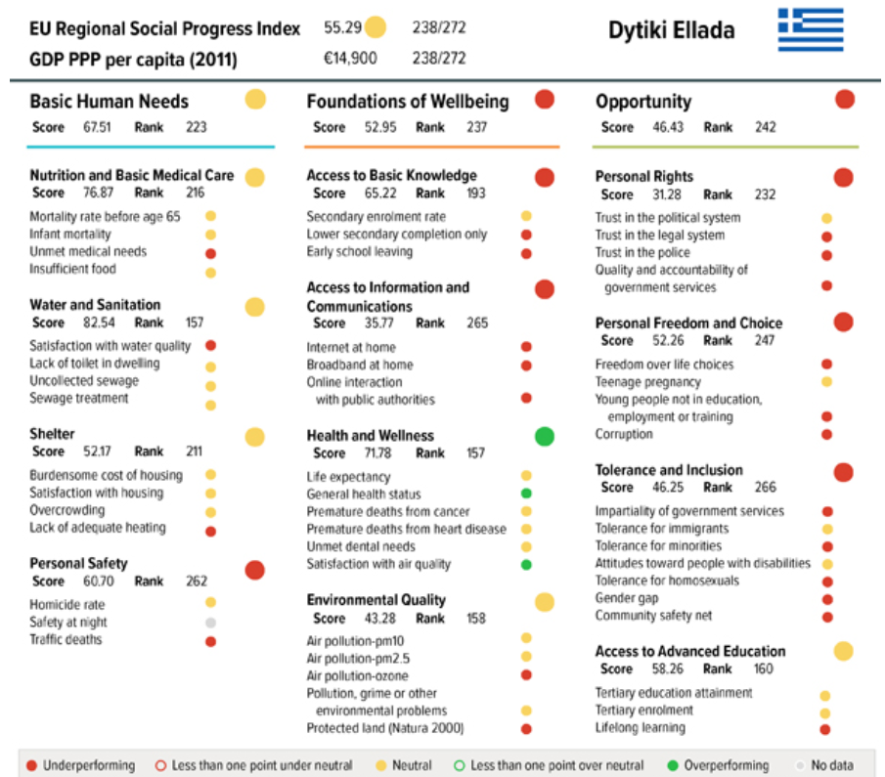

Slide 4
Outline
Do the results of the tested indicator frameworks translate reality at the regional level?
Are the tested indicators useful in monitoring social policies?
Can the results help to improve (regional) policy making and multilevel-governance?
Should other criteria or factors be added to these indicators?
How can the different policy levels interrelate to influence / improve social progress?
How should the existing measurement of social progress be strengthened in order to ensure its more useful uptake by the regional governments?

Slide 5
Do the results of the tested indicator frameworks translate reality at the regional level?
Methodology
Check indicators one-by-one in a focus group of policy makers; refinement with individuals (including experts) if need be
Results RWG
By and large the framework reflects reality; reservations were expressed on
Environmental measurements there are problems because there are not enough measuring instruments (aggregation of city data for the whole region)
Using national averages when regional data is missing is misleading
Perception indicators

Slide 6
Are the tested indicators useful in monitoring social policies?
Yes, but
They will be a lot more useful when time series will be available
Additional (tailor-made or not??) criteria are needed to select among them to prioritise policies
Examples of criteria used in the RWG (work in progress)
Distance from average EU or average national score
Path dependence as a constraint for action
GDP: Some indicators are very closely connected to GDP
Administrative level of responsibility
Availability/size of budget for intervention at the regional level

Slide 7
Can the results help to improve (regional) policy making and multilevel-governance?
Yes, significantly
For regional policy making it is an instrument to help prioritise regional policy interventions; it stimulates the selection of criteria for prioritization
For areas where the region lacks autonomy it is a justification to
  Leverage national funding for indicator improvement
  Join forces with other regions in the same Member State for addressing similar problems (RWG example: Life-long-learning)
  Join forces with other regions globally for addressing similar problems (RWG example: illegal migration)
For areas where the region applies for international support or collaboration it is a good justification (e.g. Interreg, Urbact, H2020)

Slide 8
Should other criteria or factors be added to these indicators?
YES and some others may be removed
Examples from the RWG
Tolerance and care for animals
Quality of secondary education not levels
Cost/quality of ICT access not only access itself
Young unmarried mothers, teenage alcoholism or drug addiction
Support for people with disabilities
Cultural indicators
Ways to integrate inequality???

Slide 9
How can the different policy levels interrelate to influence / improve social progress?
Significant differences between Member States
National policies: check the areas where all regions lag behind (use distance to EU average)
EU policies: check against other benchmarks (does global regional make sense?)

Slide 10
How should the existing measurement of social progress be strengthened in order to ensure its more useful uptake by the regional governments?
There are doubts on the value of perception indicators
Perception indicators should ideally be matched with objective ones (e.g. trust in the legal system substituted or complemented with time elapsing to final court decisions and/or reversal or court decisions by appeal courts)
Double check (statistical tests) indicators with potential strong correlation, same root causes (

Slide 11
Thank you for your attention
tsipouri@econ.uoa.gr

