Slide 1

Defence Research and Industry in Slovenia
Dr. Larisa Pograjc
SI EDA R&T Director
EU FUNDING FOR DEFENCE AND SECURITY
Brussels, 28th September 2016

Slide 2

„The only sure thing about future is that something unexpected will occur“
R&T Goals in SI MoD
Investment in R&T should contribute to tomorrow҆ s defence capabilities
CAPABILITY DRIVEN
Research organisations
SMEs
+ ECONOMIC IMPACT
SCIENTIFIC and TECHNOLOGICAL
EXCELLENCE
larisa.pograjc@mors.si

Slide 3
R & T priorities
System analysis, artificial intelligence
Cognitive & behavioural sciences
Processing & use of data
  - Situational awareness
  - Big data
Modelling & simulation
Training & distance learning
Autonomous systems
Support of urban warfare
larisa.pograjc@mors.si
Notes:
To mention the most relevant …

Slide 4
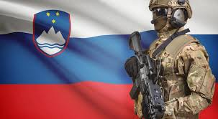
Peculiarities of SI defence
research & industry
No military institutes or research organisations
(strong will and many ideas)
No tipically (state owned) big military industry
Mostly SMEs
Excellent research, not so good implementation into the industry
Dual use products development opportunities
larisa.pograjc@mors.si
Notes:
Področja, ki predstavljajo okvir za predloge raziskovalno razvojnih projektov v podporo vojaškim zmogljivostim so:
1. področje: Razvoj novih sodobnih materialov
število prijav, ki se nanašajo na področje
7
2. področje: Povečanje vojakove zmogljivosti in avtonomije
število prijav, ki se nanašajo na področje
24
3. področje: Robotizacija in miniaturizacija v povezavi s kopenskimi in zračnimi vozili brez posadk
število prijav, ki se nanašajo na področje
8
4. področje: Odkrivanje in preprečevanje groženj različnih omrežij
število prijav, ki se nanašajo na področje
12
SKUPAJ
51

Slide 5
Applied research/Technological development/Key technologies TRL 4-6
larisa.pograjc@mors.si
Notes:
More than a decade ago the MoD started to build up a system of R&T, meant to solve long-term challenges in the field of defence, although at the beginning dual-use research and technologies prevailed. At that time there was a general opinion that an exclusively defence-aimed technological surrounding was hard to establish in Slovenia. In the years after 2006, substantial financial resources became available through two bigger programs, the first aimed at the basic research and the second one at the higher TRL levels that followed. Unfortunately, due to the crisis, which consequently resulted in the lack of financing, the process was interrupted in the phase when the results were visible. Fortunately, some of the research continued outside the MoD, through other programs. This has revealed that despite all the challenges, a broad defence research base has been established and even today we are entering into some cooperative research projects based on it (e.g. IAPUNIT- fuel cells or Hybrid drive trains for military purposes).
Now we are in the phase of resuming the process and we sincerely hope that it will be a long term commitment to match the nature of the R&T typical cycles.

Slide 6
larisa.pograjc@mors.si

Slide 7
Challenges and way forward
RESEARCH
Stable financing (no research gaps)
Human resources (new experts needed)
Balanced research
Basic vs. applied
Domestic vs. cooperative
INDUSTRY
SMEs
Defence industrial strategy
Improved bottom-up approach
Enablers of innovation
Capable of rapid-enough adjustments
larisa.pograjc@mors.si

Slide 8
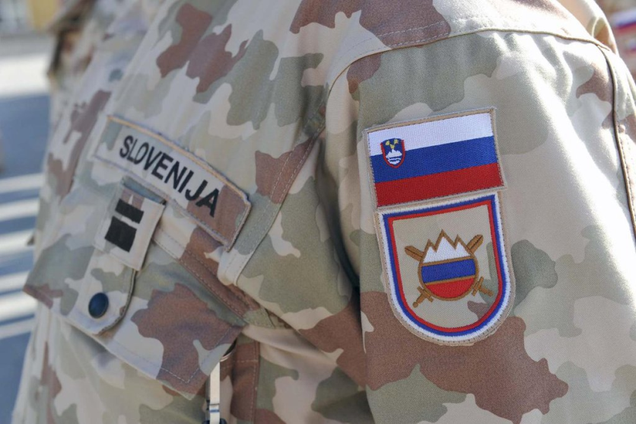
Warm thanks to:
For the welcome speech
  Dr. D. Veselinovič
  Mr. Ambassador J. Kacin
  Director Ž. Kralj
Presenters:
  EC: P. Anciaux, dr. E. Vanderweert, dr. M. Martinez, A. Alexis
  EDA: dr. P. Di Toro
  K. Bolving
  Presenters from RO and industry
Organisers: SBRA – dr. D. Veselinovič, Mr. M. Ferlinc; my colleague A. Novak
My superiors who supported the idea of this event
Permanent Representation of the RS to the EU for hosting us
larisa.pograjc@mors.si

