Slide 1
KU Leuven: innovation through internationalisation
Danny Vandenbroucke
Research Manager, KU Leuven (SADL)

Slide 2
Key facts and figures

Slide 3
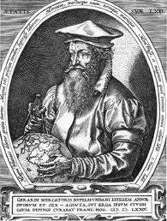
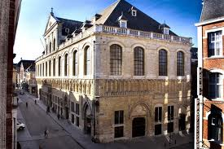
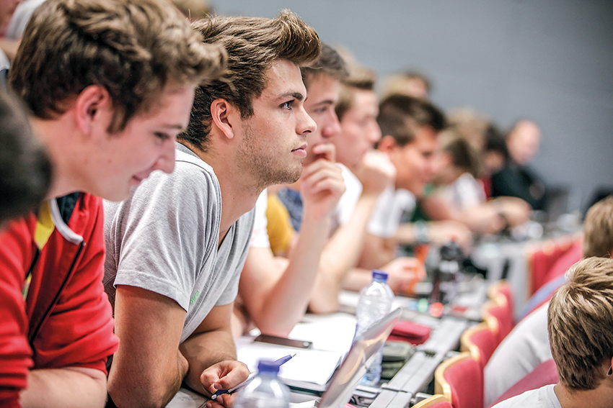
KU Leuven: key facts and figures
One of the oldest universities in Europe
  Started in 1425
Number of students (2017-2018)
  In total 56.842, 10.239 international, 150 nationalities
  Most in Leuven
Education
  78 Bachelors
  205 Masters
  44 Advanced Masters
  International programmes

Slide 4
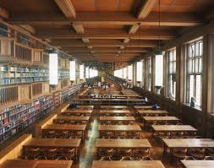
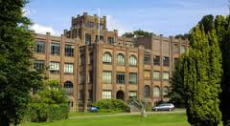
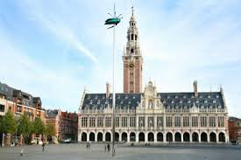
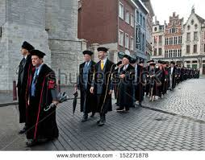
KU Leuven: key facts and figures
Staff
  12.008 (2018)
  Without University Hospitals (+9.500)
Researchers
  PhD: 5.855 of which 39% international
Research expenditure
  466,6 million € (2016)
124 spin-offs

Slide 5
KU Leuven: a highly ranked university
#5
in the Reuters World Ranking of Most Innovative Universities (2017);
the highest-ranked European university
#47
in the Times Higher Education World University Ranking (2018)
#81
in the QS World University Ranking
(2019)
#6 The sixth university in the European Commission Horizon 2020 programme
#11 The 11th university in the ERC grants programme with 72 projects (as host institution)

Slide 6
Internationalisation

Slide 7
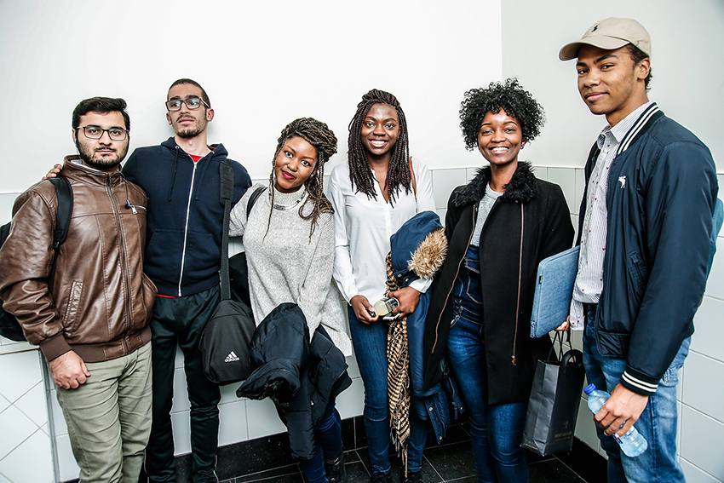
International programmes
In English:
About 3,000 courses
62 Master’s and 24 advanced Master’s programmes
4 Bachelor’s programmes
1 Master’s programme in French
1 advanced Master’s programme in Spanish
7 Erasmus Mundus programmes
ECTS label: transparent and transferable credits (European Credit Transfer System)
Co-operative programmes:
» 39 joint degree programmes
» 28 double degree programmes
» 43 programmes organised with international partners
Figures: 2017-2018 academic year

Slide 8

International students
OVER 150 NATIONALITIES
10,239 international students
18% international students
Top 5: EU
Netherlands 1,926
Italy 728
Spain 568
Germany 479
Greece 266
Top 5: non-EU
China 927
India 511
United States 366
Turkey 235
Iran 196
Figures: June 2018

Slide 9
National and international research
Research funding expenses 2016: € 466.6 million
Internal funds 19.0%
leverage to
External funds 81.0%
Special Research Fund 17.0%
(BOF)
basic research
Flemish Science Fund 20.1%
(FWO)
Industrial Research Fund 2.0%
(IOF)
Other government funds 14.5%
applied research
International/EU 8.1%
Flemish Science & 6.7%
Innovation Fund (IWT)
Industrial contracts 26.9%
Flemish Institute for 4.8%
Biotechnology (VIB)

Slide 10



International networks
Prominent position in European higher academic education
One of the leading research institutions in Europe
21 European
research
universities
Established in 2002
Approximately
850 institutions
in 47 countries
Established in 2001
37 European
multi-disciplinary
universities
Established in 1985

Slide 11
Spreading Excellence, Widening Participation

Slide 12

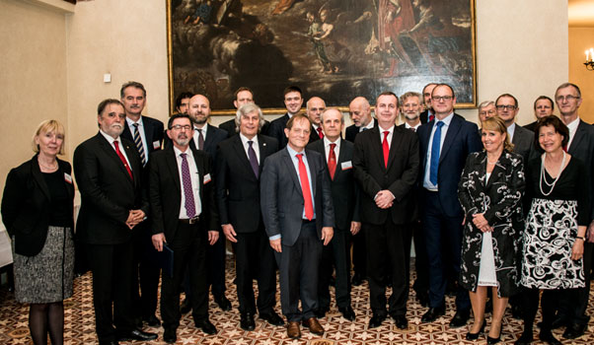

KU Leuven: CELSA initiative
Central Europe Leuven Strategic Alliance
Founded in April 2016
  8 old and famous universities
  5 European cities
    Budapest (Hungary)
    Leuven (Belgium)
    Ljubljana (Slovenia)
    Tartu (Estonia)
    Prague (Czech Republic)
Prepare joint education/research projects
  + Exchange experience
1.4 million € / call

Slide 13

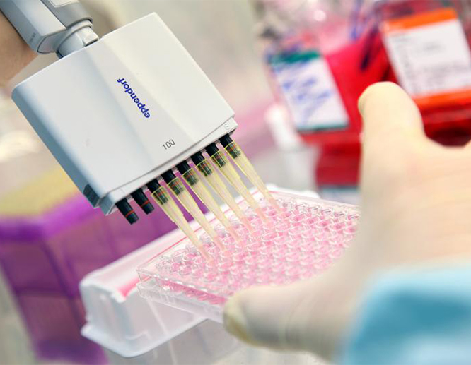
KU Leuven Research & Development
Established in 1972
One of the first university technology transfer offices in Europe
LRD advances the impact of research results on people’s lives around
the globe by means of:
Contract research
Managing intellectual property rights
Founding spin-off companies
Promoting entrepreneurship and innovation
Supporting regional development
LRD in figures
2017: 3,106 new contracts concluded
2017: € 72 million revenue from intellectual property
2005-2017: € 927 million external capital investment in spin-off portfolio

Slide 14

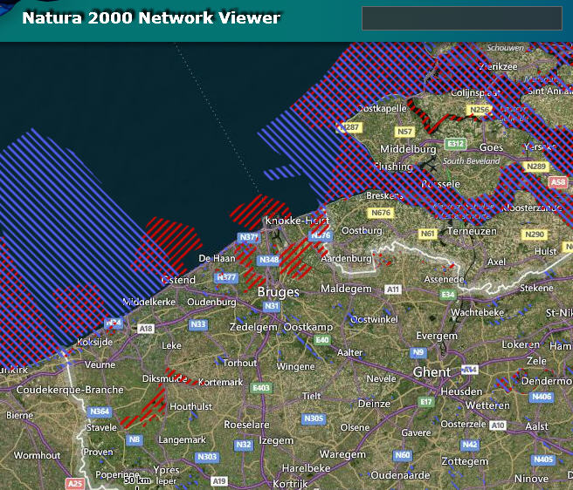
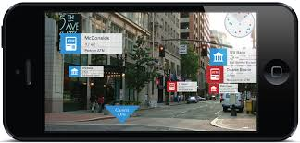
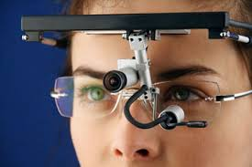
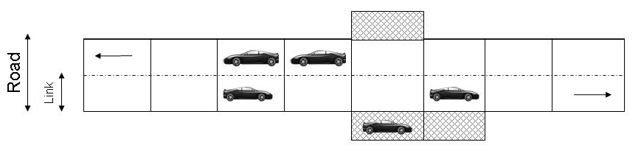
Spatial Applications Division (SADL)
One of the 77 Divisions under KU Leuven R&D
  25 years ‘young’
Knowledge and Technology Transfer in the GI S&T domain
  > 250 national and international projects with > 200 international partners

Slide 15

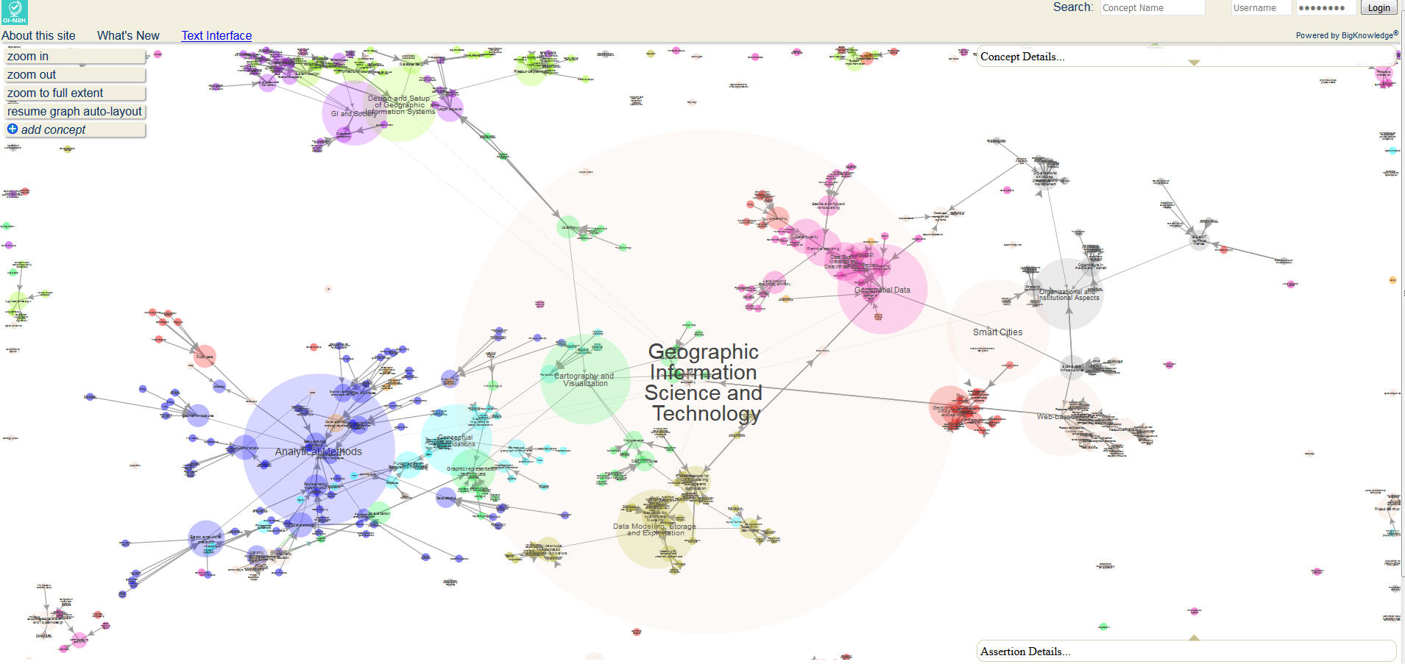
Example: Erasmus+ BESTSDI project
Ka2 CBHE in the Western Balkan
  Capacity Building in the field of Higher Education
    5 partners from programme countries
    11 partners from partner countries
    3 Associated partners
New education and research
Projects being prepared
Improve quality in higher education in the GI S&T field and enhance its relevance for the labour market
Develop, test and adapt new curricula, courses, learning material and tools in the field of Spatial Data Infrastructures (SDI)

Slide 16

Spreading excellence and widening participation
Lessons learned, the KU Leuven (SADL) perspective
Even if KU Leuven is big and offers many opportunities and support, none of its single entities can operate in isolation
Collaboration in H2020, Erasmus+ … is not a question of uni-directional transfer of knowledge and experience, it is bi-directional
It generates new opportunities: new partners, new ideas, new proposals …
There is a need for multi- and interdisciplinary approaches in a networked environment
Innovation is only possible through internationalisation

Slide 17

Spreading excellence and widening participation
To-do’s (or not-to-do’s), the widening partner perspective
Start from your strengths and interests, and believe you have something to offer at the international scene
Also look at smaller opportunities, even ‘low hanging fruit’, which can result in tangible results in the ‘short’ term; ‘big’ H2020 proposal should go hand-in-hand with small initiatives
Work in an Agile way, focus on joining dynamic eco-systems in your field so that others ‘know’ you …
Do not always work with the same partners, but establish consortia / networks that best match the needs

Slide 18

Thank you!
danny.vandenbroucke@kuleuven.be
18

