Slide 1

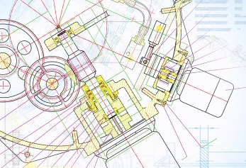
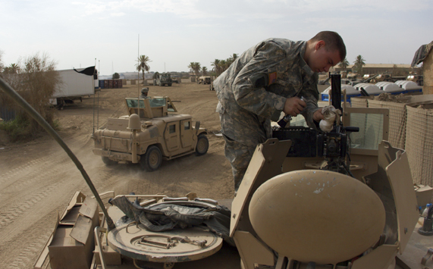



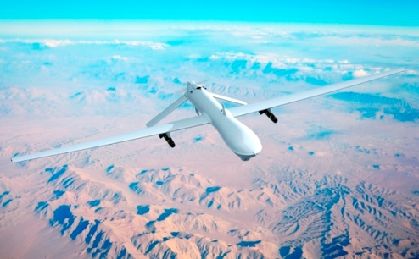





Maritime Network
Defence Network
Innovation Network for Production
“Inno-Pro”
Center for Defence, Space & Security
Aerospace
Network
Klaus Bolving, CEO, CenSec
klaus@censec.dk
+45 5213 1540
www.censec.dk
Cyber Security
Network
Homeland Security
Network
Space Network

Slide 2
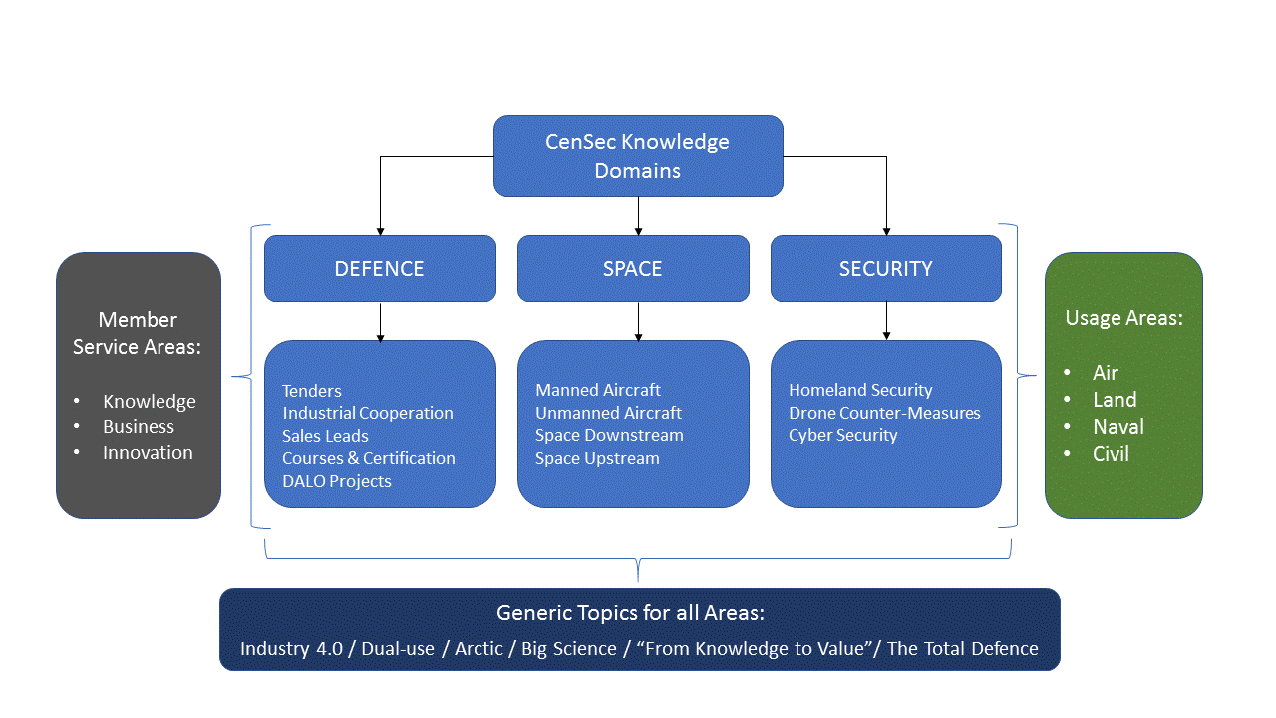
CenSec’s Strategic Focus

Slide 3
CenSec Business Cluster Concept
Leads
Network
B2B/B2G
B2A/G2A
Projects
Go-to-Market
New
Innovative Business & Capabilities
Business Comfort Zones
aa
Hand-in-hand
Quick Business
Market
Intelligence
Competence
Development
Project
Development
Business

Slide 4
Annual Defence Conference
Defence Industrial Course
European Network of Defence-Related Regions
Match-making
Business Missions
KETs4Dual-use (COSME)
Match-making
Business Missions
Maritime Network
Defence Network
Innovation Network for Production
“Inno-Pro”
National Cyber Security Platform
Building a Trans-Atlantic Cyber Security Bridge
Match-making
Business Missions
Drone applications and usability in industry Facilities
Counter Drone Project
Match-making
Business Missions
Center for Defence, Space & Security
Aerospace
Network
Cyber Security
Network
Annual Homeland Security Conference
Classified Products Network
Match-making
Business Missions
Growth in Space Upstream/Downstream
Match-making
Business Missions
Homeland Security
Network
Space Network

Slide 5
Maritime Network
Defence Network
Innovation Network for Production
“Inno-Pro”
Thanks for your Attention
Aerospace
Network
Klaus Bolving, CEO, CenSec
klaus@censec.dk
+45 5213 1540
www.censec.dk
Cyber Security
Network
Homeland Security
Network
Space Network

