Slide 1
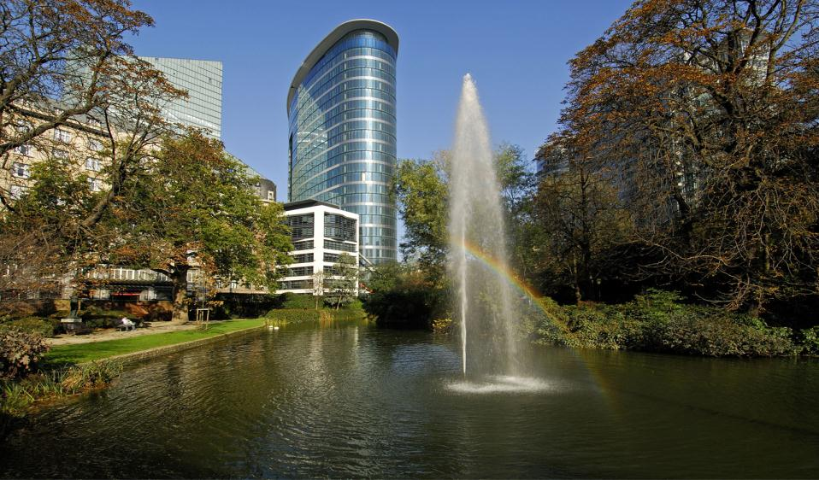
The European Research Council
Challenges and Opportunities
for Research in Europe:
ERC Perspectives
Jean-Pierre BOURGUIGNON
ERC President
© Art & Build Architect / Montois Partners / credits: S. Brison

Slide 2
What is the European Research Council?
A bottom-up, individual-based, pan-European competition with host institution in EU or Associated Countries.
Support for individual scientists
International peer-review
No predetermined subjects (bottom-up)
Support for frontier research in all fields of science and humanities
Look for high gain/high risk ambitious projects
Strategy
Scientific governance by an independent 22-member
Scientific Council, which has full authority over funding and evaluation
Support by the ERC Executive Agency (autonomous)
Only criterion: quality of research aiming for excellence
Legislation

Slide 3
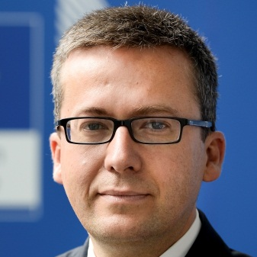
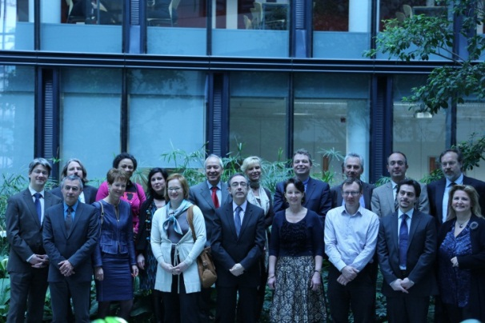
ERC Structure
The European Commission
Provides financing through the EU framework programmes
Guarantees autonomy of the ERC
Assures the integrity and accountability of the ERC
Adopts annual work programmes as established by the Scientific Council
The ERC Scientific Council
Up to 22 established researchers proposed by an independent identification committee
Appointed by the Commission (4 years, renewable once)
Establishes overall scientific strategy; annual work programmes (incl. calls for proposals, evaluation criteria); peer review methodology; selection and accreditation of experts
Controls quality of operations and management
Ensures communication with the scientific community
The ERC Executive Agency
Executes annual work programme as established by the Scientific Council
Implements calls for proposals and provides information and support to applicants
Organises peer review evaluation
Establishes and manages grant agreements
Administers scientific and financial aspects and follow-up of grant agreements
Carries out communications activities and ensures information dissemination
to ERC stakeholders

Slide 4
ERC in the H2020 Structure
The HORIZON 2020 main components:
Excellent Science
World class science is foundation of technologies, jobs, well-being
Europe needs to develop, attract, retain research talent
Researchers need access to the best infrastructures
Industrial leadership
Societal challenges
Excellent Science:
European Research Council
Future and Emerging Technologies
Marie Skłodoswka Curie Actions
Research Infrastructures
│ 4

Slide 5
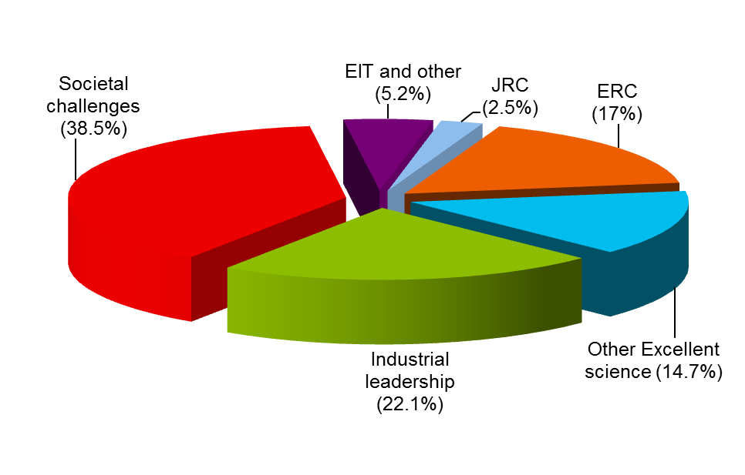
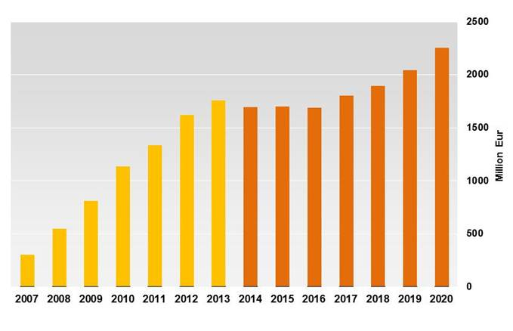
ERC H2020 Budget
ERC Budget € 13 billion

Slide 6
ERC Grant Schemes
Starting Grants
starters
(2-7 years after PhD) up to € 1.5 Mio
for 5 years
Consolidator Grants
consolidators
(7-12 years after PhD) up to € 2 Mio
for 5 years
Advanced Grants
track-record of
significant research
achievements in the
last 10 years
up to € 2.5 Mio
for 5 years
Proof-of-Concept
bridging gap between research - earliest stage of marketable innovation up to €150,000 for ERC grant holders

Slide 7
Creative Freedom to Individual Grantees
ERC offers independence, recognition & visibility
to work on a research topic of own choice, with a team of own choice
to gain true financial autonomy for 5 years
to negotiate with the host institution the best conditions of work
to attract top team members (EU and non-EU) and collaborators
to move with the grant to any place in Europe if necessary (portability of grants)
to attract additional funding and gain recognition; ERC is a quality label
│ 7
Notes:
7

Slide 8
Evaluation Panel Structure 2016
Physical Sciences & Engineering
PE1 Mathematics
PE2 Fundamental Constituents of Matter
PE3 Condensed Matter Physics
PE4 Physical and Analytical Chemical Sciences
PE5 Synthetic Chemistry and Materials
PE6 Computer Science and Informatics
PE7 Systems and Communication Engineering
PE8 Products and Process Engineering
PE9 Universe Sciences
PE10 Earth System Science
Life Sciences
LS1 Molecular and Structural Biology and Biochemistry
LS2 Genetics, Genomics, Bioinformatics and Systems Biology
LS3 Cellular and Developmental Biology
LS4 Physiology, Pathophysiology and Endocrinology
LS5 Neurosciences and Neural Disorders
LS6 Immunity and Infection
LS7 Diagnostic Tools, Therapies and Public Health
LS8 Evolutionary, Population and Environmental Biology
LS9 Applied Life Sciences and Non-Medical Biotechnology
Social Sciences and Humanities
SH1 Individuals, Markets and Organisations
SH2 Institutions, Values, Environment and Space
SH3 The Social World, Diversity, Population
SH4 The Human Mind and Its Complexity
SH5 Cultures and Cultural Production
SH6 The Study of the Human Past
│ 8

Slide 9
How Are the Proposals Evaluated?
STEP 1
STEP 2
Remote assessment by Panel members of section 1, part B1: synopsis and PI
Remote assessment by Panel members and reviewers of full proposals: part B1+ B2
Panel meeting
Panel meeting
StG & CoG: Interviews
Proposals rejected
(score B & C)
Proposals retained
for step 2 (score A)
Ranked list of proposals (scores A & B)
Feedback to
applicants
Redress

Slide 10
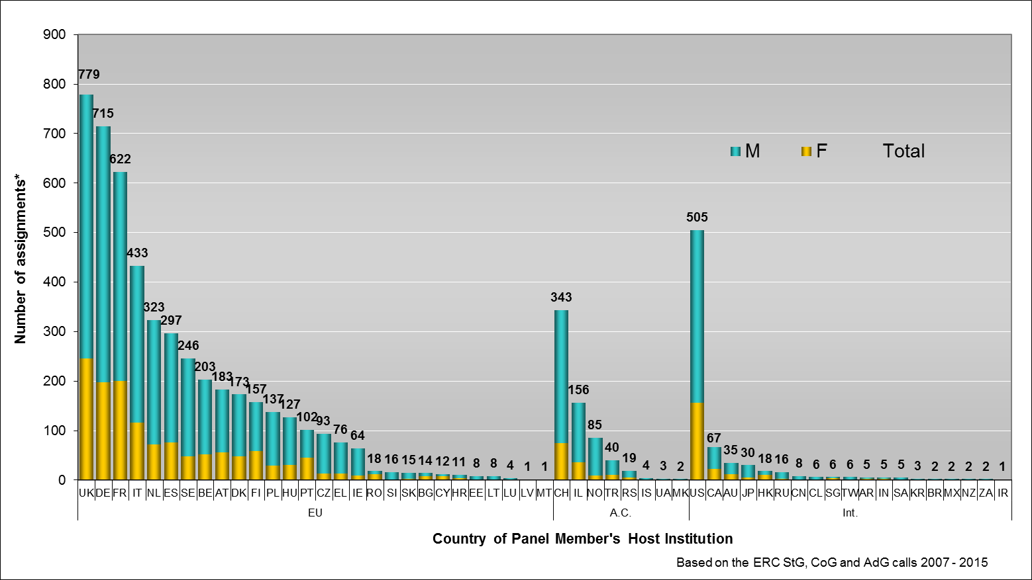
Panel Members by Country and Gender
Averaged over the first 19 ERC calls 27% of the ERC panel members were women
│ 10
* Number of instances that experts of a certain country are contributing to the ERC peer review

Slide 11
ERC Calls Planning
ERC calls | Budget | Call Publication | Submission Deadline(s)
Advanced Grants ERC-2016-AdG | 540 M€ | 24 May 2016 | 1 September 2016
Proof of Concept ERC-2016-PoC | 20 M€ (3 deadlines) | 22 October 2015 | DL3: 4 October 2016
Starting Grants* ERC-2017-StG | 605 M€ | 19 July 2016 | 18 October 2016
Consolidator Grants* ERC-2017-CoG | 575 M€ | 20 October 2016 | 9 February 2017
Advanced Grants* ERC-2017-AdG | 567 M€ | 16 May 2017 | 31 August 2017
Proof of Concept* ERC-2017-PoC | 20 M€ (3 deadlines) | 19 July 2016 | DL1: 19 January 2017
*) indicative summary; pending the approval of WP2017

Slide 12
ERC Achievements

Slide 13
After 9 Years, a Success Story
Highly recognised by the research community
Over 6000 top researchers funded
65% are at an early-career stage
67 nationalities represented among the grant holders
Working in almost 677 different institutions in 32 countries
Over 40000 researchers and other professionals working in ERC teams
More than 10 billion Euros spent since the creation of ERC
Efficient and fast grant management

Slide 14
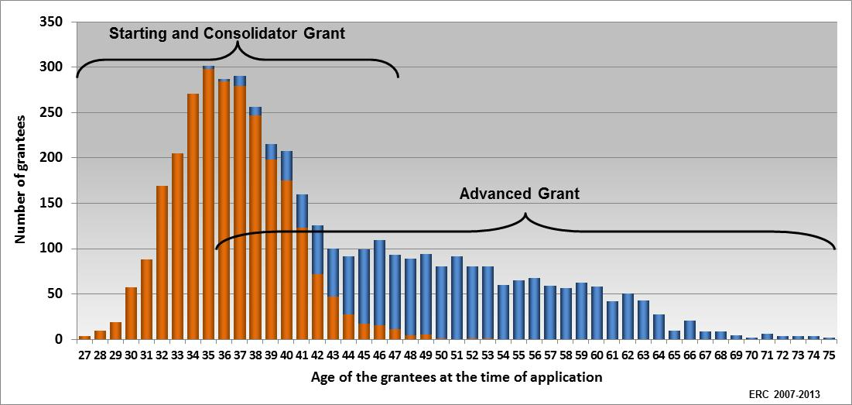
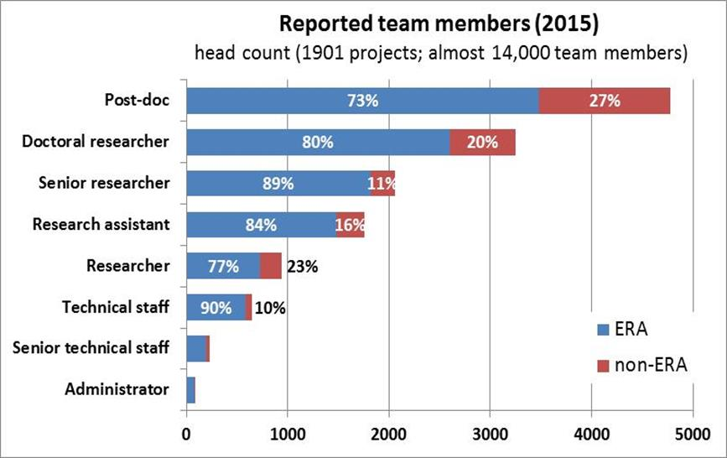
Priority to Young Scientists
+ 30 000 PhD and post-doc researchers working in ERC teams.
Two-thirds of ERC grants to early-stage Principal Investigators.

Slide 15
ERC Delivers
71% of the first 200 completed ERC-funded projects made scientific breakthroughs and major advances in science (as judged by panels of peer reviewers)
7% of the ERC-acknowledging publications were among the top 1% most cited in their scientific field and publication year
20% of completed LS and PE projects reported at least one patent (on average 2 patents reported per project)

Slide 16
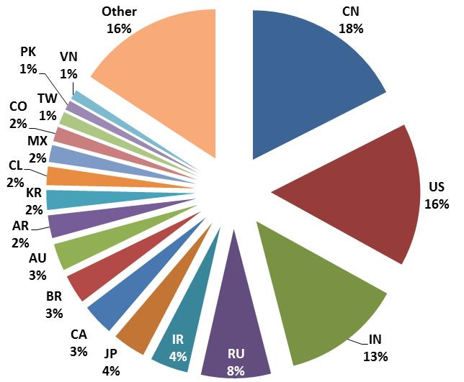
Attracting Researchers to Europe
Nationality of ERC project teams (PIs not included)
Analysis of 1,901 Starting and Advanced Grants
EU: 71%
Assoc. Countries: 10%
non-ERA: 17%
unknown: 2%
In all ERC grants
+ 7,500 non-ERA team members
most from
China, US, India, and Russia

Slide 17
ERC Projects in Slovenia

Slide 18
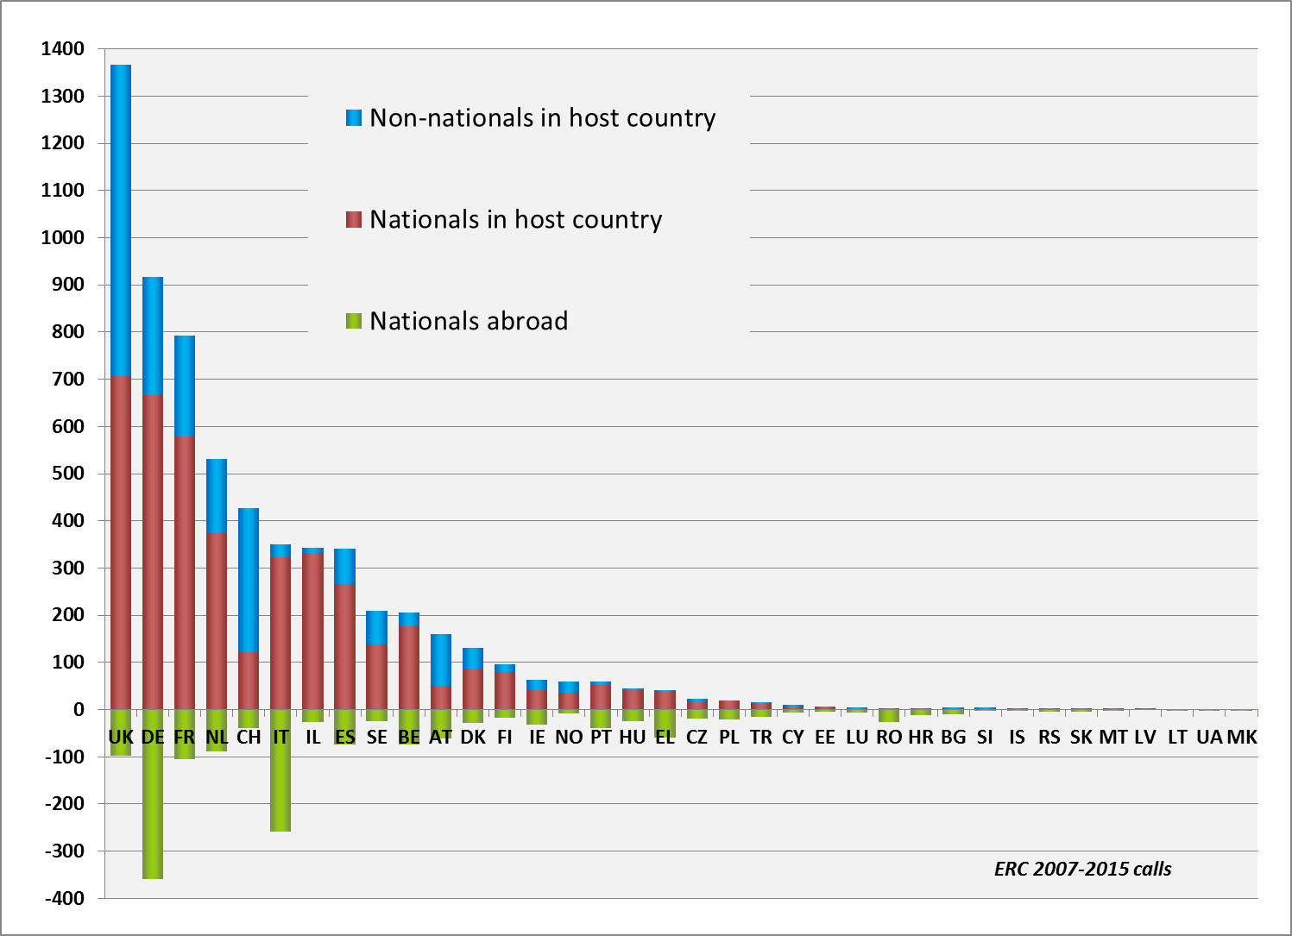
Grantees at Home and Abroad
2 Slovenian PIs abroad. in UK (2 consecutive grants) and Norway

Slide 19
The European Research Council
More information: erc.europa.eu
National Contact Point: erc.europa.eu/national-contact-points
Sign up for news alerts: erc.europa.eu/keep-updated-erc
Follow us on
www.facebook.com/EuropeanResearchCouncil
twitter.com/ERC_Research
www.linkedin.com/company/european-research-council

