Slide 1
Research and Innovation Funding in Slovenia
prof. dr. József Györkös
Director
Slovenian Research Agency (ARRS)
Brussels, May 2015

Slide 2
Contents:
  General Introduction
  National Funding of R&I in Slovenia (ARRS‘ Funding)
  ARRS´ Portfolio – Basic and Applicative Research
  International Cooperation
  Slovenian Cooperation in Horizon 2020
  Conclusions

Slide 3
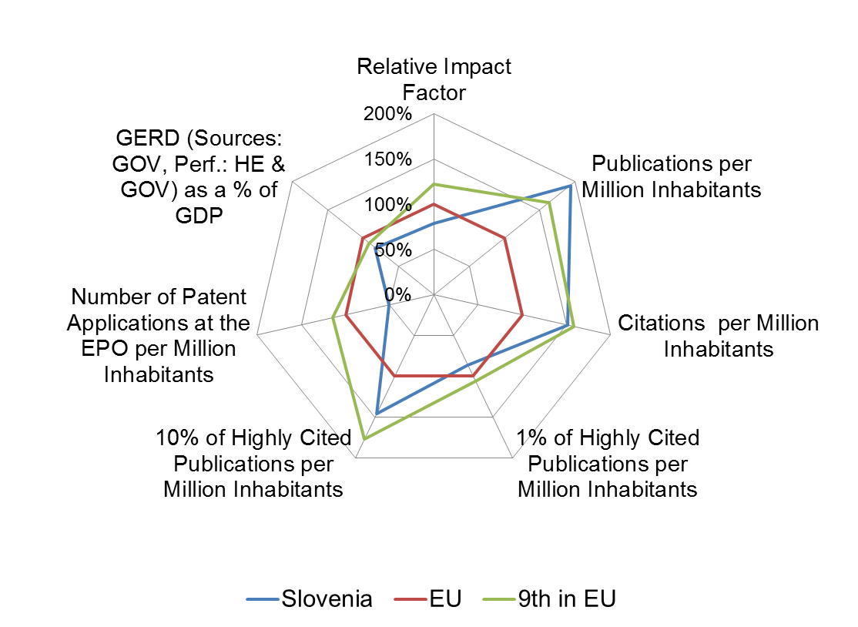
Slovenia: Key Indicators
General Introduction

Slide 4
  National Funding of R&I in Slovenia (ARRS‘ Funding)

Slide 5
  ARRS´ Portfolio – Basic and Applicative Research

Slide 6
  International Cooperation - 1

Slide 7
  International Cooperation - 2

Slide 8
  Slovenian total of received funds: 22,4 mio EUR [LU – 7,5; DE – 771,1]
  Slovenian Cooperation in Horizon 2020

