Slide 1
Brussels – 8th of October – Open days – European Commission
SMART-SPACE project presentation
Jean Jacques BERNARDINI – Head of Department Europe and Innovation - Grand E-nov

Slide 2
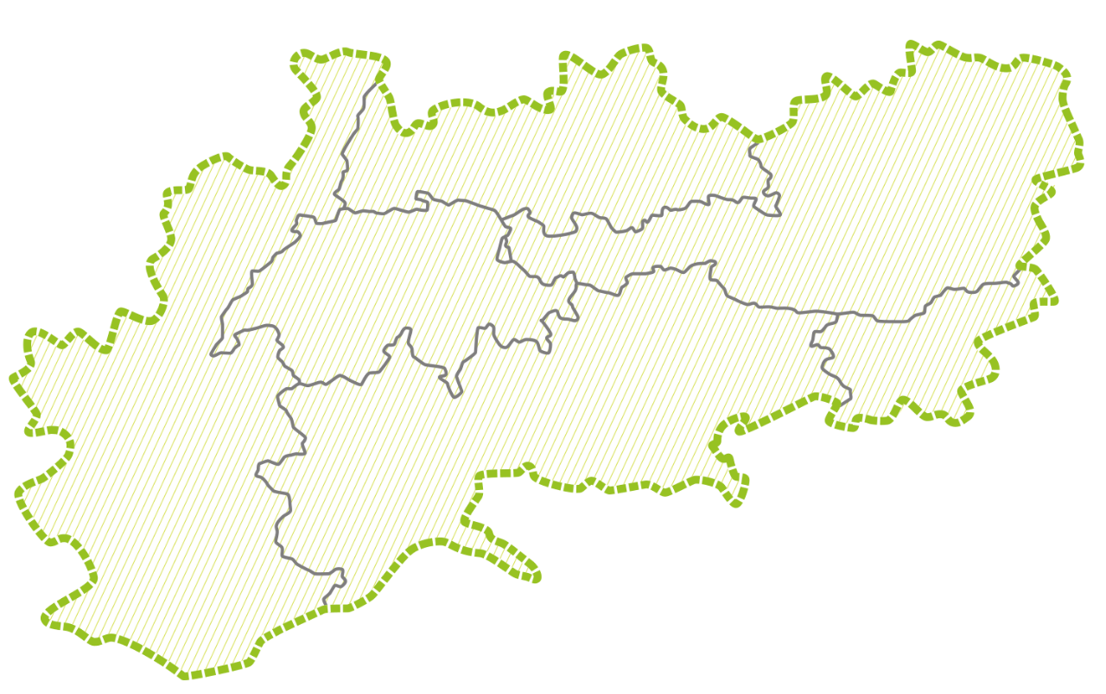














THE PARTNERSHIP AND THE AREAS
2 partners
5 observers
2 areas
2 partners
4 observers
2 areas
1 partners
1 observers
1 area
4 partners
4 observers
3 areas
3 partners
3 observers
3 areas

Slide 3

SMART SPACE overall objective
SMART-SPACE project addresses to clusters, SMEs from traditional sectors (mechanical, textile and chemical) and all innovation actors to strengthen the application of digital technologies and eco-innovation procedures to processes and products, increasing the competiveness and the potential for business innovation.

Slide 4

SMART-SPACE results/impact
Policy makers and Innovation stakeholders integrate smart manufacturing innovation processes within the AS industrial system with a shared-model of sustainable growth
Public and Private intermediaries increase their competence to assist SMEs from traditional sectors to finalise smart innovation processes
SMEs from traditional industrial sectors are assisted in adopting the digital technology and added value-services to improve their products and their business model

Slide 5
SPECIFIC OBJECTIVES
Participation of Innovation Actors
SMART SPACE strategy
AS Strategic Partnership
Develop Intermediaries’ competence
Training activities
Awareness activities
Promote Innovation processes
SMEs assisted to identify smart solution on product, services, etc
Tools/services available
Opportunities of cooperation (S3; OP ERDF)

Slide 6
SMART-SPACE
PROJECT FRAME
SMEs needs assessment and definition of their maturity level toward digitisation processes
Training actions addressed to operators and cluster managers
ALPINE DIGITAL INNOVATION HUB implementation:
Services addressed to SMEs
Training for Intermediaries(BIOs’ operators and Clusters)
Model of cooperation and financial tools to support Industry 4.0
Intermediaries competence and learning needs investigation – CV profile elaboration
Pilot Action addressed to SMEs: relationships with COMPETENCE CENTRE and new project/services and joint cooperation with SMEs
Policies and networking: needs, potentialities and expectations
National and Alpine pilot addressed to Regional Authorities to strengthen the cooperation on Industry 4.0 topics

Slide 7
SMART-SPACE LOGICAL ROADMAP
ANALYSIS
State of the art
SWOT
Implementation
Tools&services
Training contents
Awareness and Piloting
Intermediaries
SMEs
Awareness
methodologies
Stakeholders
Follow-up
AS strategy
AS DIH
AS strategic partnership

Slide 8
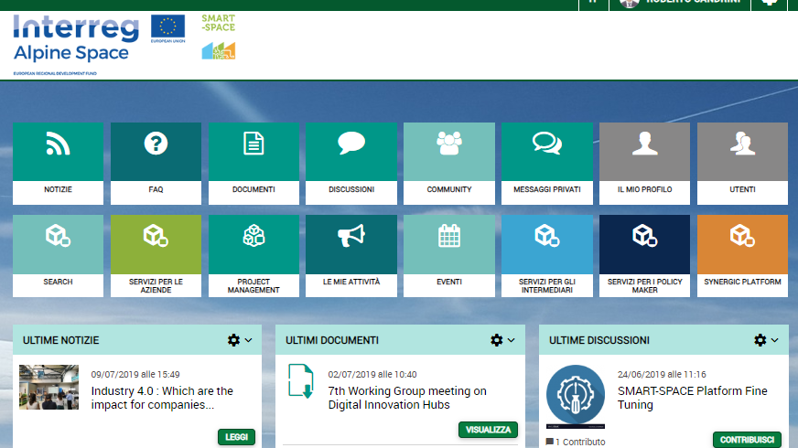

SMART SPACE DIGITAL INNOVATION HUB PLATFORM
www.smartspacehub.eu

Slide 9
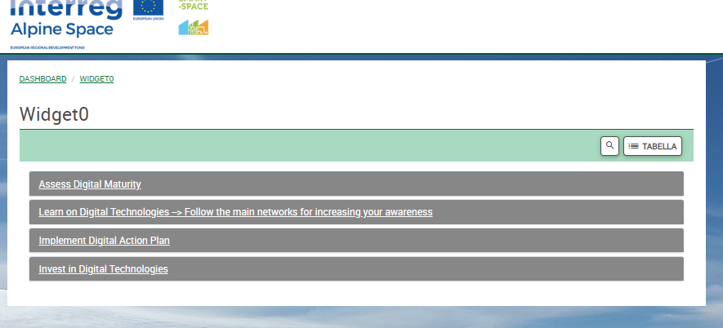
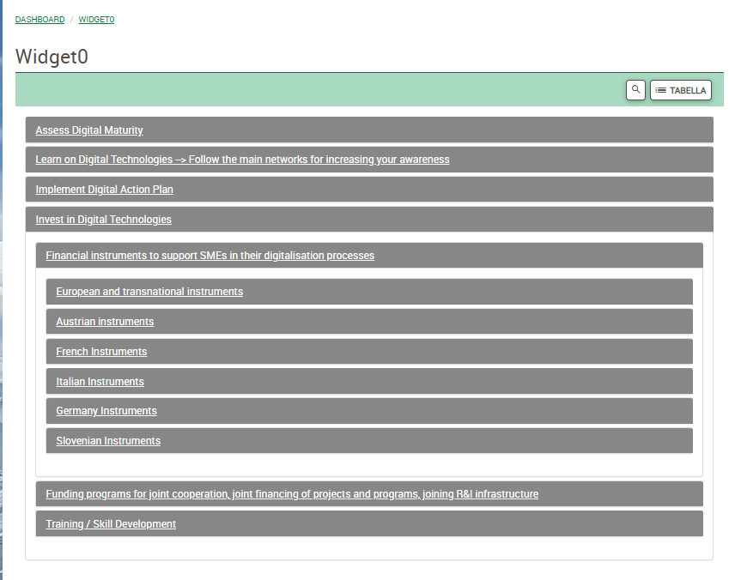
TOOLS to support smeS

Slide 10
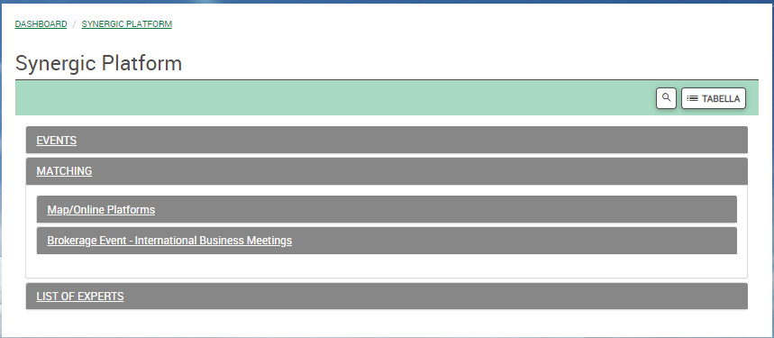
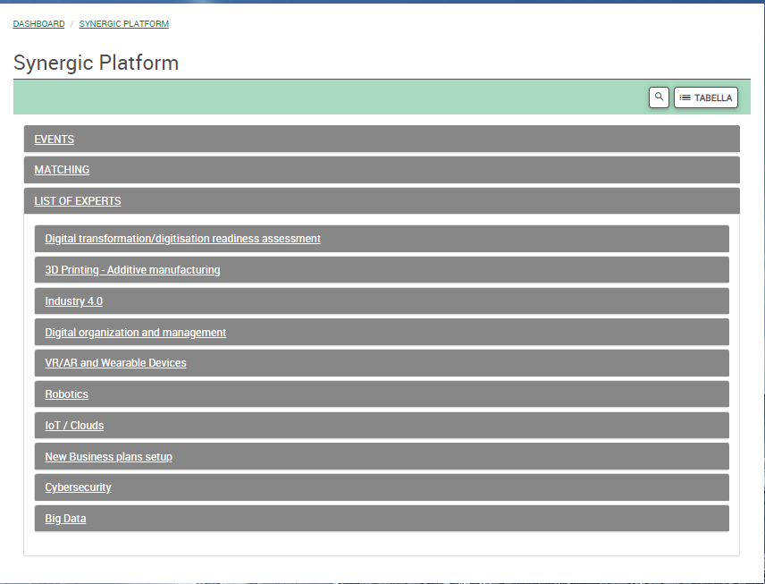
TOOLS TO SUPPORT SMEs-2

Slide 11
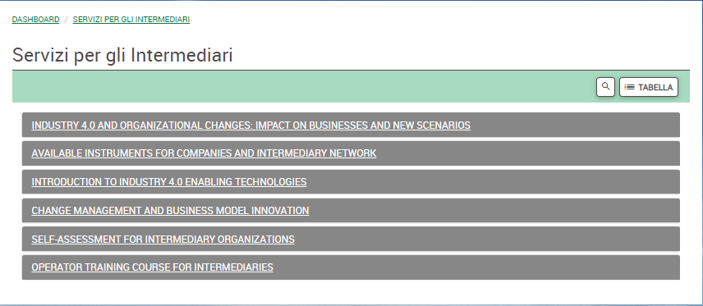
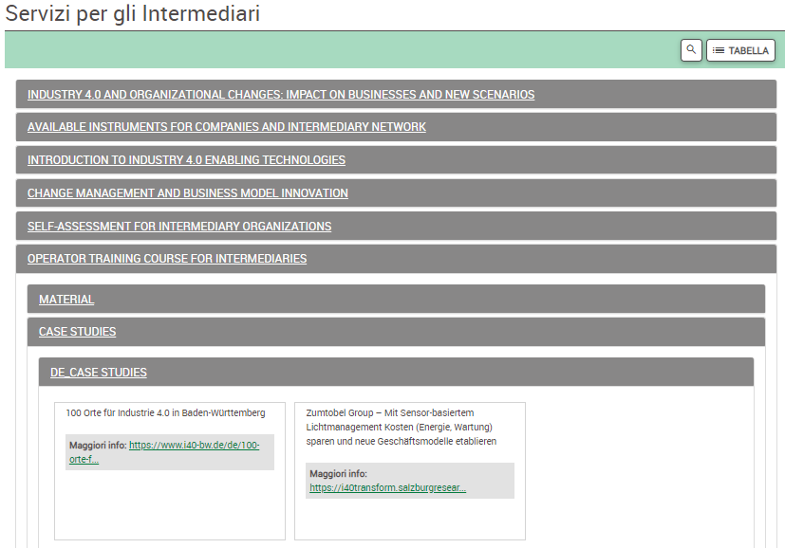
Tool to support intermediarY organizations

Slide 12
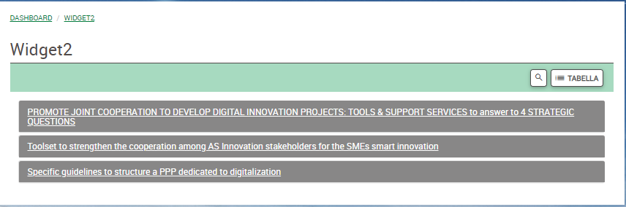
Tool to support policy makers

Slide 13
..some DATA FOR AN OVERVIEW
Topic | data
AS public actors involved to develop the SMART SPACE strategy | 40
Innovation intermediaries trained (train the trainers and local training) | 50
SMEs involved and assisted (national and transnational level) | 300
Pilot actions addressed to SMEs | 11
Pilot action(national) addressed to stakeholders and policy makers | 5
Pilot action (transnational) addressed to stakeholders and policy makers | 1
Meetings with the Observers | 4

Slide 14




Pilot Action and feasibility study
What are Digital Innovation Hubs in practice?
Why everyone is concerned about DIH and can benefit from it?
➔ Comparison of European initiatives and DIHs in
How and why to set up cooperations between DIH at EU level?

Slide 15
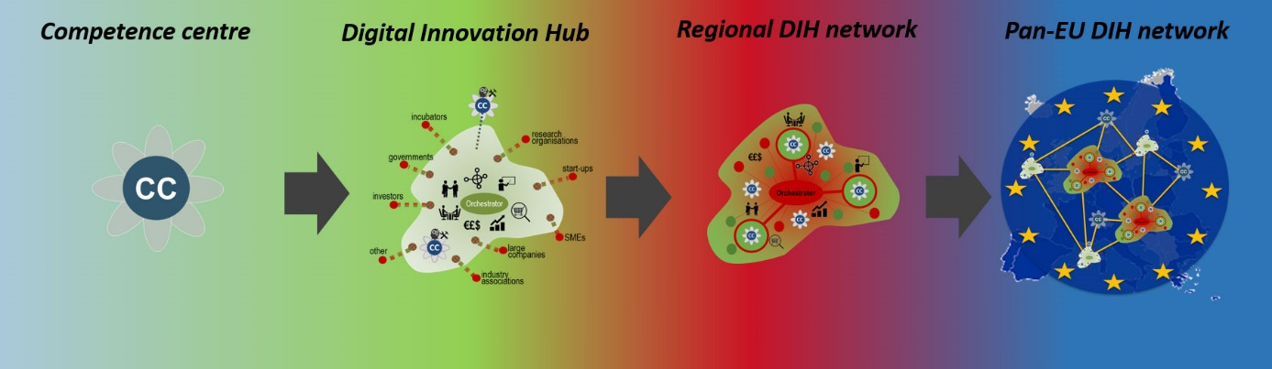

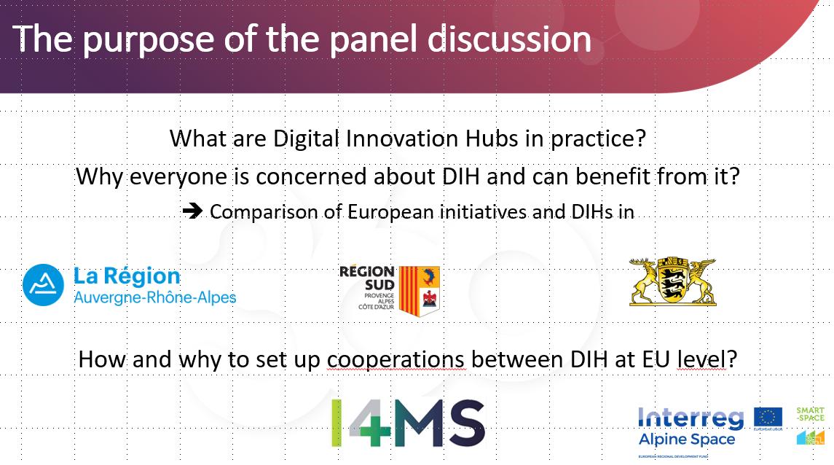
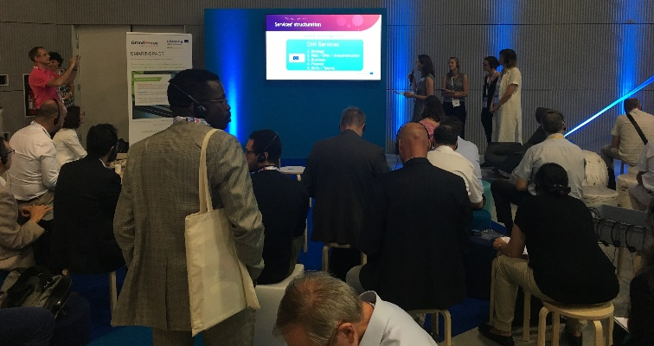

DIH Concept and Evolution
Only a pan-European network of DIHs could offer the best possible support regardless of the technological domain and removing any constraints linked to regional capacities
Digital Innovation Hub :
L’Europe au service de votre transformation digitale

Slide 16
Grand E-nov
www.grandenov.fr
jj.bernardini@grandenov.fr

