Slide 1


AI supporting the DIME-PEMSII-ASCOP framework
AI for Military Operations Planning
István Szabadföldi
Doctoral School of Military Engineering
National University of Public Service, Hungary

Slide 2
Research objective:
Military OPLAN supported by AI
With regard to strategic and operational military planning, the use of AI is intended to play a crucial role in PMESII (Political, Military, Economic, Social, Infrastructure, Information) methodology and in the selection and evaluation of the expected impact of the developed Course of Actions (COAs).
The objective of the research is to explore and present these possibilities.

Slide 3
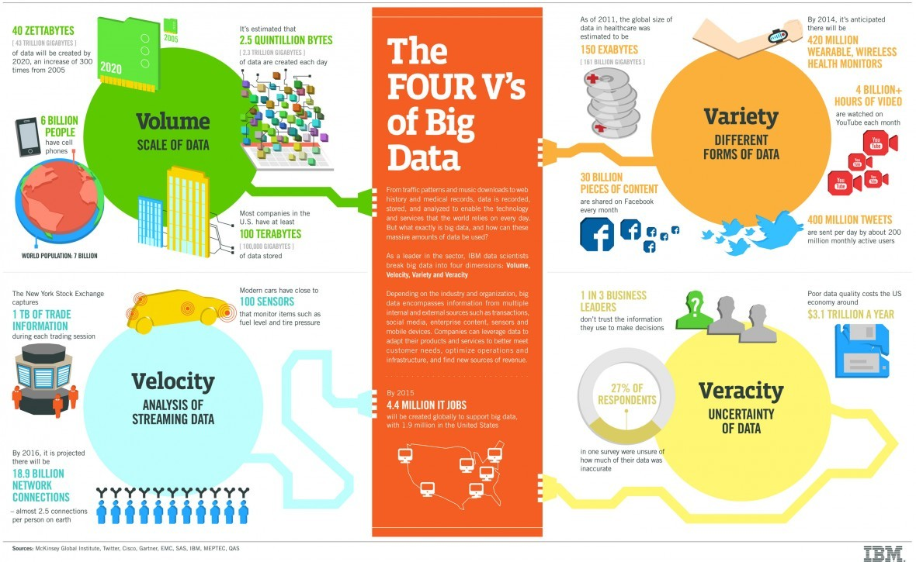
& the 5th challenge: VALUE

Slide 4
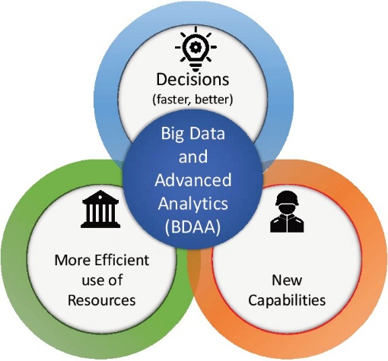
AI and Big Data Advanced Analytics
(BDAA) in defense
- collection (sensors);
- communication;
- analysis;
- decision making

Slide 5
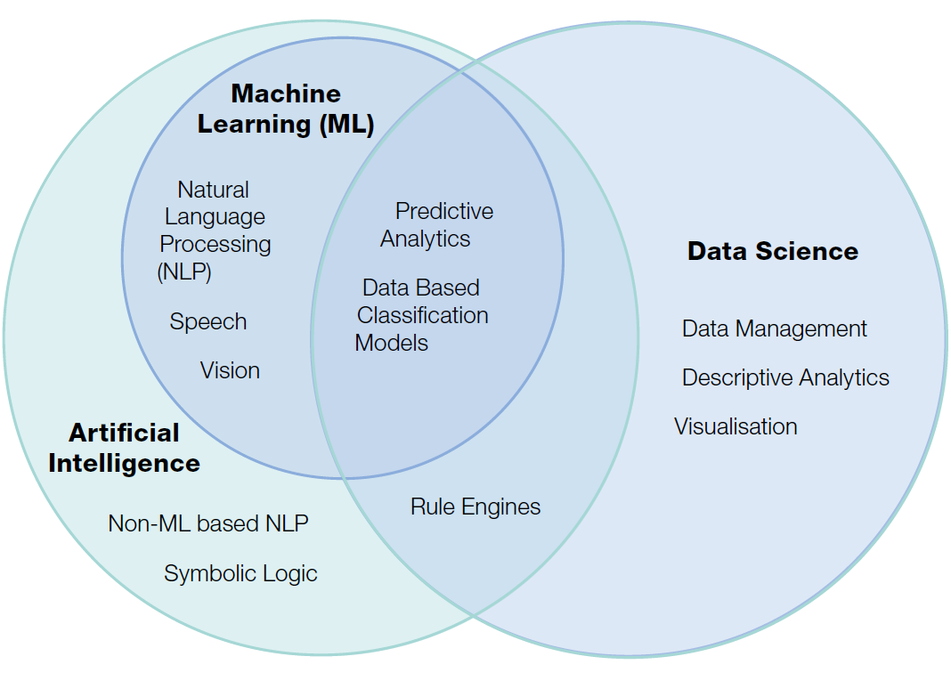
The relationship between AI, Machine Learning and Data Science
(Source: The_Dstl_Biscuit_Book_WEB,

Slide 6
Expectations for AI solutions in Military
Intelligent - to exploit integrated AI, knowledge-focused analytic capabilities, and symbiotic AI/human intelligence to provide disruptive applications across the technological spectrum.
Interconnected – to exploit the network of virtual and physical domains, including networks of sensors, organizations, individuals and autonomous agents, linked via new encryption methods and distributed ledger technologies (blockchain).
Distributed - to employ decentralized and ubiquitous large-scale sensing, storage, and computation to achieve new disruptive military effects.
Digital - to digitally blend human, physical and information domains to support novel disruptive effects.
(Source: ‘NATO 190422- ST_Tech_Trends_Report_2020-2040.pdf p. 6)

Slide 7
AI applications in Military fall into three categories:
- tactical
- operational
- strategic
AI based systems
At the strategic level, the use of AI can influence how the military leadership organizes its order, force grouping, war strategies, decisions on the scale and escalation of conflict, intelligence sharing and interpretation, the extension and nature of war, the consequences of using special means, etc.

Slide 8
The primary reasons for using AI-based military systems are:
- effective decision support,
- handling large amounts of data,
- situational awareness,
- visualizing a changing scenario,
- and generating appropriate responses.
In the field of military application, AI C2 systems can provide critical support if time is limited or if the number of options is too large for one to analyze alternatives for action.

Slide 9
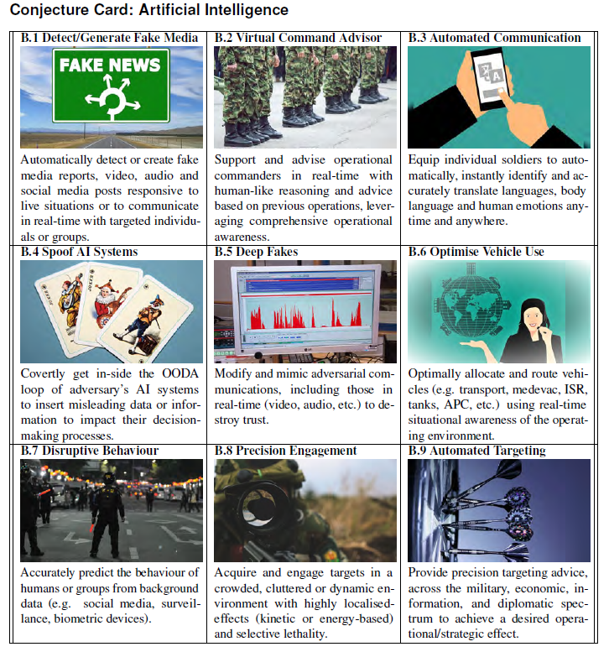
Presumption of the applications of AI in Military
(Source: NATO 190422-ST_Tech_Trends_Report_2020-2040

Slide 10
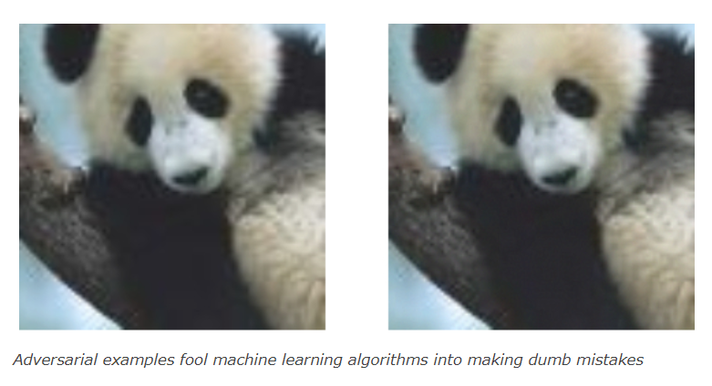
The right image is an “adversarial example.” It has undergone subtle manipulations that go unnoticed to the human eye while making it a totally different sight to the digital eye of a machine learning algorithm.
Adversarial ML
To human observers, the following two images are identical. But researchers at Google showed in 2015 that a popular object detection algorithm classified the left image as “panda” and the right one as “gibbon.” And oddly enough, it had more confidence in the gibbon image.
The algorithm in question was GoogLeNet, a convolutional neural network architecture that won the 2014 ImageNet Large Scale Visual Recognition Challenge (ILSVRC 2014).

Slide 11
EBO - effects that may - with different degrees of probability - be achieved through diplomatic, psychological, military, or economic actions
(DIME actions).
EBO’s system-wide view considers not just military effects, but also political, economic, social, information, and infrastructure effects
(PMESII effects)
A State decides to influence another State
with
Effects-based operations (EBO)
- a methodology for planning, executing, and assessing operations to attain the effects required to achieve desired national security objectives.
-a holistic view - considers the full range of direct, indirect, and cascading effects

Slide 12
Military Operations
Hybrid Warfare
–
According to the Gerasimov Doctrine.

Slide 13
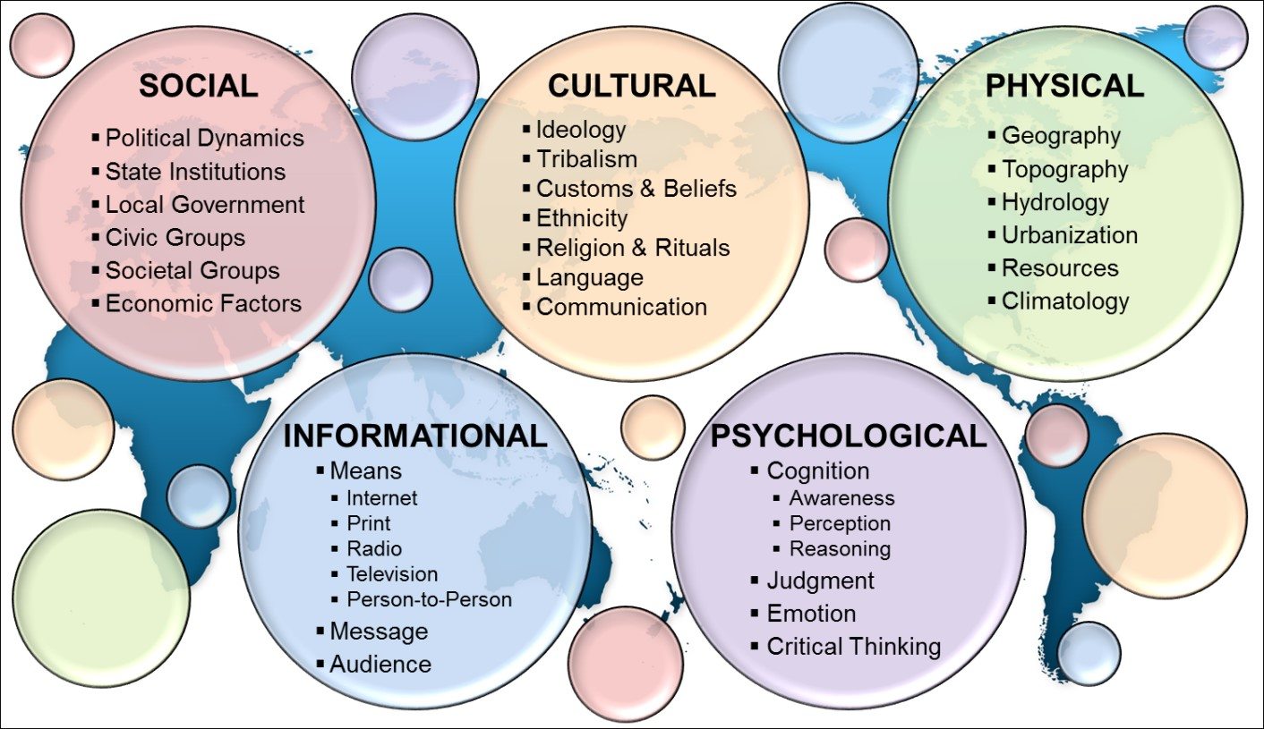
Understanding the Operational Environment – Key to Success
Sociocultural Aspects (U.S., 2015)

Slide 14
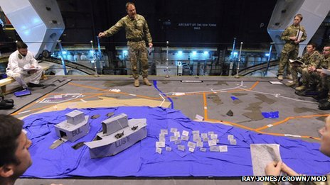
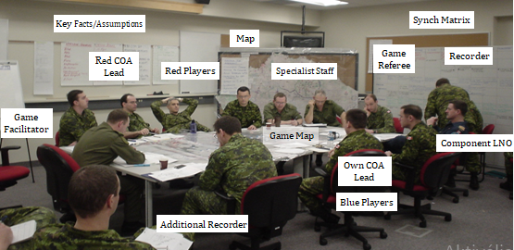
OPLAN
War Game
- Modeling is a conscious attempt to predict the course of an operation. Try to predict the activities, reactions, counter-reactions, the operation, the dynamics of combat.
- The war game is conducted in order to collide the developed action variants with the action variants of the opposing party and to clarify the cooperation.

Slide 15
The evaluation of the expected impact of the planned COA is built along the DIME/PMESII/ASCOP framework
The DIME: Diplomacy, Information, Military and Economy.
PMESII describes the operational environment in six domains: Political, Military, Economic, Social, Information and Infrastructure.
ASCOPE encompasses Areas, Structures, Capabilities, Organization, People and Events.
In addition, the aspects of information collection requirements (ICR) and information capabilities requirements (ICR)
We can refer to as
DIME/PMESII/ASCOP/ICR2.

Slide 16
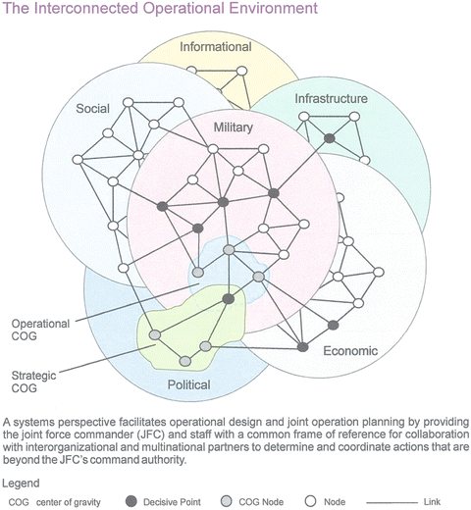
PMESII – The interconnected Operational Environment
Objectives:
Influence on Center of Gravity (COG)
Strategic – Political domain
Operational – Military domain

Slide 17
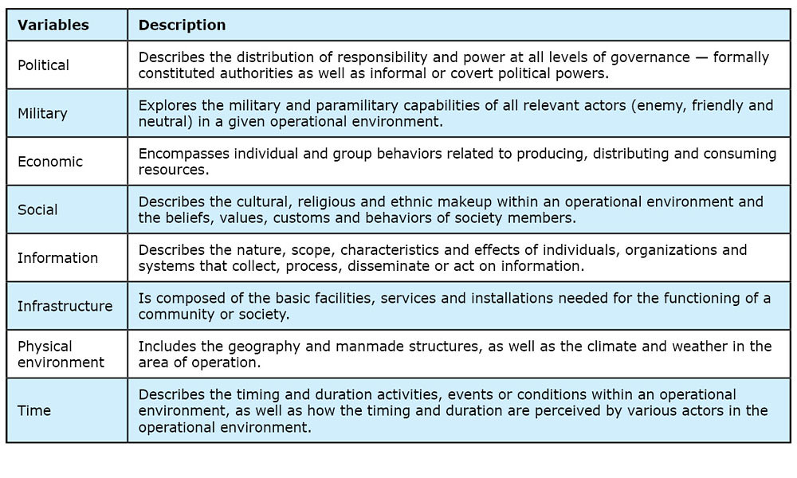

Slide 18
Three levels of warfare:
- strategic
- operational
- tactical military strategy is the highest level - as the ‘orchestration of war’
Military operations - achieving political and strategic objectives of the states
AI is to be applied in each level

Slide 19
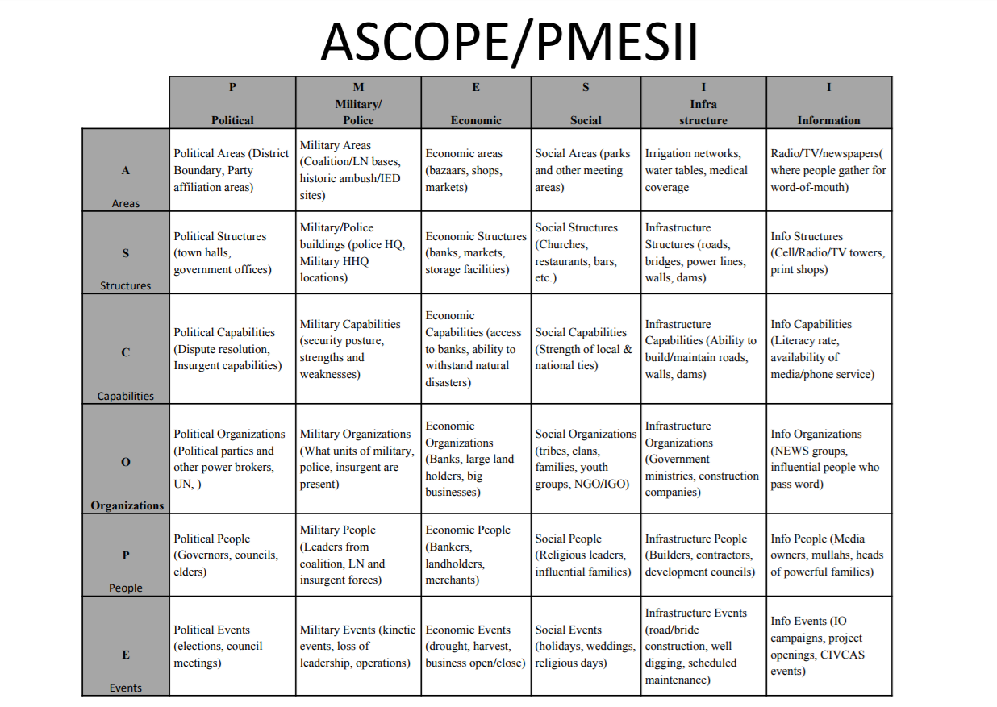

Slide 20
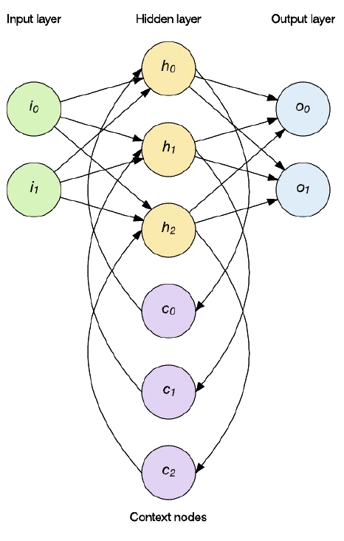
Using the PMESII/ASCOPE matrix
and consider the
PMESII variables: Political, Military, Economic, Social, Information and Infrastructure.
and the
ASCOPE variables: Areas, Structures, Capabilities, Organization, People and Events.
as inputs to a Deep Neural Network AI technolgy
The result would be a more close-to-reality set of scenarios used for simulation and modelling

Slide 21
Proposed Architecture for Maritime Artificial Intelligence System.
Source: ARTIFICIAL INTELLIGENCE AT THE OPERATIONAL LEVEL OF WAR, LCDR Steven I. Davis, U.S. Navy

Slide 22
Conclusion
AI is opening up new perspectives in Military OPLAN and generally in defense technologies.
The outcome of the research has dual usage opportunity since the methodology and algorithms developed may be applicable in other governmental policy development like new healthcare policy, foreign trade contract, etc.

Slide 23

SZABADFÖLDI István
Thank you for your attention! istvan.szabadfoldi@bancraft.eu
+36-30-864-8523 www.bancraft.eu

