Slide 1


Republic Slovenia, Municipality of Maribor
Project : wcycle
Urban Circular Economy Center
Cabinet of the Mayor
Brussels, 12.10.2016

Slide 2
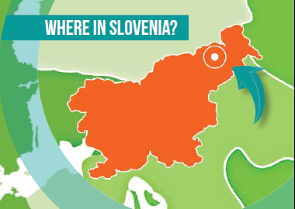
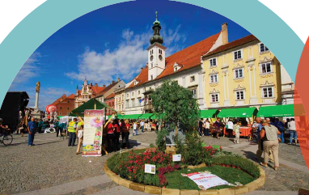
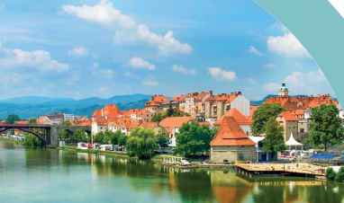

WHO AND WHERE WE ARE
MARIBOR

Slide 3
PROJECT WCYCLE
WHAT IS THE WCYCLE PROJECT
Wcycle is a strategic development project of the Municipality of Maribor in the field of integrated management of all waste generated in the region on the basis of circular economy policy, energy and water management and the use of processed waste as a new resource
PROJECT APPROACH
Defining the project‘s baseline
Determining the project objectives
Designing the organizational model

Slide 4
PROJEKT BASELINES
BASIS FOR THE PROJECT AND THE ORGANIZATIONAL
MODEL
The city does not have a landfill site and does not want to have one, also does not want to dispose waste of by incineration
In the process of recovery are to be included all types of waste resulting from the population, utilities, construction, industry, agriculture and water management
The advantage of processing is the material recovery - recycling, followed by use in energy and, as a last, production of new composites
Recovery operators for specific project pillars are the companies owned by the municipality, which are already carrying out public services, the responsible for softer contents (sharing, repair, reuse, self-supply) is the municipality
New recovery capacities are planned preferentially planned in the areas of degraded municipal land with the aim for their sustainable management and revitalization

Slide 5
PROJECT OBJECTIVES
TRANSITION INTO CIRCULAR ECONOMY AND EU GOALS
By 2030, recycle 70% of municipal waste and 80% of packaging waste
From 2025, prohibited the dumping of waste, which can be recycled, in landfills
By 2025, reducing marine waste and food waste by 30%
Improving the traceability of hazardous waste
By 2030, increasing the resources productivity by 15%
STRATEGIC OBJECTIVES OF THE PROJECT
Reducing environmental burden
Reducing the use of natural resources
Increasing the use of recovered materials, energy and water
Creating new mostly green jobs
Creating added value and economic growth
Use of new technologies, and our own research and development

Slide 6
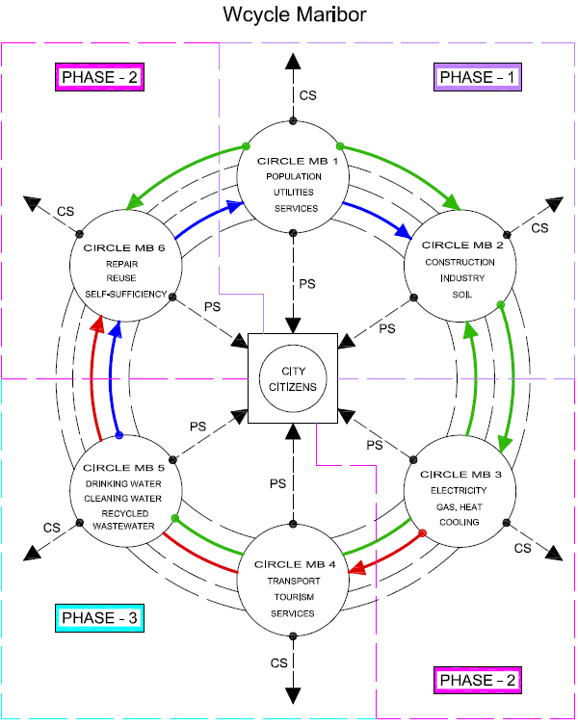
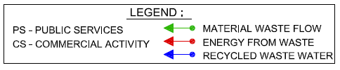

Slide 7
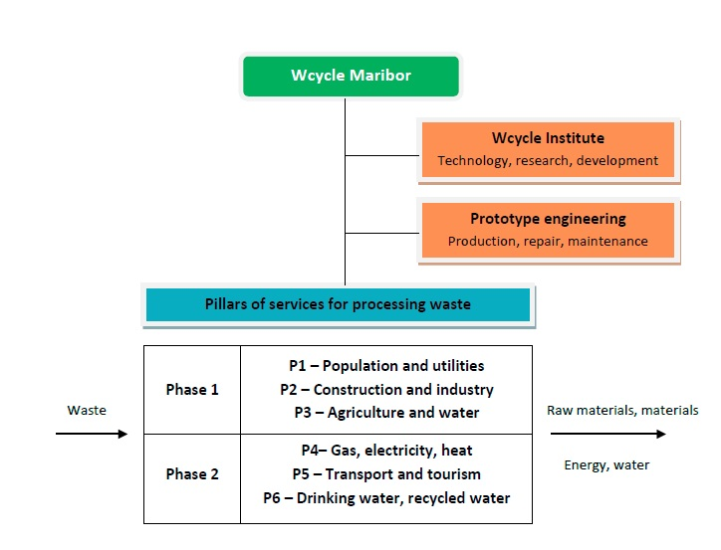

Slide 8
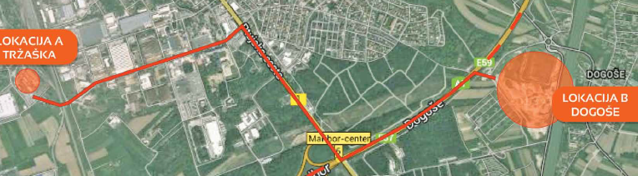
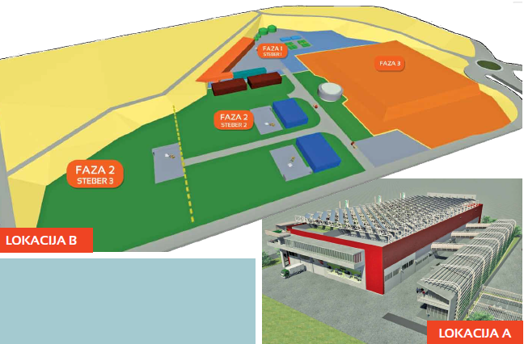
PRESENTATION OF THE PHASE A AND B LOCATIONS

Slide 9


CONCLUSION
Waste management due to new requirements of environmental legislation and the lack of appropriate solutions is becoming a major global business opportunity
The city of Maribor is setting high goals in the area of processing waste from all sources of their generation, which it wishes to achieve through the construction and operation of the pilot plant for processing waste Wcycle Maribor
Production operating companies for different service pillars are the companies mainly owned by the Municipality, which are the blood vessels of the city and which are obliged to carry out their public services for citizens and to provide the highest quality conditions of their residence and living in an urban area in general

Slide 10

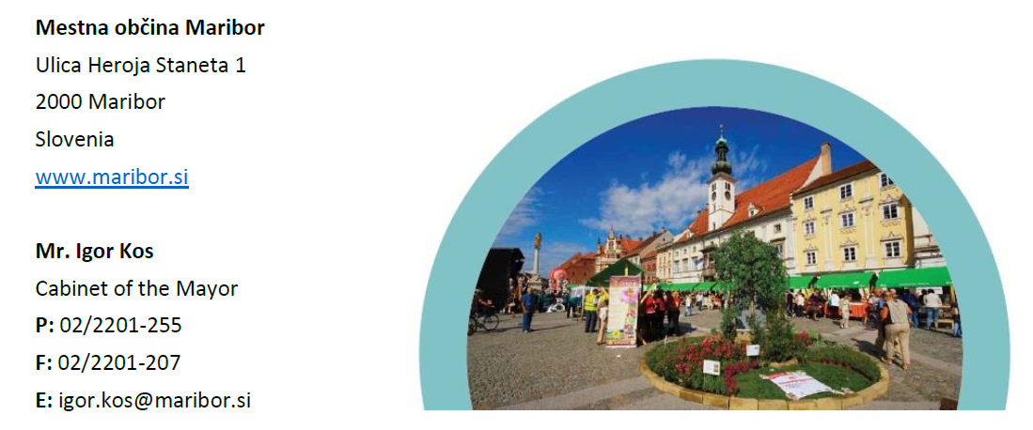
M: +386 51 658 337

