Slide 1

Advanced Materials as the Principal Key Enabling Technology for Energy- and Resource-efficient Processes within the Emerging Circular Economy
NEJC HODNIK
Advanced Materials in Circular Economy
D13 Department of Catalysis and Chemical Reaction Engineering
Dr. Nejc Hodnik

Slide 2
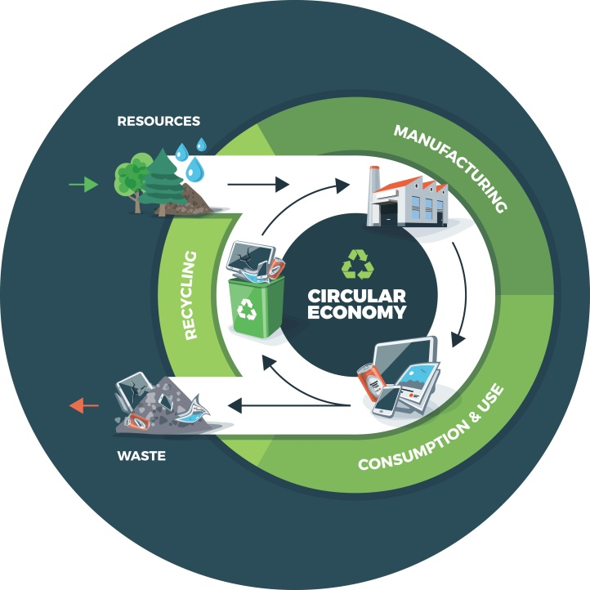
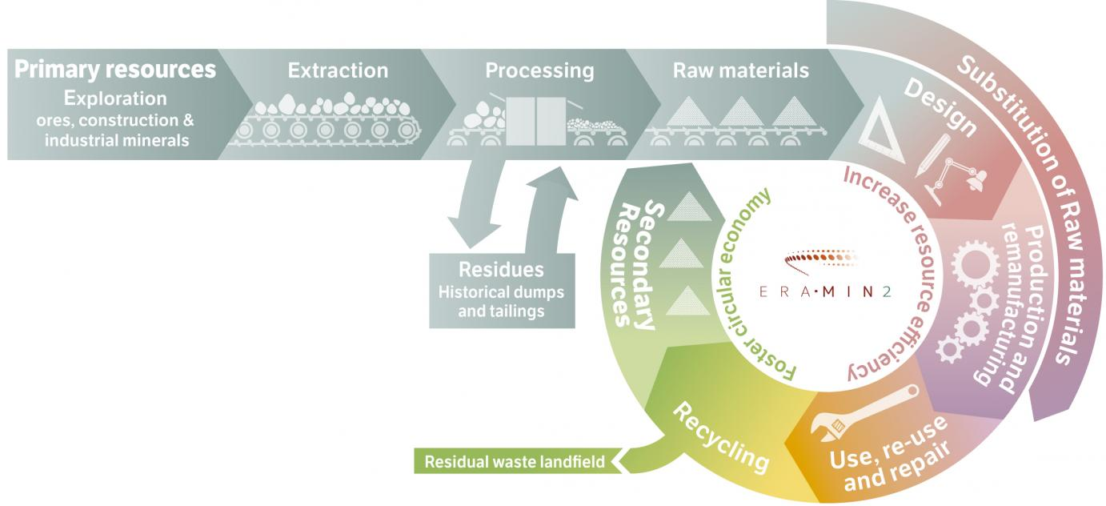
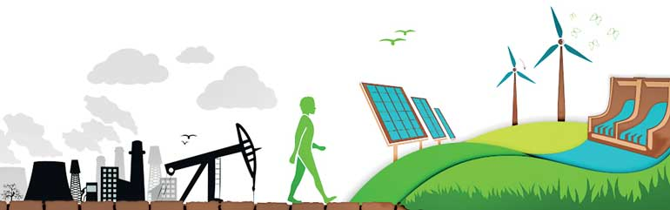
NEJC HODNIK
Advanced Materials in Circular Economy
On one side our development and life quality is dependent on raw materials resources and economics, however on the other side it is limited by pollution and negative climate changes.
Strategies towards sustainable future:
EU's transition to a circular economy
  no supply risk!
EU's transition to a low-carbon economy
  clean and renewable energy!
http://www.ies.be/node/3632
http://www.ft.lk/article/482633/Green-finance--Financing-the-transition-towards-a-low-carbon-economy

Slide 3

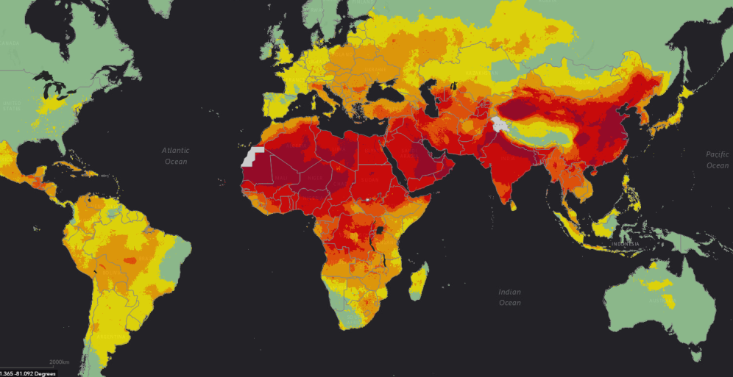
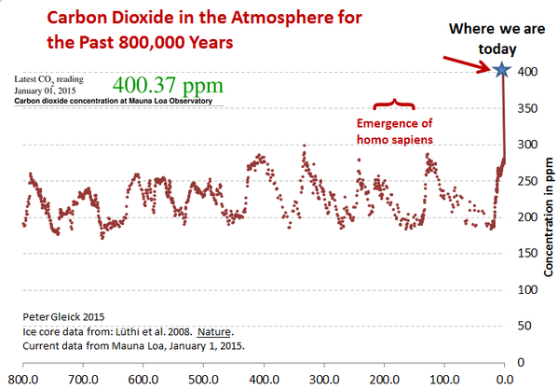
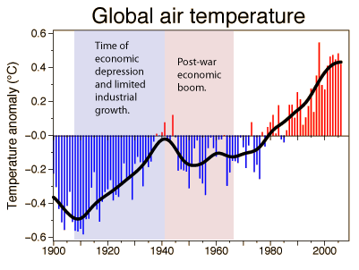
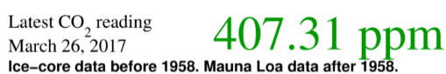
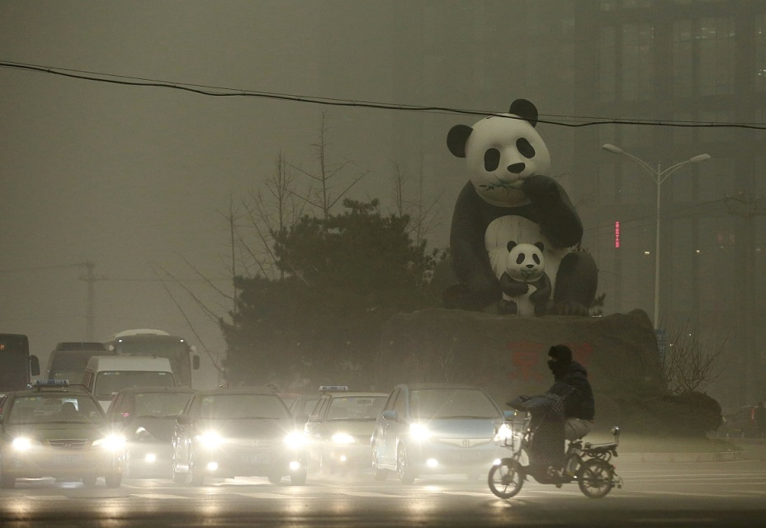
Problem!
Global Worming!
We must slow down global worming (below 2 °C) -> rise of greenhouse gas CO₂, that mostly comes from burning of fissile fuels (coil, oil and gas).
„KEELing curve“
Pollution
-> to lower atmospheric pollution levels in big cities
Beijing
PM2.5 598 µg/m3
Max 25 µg/m3
Annual mean ambient PM2.5 (µg/m3); swathes of the world are coloured yellow (11 - 15), orange (16 - 25), red (26 - 69) and purple (70 or more), meaning air quality breaches WHO limits. Fine particles primarily come from car, truck, bus and off-road vehicle (e.g., construction equipment, snowmobile, locomotive) exhausts, other operations that involve the burning of fuels such as wood, heating oil or coal and natural sources such as forest and grass fires.
https://scripps.ucsd.edu/programs/keelingcurve/
-2016 was the warmest in history
-16 out of 17 warmest years were after 2001
http://www3.epa.gov/climatechange/ghgemissions/global.html

Slide 4
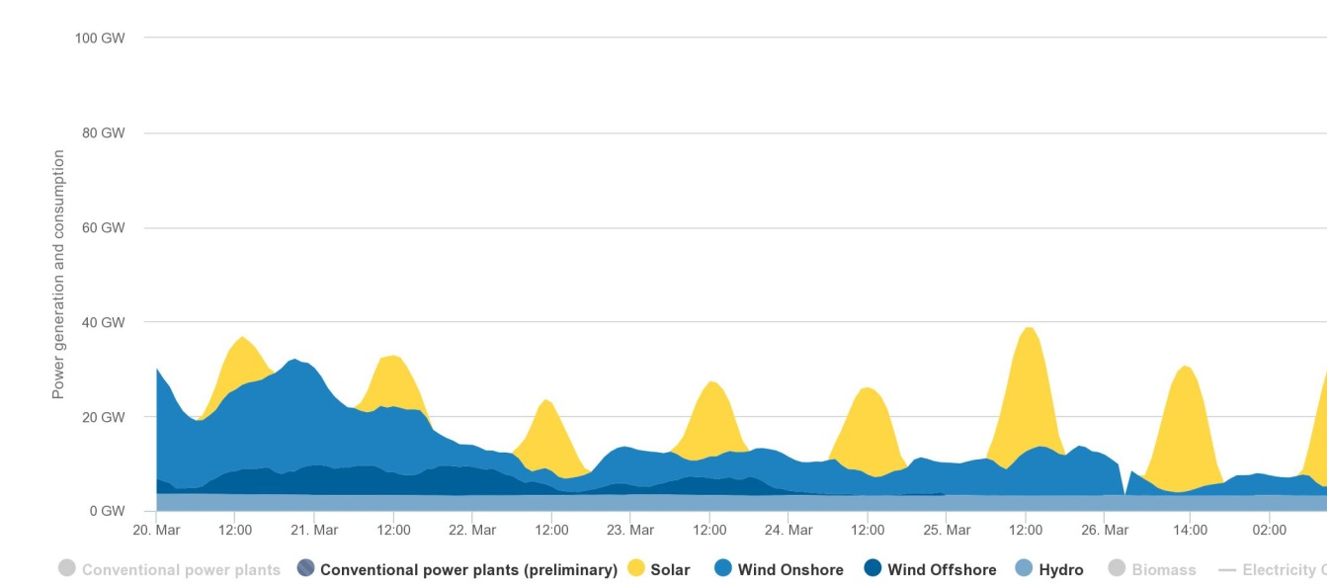
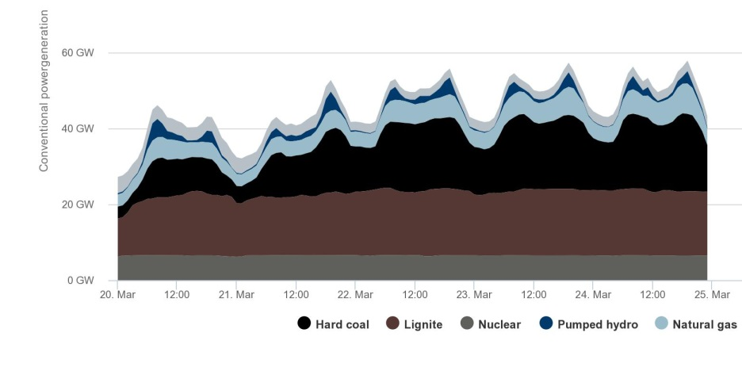
What we can do?
NEJC HODNIK
Advanced Materials in Circular Economy
As scientists we can find new or more efficient ways for everyday tasks to be (more) sustainable.
To lower the dependance from fossile fuels
  Like turning CO₂ to chemicals or biomass to fuel
Utilize intermittent energy sources like sun and wind (renewable sources)
Current Grand Challenges: to store energy & catalytic conversion processes
The fluctuating Germany energy production from wind and solar including (mismatched) power demand in the last week. Conventional Power Generation
https://www.agora-energiewende.de/en/topics/-agothem-/Produkt/produkt/76/Agorameter/

Slide 5
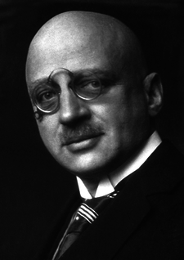
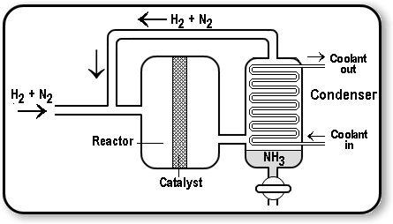
What we can do?
NEJC HODNIK
Advanced Materials in Circular Economy
Example from history: Haber–Bosch process (1910):
is an artificial nitrogen fixation process and is the main industrial procedure for the production of ammonia today
The process converts atmospheric nitrogen (N₂) to ammonia (NH₃) by a reaction with hydrogen (H₂) using a metal catalyst under high temperatures and pressures
Before the Haber process, ammonia had been difficult to produce on an industrial scale; Grand Challenge.
Fritz Haber
1919 - Nobel Prize
https://en.m.wikipedia.org/wiki/Haber_process
Although the Haber process is mainly used to produce fertilizer today, during World War I it provided Germany with a source of ammonia for the production of explosives.
https://chemstuff.co.uk/academic-work/a-level/the-haber-process/

Slide 6
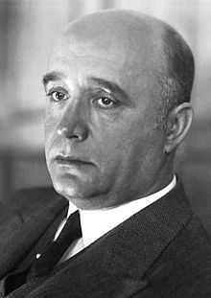
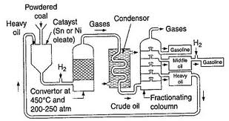
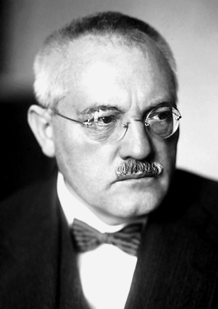
What we can do?
NEJC HODNIK
Advanced Materials in Circular Economy
Example from history: Bergius process (1913):
is a method of production of liquid synthetic fuel by catalytic hydrogenation of high-volatile bituminous coal at high temperature and pressure.
Before the Bergius process, liquid fuel like diesel oil or petrolium was difficult to get, especially in Germany; Grand Challenge.
Fredrich Bergius
1931 - Nobel Prize
https://en.m.wikipedia.org/wiki/Haber_process
The Fischer–Tropsch process (1925) is a collection of chemical reactions that converts a mixture of carbon monoxide (CO) and hydrogen (H₂) into liquid hydrocarbons - fuel.
Carl Bosch
1931 - Nobel Prize
https://chemstuff.co.uk/academic-work/a-level/the-haber-process/

Slide 7
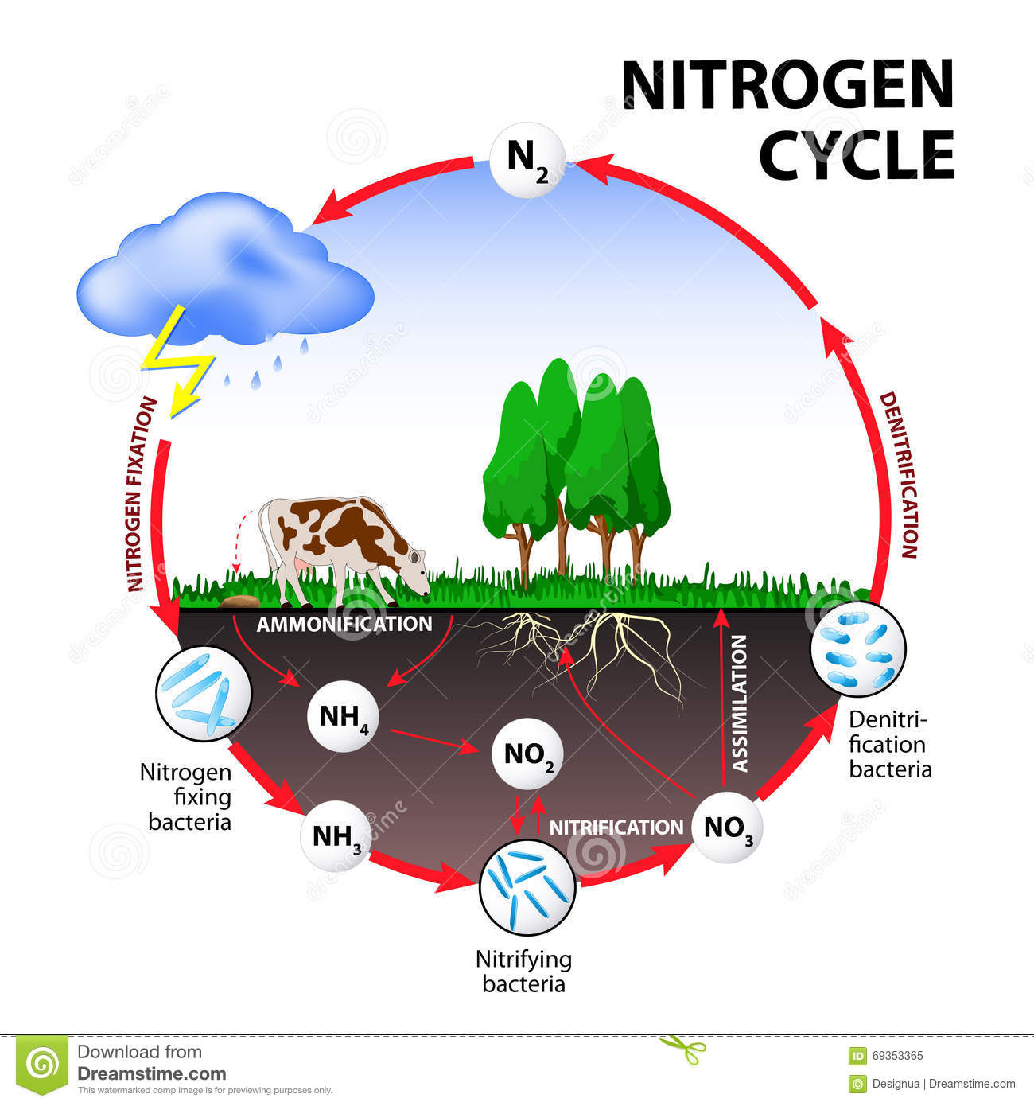
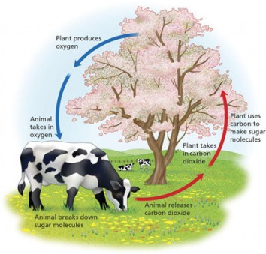
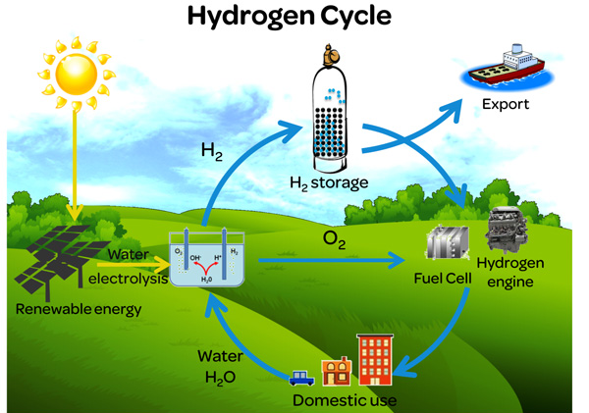
NEJC HODNIK
Advanced Materials in Circular Economy
CO₂ cycle
http://ecoregionproject.weebly.com/nitrogen-oxygen-and-carbon-cycles.html
Energy
https://www.dreamstime.com/royalty-free-stock-photos-nitrogen-cycle-image29063058
Fertilizer -> food
Common for all conversion processes -> catalysis
-90-95% of all industrial chemical processes
http://www.merlin.unsw.edu.au/energyh/about-hydrogen-energy/

Slide 8
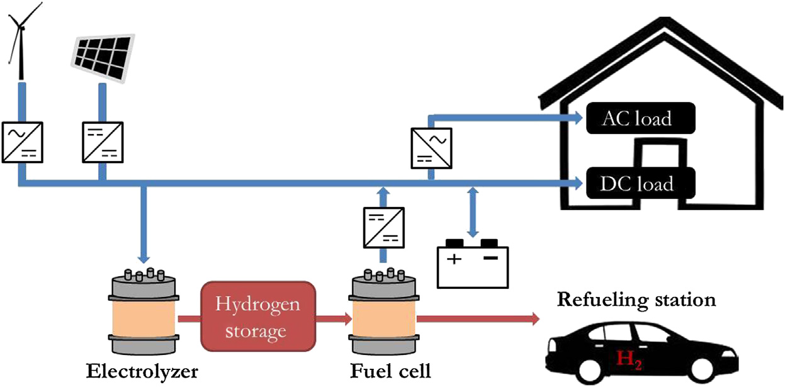
What we can do?
NEJC HODNIK
Advanced Materials in Circular Economy
Hydrogen cycle at home:
self sustained hydrogen home
Current Grand Challenges: to store energy & better catalytic processes

Slide 9
What we can do?
NEJC HODNIK
Advanced Materials in Circular Economy
Topics: batteries, catalysis, hydrogen, CO₂, methane, biomass, adsorbers, absorbers, pharmaceutical process engineering, …
Projects: currently participating in >20 H2020 projects and ERA-NETs, COSTs, NATOs, Bilateral scientific projects, etc., in addition to National funding
Recent Articles (IF>10): Science, Nature Materials, Angewandte Chemie, Accounts of Chemical Research, Nature Communications, Advanced Energy Materials, Advanced Functional Materials , JACS, PNAS, ...
Patents: catalysts (US, WO, 2 x Patent appl.), coatings: 2 sold to Alanod SOLAR, etc.
Industry collaboration: Helios, HONDA, Lek, Krka, Julon, Hella, ALSTOM POWER, Silkem, BRIGHTSOURCE INDUSTRIES, etc.
Academic international collaborations: Argonne National Lab (USA), Max-Planck Institute, Helmholtz Institute, Fraunhofer Institute, University of California San Diego, CNRS, etc.
Equipment&infrastructure: state-of-the-art electron microscopes (SEM, HR(S)TEM, AFM), new modern building, NMR center, spectroscopies (IR, Raman, UV-Vis), synthetic methods, etc.
Approach: »multi-scale« & »inter-disciplinary«

Slide 10
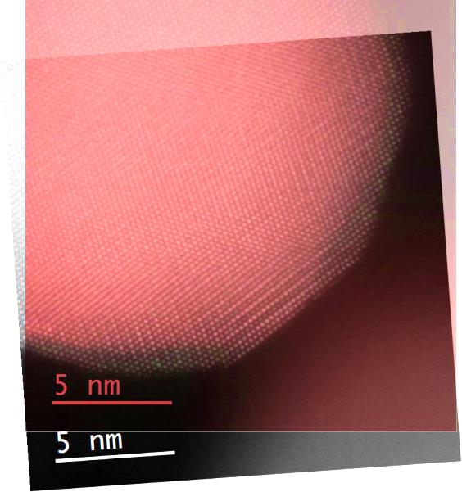
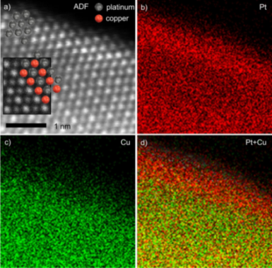
What we can do?
NEJC HODNIK
Advanced Materials in Circular Economy
Topic 1: batteries (energy storage)
Topic 2: adsorbers (energy storage)
Topic 3: catalysis (energy conversion)
Topic 4: recycling of PGM

Slide 11
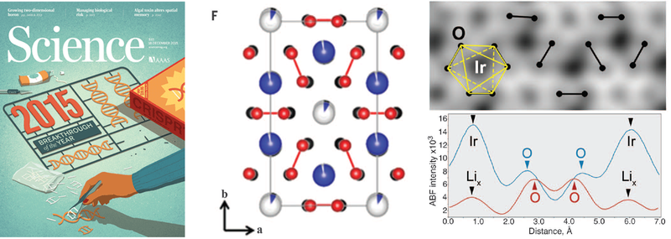
What we can do?
NEJC HODNIK
Advanced Materials in Circular Economy
Topic 1: batteries (energy storage)
Li-ion, Li-sulphur, Mg-ioni, Na-ion, ...
Visualization of O-O peroxo-like dimers in high-capacity layered oxides for Li-ion batteries
McCalla et al., Science 2015, 350, 1516-1521.
Notes:
The quest for better rechargeable batteries means finding ways to pack more energy into a smaller mass or volume. Lithium layered oxides are a promising class of materials that could double storage capacities. However, the design of safe and long-lasting batteries requires an understanding of the physical and chemical changes that occur during redox processes. McCalla et al. used a combination of experiments and calculations to understand the formation of O-O dimers, which are key to improving the properties of these cathode materials.

Slide 12
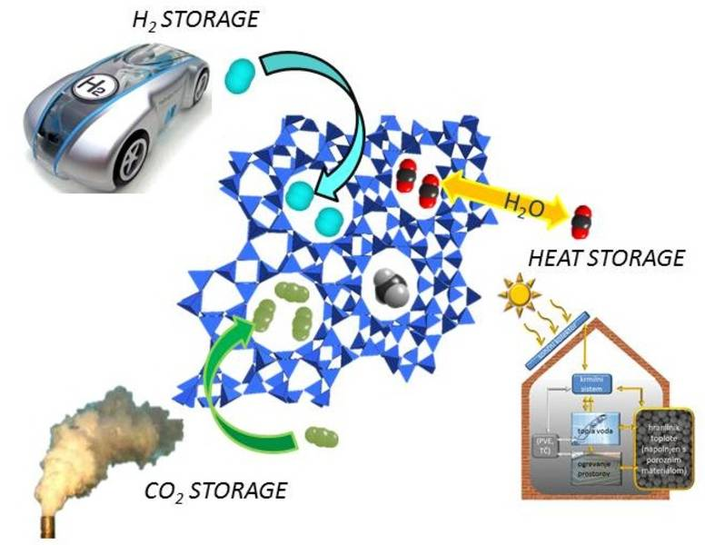
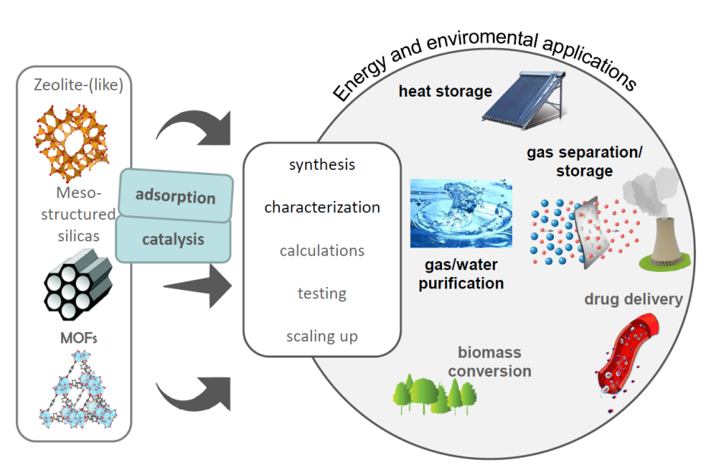
What we can do?
NEJC HODNIK
Advanced Materials in Circular Economy
Topic 2: adsorbers (energy storage)
  Zeolites, Meso-structured silicas, metal-organic framework materials (MOFs)
Superior Performance of Microporous Aluminophosphate with LTA Topology in Solar-Energy Storage and Heat Reallocation
Krajnc et al., Advanced Energy Materials, 2017, 1601815.
Notes:
development of inorganic and metal-organic framework materials for their use in hydrogen storage, CO2 capture and storage and heat storage applications (e.g. seasonal storage of solar thermal energy or waste heat storage)
Here, solar energy is used to dry (expel water from) the hydrophilic porous material. The 'excited' dried material can be stored for a very long time without thermal losses. When at a later stage water vapour is let into this porous material in a controllable manner, adsorption of water molecules into the pores releases the stored energy in the form of sensible heat.

Slide 13
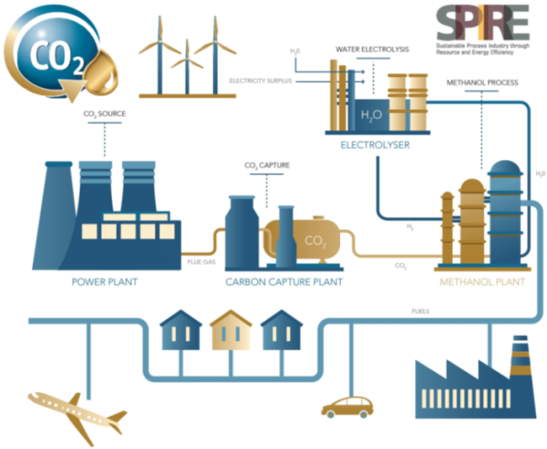

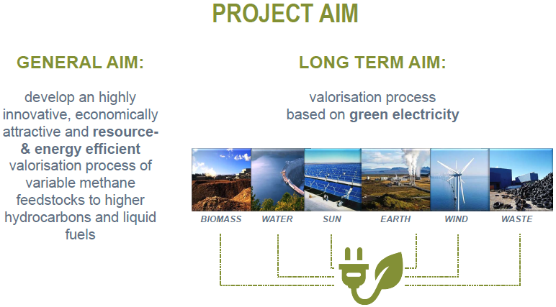
What we can do?
NEJC HODNIK
Advanced Materials in Circular Economy
Topic 3: heterogeneous catalysis (CO₂ activation)
carbon capture and utilisation (CCU): hydrogenation, alkylation, hydro-formylation, polymerisation, carbonates…
MefCO2 (Horizon 2020) FReSMe (Horizon 2020) ADREM (Horizon 2020)
(methanol from thermal power stations) (methanol from steel industry as fuel) (chemical reactor design)

Slide 14
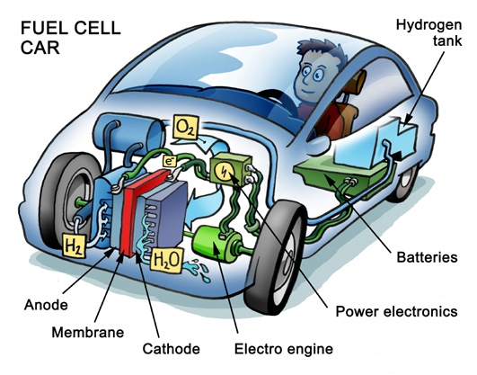
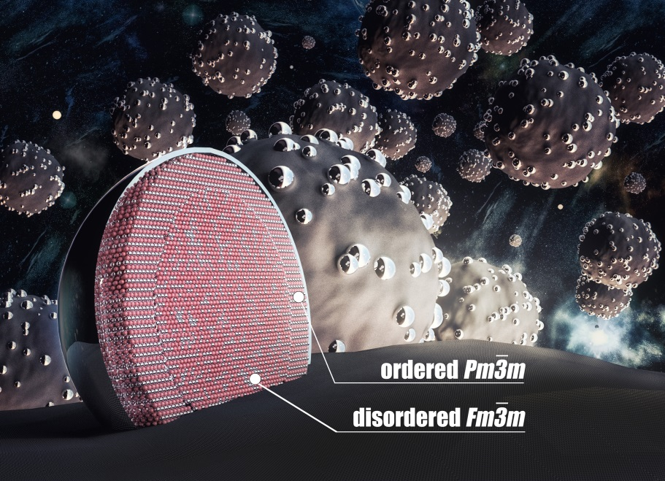
What we can do?
NEJC HODNIK
Advanced Materials in Circular Economy
Topic 3: electro-catalysts (energy conversion)
Positive Effect of Surface Doping with Au on the Stability of Pt-Based Electrocatalysts
Gatalo et al., ACS Catalysis, 2016, 6, 1630–1634.
- US 9147885 Patent
https://en.wikipedia.org/wiki/Fuel_cell

Slide 15
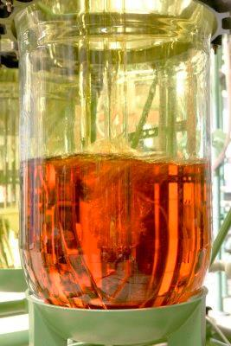
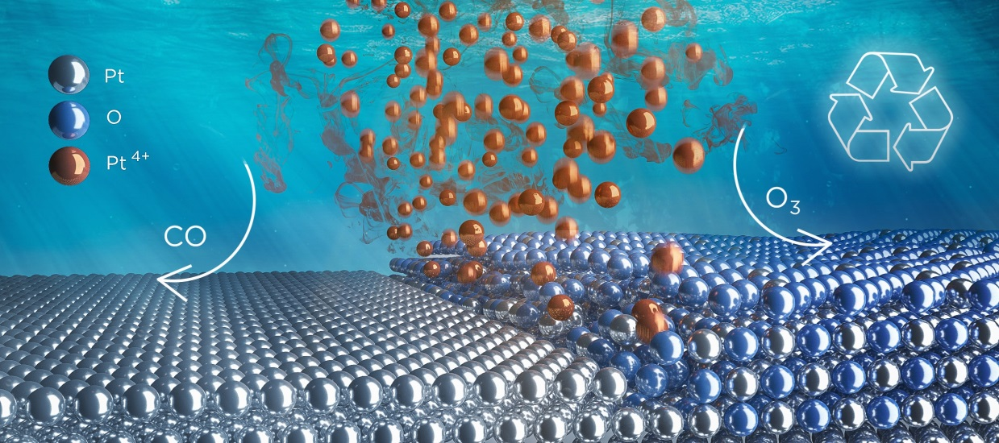
What we can do?
NEJC HODNIK
Advanced Materials in Circular Economy
Topic 4: recycling of PGM
Platinum recycling going green via induced surface potential alteration enabling fast and efficient dissolution
Hodnik et al., Nature Communications, 2016, 7, 13164 .
- DE Patent App. Nu. 10 2015 118 279.
Yellow - [PtCl₆]²⁻
catalysts are usually PGM

Slide 16
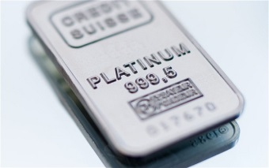
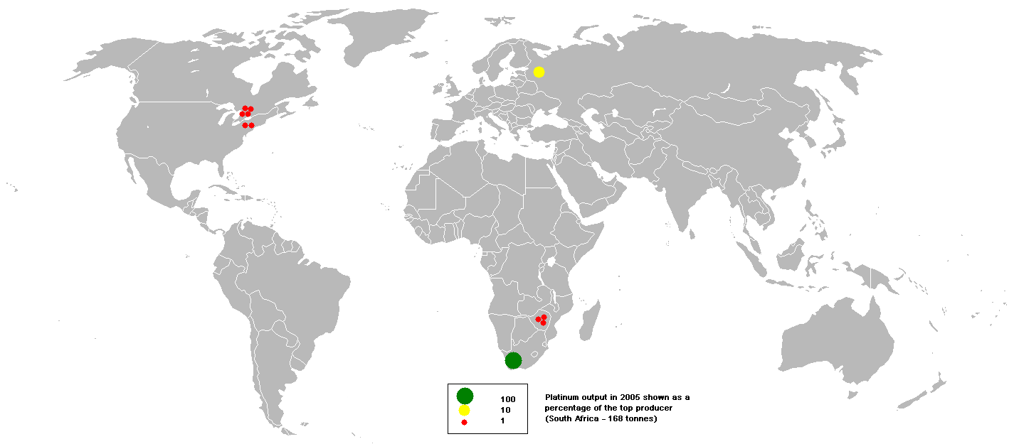
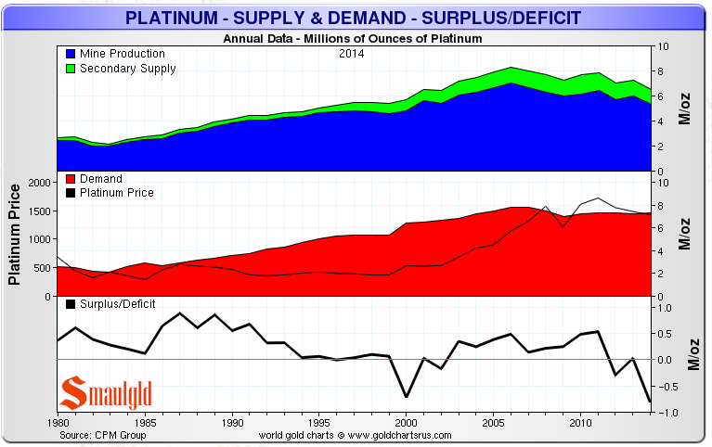
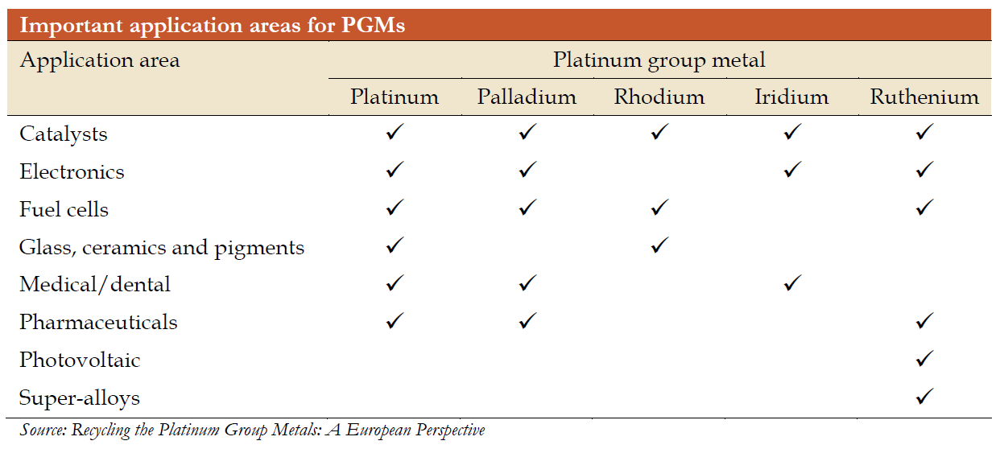
Platinum!
NEJC HODNIK
Advanced Materials in Circular Economy
For EU urban mining is the obvious way to minimalize import dependence from foreign countries.
Source: http://en.wikipedia.org/wiki/Platinum; https://smaulgld.com/platinum-supply-and-demand, http://www.canplats.ca/html/Investor_Information/Platinum_Market/index.cfm, www.platinuminvestment.com

Slide 17
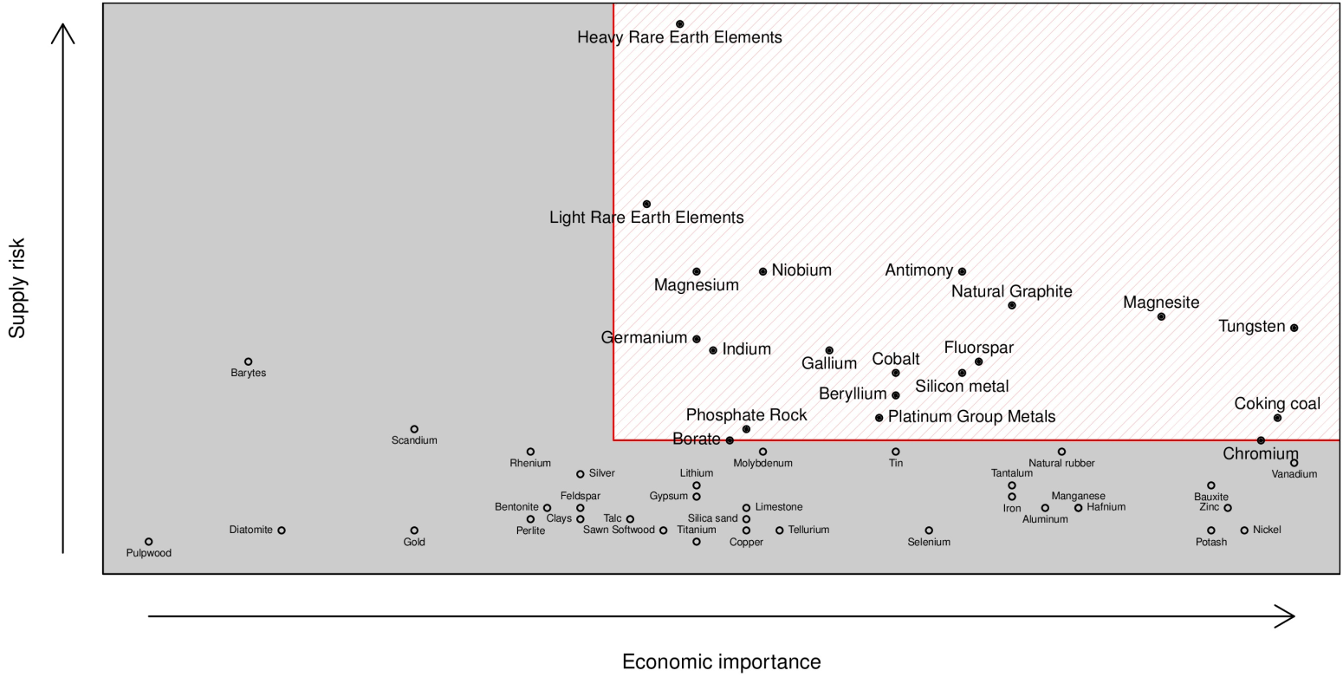
Critical Raw Materials - CRMs
EU makes a list of materials that are of supply risk to our well-being
CRMs demand is increasing – High tech equipment like cell phones contain CRMs (also PGM)
Solution – Recycle and not export to third world countries (environment and health problems)
Circular & Hydrogen Economy!
Critical Raw Materials for the EU 2014
http://europa.eu/rapid/press-release_MEMO-14-377_en.htm

Slide 18
Thank you for your attention!
“Besides improving the technology we should also try to adapt human habits.”

Slide 19
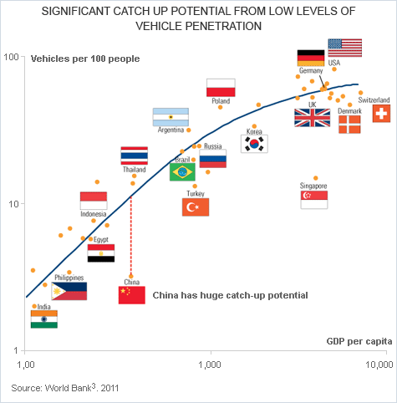
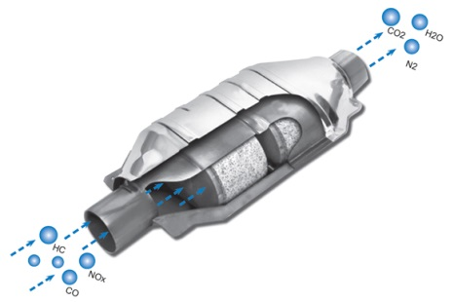
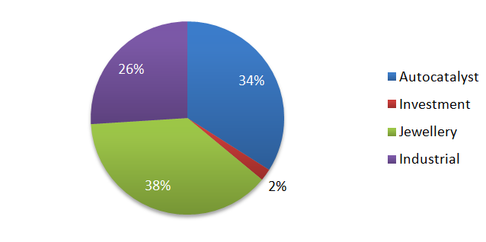
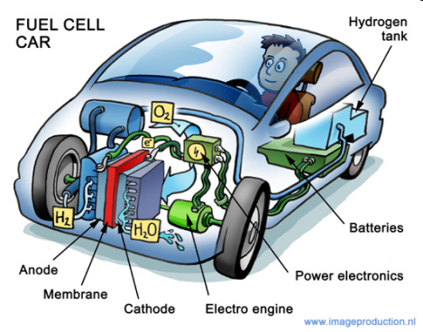
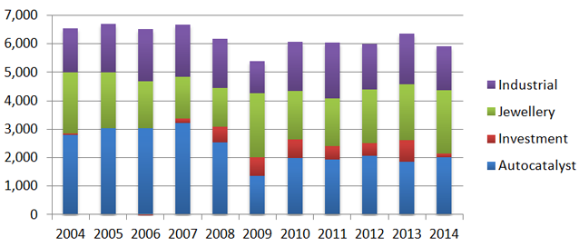
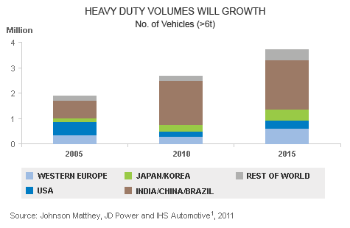
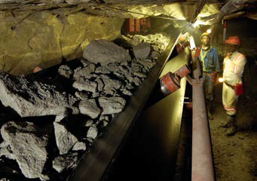
Platinum!
NEJC HODNIK
Advanced Materials in Circular Economy
Platinum Net Demand By Application 2014 Total 184 tons net
Automotive Catalytic Converters
-Now
3-15 g of Pt
Platinum Demand By Application
Fuel Cell Cars
-Future
30-40 g of Pt
Proven resources: 30,000 tons respectively.
Annual production: 200 tons respectively.
Reserves: in the range of 100 years.
Mining Ores
-not in EU
Source: http://en.wikipedia.org/wiki/Platinum; https://smaulgld.com/platinum-supply-and-demand, http://www.canplats.ca/html/Investor_Information/Platinum_Market/index.cfm, www.platinuminvestment.com

