Slide 1
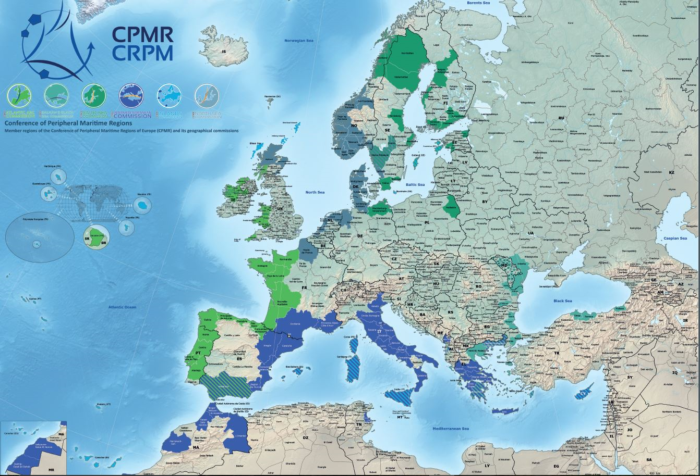
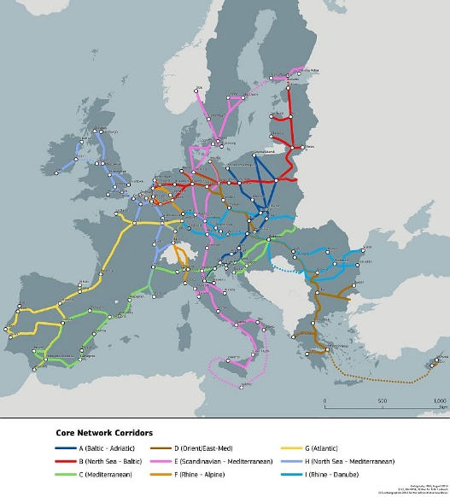
CEF, TEN-T and Motorways of the Sea
Revisions : Maritime Regions are ready
Eleni Marianou
Secretary General of the CPMR
Transport & Logistics Conference
22 March 2018

Slide 2
CEF and TEN-T post-2020: how can the situation of the maritime peripheries be improved?
January to March 2018 – CPMR raising the awareness of the Commission (Commissioner Bulc) and the Parliament (Chair of the Trans Committee) about CEF II
29 May 2018 : EC to publish CEF II regulation proposal (and ERDF regulation, including territorial cooperation – ADRION - also to be screened as regards its level and modalities of support to transport infrastructure)
21 June, Political Bureau, Estonia : CPMR to react to the proposal, followed by an intense campaign focused on the Parliament
  Still lacking from the Commission :
  A real territorial impact assessment of CEF I – forgotten in the 14th of February mid-term review of the CEF
  A clear view on how macroregional (EUSAIR) and sea basin strategies match with TEN-T policy and maps

Slide 3
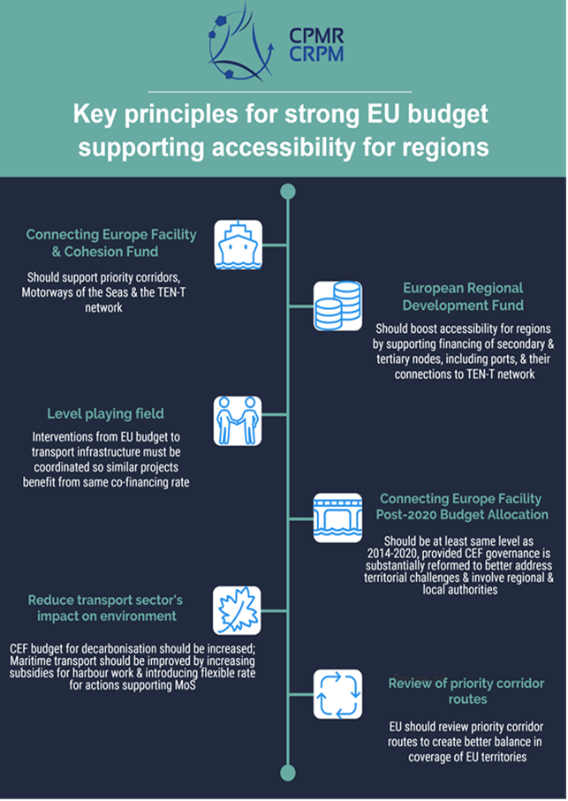
our key messages for forthcoming negotiations : yes to a strong cef budget, but only if …
Key priority for maritime Regions : ports must be treated as cross-border entities
Funding rate must be upgraded from 20 % (CEF I) to 40 % (CEF II)

Slide 4
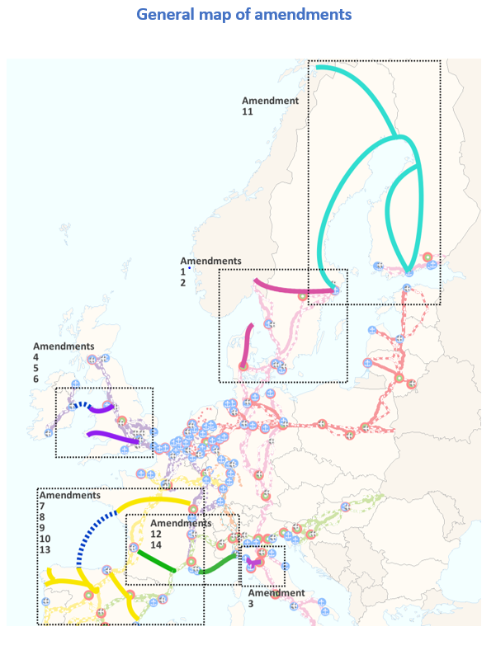
June 2017 : CPMR’s proposed amendments to Annex 1 of the CEF (corridors)
14 amendments proposed by CPMR’s Geographical Commissions on 6 corridors:
4 of them impact 2 corridors : With the benefit of its experience in sea basins, macro-regions and transnational cooperation, CPMR’s contribution is crucial : cross-cutting approach and proposals concerning inter-connections between the corridors
Corridors’ amendments currently discussed between DG Move and Transport Ministries : still time to lobby for improved coverage of EUSAIR area and Western Balkans
CPMR is at your disposal

Slide 5
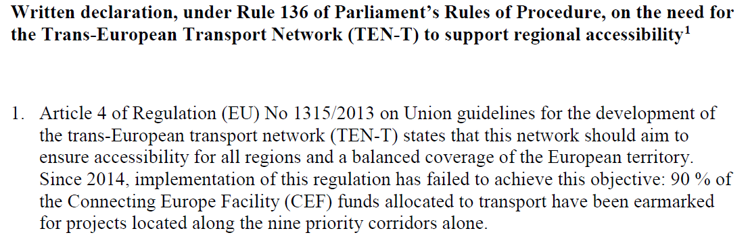
CPMR asks for a revision of TEN-T guidelines and maps before 2023 …
  Update criteria and maps of the core network – needed by Brexit and the necessity to better integrate EU neighbours
  Reword Article 21 – Motorways of the Sea - to the benefit of comprehensive ports, discriminated by current guidelines
  Here again, the Parliament can support the move : 100 MEPs signed a Written Declaration, prepared by CPMR, recalling that TEN-T policy must improve territorial accessibility :

Slide 6
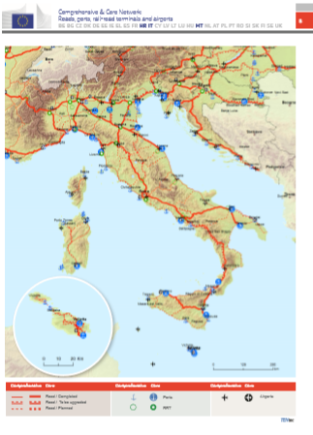
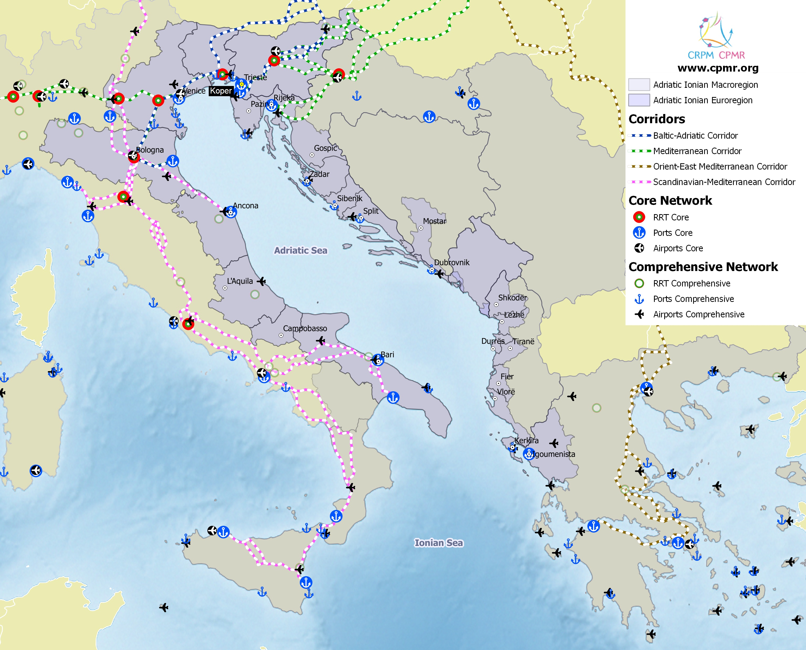
  How to get a better coverage of EUSAIR area by the CEF ?
  Current Core and Comprehensive Transeuropean Network

Slide 7


Motorways of the Sea :
Looking forward to DIP 2 in Ljubljana
TEN-T Days 27 April 2018
The Detailed Implementation Plan should :
introduce a territorial pillar for a balanced coverage of all sea basins (including Adriatic-Ionian), with a development strategy for each sea basin and extension of the MoS to ports outside the EU;
introduce a “modal shift” component to support the demand for maritime services.
The forthcoming CEF arrangements on MoS should:
include provisions to ensure that projects aimed at serving islands and peripheries are prioritized, for example by means of specific calls for projects
be based on an amended interpretation of Article 21 of the TEN-T that would make links eligible between two ports of the comprehensive network as well as between an EU and a non-EU port.

Slide 8
MARITIME TRANSPORT DIMENSION real opportunities for Adriatic Ports : shorter maritime routes to the Centre of Europe
A recent illustration : « Mercedes prend la route du sud »
French Press Article 10 March 2016
Mitsui OSK Lines, a Japonese company, will start a new service to Asia from Koper (Slovenia) to export cars produced in Germany by the Daimler group. Mercedes was previously exporting from the port de Bremerhaven, but wants to reduce its carbon print and the length of the maritime route.
Historically, it is the first time that the Daimler group exports to Asia via the Mediterranean and not via the North Sea . Four departures a week to Singapour, Hong-Kong and 3 Chinese ports

Slide 9
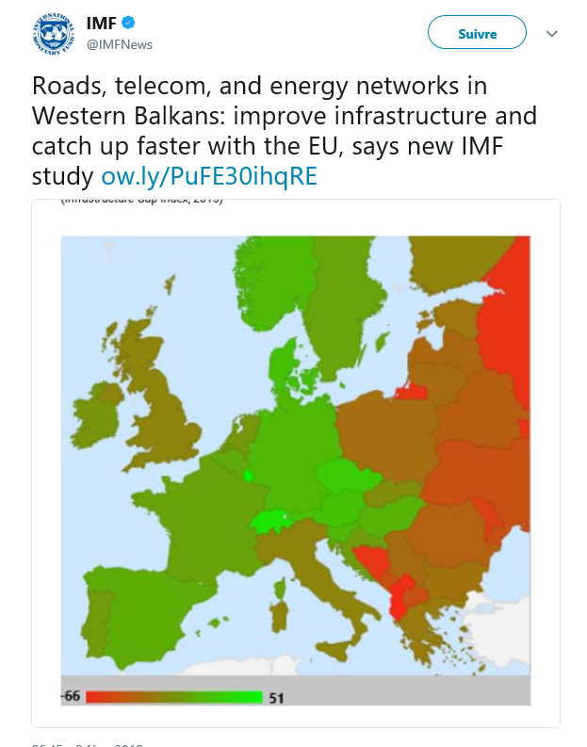
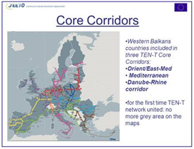
Challenging (IMF) or promising (SEETO) perspective ?

Slide 10

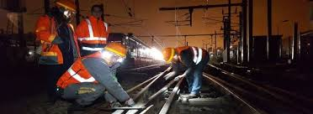
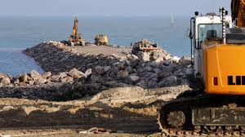
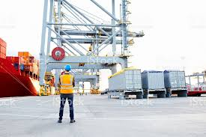
AT YOUR DISPOSAL …
Thank you!
www.cpmr.org

