Slide 1
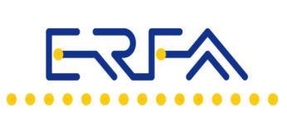
Future developments and investments in European Rail Freight Transport and Logistics Conference Carole Coune Acting S.G.
Brussels, 22th March 2018
www.erfarail.eu

Slide 2
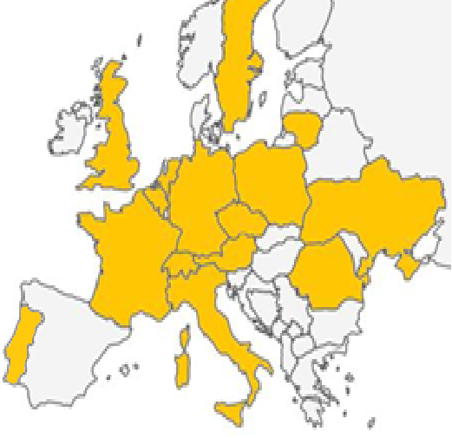
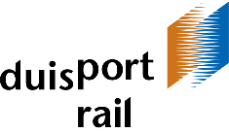
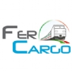
Who we are ?
30 members

Slide 3
WHO DO WE REPRESENT? Our role ?
Freight railway undertakings (34 % market share)
Wagon keepers,
Freight forwarders,
National associations
Support for a truly competitive rail sector. The rail incumbents have an interest to protect their market share and a kind of status quo.
Our members are united in a shared interest to expand their businesses and generate more demand for rail services
Modal shift
Reducing rail’s costs
Improving quality and performance
Removing access barriers and competitive distortions

Slide 4
The main future developments/investments in rail freight will take place in the field of these 3 challenges
Reducing rail’s costs
Improving quality and performance
Removing competitive distortions
COMPETITIVENESS

Slide 5
The main future developments/investments
Reducing rail costs ➔ Track access charges
Internal challenge
- Rail freight operators needs : transparent rules and according to the EU framework, in all the member states

Slide 6
WHY ? Enforcement and transparency
The level of rail’s track access charges is critical to rail’s competitiveness and can be a real barrier to modal shift!
EU rules exist to improve TRANSPARENCY, CONSISTENCY and EFFICIENCY of Access Charges
BUT
Enforcement
Transparency of what RUs are paying for
ERFA aims to Improve visibility and enforcement of EU rules by IM and Member States
TACs = 20-35% of RU costs
TAC increase WITHOUT
improvt of quality
Road does not pay a similar per km toll
Rail competitiveness

Slide 7
The main future developments/investments
Reducing rail costs ➔ Track access charges
External challenge
- Rail freight operators needs : track access charges competitive with road

Slide 8
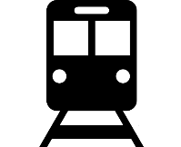
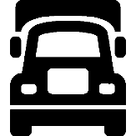
WHY ? USER PAYS PRINCIPLE NOT CONSISTENT
TACs = 20-35% of RU costs
TAC increase WITHOUT
inprovt of quality
Road does not pay a similar per km toll
Rail competitiveness
User pays principle
 | Trains pay for every single kilometer of track, in line with the distance-based principle. 100% of the European rail network is tolled. Covers 60% infrastructure costs | Trucks’ charges are limited and fragmented: depending on Member States 20% of motorways and main roads in Europe are tolled. Covers 20% of road infrastructure costs
Can the revision of the EU road charging legislation help? Is there political support to restore a balance ?

Slide 9
The main future developments/investments
Improving quality and performance ➔ Interoperability
ERTMS / Noise reduction/Languages ⬄Dig.⬄O.D.

Slide 10
The main future developments/investments
ERTMS
Single harmonised Control, Command, Signalling and Communication system that is fully interoperable across borders.
2 parts : The European Train Control System (ETCS), and the Global System for Mobile communications — Railways (GSM-R)
2 kind of investments : on infrastructure / on board
A necessity for a safe, efficient and competitive single european rail market
Notes:
The ETCS or European Trains control system is an automatic train control system that operates with the aid of balises in the track and a computer system in the train cab. Both the rail infrastructure and the train must be equipped with the system.
The balises in the track detect the precise location of the train so that the maximum permitted speed can be calculated. They then send the necessary route information to the onboard computer in the train (for ETCS2 this takes place via GSM-R, see below). The onboard computer will then keep the train driver constantly informed of the maximum permitted speed of the train as well as all information from the trackside signals. This ensures that the driver can continually comply with the signals, even if his train is travelling too fast to see the signs and signals beside the track.
The ETCS system will also monitor the driver and correct him if necessary. If, for instance, there is a red signal two kilometres further along the track, the ETCS system will ask the driver to slow down. If the driver does not keep to the maximum speed limit, does not brake in time or drives through a red light, the system automatically corrects the speed of the train or activates the emergency brake.

Slide 11
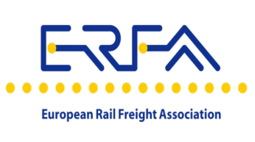
Aim for the ERTMS goals!
Improved safety
Europe wide interoperability
One single truly interoperable system
Full compatibility
Backwards and forwards
Track and train
Whoever the supplier
Reducing the costs
Removing the borders
Reducing system costs
Increased railway capacity
Improve competitiveness with road
Increasing modal shift to rail
Accelerate change
Notes:
MODAL SHIFT / A KEY ENABLER FOR DECARBONISATION

Slide 12
The main future developments/investments
Improving quality and performance ➔ Interoperability
ERTMS
why is ERFA, the voice of new entrants, supporting ERTMS ?

Slide 13
The main future developments/investments
Improving quality and performance ➔ Interoperability
ERTMS
why is ERFA, the voice of new entrants, supporting ERTMS ?
ERFA members are operating crossborder freight trains with high quality and efficiency aims, using their access rights on the single european rail area.
Trains equipped with ERTMS systems and components manufactured by any qualified ERTMS supplier are able to run on tracks equipped with ERTMS of any other supplier. This enables the easy and seamless coordination of domestic and international train services and it also encourages competition

Slide 14
The main future developments/investments
Improving quality and performance ➔ Interoperability
ERTMS
why is ERFA, the voice of new entrants, supporting ERTMS, financed by IM/MS and RU supported by EU funds ?
Confident that the condition to succeed will be met before 2030:
the benefits for infrastructure, ⬄ RU’s costs for deploying ERTMS
maintenance, capacity
and performance
Notes:
Only 10 % of the CEF funding dedicated to the on-board deployment of ERTMS have benefited to rai new entrants – 25 years for 100 % deploying ERTMS on the core network corridors (target 2030). In Belgium, for exemple, ETCS has so far been installed on:
the Brussels-North – Leuven line;
the Schaerbeek – Mechelen line;
the Diabolo rail link (to and from Brussels National Airport);
the Mechelen – Leuven line, between Hever and Wijgmaal.
The lack of a business case for today's railway undertakings, who will face the costs, but very little of the benefits of ERTMS, should be addressed as a priority.

Slide 15
The main future developments/investments
Improving quality and performance ➔ Interoperability
ERTMS / Noise reduction/Languages⬄Dig.⬄O.D.

Slide 16
The main future developments/investments
Noise reduction
UIP wagon keepers (50 % tons-km in Europe)+ ERFA members + others
about 0, 5 billion wagons to retrofit in Europe ?
Target : 2026 ? 2028 ? With exemptions ?
Our position : “First international wagons, then national approach” (where the definition of “international” is based on the use of the wagon)
Notes:
“First international wagons, then national approach” (where the definition of “international” is based on the use of the wagon) has to taken into account to define a phasing that does not endanger competitiveness

Slide 17
The main future developments/investments
Improving quality and performance ➔ Interoperability
ERTMS / Noise reduction/
Languages⬄Digitalisation⬄Open data

Slide 18
DIGITALISATION : ETRMS is the backbone of digitalisation
Digitalisation – Asset Intelligence => which improvements ?
Improved productivity
Customer benefit
Optimized maintenance
Improved estimated time of arrival
Real time fleet management
Real time shock detection
Reduced turnover time
Reduced manual wk
Better forecast of fleet utilization
New services for customers
Real time tracing of transports
Event messages tailored for the customer’s needs
Monitoring of the good’s quality in real time
Specific thresholds, e.g. Temperature
Triggered actions
Higher reliability
Better understanding of damages
Early recognition of damages
Reduction of damages
Improved processes at workshops
Pro-active handling

Slide 19
OPEN DATA : common understanding
=> A single european language ?
DRIVER LANGUAGE
Language requirements are costly for the rail business
They remove the economic incentives for transporting
goods on rail over longer distances
ERFA Promotes ONE SINGLE OPERATIONAL LANGUAGE for rail
One Single operational language will allow rail to compete with other modes of transport!

Slide 20
The main future developments/investments
Removing competitive distortions
COMPETITION AND COOPERATION

Slide 21
COMPETITION ISSUES
ERFA strongly welcomes the decision by the European Commission (end 2017) to fine the Lithuanian incumbent rail company 28 million Euros for an unprecedented case of anti-competitive behavior that took place in 2008: dismantling public rail infrastructure in order to penalise a rail customer!
The competition rules has to be enforced everywhere in Europe.
COOPERATION ISSUES
Open dialogue between ALL RUs , IMs and EU decision-makers => handbook for contingency management
First step to effective cooperation between IM/RU

Slide 22
Modal shift : a key-enabler for decarbonisation
THANK YOU

