Slide 1



Transport & Logistics Conference 2018
22 March 2018
Rue du Commerce 44, Brussels
BOŠTJAN KRAJNC
Municipality of Velenje and
Energy agency of Savinjska, Šaleška and Koroška region

Slide 2

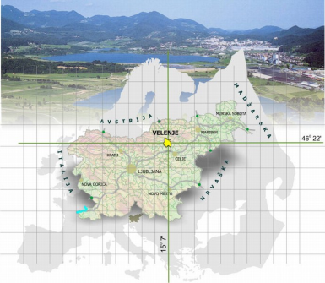
City Municipality of Velenje
The Savinjsko-šaleška (SAŠA) region is part of the Savinjska statistical region and includes the teritory of 10 municipalities; Savinjska is the 3 largest region in Slovenia, with a surface of 2.301 km2 (11,4% of total national territory) and is home to 253.845 residents (2016).
For decades and in the present, SAŠA region represents the largest pool of energy production in Slovenia, producing electrical energy, heat and cold, mainly by utilizing local reserves of lignite. The region is otherwise abundant (besides coal) with biomass, sunlight and hidro sources of energy.
The main challenge going forward is to continue the regions traditional role in the national energy system, but gradually move away from fossil fuel based production to utilizing other available sources of energy!
The long-term vision (particularly for the City of Velenje) is to turn away from its heavy industrial background and focus on the development of clean industries and sustainable tourism while exploiting their outstanding experience and newly generated know-how in the field of energetics.

Slide 3
What has been done?
Foundation of a local energy agency in 2006 (Beginning of KSSENA)
Energy analysis of local public buildings stock (Detailed energy audits, thermographic analysis, construction physics energy modelling, etc.)
Adherence to the Covenant of Mayors initiative in March 2010 -> Sustainable Energy Action Plan confirmed 2012
Development of an EMIS system for public buildings (FPE->DEM->E2 manager)
Energy refurbishment of public buildings
Investment into renewable energy sources (PV power plants on public buildings, CHP units in primary schools)
Investment into the optimization of the public lighting system
Development of a standalone street light system powered by RES (ESUS)
Project inception and development, trainings and education, acquiring private and public capital, cooperation in transnational consortia…

Slide 4
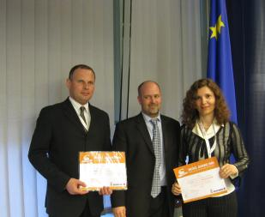

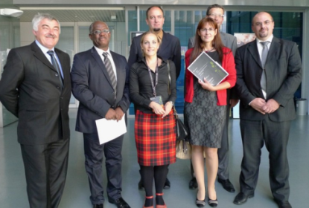
Awards
2010:
Brussels: Best EE promotional campaign (Project MOVE)
Maribor: Velenje, Energy most Efficient large Municipality in Slovenia (portal Energetika.net)
2011: Ljubljana: Velenje Energy most Efficient large Municipality in Slovenia (Energetika.net)
2012: Finalists of the Finance media portal competition – Best RES project
2014: Ljubljana: Velenje Energy most Efficient large Municipality in Slovenia (Energetika.net)
2016: Ljubljana: Velenje Energy most Efficient large Municipality in Slovenia (Energetika.net)

Slide 5
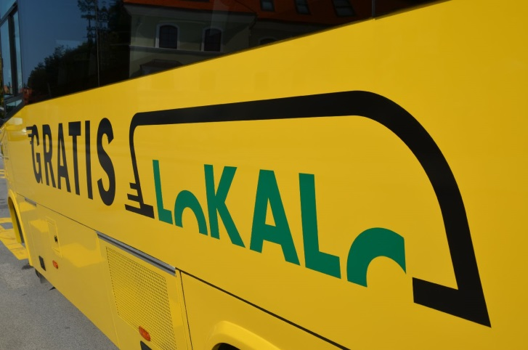
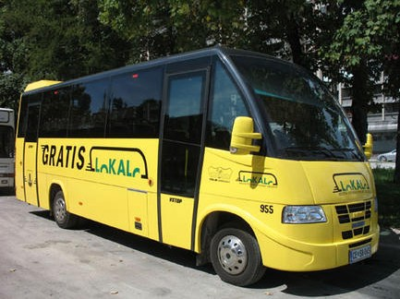
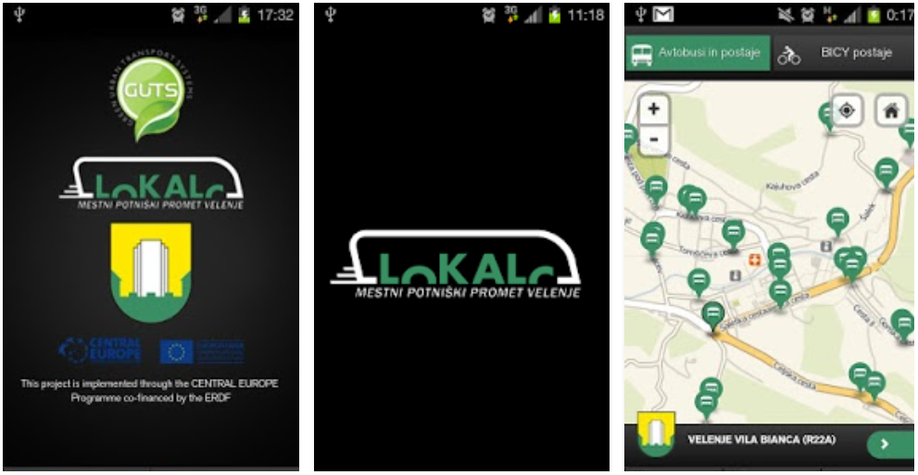
The LOKALC project
Free city public transport (minibus)
5 lines, 43 stations
35.000 passengers per month
Saving 2.000.000 tons of CO2 annually.
A specially-fitted bus runs the yellow route and is also disabled-friendly.
Smart phone application enables up-to-date information on bus arrivals on the stations.

Slide 6
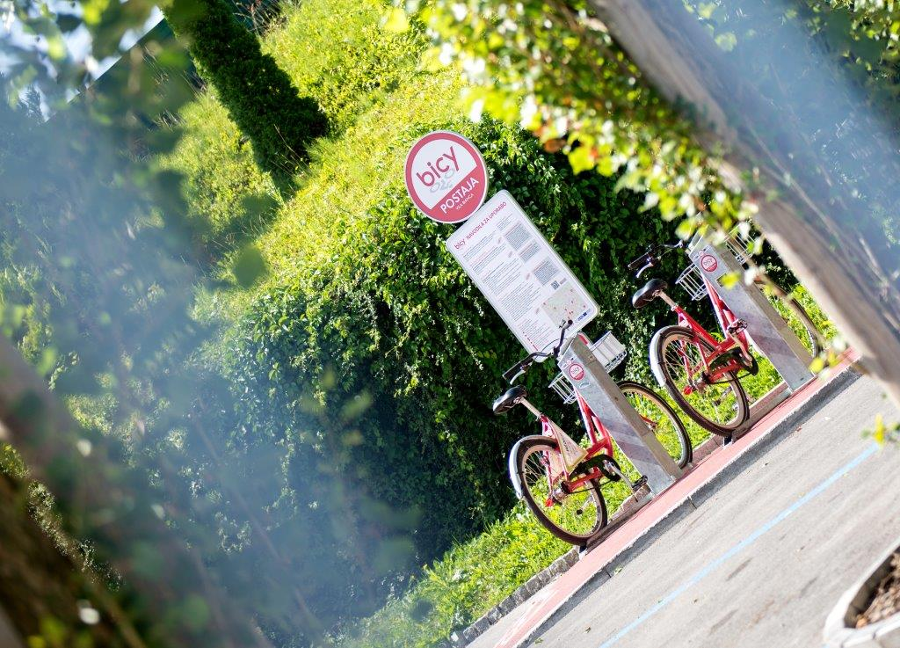
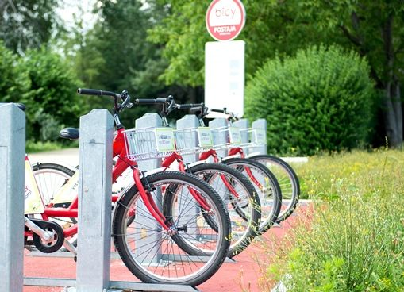
The project BICY
(bicycle-sharing system)
Free system for automated rent of city bikes
71 bikes, 15 stations, 104 bike docks in Velenje and Šoštanj
Free rent for users up to 14 hours (weekly); the system includes quality bike KRPAN (Slovenian manufacturer)
Over 84.935 registered users since the beginning of operation of the system BICY;
104.526 times rented – weekly up to 1.500
Annual Operational costs (maintenance, upgrades and additional purchases) of BICY: 53.214,31 € (2016)

Slide 7
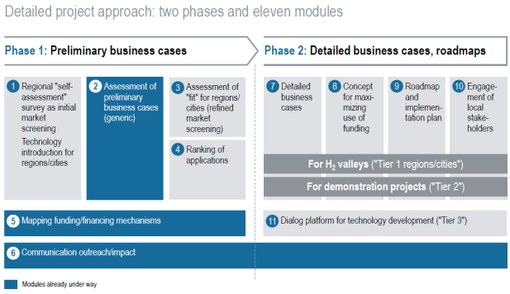




Initiatives…
To this end the City Municipality of Velenje adhered to several initiatives:
Covenant of Mayors (Sustainable energy on the local level)
CIVINET Slovenia-Croatia (Mobility and transport)
FEDARENE, KLEAS (Cooperation in networks of
expert organizations)
…
FCH JU Cities and regions initiative
In 2016, the FCH JU undertook significant efforts to reach out to all those European regions and cities having an interest in the potential use of fuel cell and hydrogen (FCH) based products to help them achieve their decarbonisation goals. With the specific goal of establishing an ambitious collaboration platform to facilitate market introduction, the FCH JU took on a large scale effort to reach out to as many regions and cities in Europe as possible and offered to work closely with them to develop market opportunities.

Slide 8
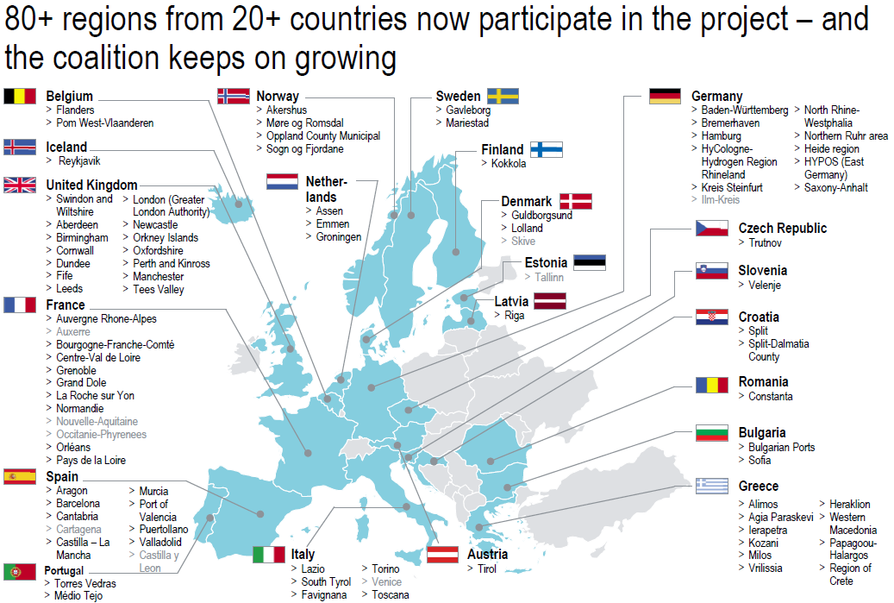
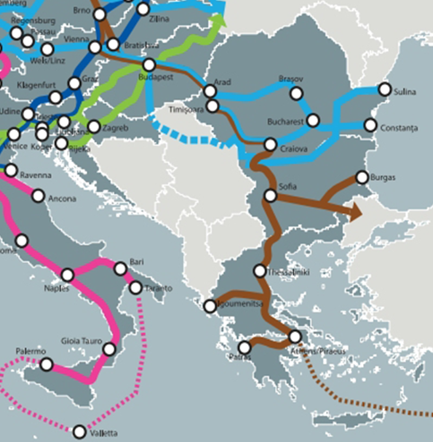

Slide 9
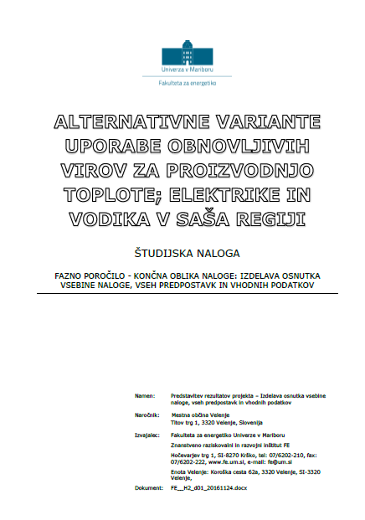
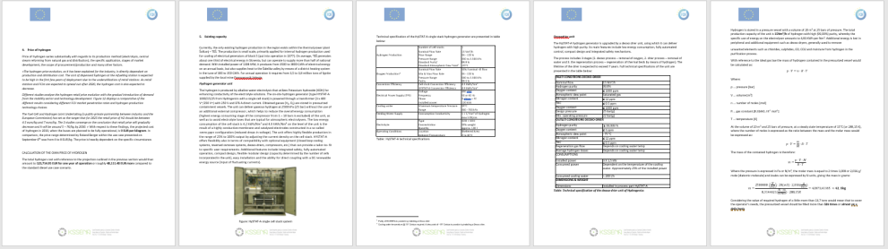
What has been done within the Regions and Cities initiative?
Developed analysis on hydrogen use and potential of RES in the SAŠA region
Concept of the investment project for hydrogen mobility
Study tour for the carrier of the FCH JU regions and cities initiative, Roland Berger consulting
Communication and networking with industry representatives (Hydrogenics, Daimler, Toyota, etc.)
Established consortia of local/national partners (hydrogen producer, public transport operator, Municipal representatives, national energy company, business development agency, etc.)

Slide 10
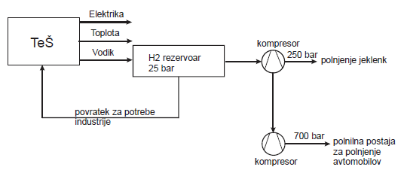
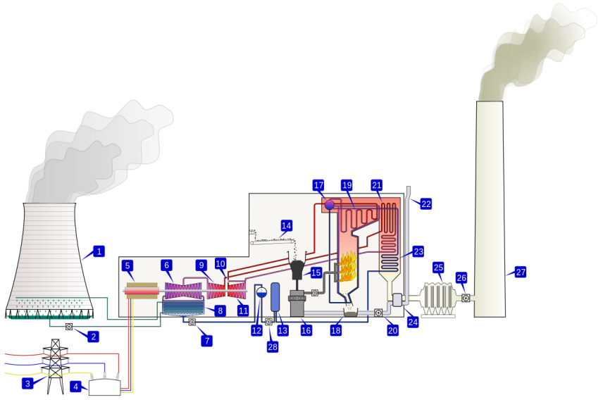

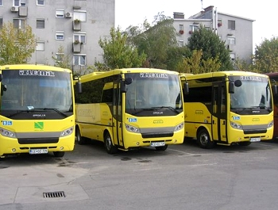
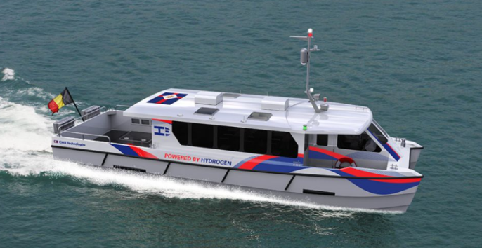

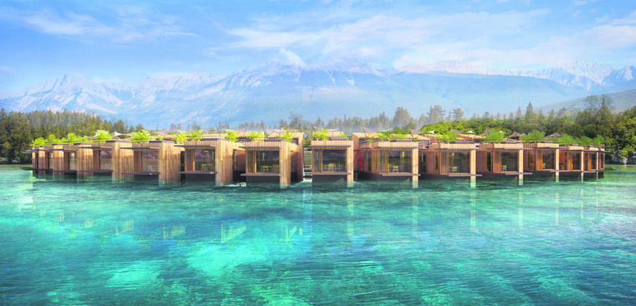
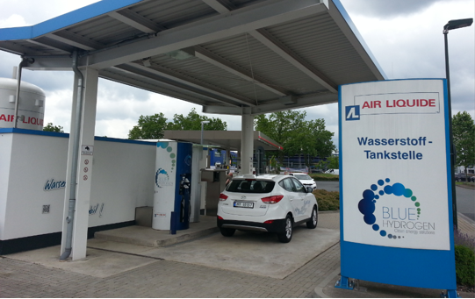
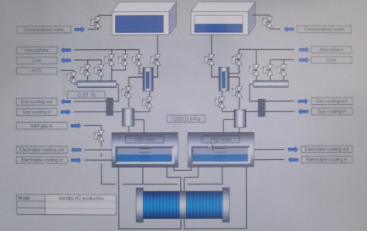
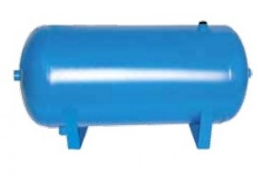

Sustainable mobility and tourism
250 V, 376 A
25 bar
350 bar, 700 bar

Slide 11



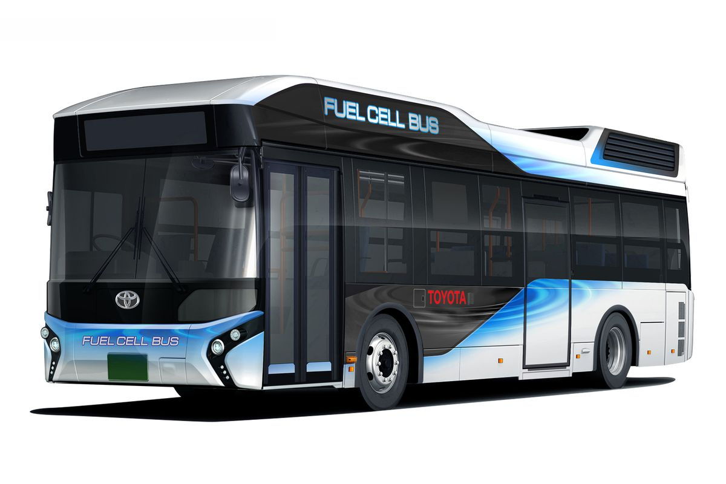
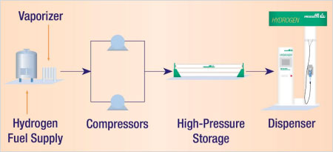
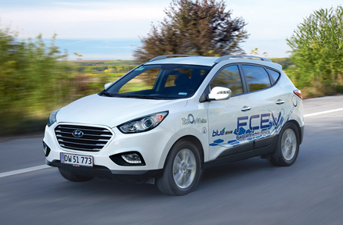


Slide 12

Main focus
The project will develop and deploy a replicable, balanced and integrated hydrogen economy by facilitating investment into market-ready hydrogen technologies.
The goal is to make use of available local hydrogen sources and apply it in applications for reducing green-house gas emissions, starting with zero-emission public transport.
Primarily, the investment project shall include the construction of a 1)hydrogen fueling station, 2)modernization of the current fleet of diesel powered minibuses with fuel cell electric vehicles (FCEV) operating within the local public transport service and the 3)upgrade of local hydrogen production facilitates.
The hydrogen fueling station will include re-fueling at both 350 bar and 700 bar. This will allow the operator to plan and guarantee demand for hydrogen based on regular and predictable requirements of the local public transport service, so that the operation of the station is continuous. On the other hand, the project is focused to support the European network of hydrogen fueling stations for personal vehicles, for which the 700 bar stage is required.
The FCEV buses will be deployed in local and inter-urban public transport, substituting standard diesel buses in operation.

Slide 13
Main focus
Hydrogen of high purity is being produced by the Šoštanj Thermal power plant. The production is relatively small scale, but in its current state would be sufficient to supply approximately 80% of the hydrogen requirements for local public transport.
The unit was established with a primary goal to supply the technical tasks of power plant maintenance with oxygen, thus while hydrogen is being used mainly for cooling of electrical generators of block 5, a substantial amount is vented to local surroundings. Current studies show that upgrading the production unit to service the requirements for public transport as envisaged by the project would not cause a considerable increase of primary fuel (lignite) use, and would have a positive impact on operational stability of the power plant.
The strategic focus of the project is to provide hydrogen refueling capability to the Graz-Ljubljana-Zagreb corridor and expand the European network of refueling stations, by placing the station nearby the third national development axis (Fastlane on route F2-2 connecting the lower part of the Savinjska valley with Velenje and beyond to Koroška region, for which a national spatial plan has already been confirmed). Đ
The capability to refuel personal FCEVs will make the region and Slovenia in general, more attractive to owners of such vehicles, predominately from western and Scandinavian countries!

Slide 14
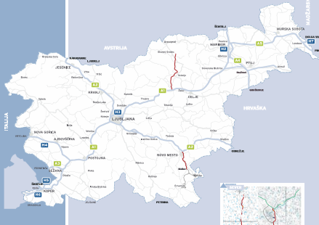
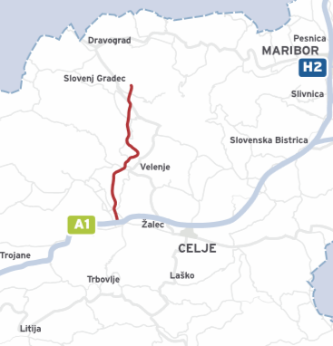
The third development Axis - north
The northern part of the third development axis is divided into two sections:
- from the Šentrupert junction on the A1 motorway (Šentilj-Koper) to the Velenje south terminal, about 14 km
- from the connection Velenje south to the connection Slovenj Gradec south, about 17,5 km.

Slide 15
Long-term ambition
City municipality of Velenje plans to make substantial investment for supporting green local tourism in the following years particularly on the Velenje Lake, where the goal is to expand the zero-emission transport to water going vessels with a demonstrational hydrogen powered boat that will link the touristic activities and content associated to sustainable development.
The long-term ambition of the project is to support further investment into hydrogen technologies, with hydrogen as an energy vector being at the cornerstone of the energy transition of the Šaleška Valley, that aims to substitute the gradual shut-down of the lignite thermal power plant Šoštanj (providing from one third to one half of the national electrical energy supply) with an ever-increasing share of renewable energy sources in the energy mix.
The long-term outlook of the project is to transform a region deeply characterized by decades of energy production by fossil fuels to a » Hydrogen valley«, utilizing vast potentials of locally available renewable energy in a system focused on grid stability and pollution reduction. A concept, that is relevant and directly applicable to numerous regions across Europe and beyond.

Slide 16
- Sustainable business case
- Existing infrastructure
- Integrated and replicable concept
- Substantial knowledge and experience on both the local and regional level
- Public support
Advantages

Slide 17


Thank you!
bostjan.krajnc@kssena.velenje.eu
Tel.: +386 3 8961 520
info@kssena.velenje.eu
www.kssena.si

