Slide 1




Strategic research and innovation partnership (SRIP) –
Networks for the transition to circular economy
Sustainable Business Models in Circular Bioeconomy
Innovative Circular Products from diverse biomass resources
Bojan Borin
23 September 2019 I Brussels
Investment is co-financed by the Republic Slovenia and the EU under the European Regional Development Fund.

Slide 2

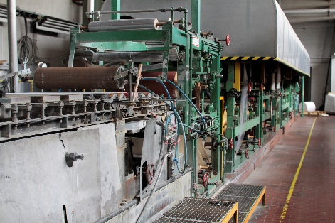
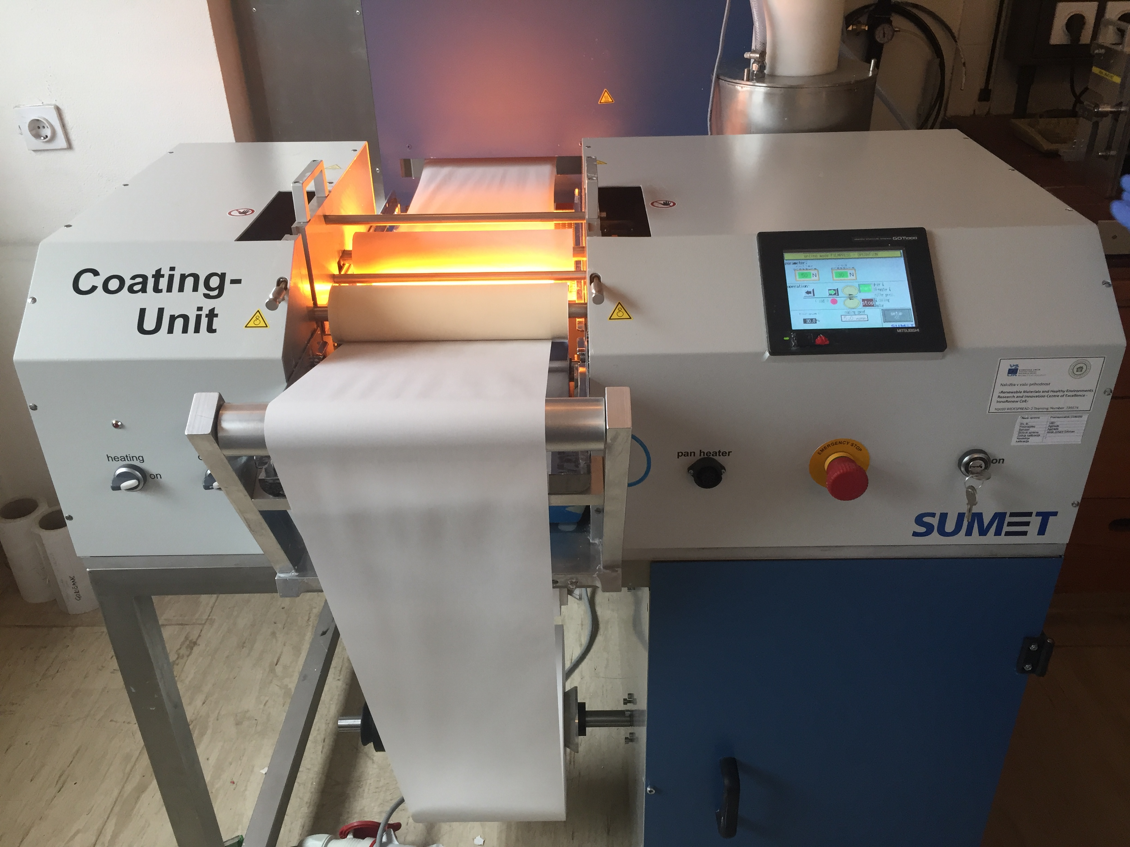
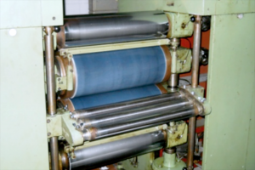
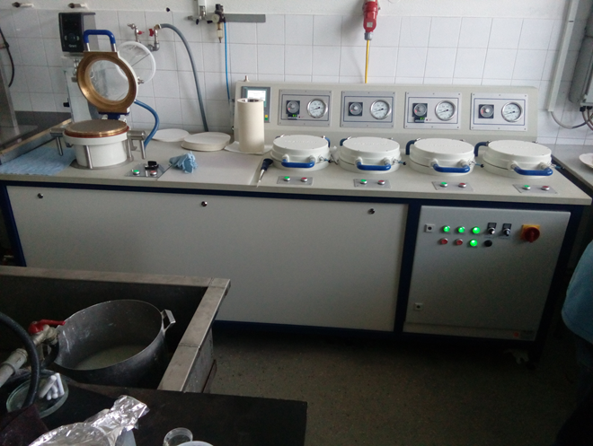
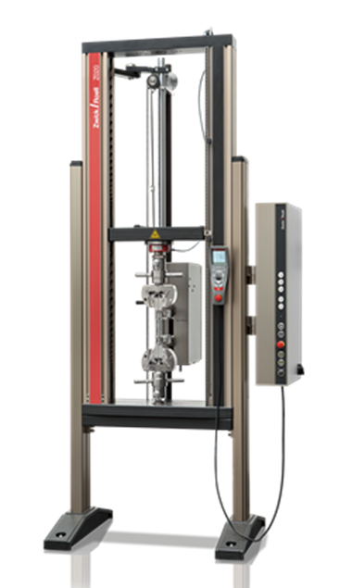
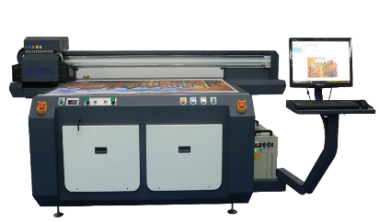
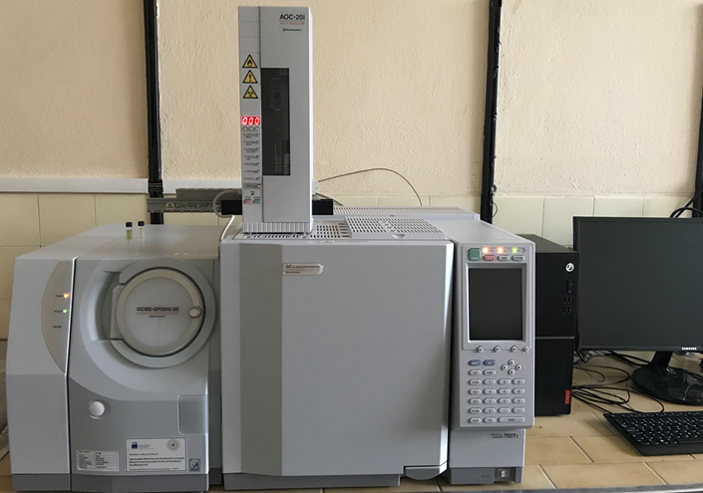
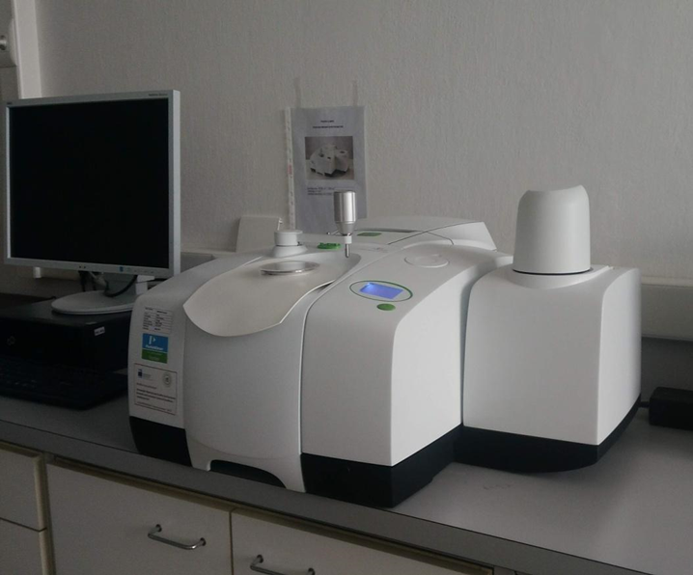
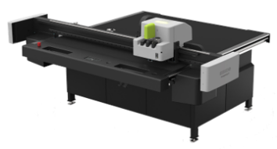
About ICP – Pulp and Paper Institute
R&D
Comprehensive knowledge on renewable natural fibrous materials
Development of new, bio-based materials and bio-based products
Interdisciplinary team of experts
Accredited laboratory according to ISO 17025:2017 for mechanical, chemical and microbiological testing
Comprehensive research infrastructure for laboratory and semi-industrial trials

Slide 3
Main reasearch field
Valorisation of diverse biomass resources for raw materials and efficient treatment processes
Multifunctional cellulose materials
Biocomposites and technologies in production of fibre webs

Slide 4




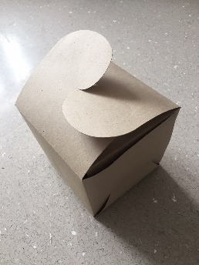

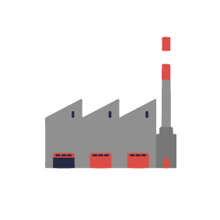
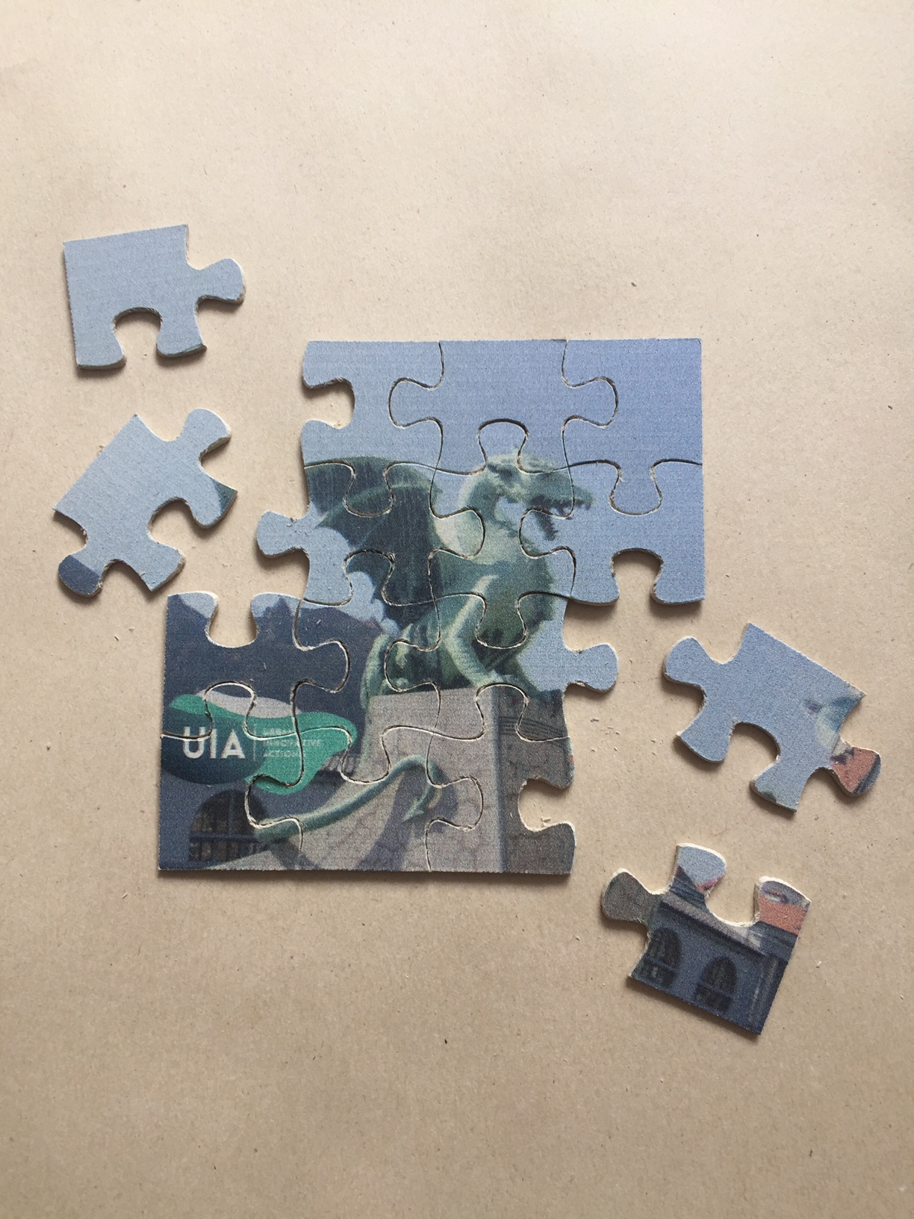
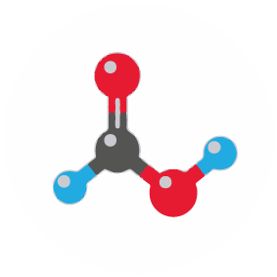
Database on lignocellulosic biomass
Digestion of biomass & isolation of components (DES)
New business models (collection and re-use of urban biomass residues - invasive plants)
Advanced processes in (nano) cellulose production
Green chemicals (coatings, adhesives, resins)

Slide 5




Paper/board with improved and new FUNCTIONALITIES
Improved BARRIER and SENSORY PROPERTIES
SMART PACKAGING
with printed sensors
YARN with functional
cellulose fibers

Slide 6





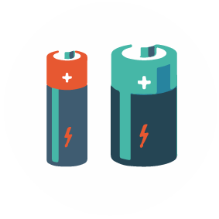
Bio-based filtering materials
Insulating materials
Thin/light polymer composites
Battery separators

Slide 7






Current Projects
CEL.CYCLE – Discarded potential of biomass
Potential of biomass for development of advanced materials and bio based products
InnoRenew CoE
Development of the Renewable Materials and Healty Enviroments Research and Innovation Center of Excellence
APPLAUSE (Alien PLAnt SpEcies)
From harmful to useful invasive alien plant species citizens‘ led activites
J2-8182 - Catalytically-assisted high efficiency and low-cost nanostructured sensors based on modified screen printed electrodes for analytical chemistry
BRIDGE2BIO
Bridging Gaps in Bioeconomy: from Forest and Agriculture Biomass to Innovative technological solutions
BIOEASTsUP
Advanced Sustainable Circular Bioeconomy in Central and Eastern European Countries
For more information about the projects, visit our website:
http://icp-lj.si/1540-2/research-and-development/current-projects/?lang=en

Slide 8
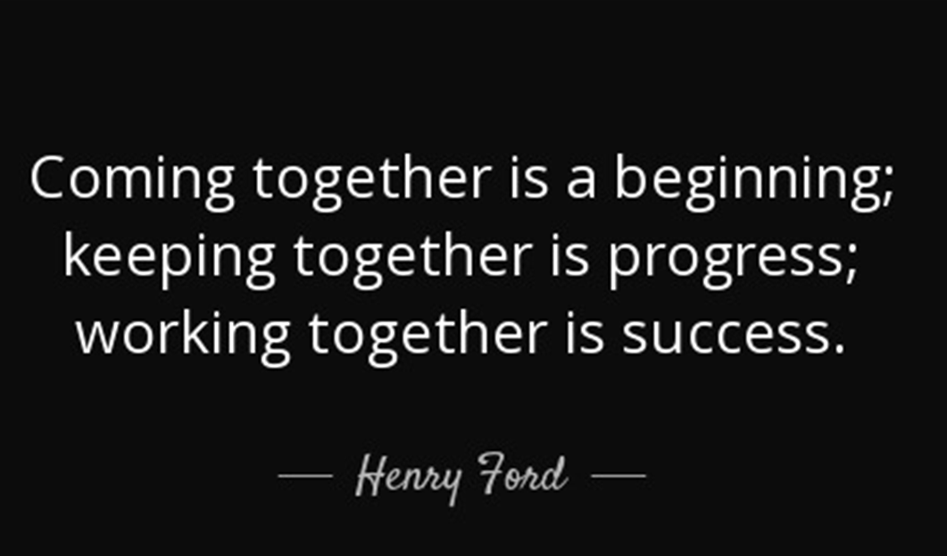

Looking forward for future cooperation!
Contact:
Bojan Borin, Head of Laboratory
+386 1 200 28 15
bojan.borin@icp-lj.si
www-icp-lj.si
Investment is co-financed by the Republic Slovenia and the EU under the European Regional Development Fund

