Slide 1



The importance of creativity in development of SMEs the creainnovation experience
Andrea Vignoli
Viterbo Chamber of Commerce and Industry
Bruxelles, 8th of October, 2019

Slide 2
Overview of the Project
Title: Create sustainable Innovation in SMEs using creative methods and processes
Acronym: CreaInnovation
Approved on the 2nd Call for Modular Projects of Interreg MED Programme
Priority axis 1: Promoting Mediterranean innovation capacities to develop smart and sustainable growth
Objective 1.1: To increase transnational activity of innovative clusters and networks of key sectors of the MED area
MED Green Growth community – Horizontal Project SYNGGI

Slide 3
THE PROJECT PARTNERS
Chamber of Commerce of Viterbo, Italy
University of Algarve, Portugal
Centre for Research and Technology Hellas, Greece
Barcelona Official Chamber of Commerce, Industries, Services and Navigation, Spain
Scientific Research Centre Bistra Ptuj, Slovenia
University of Zagreb Faculty of Electrical Engineering and Computing, Croatia
Gers Chamber of Commerce and Industry, France
Sarajevo Economic Region Development Agency, Bosnia and Herzegovina
Ministry of Economy, Montenegro

Slide 4
Overview of the Project
“the project aims to develop and test transnational business innovation capabilities through the practice of creativity methodologies, tools and processes in innovation workshops with the MED SMEs, involving creativity experts competencies, external managers and young students, generating sustainable business ideas, driven and evaluated by a sustainability evaluation model assembled in the project”

Slide 5
CREATIVITY FOR A SUSTAINABLE INNOVATION GROWHT
It's possible….
to innovate in a sustainable way
improve one's creative capacity
increase the creative capacity of companies

Slide 6

INNOVATION & CREATIVITY
Innovation is the result of the creative ability to generate ideas and the creative capacity to make them operational
The creative capacity inherent in each one, if stimulated and developed through specific methods and processes, allows a more profitable and easier ability to generate innovative ideas
Managerial ability then allows the idea to be converted into a successful business.

Slide 7
Definition of creativity.
Creativity is a mental and sociological process that implies the cognitive ability of the mind to:
see things from a new perspective,
produce new ideas and new concepts,
establish unprecedented relationships between different elements.
According to Henry Poincaré:
Creativity is combining existing elements
with new connections, which are useful.

Slide 8
Development of creativity.
Creativity is a particular form of intelligence strongly based on the aesthetic dimension.
As such it can be stimulated, exercised and transmitted through a method / path and aimed to the production of innovation.
The basis of creative processes is the comparison between alternative points of view that trigger a socio-cognitive conflict.
Source: R. Pederneschi

Slide 9
Objective of the process of stimulating creativity.
Provoke an "epistemological perturbation" to bring out new, original and shared points of view by using alternative and complementary knowledge methods with respect to the classical cognitive processes of an intuitive, emotional and divergent type.
Essential conditions for creativity are the plurality of points of view and reference to the subject
Source: R. Pederneschi

Slide 10
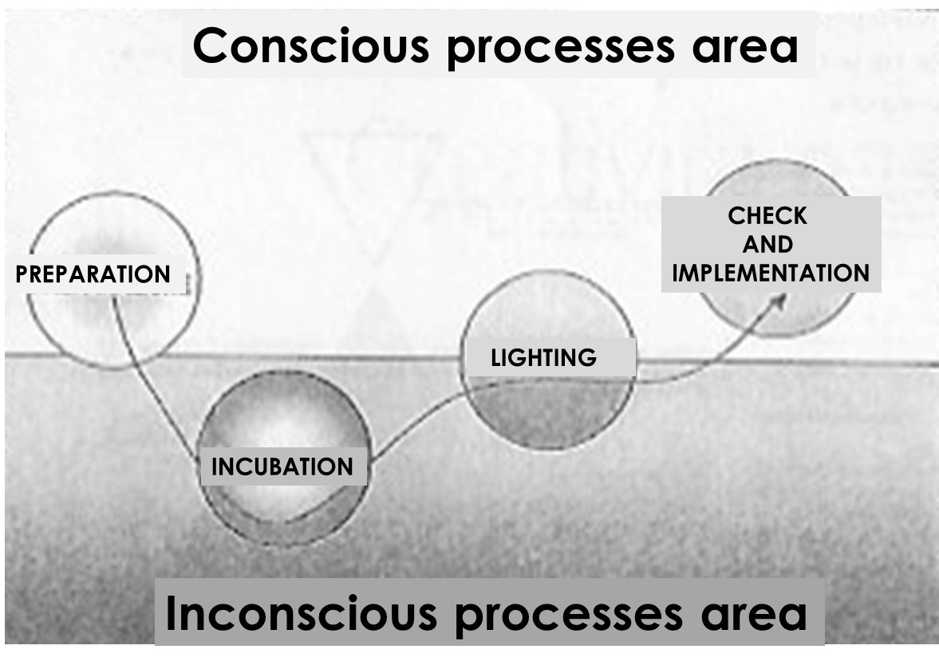
The creative research method
Creativity as "aesthetic intelligence" can be learned and cultivated like logical-rational intelligence.
The spontaneous process
Source: R. Pederneschi

Slide 11

CONNECT LEFT AND RIGHT SIDE OF THE BRAIN

Slide 12
Thought preferences
5. In the face of a challenge I like:
a. ask questions and gather information.
b. trust my intuition to proceed.
c. carefully examine the pros and cons of each solution.
d. see ideas take shape and become concrete.
6. I like spending time. . .
a. working with information.
b. thinking of new possibilities.
c. do the "right" things.
d. testing, prototyping, realizing.
7. Faced with a challenge I like:
a. find a solution that is well thought out.
b. think in global and abstract terms.
c. analyze every possible alternative.
d. focus only on those ideas that I feel will work.
1. In the face of a challenge I like:
a. take time to clarify it perfectly.
b. look at the overall picture.
c. try to build solutions that work.
d. See that things happen and come about quickly.
2. I am very motivated by. .
a. a need for a clear understanding of the facts.
b. a great idea.
c. an opportunity to perfect an existing solution.
d. a job to do.
3. In the face of a challenge I like:
a. take all the time I need to assess the situation.
b. play with ideas and possibilities.
c. plan the various steps that lead to the result.
d. structure the ideas so as to transform them immediately.
4. I learn better through. . .
a. facts, research, data.
b. stories, ideas, concepts.
c. evaluation of options.
d. trying things out.
8. Faced with a challenge:
a. I try to rationalize the framework.
b. I look for all possible alternatives.
c. I take the time to reflect.
d. I feel the urgency to find the solution.
9. In the face of a challenge I like:
a. don't underestimate the details.
b. have a space and stimuli to think.
c. pursuing the perfect solution.
d. act immediately.
Score: How often the answer is: a .___ b. ___ c. ___ d. ___

Slide 13
Your level of preference
9
8
7
6
5
4
3
2
1
A - Clarifier
cautious and structured thinker who likes to collect data to understand reality and identify problems, gaps and opportunities
B - Ideator
playful and original thinker who likes to see the "big picture" and create new connections that could break the paradigm
C - Developer
detailed planner who likes to evaluate and refine the best version of a solution and predict how it will go on with the most success
D - Implementer
confident, action oriented risk operator who loves learning by doing

Slide 14
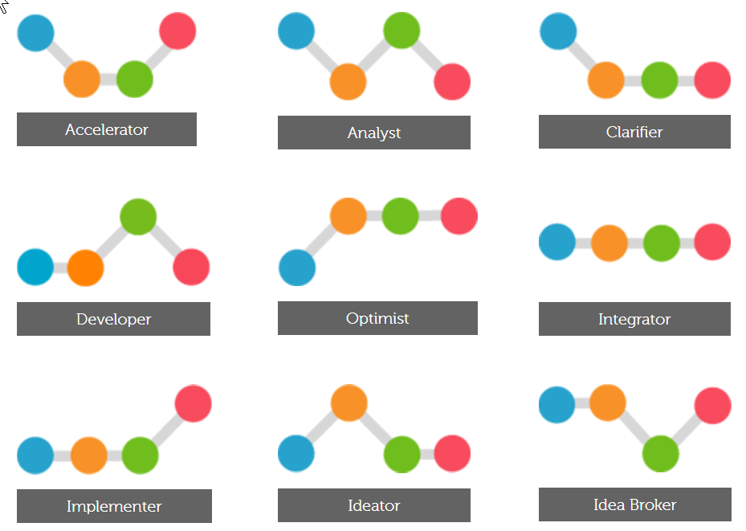
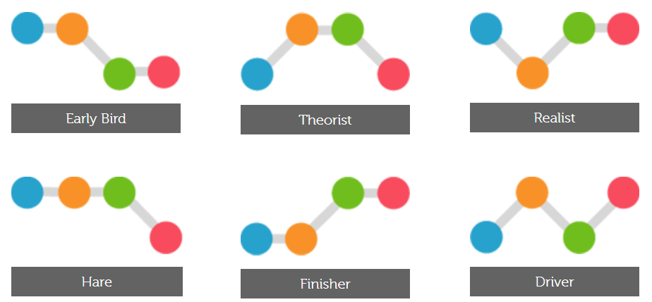
The FourSight Thinking Profiles Index
https://foursightonline.com/foursight-profile-index/

Slide 15
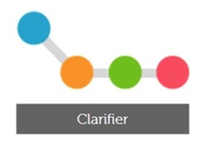
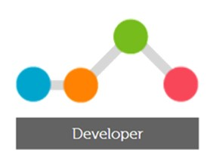
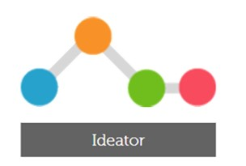
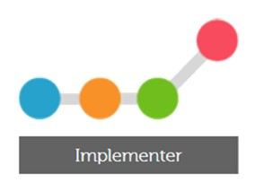
THE BEST CREATIVE TEAM
Notes:
A - Clarifier
cautious and structured thinker who likes to collect data to understand reality and identify problems, gaps and opportunities
B - Ideator
playful and original thinker who likes to see the "big picture" and create new connections that could break the paradigm
C - Developer
detailed planner who likes to evaluate and refine the best version of a solution and predict how it will go on with the most success
D - Implementer
confident, action oriented risk operator who loves learning by doing

Slide 16

The courage to change
Creativity and innovation need more forms of courage, each of which must be embodied by an organizational entity that takes responsibility for it.
Break the reassuring patterns, both own and of others, that have produced success.
Find the strength to put change into practice by example.
Allow the mistake by allowing the people involved in the innovative process to make mistakes.
Source: R. Pederneschi

Slide 17










The testimonies
Companies that have followed creative paths to generate innovative, successful ideas

Slide 18
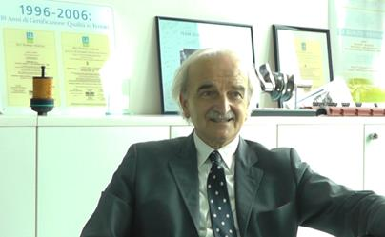

The Ferrari case: the problem.
Ermanno Bonfiglioli
(past chief of strategic projects)
"Among the seminars accessible to employees was a course on creativity ..."
"I must say that the consultant was really good, the meetings with her were really important to open the mind, to approach and talk about things other than the moon, the woods, a skyscraper, but seen in a different perspective, not the one that enters your mind and then you never get out. "
“After following the seminar I considered it challenging and useful for my structure to try to make a similar experience with the group of 35 designers who worked with me in the company to address a problem of strategic importance that was thought unsolvable:
the reduction of the weight and the cost of the engine. "

Slide 19
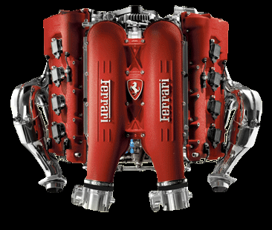
The Ferrari case: the challenge
A challenge to be faced at a first reading through a logical-rational approach, but not for Ermanno Bonfiglioli who stated:
"An engine, to work well
it must also be beautiful "
So a challenge to be faced with a "creative" approach out of the classical industrial thought patterns.

Slide 20
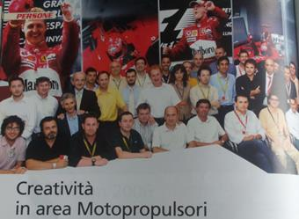
The Ferrari case: the solution
"Initially there was a moment of loss, the consultant began to talk about beauty and aesthetic concepts, then the boys all succumbed to the charm of the method, the charm of the story, the charm of how to set an idea differently.
Among the techniques used, each designer was asked
to impersonate a piece of the engine, and to bring the piece into the workshop, as if it were something we say, "it's your personal, you are ... so, look at it, etc."
In this immense salon equipped with walls on which were attached meters and meters of paper to be able to write, the designer, who did not have the CAD with him, had to stand in front of a wall, using felt-tip pens and generate ideas there. The experience lived along the way confirmed the initial intuition: ideas and solutions were produced that had not yet been taken into consideration.

Slide 21

The tangible results
«With regard to the reduction in engine weight, a reduction of around one kilo was obtained from five parts. But above all, and this is the most important point, we have reduced the weight, without increasing the cost. On just as many details, only the cost has been reduced. "
«A series of ideas have been implemented in the short term (such as the phonic wheel for distribution, the gearbox with 40% less weight and the reduction of construction times, the GDI head covers reducing their weight and noise, simplifying also the assembly) and then other ideas that have been carried out in subsequent projects because they are too invasive to be included in the product in use. »
"We have had fertile ground to carry forward eighty percent of the ideas quietly. There were others that were a bit "out of focus", as clear as content, but very difficult to take home, because it meant changing the technological process that is the core of Ferrari. So, you always have to go and deal with what is your business reality. "

Slide 22
Other tangible results
"Among the results obtained a significant importance is this opening of the mind towards the fact of approaching the work in a different way."
"Some of the participants reiterated the concept of getting rid of some blocking beliefs, bringing home a new cultural setting ".
“I can say it was a matter of philosophical creativity and this thanks to the method, to the way of working of the consultant who brought the engineers to another level, who, after a little confusion, realized that without that change of perspective they would not have embarked on another way.”

Slide 23
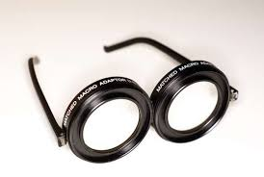
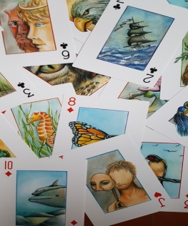

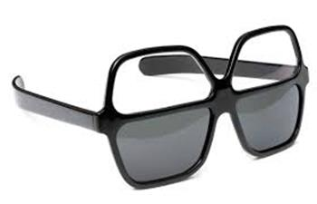
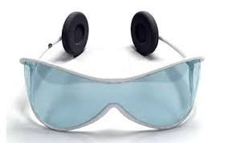
Stimulate creativity
Walk away
I daily
I creative
interpretative
Subjective
Participatory
Descriptive
Objective
Sabbath year
The superhero I (my qualities the superlatives, the superhero, the superpowers, what limits are overcome, what message to the world)
Excursions (scene from a movie, an object and how it feels, a character and his fantastic story ...)
Eureka cards

Slide 24
The portfolio of techniques
PROJECTIVE
Fictional
COMBINE
Excursions,
Eureka cards
Body identification
Dreaming of the solution
The Checklist (adapt, modify, add, subtract, multiply, divide, replace, rearrange, reverse, combine),
Brainwriting,
sociodrama,
Inconscious
Conscious
5W + H (Who, What, Why, When, Where, How)
Tree of ideas / mind maps
Benchmarking
Morphological matrix (verbs, adjectives, concepts, objects, places, ..),
Concatenation (from 4 keywords their evolution by analogy),
Cirano (narrative: comic, tragic, lyrical, heroic, solemn)
ANALOGICAL
RATIONAL
Real

Slide 25
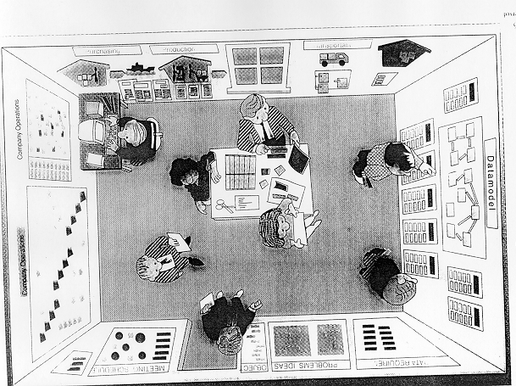
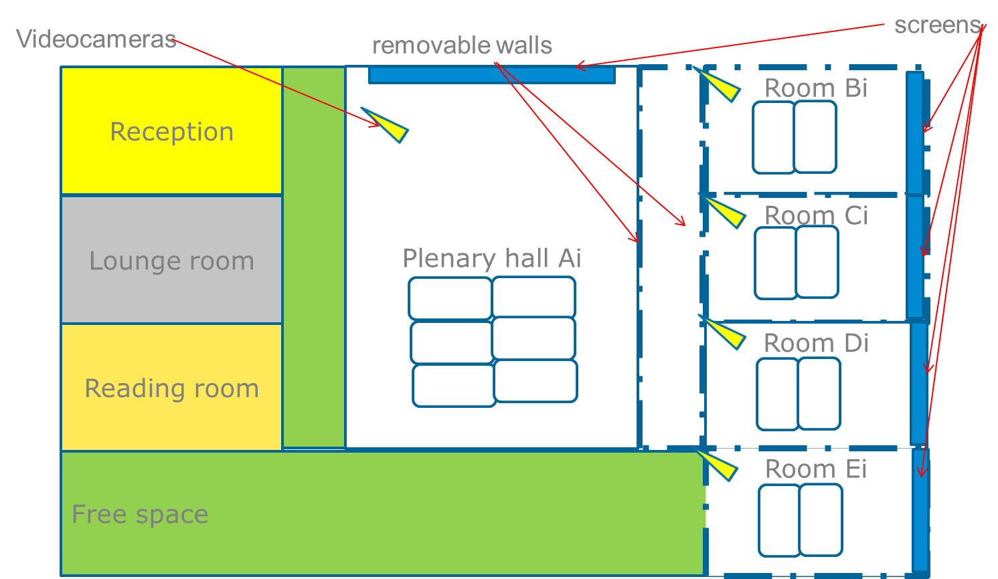
Workshop location & facilities
Possibly outside the SME premises
One main room and 2 small rooms for subgroups
Free walls on which to attach sheets (brown paper)
Flip Chart
Video projector
Internet connection

Slide 26
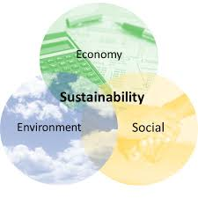
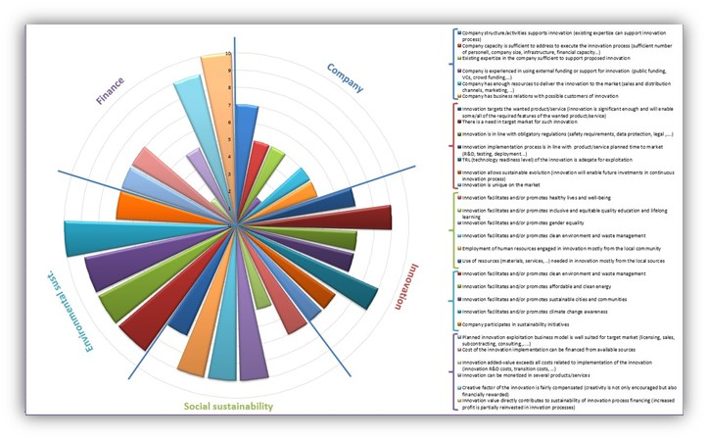

The creative process FOR SUSTAINABLE INNOVATION
?
?
?
!
?
?
?
SUSTAINABILITY
AWARENESS
ANALYSIS
DIVERGENCY
CONVERGENCY
BUSINESS IDEA
SUSTAINABILITY
EVALUATION
INNOVATION
STYMULI

Slide 27

Analysis: deepen the theme of the idea
Fishbone / Ishikawa
6 Hats (objectivity, emotions, negativity, optimism, creativity, control)
Eureka cards
Cirano (narrative,: comic, tragic, lyrical, heroic, solemn, ..)
What would happen if .. (eliminate, double, extend, ...)
List of attributes (physical, psychological, technical, emotional, economic, ..)
Drawing of the problem
Five senses
Mind Map
Dark and Laurel
King of the mountain
…..
What is the real problem?
What are the causes?
What is our goal?

Slide 28

Divergency: ideas generation
Rational, Associative, Projective, Analogical
Generate the highest number of ideas
Suspension of judgment
Without constraints, everything is possible
5W + H (Who, What, Why, When, Where, How)
Tree of ideas / mind maps,
The Checklist (adapt, modify, add, subtract, multiply, divide, replace, rearrange, reverse, combine),
Morphological matrix (verbs, adjectives, concepts, objects, places, ..),
Brainwriting,
sociodrama,
Excursions,
Eureka cards
Concatenation (from 4 keywords their evolutions by analogy),
Cirano (narrative: comic, tragic, lyrical, heroic, solemn)
…..

Slide 29
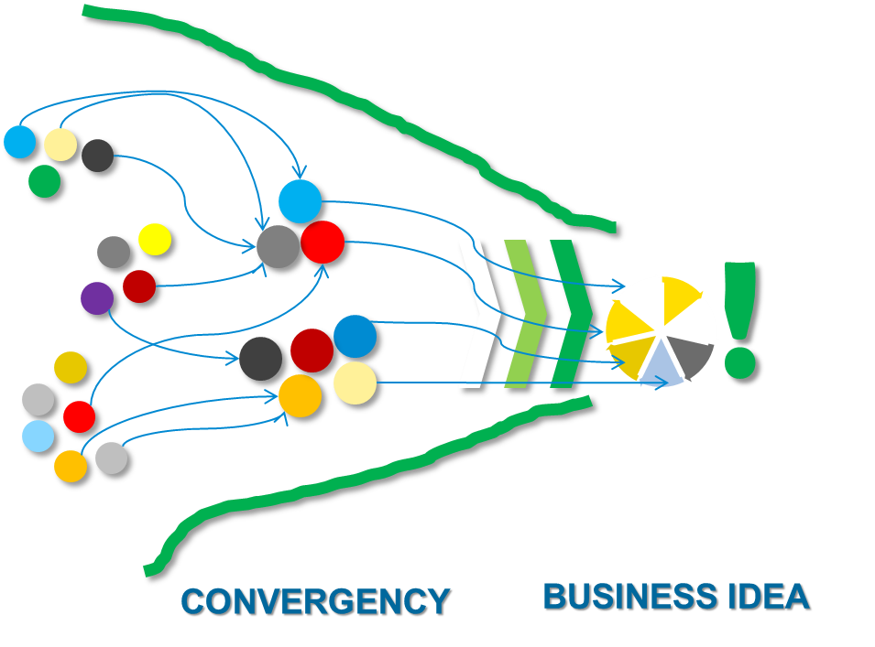
Convergency: finalization of ideas
5W + H (Who, What, Why, When, Where, How)
Highliting / Yellow Ideas
Angel's lawyer
Assist and resist
Catastrophe
Vote
LKO (Likes, Concerns, Opportunities)
PPCO (Plusses, Potentials, Concerns, Overcomes)
PCA (Paired Comparison Analysis)
…..

Slide 30


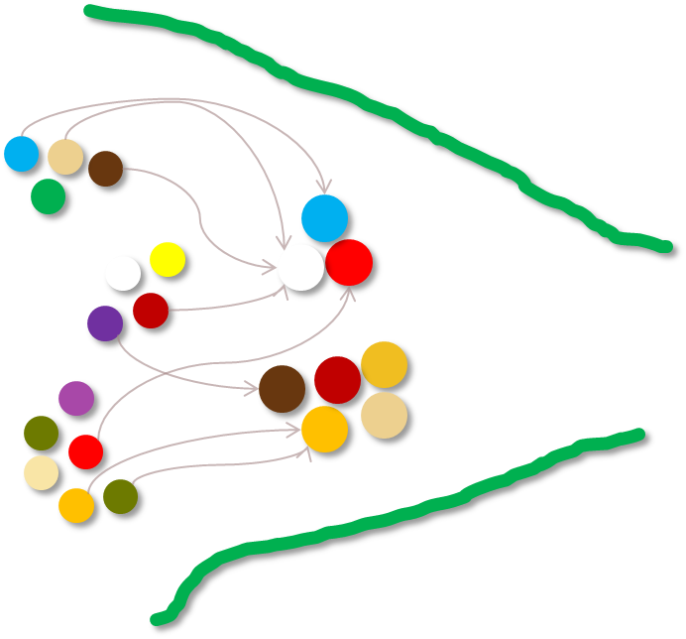
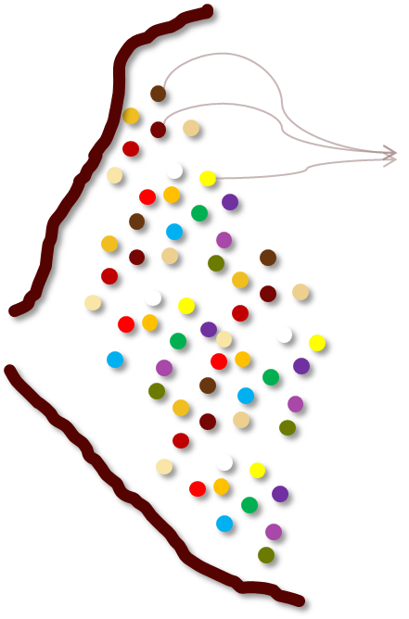

Workshop process & duration
1 or 2 days
Welcome & objective set-up
Icebrakers and creativity stymulus
Action plan
Problem/opportunity definition/setting
Sustainability focusing
Innovation opportunities stymulus
Ideas generation (divergence)
New Business concept design (convergence)
Possible obstacles overcome (divergenc & convergence)
solution definition and sustainability evaluation

Slide 31
THANKS FOR YOUR ATTENTION
Andrea Vignoli
Viterbo Chamber of Commerce and Industry
cciaavt.eu@gmail.com

