Slide 1

advanced materials in circular economy
Opportunities for development of advanced
materials in circular economy
Case example: National Institute of Chemistry
Prof. Gregor Anderluh, director

Slide 2
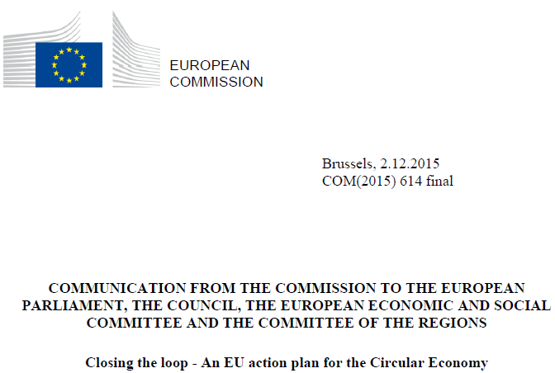
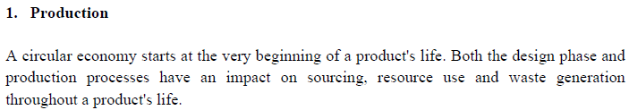
advanced materials in circular economy

Slide 3
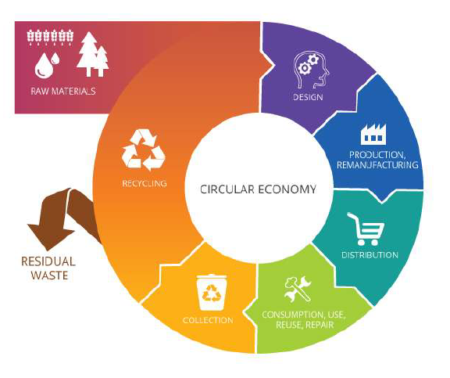
advanced materials in circular economy
Responsible
Green
Bio-based
Sustainable

Slide 4

advanced materials in circular economy
Smart Specialisation Strategy of Slovenia
20. 9. 2015
Priority Areas
Smart Cities
Smart Buildings
Circular Economy
Functional Foods
Tourism
Factories of the future
Health, Medicine
Mobility
Materials as end products
2016
Projects
Strategic Research and Innovation Partnerships
To come
Projects
Infrastructure

Slide 5
advanced materials in circular economy

Slide 6









advanced materials in circular economy
Projects
ongoing projects
10
H2020 projects
3
M.ERA-NET
76 national projects
2
ERA-NET projects

Slide 7
advanced materials in circular economy
Projects
FReSMe, From Residual Steel Gasses to Methanol, 2016.
ADREM, Adaptable Reactors for Resource- and Energy-Efficient Methane Valorisation, 2015.
MefCO2, Synthesis of Methanol
from Captured Carbon Dioxide Using Surplus Electricity, 2014.

Slide 8
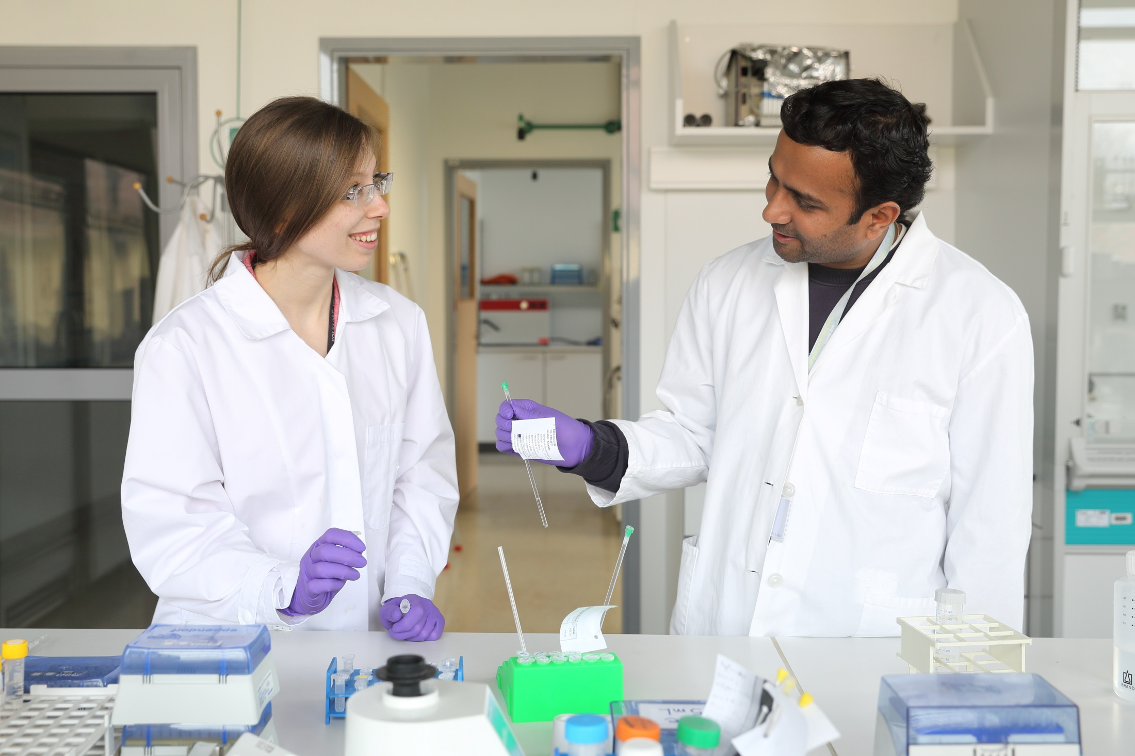
advanced materials in circular economy
300 employees
130 researchers with PhD
66 PhD students
in expanding knowledge of chemistry and associated studies
in transferring knowledge to younger generations
in applying newly acquired knowledge to industry

Slide 9
advanced materials in circular economy
Life sciences
Theoretical chemistry
Analytical chemistry
Materials research
Chemical engineering and catalysis
Chemistry and related disciplines
Health
Energy
Environment
Food
Climate
Pressing challenges

Slide 10








advanced materials in circular economy
Cooperation with industry
Services
Projects
R&D contracts

Slide 11
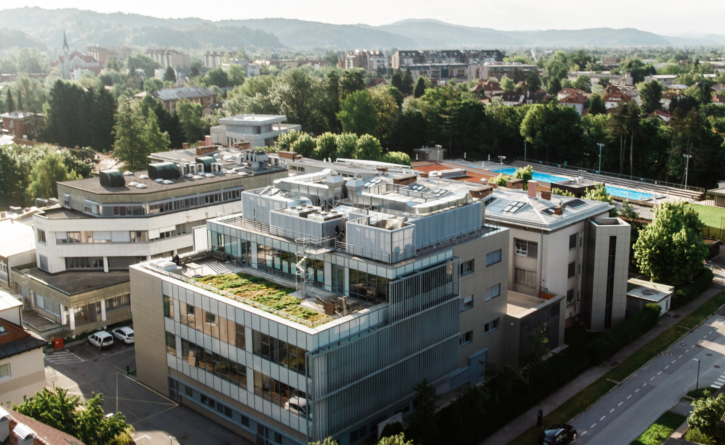
advanced materials in circular economy
PREGL RESEARCH CENTER
10 Mio EUR
3800 m²
Finished 2013

Slide 12
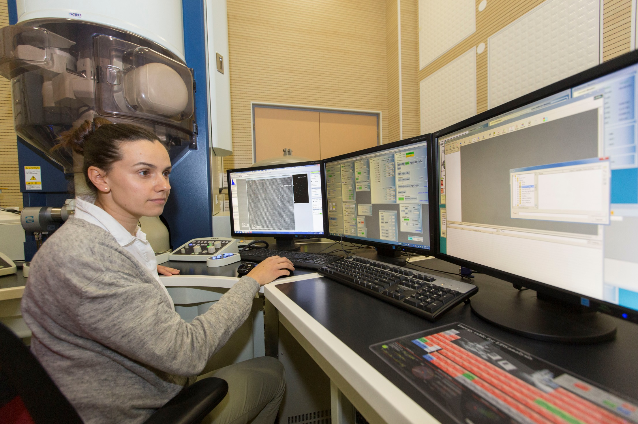
advanced materials in circular economy
Supra 35 VP EM with EDX analysis
800 MHz NMR spectrometer National NMR Centre (CERIC/ERIC)
AR-STEM (Jeol, ARM 200 CF)
Confocal microscopy (Leica TCS WLL SMD platform)
High performance computing cluster

Slide 13
advanced materials in circular economy
Responsible
Green
Bio-based
Sustainable

Slide 14
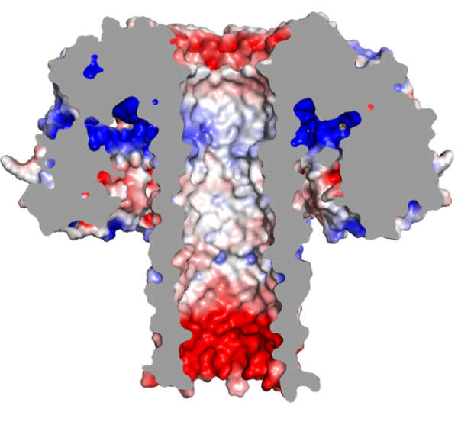
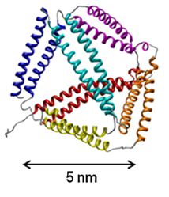
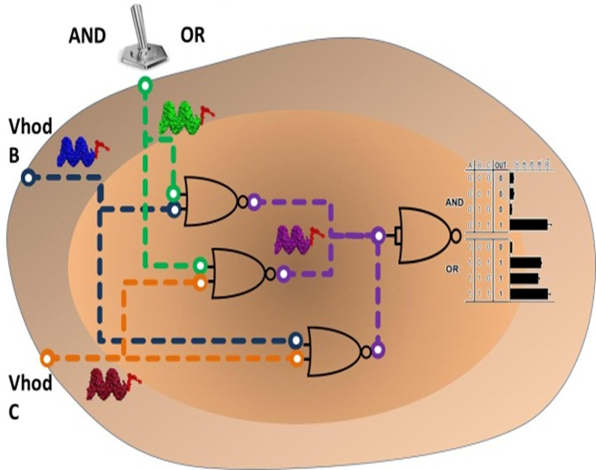
advanced materials in circular economy
Podobnik M et al. (2016)
Nature Comm. 7:11598.
Gradišar H et al. (2013)
Nature Chem. Biol. 9: 362-366.
Gaber R et al. (2014)
Nature Chem. Biol. 10: 203-208.

Slide 15
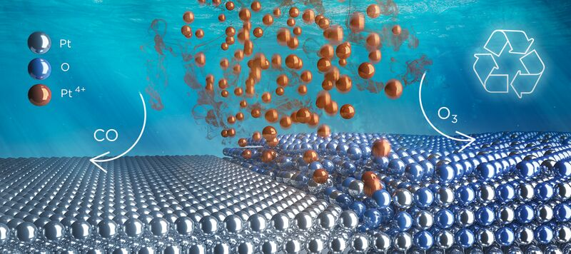
advanced materials in circular economy
Hodnik N et al. (2016) Nature Commun. 7:13164.

Slide 16
advanced materials in circular economy
Responsible Research and Development
ADVANCED MATERIALS
Modelling
Materials for energy
storage and conversion
APPLICATIONS
CO₂ capture and conversion
Batteries
Coatings
Drug delivery
Vaccines
Sensors
(bio)catalytical materials, graphene, nanoparticles, microporous
materials, raw materials
Innovation improvement, investment increase, economy growth
Personnel development, capacity building
Biomimetic
nanomaterials
Regional development
foldamers, polypeptide networks, nanopores, bionanostructures
Research
Training
Innovation
Pilot
Demonstration

