Slide 1
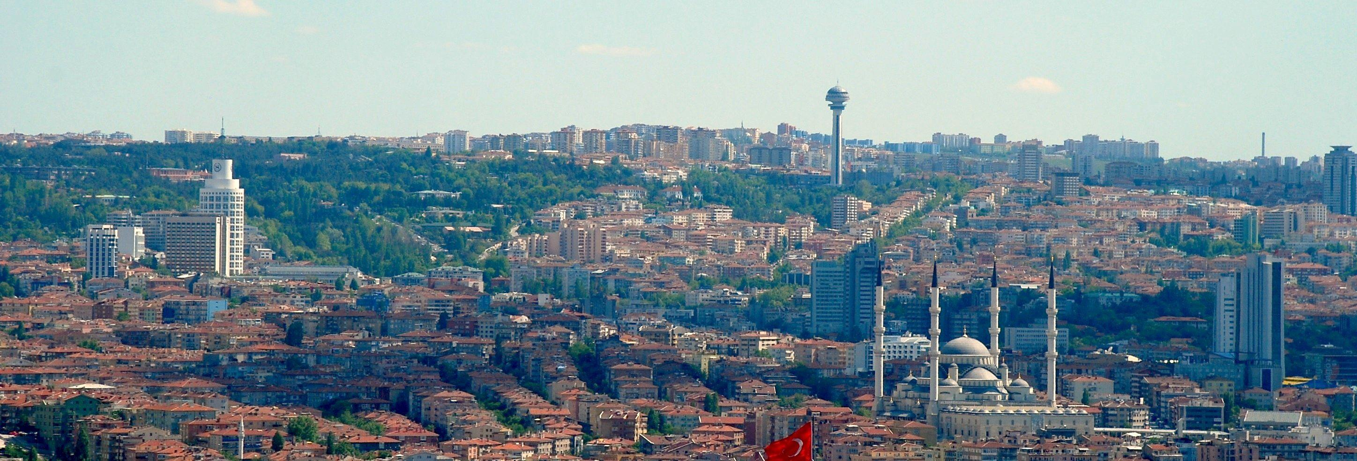
Circular Economy and
Waste Management in Çankaya
Anil Sevinc
Vice Mayor of Çankaya Municipality, 12.10.2016
www.cankaya.bel.tr

Slide 2
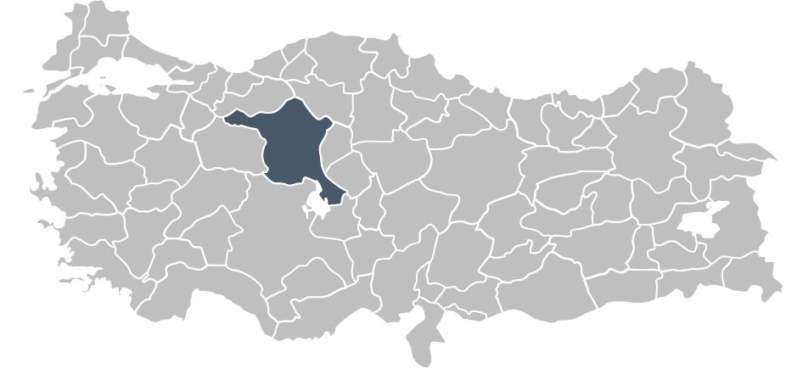
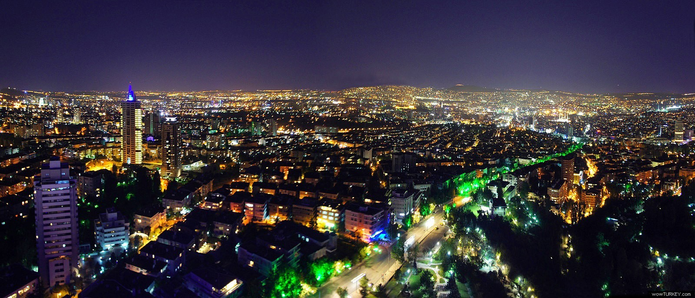
Ankara:Capital City of Turkey
Çankaya:Largest District of Ankara and Turkey

Slide 3
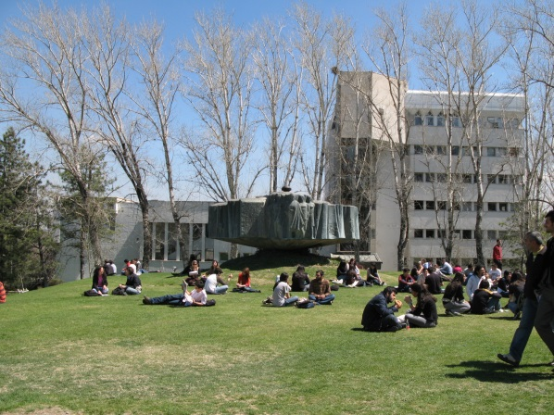
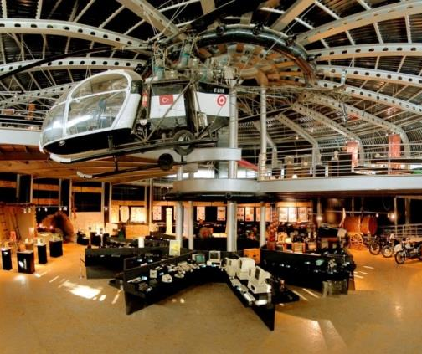
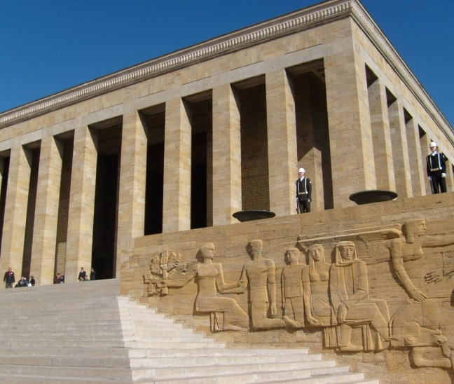
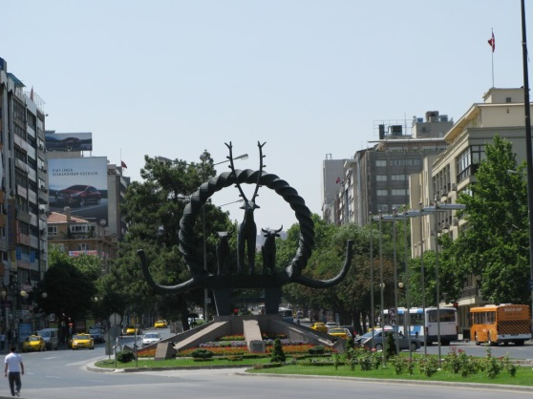
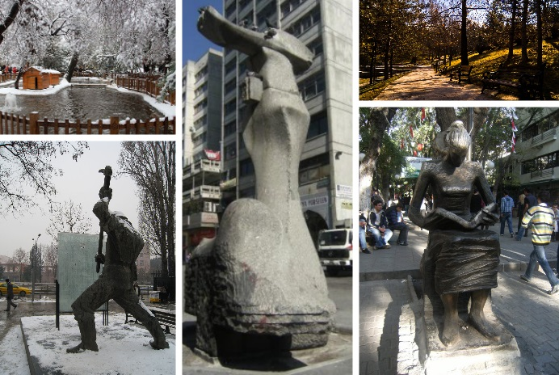
ÇANKAYA with Numbers
The population: 922.536
Population during the day time: more than 2 Million
Number of Neighbourhoods/Districts: 124
Number of Universities: 12
Number of Students: more than 100.000 103 primary schools- 46 high schools- 59 private schools
Number of dwellings: 333.537 Number of offices- work places: 107.000
High quantity of waste and recycling potential

Slide 4
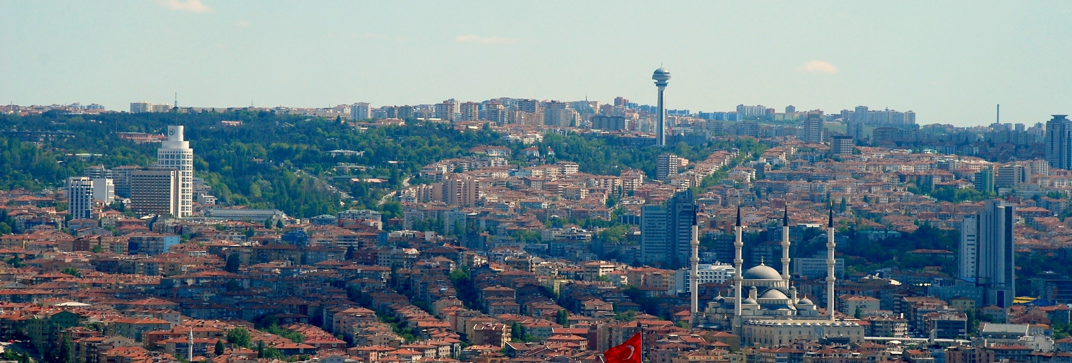
Waste Management
in Turkey

Slide 5
WASTE MANAGEMENT IN TURKEY
The EU Waste Packaging Directive, was adopted in 2004 in Turkey and published as “Control of Waste Packaging Regulation” on 30th of July 2004, then it has come to its final stage in 2011, considering the needs of the relevant sectors.
According to the Metropolitan Municipality Law and the Municipality Law sole responsibility for the management of municipal waste falls on the municipalities. District municipalities are responsible for providing all services regarding collection, transportation, separation and disposal of solid wastes. The recycling, disposal and storage of the waste is the responsiblity of metropolitan municipalites.

Slide 6
Environmental Services in Çankaya Municipality

Slide 7
WASTE MANAGEMENT IN ÇANKAYA
Çankaya Municipality has a holistic approach for recycling processes, which controls and improves the methods for preventing the solid waste that harms the citizens’ health.
In the context of solid waste management,
organic waste
packaging waste
waste batteries and accumulators
waste vegetable oil
electronic and electrical appliances waste
are collected, seperated, recycled or eliminated ultimately.
We are NOT garbage!

Slide 8
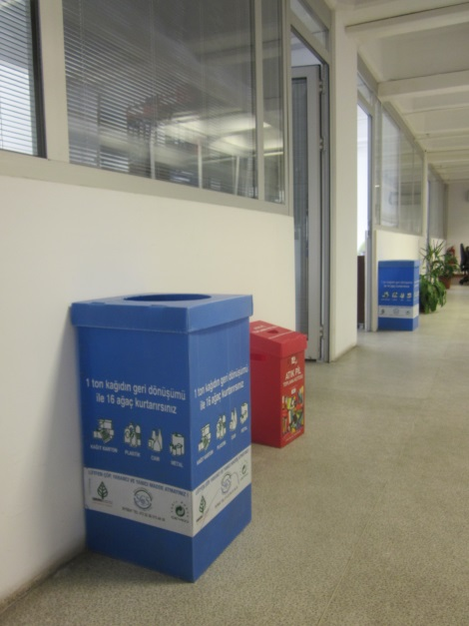
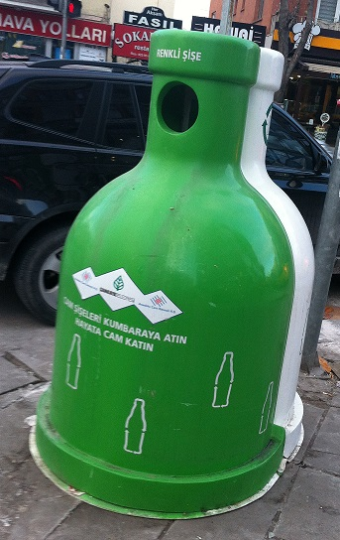
COLLECTING SYSTEM AND EQUIPMENT
FOR PACKAGING WASTE
Environmental Protection and Control Department is responsible for the collection of recyclable waste.
There are 3 licensed companies working for the municipality, that collects the waste 6 days of the week.
1820 containers and 35.000 indoor boxes are placed all over the district for the accumulation of the packaging waste.
Packaging waste is collected separately at the source with 28 vehicles.
There are 43 employers for the collecting work and 24 employers for the separation work.

Slide 9
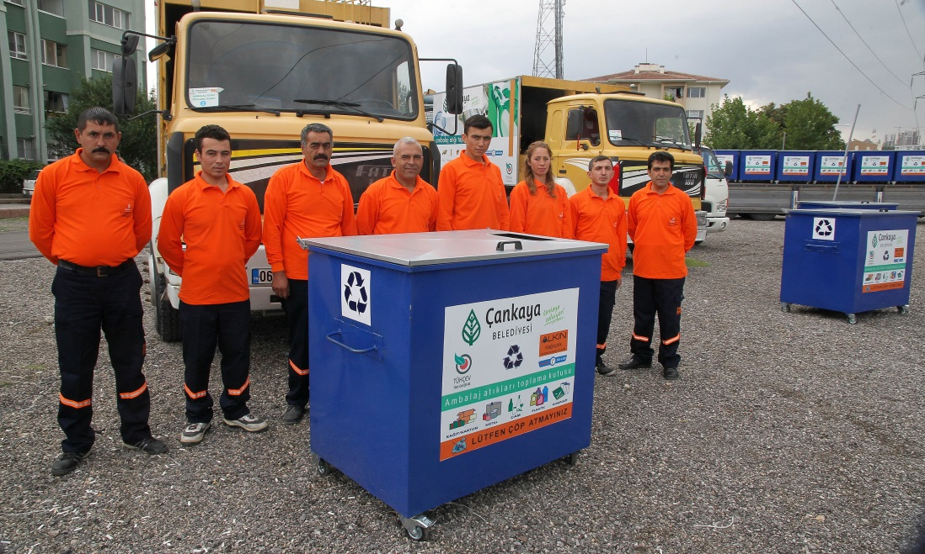
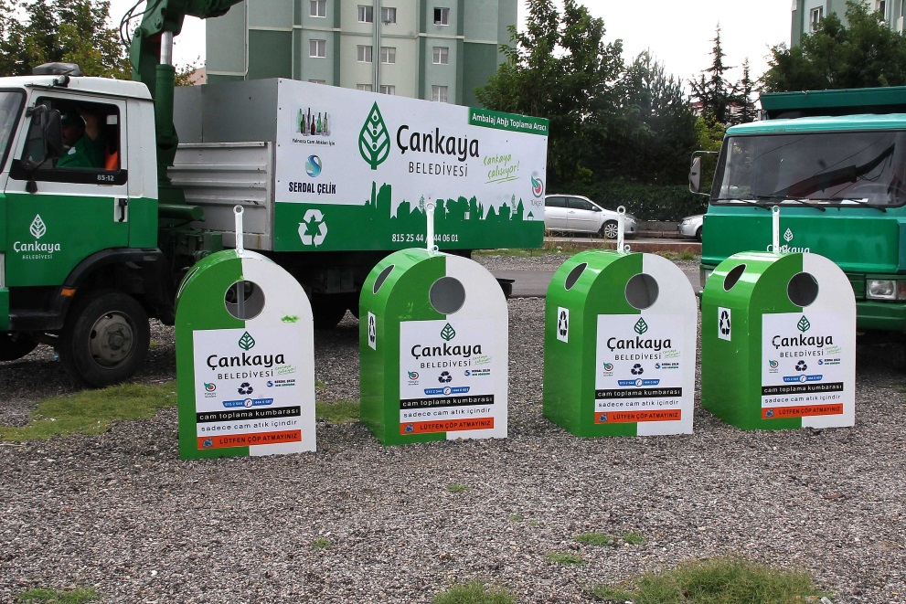
WASTE MANAGEMENT IN ÇANKAYA
Çankaya Municipality has been implementing the “Recycle the Packaging Waste” project since 2006.
Approximately 25.000 tons of packaging waste was collected from 124 neighborhood and sent to recycling facilities in 2015.
Paper-carton, glass, metal, plastic, composite, etc. waste is separated and accumulated at their sources (dwellings, private offices, schools, public offices).
Packaging waste is collected and transported to relevant industrial enterprises in order to be recycled and used again.
Financial value of the waste collected in Çankaya is around 4.3 Million Euro

Slide 10
In 2015;
284,16 million liters of water and 182.325 trees were saved by recycling of paper and paper- composite waste.
402 tons of CO₂ emissions was prevented by recycling of glass waste.
4,6 million liters of gasoline was saved by recycling of plastic waste.
121.862.000 kWh electric was saved by recycling of paper and paper-composite, glass, plastic and metal waste.

Slide 11
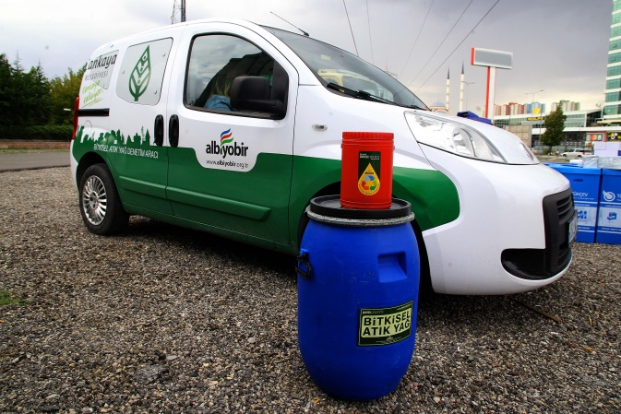
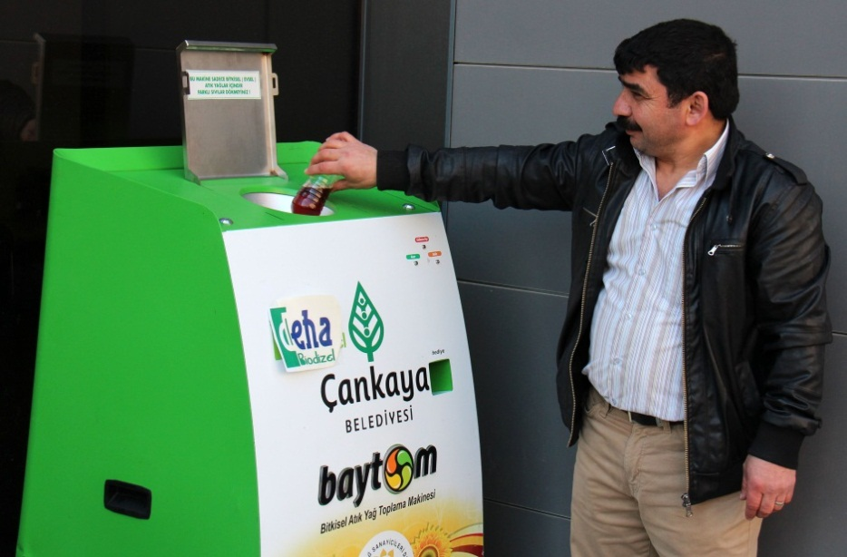
WASTE VEGETABLE OIL
There are 30 waste vegetable oil points in Çankaya and in order to increase awareness of the citizens about unhealthy effects of waste vegetable oil in the nature .
Citizens who bring 5 liters of waste oil are promoted.
Çankaya Municipality encourages business centers and dwellings to keep the waste vegetable oil which is used in the kitchen and to deliver them to related companies which are licensed by the Ministry of Environment and Urbanization .
Waste vegetable oil is collected by the 2 licensed companies with 10 vehicles every week.
439.487 kg of waste vegetable oil were collected in the district in 2015, preventing them to be poured in the garbage or sinks. In this way collected waste oil were recycled to nature-friendly biodiesel.
There are awareness raising campaigns organized regularly which increases the oil quantity collected from dwellings and schools.

Slide 12
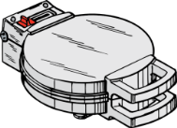
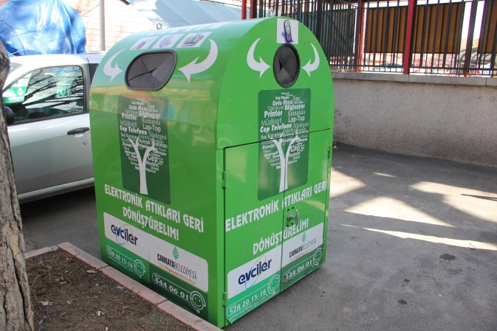
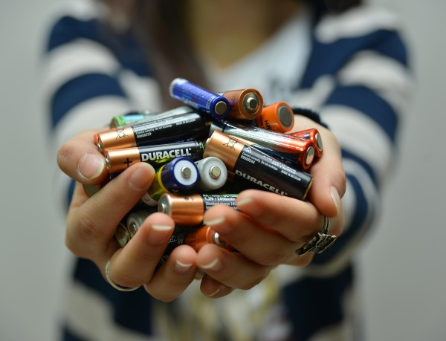
ELECTRONIC AND ELECTRICAL APPLIANCES WASTE
Electronic and electrical appliances waste (E-waste) collecting is a crucial policy tool that affects Municipality’s not only financial matters but also its policies on environmental pollution.
E-waste is collected with a specified schedule. There are 4 containers in the district that citizens can drop their e-waste. 10.808 kg of e-waste was collected all over Çankaya in 2015.
There are waste battery collection points in social houses of the Municipality, in management buildings of crowded housing sites, in schools and in some of municipal police stations.
E-waste that is not portable is collected from dwellings or business centers with municipality vehicles every week.

Slide 13
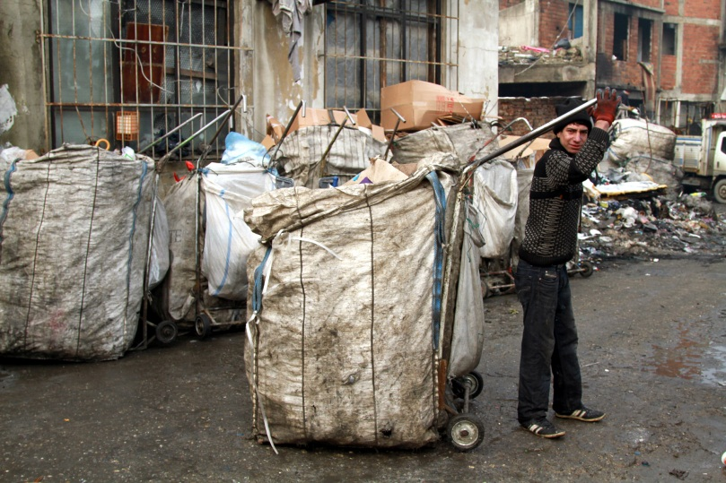
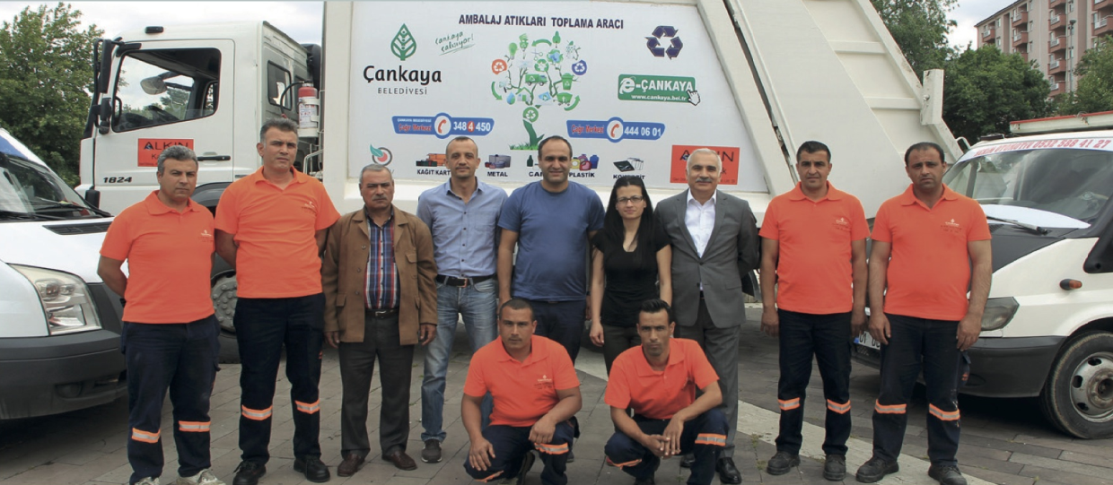
AN AWARD-WINNING PROJECT!
INTEGRATING WASTE PICKERS into MUNICIPAL WASTE MANAGEMENT
Recycling of the waste materials has caused a new economic sector: Waste Pickers.
It is known that in Çankaya over 2.000 waste pickers are working without work safety and security .
Increasing unemployment, immigration and the refugee problem in Turkey worsened the situation.
A pilot area was chosen for the project according to socio-economic levels, inhabiting areas and the density of the population of waste pickers.
They have been trained on work safety and communication. After the training their vehicles were modified according to the regulations and they started to work with social insurance wearing uniforms.
The project was awarded as a best practice on environmental services by «World Health Organization – Healthy Cities Association».

Slide 14
Training, Information and Awareness-raising

Slide 15
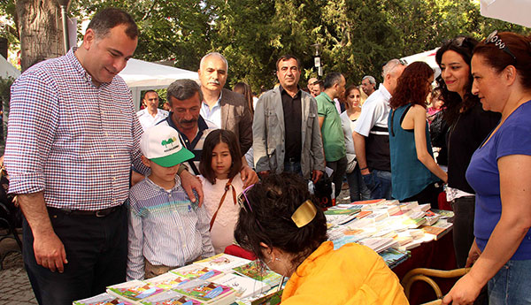
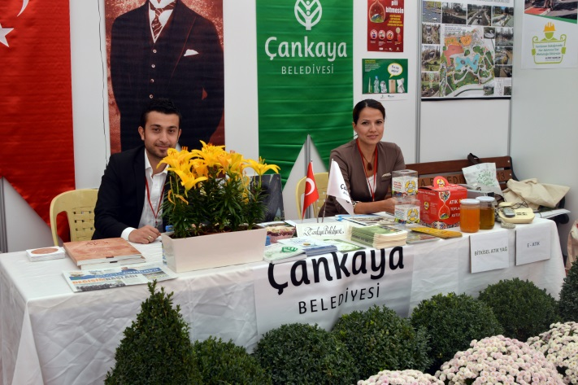
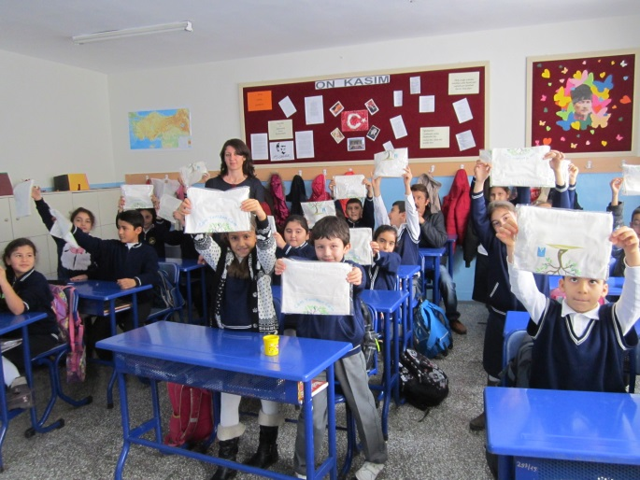
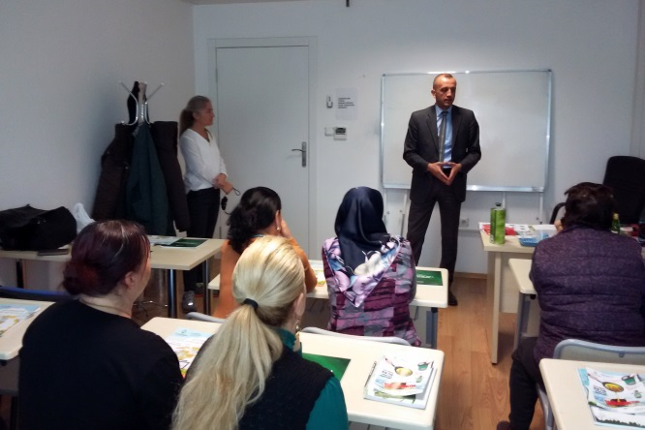
All activities of Çankaya Municipality are supported with visibility materials such as banners, posters, leaflets and information booklets in order to increase awareness and consciousness about the environmental protection.
Since 2006, Çankaya Municipality has informed 602.184 people about environmental protection, and totally 25.731 students and staff in governmental institutions has been trained.

Slide 16
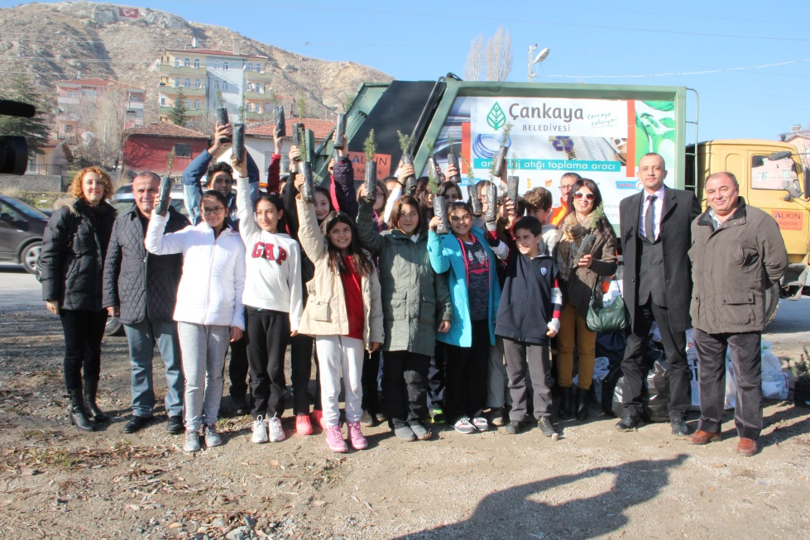
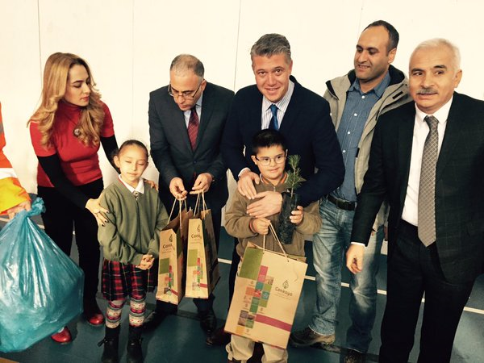
FROM WASTE TO TILLERS
Çankaya Municipality initiated “Waste Become Tillers, Çankaya Breathes Clean Air” campaign in a pilot neighborhood and citizens who brought two bags of recyclable waste received a pine tiller from the Municipality.
2.940 tillers were distributed to citizens in the pilot area, and the Municipality supported the citizens who would like to plant their tiller.
The campaign was a success increasing especially the children’s green consciousness and our Municipality plans to disseminate the action in all over Çankaya district.

Slide 17
Related Programs and Projects

Slide 18
European Commission
Covenant of Mayors
Civil Society Dialogue between EU and Turkey - IV
Environment Program
«Climate Resilience through Rain Harvesting» Project

Slide 19
Thank you for your attention
www.cankaya.bel.tr

