Slide 1




RECOVER
Circular Economy applied in the Absorbent Hygiene Products Industry
Orsola Bolognani
Grant & Logistic Modeling Manager - AHP-R BU at FATER SpA

Slide 2



Founded in 1958 by Angelini
Since 1992, a joint-venture between Procter&Gamble and Angelini
1,600 employees
1,000 related employees
Turnover: € 911 milion
4,563,900,882 products per year
4% of turnover in R&D
5 facilities: Pescara (Abruzzo), Campochiaro (Italy), Porto (Portugal),
Mohammidia (Morocco), Gebze (Turkey)

Slide 3
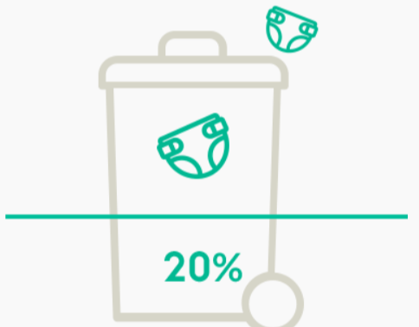
Absorbent Hygiene Products* (AHPs) waste contribute between 3-4% of the total Municipal Solid Waste
Each year 900,000 tons of AHP waste are incinerated or landfilled in Italy, 8,500,000 tons in Europe and over 30,000,000 tons in the world
In the contexts where the new EU recycling targets are achieved, used AHPs account for up to 20-25% of non-recycled residual waste.
RESIDUAL WASTE
USED ABSORBENT HYGIENE PRODUCTS
* Absorbent Hygiene Products = baby diapers, female pads, adult incontinence products

Slide 4
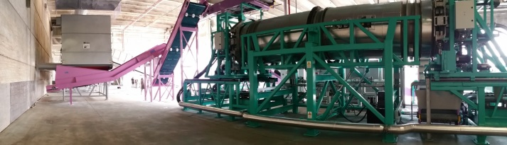
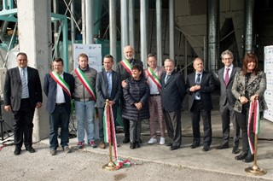
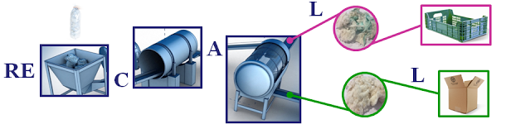


Start of R&D activities on AHP waste recycling
Demonstration of the first pilot recyling plant
(1.500 t/year)
Inauguration of the industrial-scale recycling plant
(10.000 t/year)
Industrialization
expansion
R&D on SRM applications
2008
2015
2017

Slide 5


Call for proposal: POR FESR Abruzzo 2014-2020
Timeline: 03/2017 – 03/2020
Scope: researching and developing prototype technologies for the creation of the first-ever bio-refinery in the world, which will use Absorbent Hygiene Product waste to produce – among other things – high value-added bio-fertilizers
3 Partners
From Abruzzo (ITALY)

Slide 6
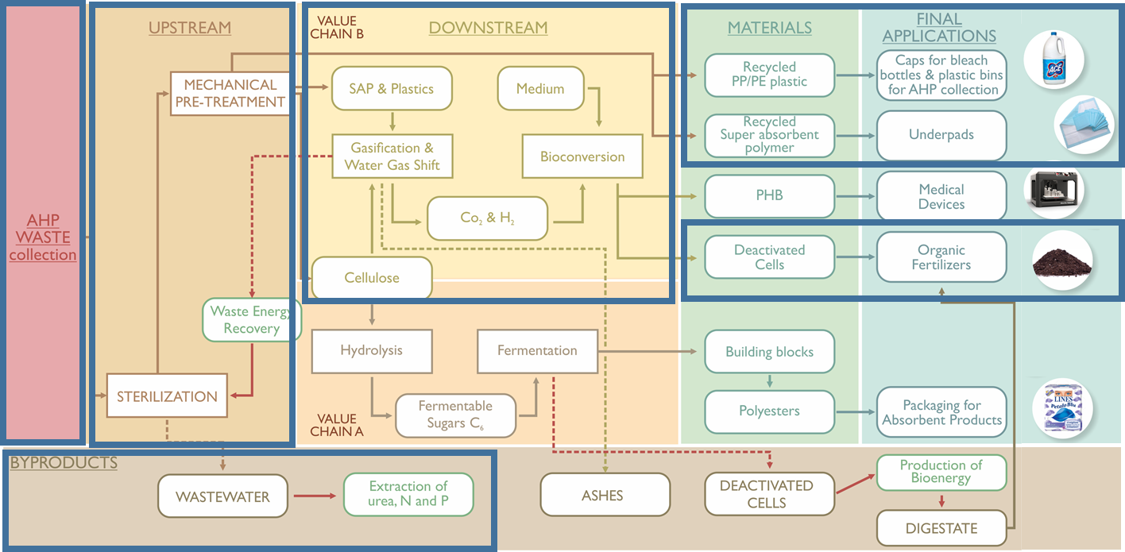
THE BIO-REFINERY MODEL

Slide 7
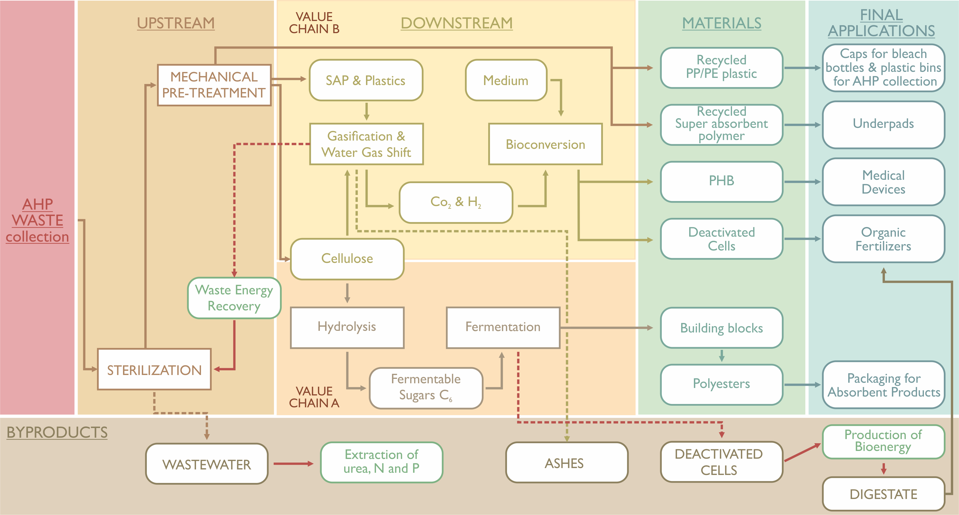
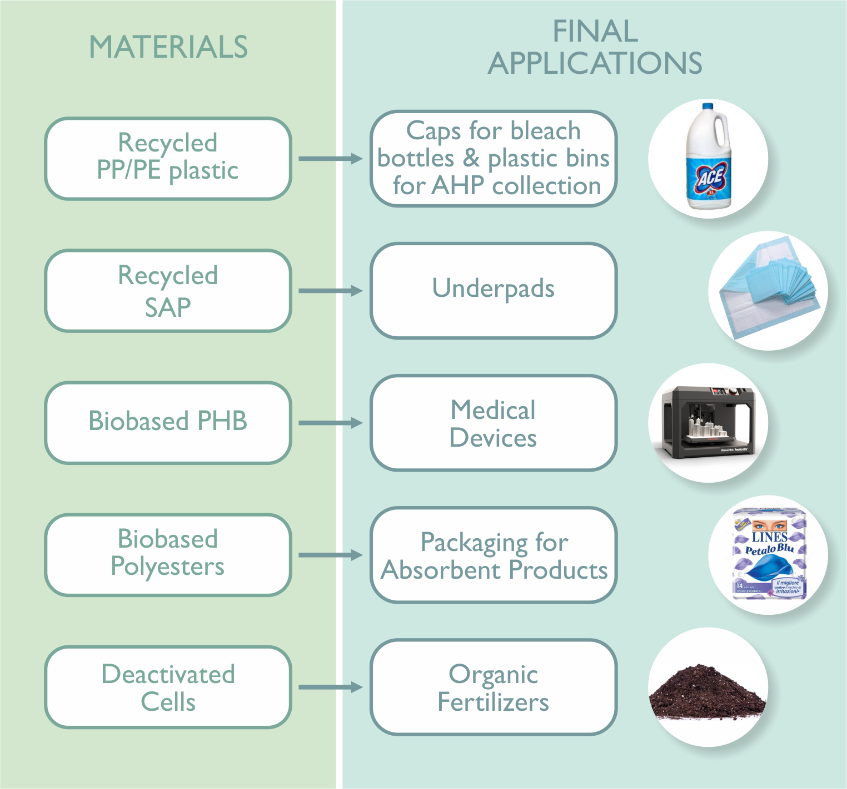
THE BIO-REFINERY MODEL
RECOVER will develop the first hybrid recycling technology, able to recycle post-industrial and post-consumer AHP waste. Post-industrial diaper waste is a great opportunity in Abruzzo Region, also known as Nappy Valley

Slide 8
Thank you for your kind attention!
Contact:
Orsola Bolognani
bolognani.o@fatergroup.com

