Slide 1
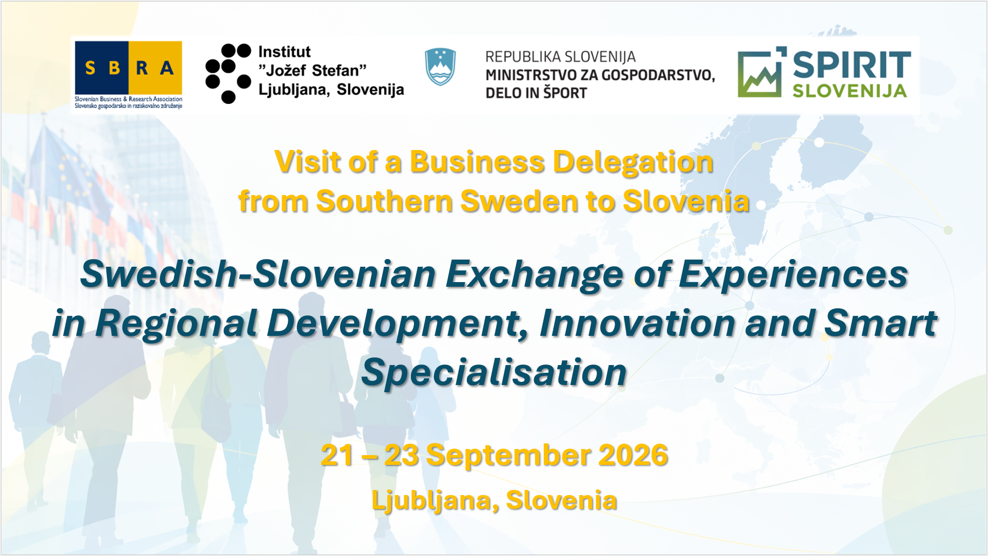

Slide 2

Swedish-Slovenian Exchange of Experiences in Regional Development, Innovation and Smart Specialisation,
Inštitut Jožefa Stefana, Ministrstvo za lokalno samoupravo, kohezijo in regionalni razvoj, TOP, PMiS, GOZDIS, SPIRIT
Doc. Dr. Draško Veselinovič,
Director, SBRA, Brussels
Sept. 2026

Slide 3
Our SBRA Structure
Established in 1999;
Five employees;
Connects business, research and local communities in Slovenia with other European business, research and local communities and the EU institutions and other public and private bodies at the EU level;
EU funding;
High-level events incl., conferences, workshops, round tables, promotions and collecting all useful info for our clients/members;
Our clients are not only Slovenian entities since our presence, references and respect in Brussels date more than 25 years back in history.

Slide 4
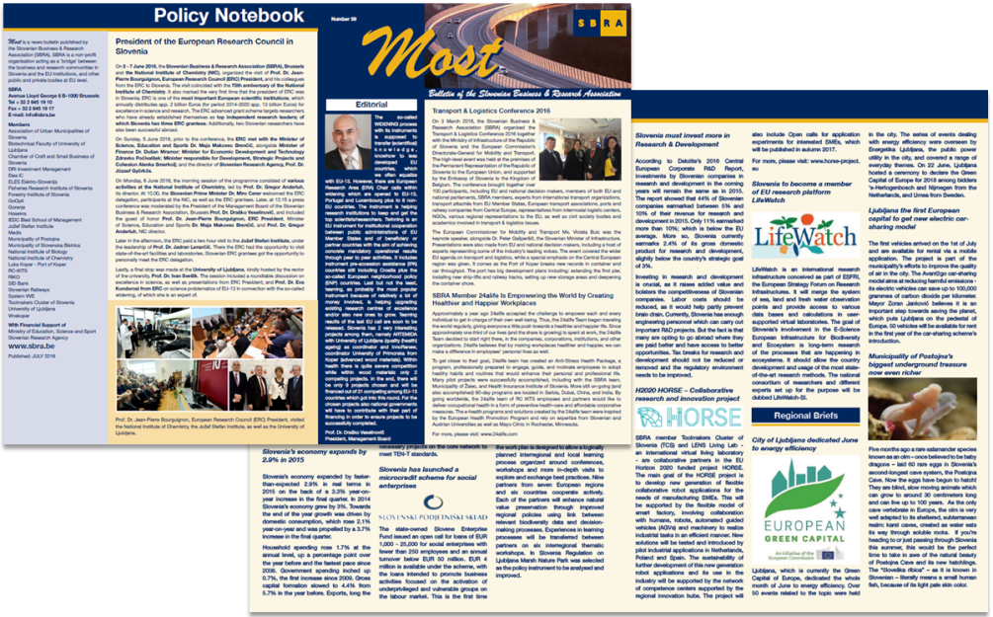
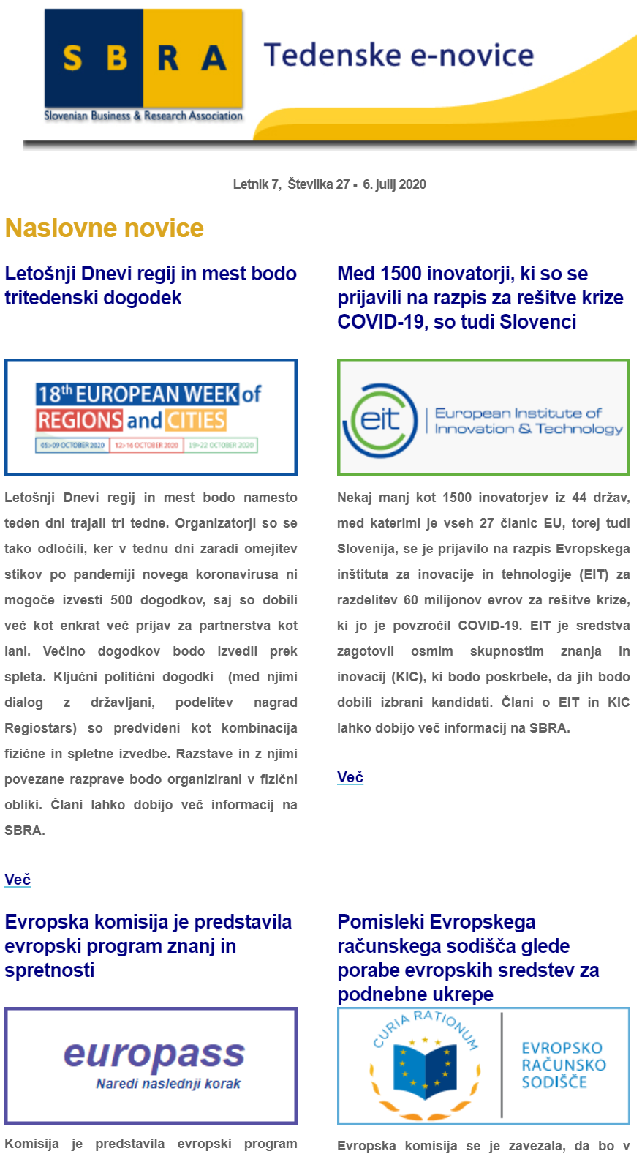
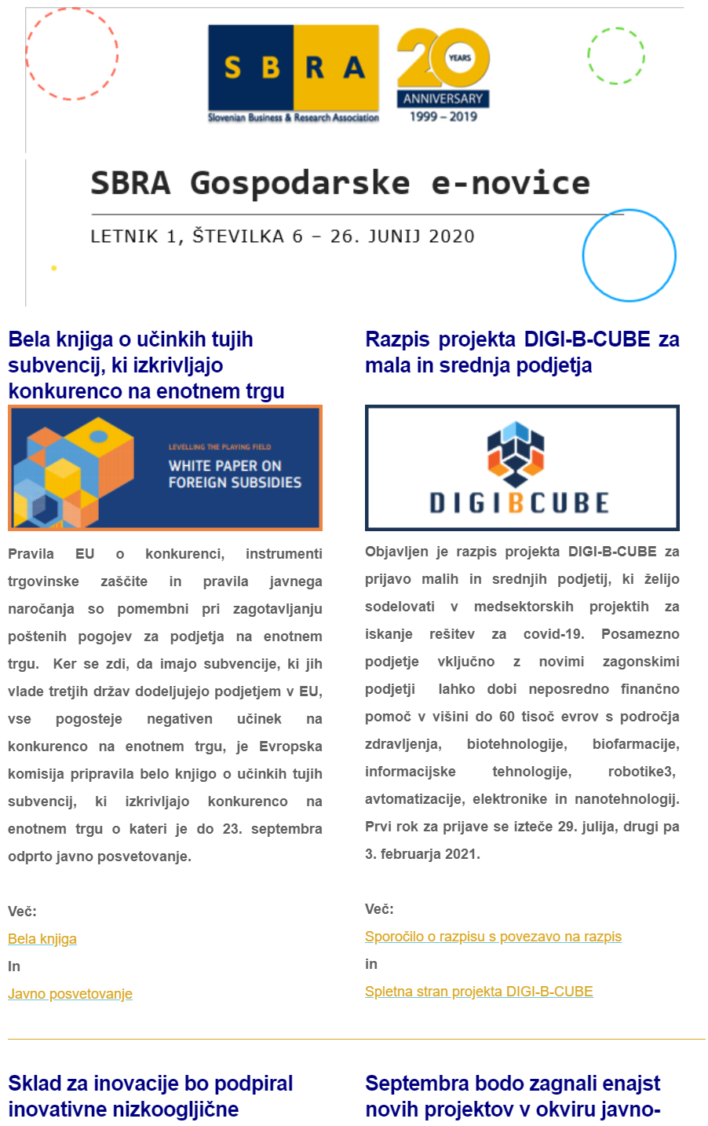
Core Activities
Informing members on economic developments, with a renewed focus on EU projects, programs and funds. A weekly scan of news, relevant calls, events, publications,etc. – disseminated via weekly e-news bulletin. Additionally, a bimonthly news bulletin regarding the economy.
Partner Search – besides informing members of relevant EU programs and projects, we actively strive to find and search for relevant partners and potential project consortia.
Training – preparing workshops and study trips for its members
Networking – Network of European Financial Institutions for Small and Medium-Sized Enterprises (NEFI), membership in IGLO (Informal Group of RTD Liaison Offices), ERRIN (European Regions Research and Innovation Network), UnILiON (Universities Informal Liaison Offices Network), Vanguard initiative (regional network for promoting regional innovation ecosystems) and ENDR (Network of Defence Related Regions), NFP for Slovenia in defence.
Promotional events, publishing reports and organising conferences. Publication MOST allows us to widely disseminate our members’ achievements.

Slide 5
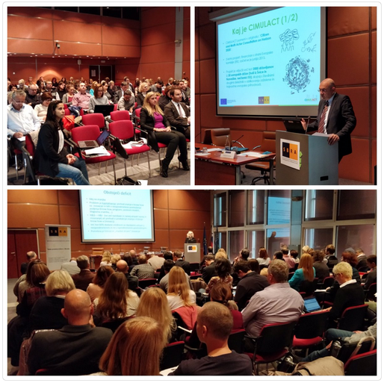
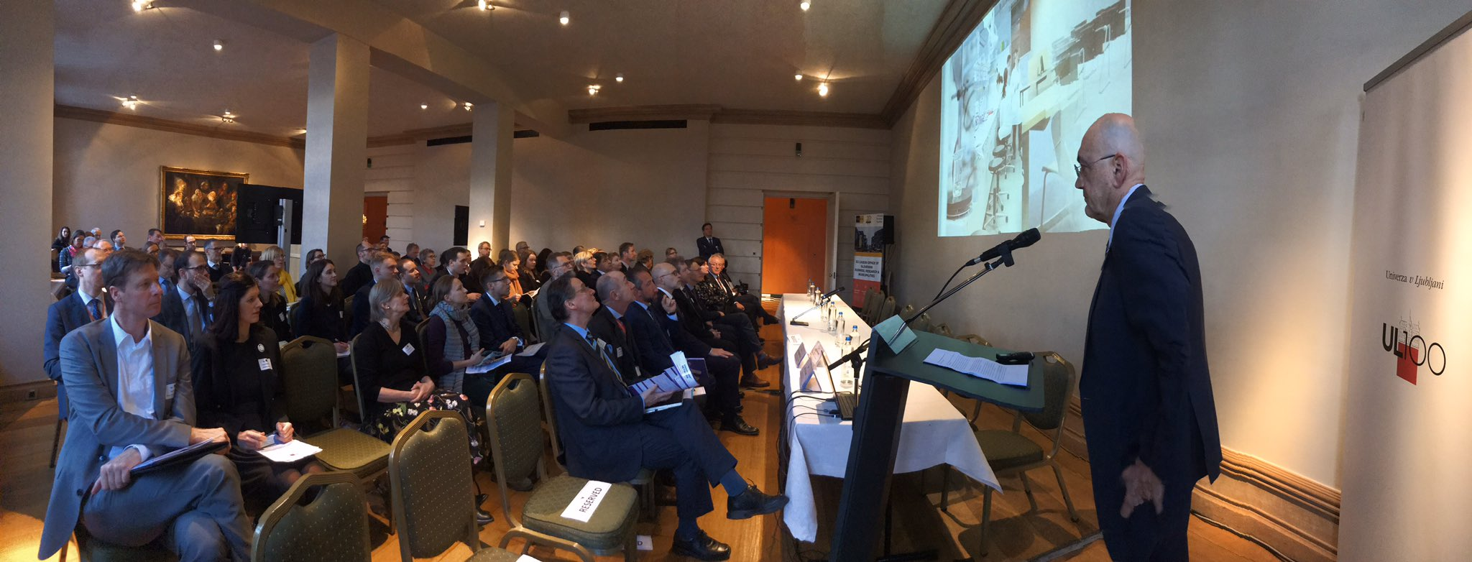
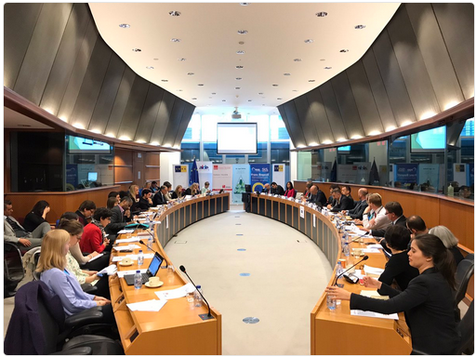
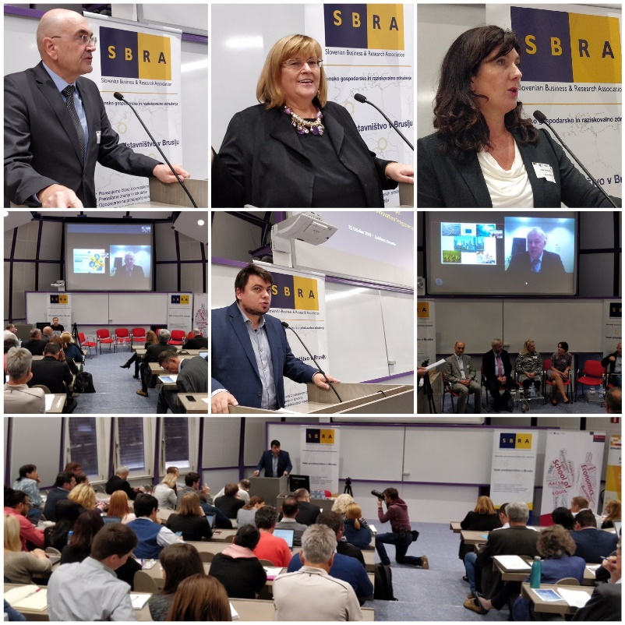
Organisation of numerous high-level events

Slide 6
Organisation of numerous high-level events

Slide 7
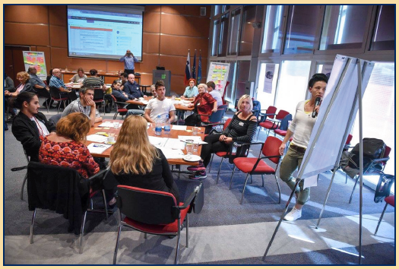
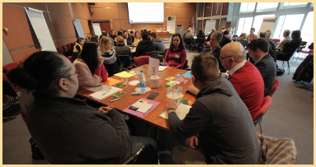
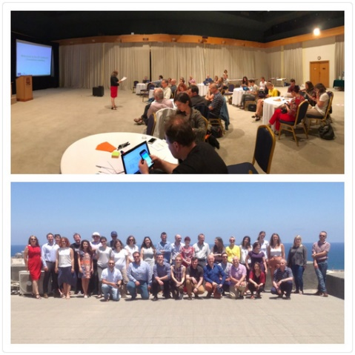
SBRA itself involved in various EU Projects: including CIMULACT & HIGHER
CIMULACT: Citizen and Multi-Actor Consultation on Horizon
HIGHER: Better Policy Instruments for High Innovation Projects in the European Regions
Previous EU Projects include: WBC-INCO.NET, BIOENERGIS, E-BUSINESS FOR CRAFT, BIS-RTD, REGIONS4RESEARCH, TASBOR, Great IST, SYCP, etc.

Slide 8
Why is it important to be present in Brussels
80% of all national legislation is decided in Brussels
Record EU budget in the amount of more than 1.800 bn euros for the period 2021-2027
Officially, more than 12.000 different representation offices in Brussels
Getting the EU funding for R&I activities is a gradual process that requires:
Early access to working programmes and information on calls for proposals
Constant communication with EU institutions
Regular promotion of R&I activities on the EU level
Networking and matchmaking activities for building project proposals
Membership and constant presence in different R&I partnerships that co-decide EU funding programmes and research policies
Personal contacts and cooperation with other representatives
Bilateral trading activities for the Slovenian companies in Belgium and sometimes also broader in Luxembourg and vice versa

Slide 9
What is Framework Programme 10?
Next EU Framework Programme for Research and Innovation from 2028-2034.
General Goals: to strengthen EU competitiveness, scientific excellence, and address global challenges
Multiannual Financial Framework 2028-2034, European Competitiveness Fund
2000bn eur
MFF
ECF
166,2
HEU 2.0
106,9
68,1

Slide 10
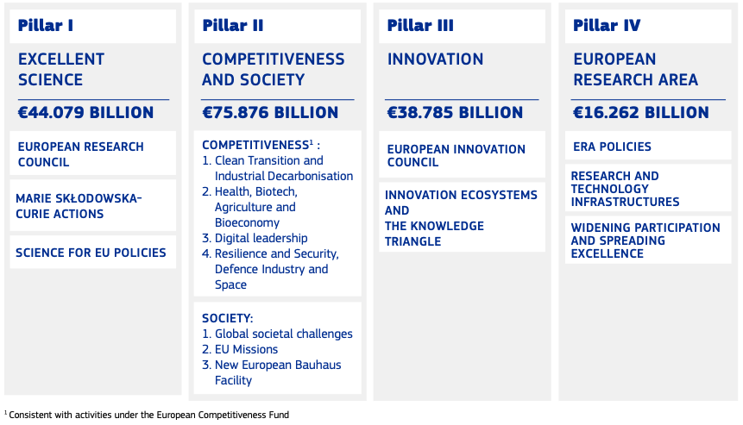
FP10
175 billion eur
1 January 2028-31 December 2034
Payment appropriations to 2040
Implementation by 2 specific programes:
HEU 2.0
ECF

Slide 11
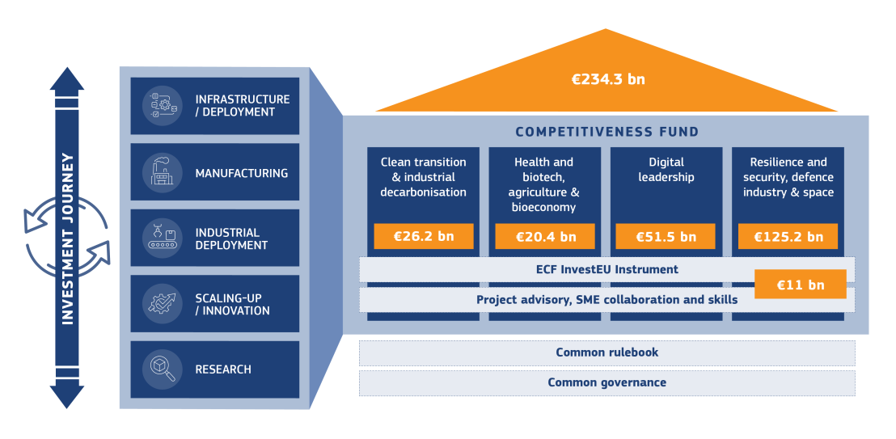

Slide 12

Thank you!
Slovenian Business & Research Association
Rue Belliard 40
1040, Brussels, Belgium
tel: +32 496 556131, +386 41651004
drasko.veselinovic@sbra.be
www.sbra.be

