Slide 1
Horizon Europe Matchmaking Event on Digital and Emerging Technologies and Human-centred AI
In the heart of the textile transformation

Slide 2
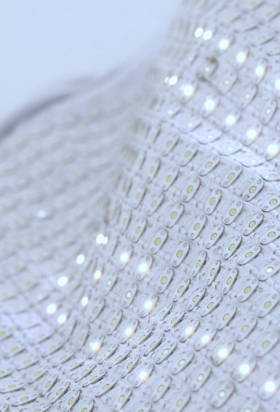

Sommaire
TECHTERA SHORTLY
TEXTILE CONTEXT
EXAMPLES OF DIGITALISATION
NEXT BIG CHALLENGE FOR THE DIGITALISATION
TECHTERA’S EUROPEAN PARTICIPATION IN EDIH

Slide 3

TECHTERA SHORTLY
Horizon Europe Matchmaking Event
Competitiveness cluster dedicated to the French textile industry
Ambition: to stimulate competitiveness through innovation + dissemination
250 members (2021 figures)
580 million euros invested in 227 projects
+ 130 companies supported at trade fairs and missions in 2019
A European and world wide network

Slide 4
TEXTILE CONTEXT
Horizon Europe Matchmaking Event
Representation of the textile industry
Sources : David Rigby Associates

Slide 5
TEXTILE CONTEXT
Horizon Europe Matchmaking Event
Specific skills no longer taught at school
High average age
Not familiar with new technologies
Wide range of economic models

Slide 6
EXAMPLES OF DIGITALISATION
Horizon Europe Matchmaking Event
Conception : 3D, avatar
Production : shoes made in France
Customer experience : to show with the most real effect the products (aspect, fallen, etc…)
AI : price prediction, trend detections

Slide 7
NEXT BIG CHALLENGE FOR THE DIGITALISATION
Horizon Europe Matchmaking Event
Re-industrializing and relocating textile activities in France
To be more competitive
To keep and transmite our skills and knowledges
TECHTERA is not a pure player

Slide 8
TECHTERA’S EUROPEAN PARTICIPATION IN EDIH
Horizon Europe Matchmaking Event
MinaSmart
Polytronics

Slide 9







Remerciements
Thanks for your attention
Techtera thanks all its members, partners and funders.
François-Régis NEPOTE VESINO
06 23 59 66 21
frnepote@techtera.org

