Slide 1
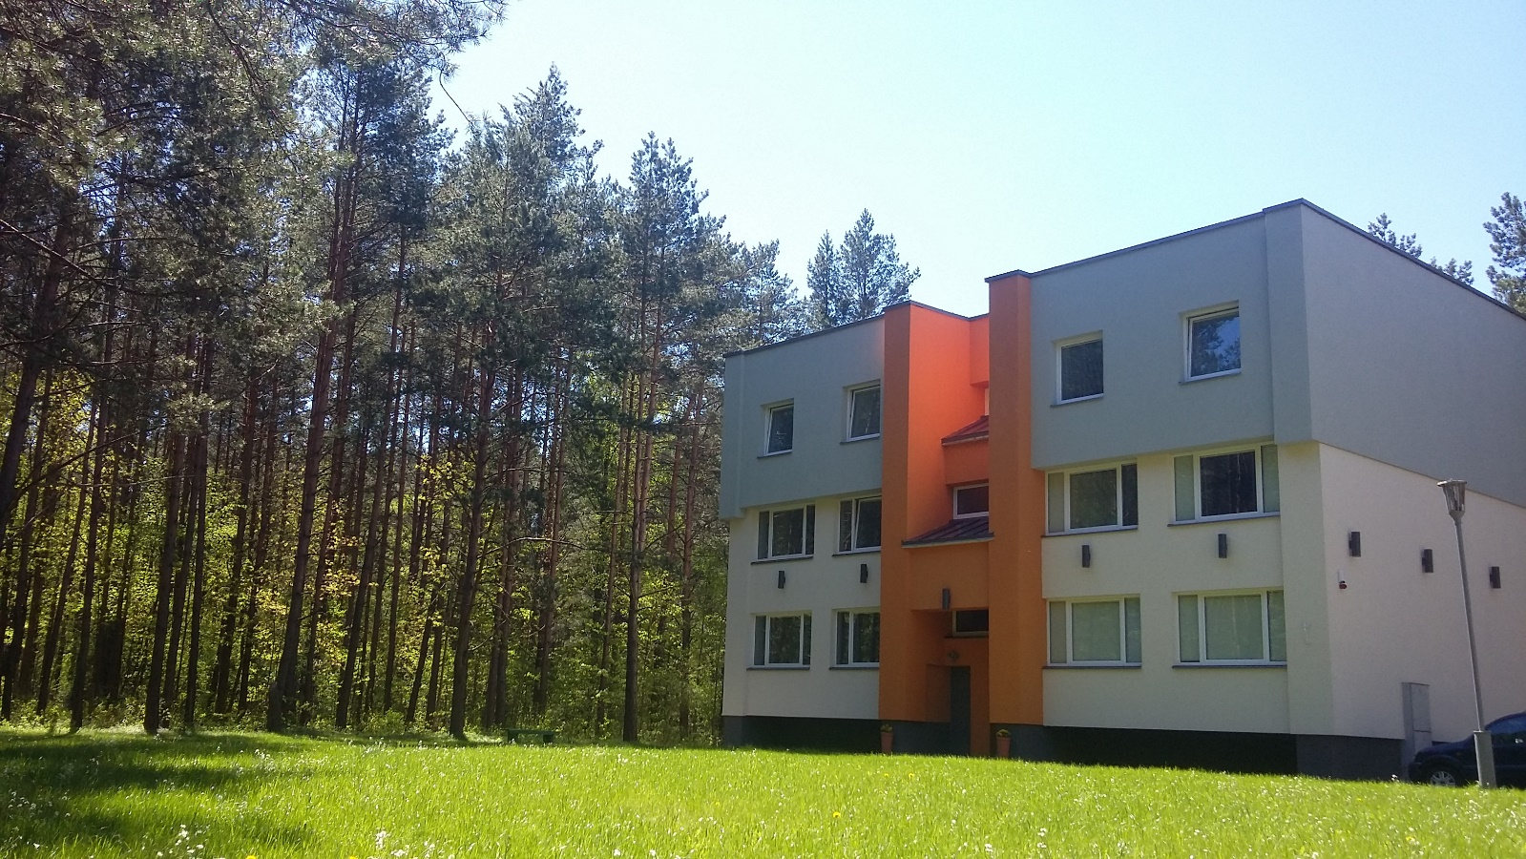
Support Center for Sexually Abused Children
Lithuania, Vilnius
Director Gytė Bėkštienė
Networking event on Digital and Emerging Technologies and
Human-centred AI
24 January, 2022

Slide 2
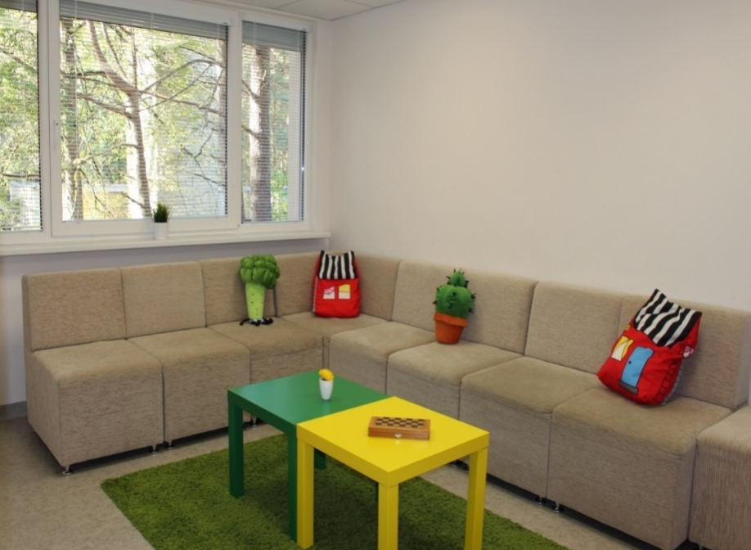
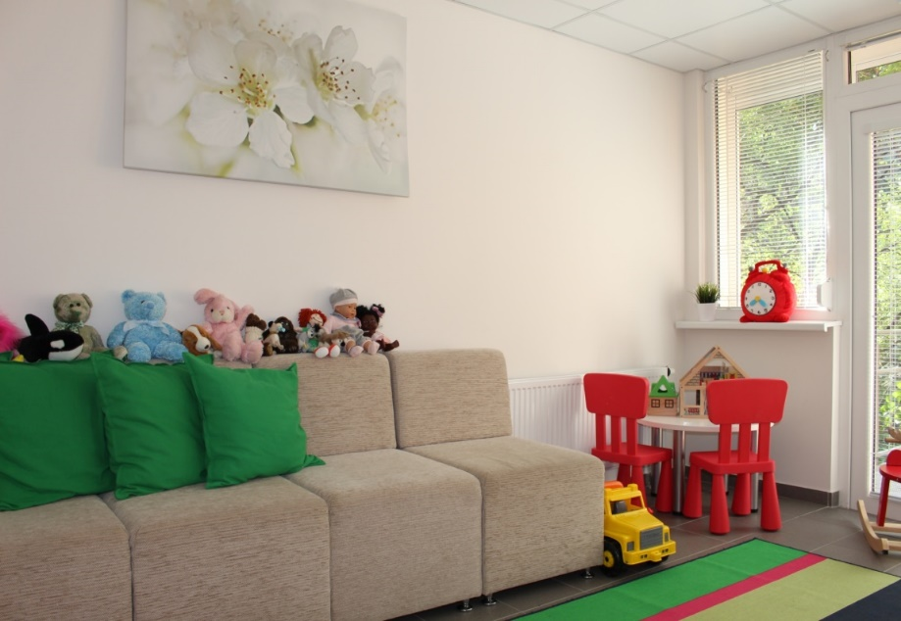
Opened at 2016 this support centre is the only one in the Lithuania where specialized, complex service for sexually abused children and their family members are provided.
Since the opening of the Centre at the 3rd of June in 2016 until the end of 2021, the services were provided to 1519 children, out of whom 1021 were girls and 498 were boys.

Slide 3
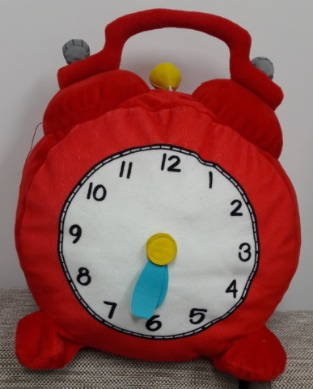
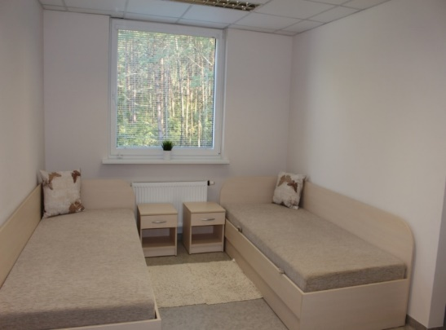
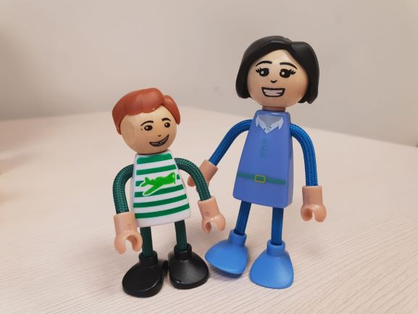
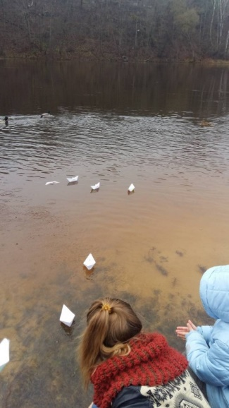
Our services are provided 24/7
There are 10 sleeping places here at the time
Child can stay alone or with parents / guardians;
Usually, children stay here for three days, if necessary, longer

Slide 4
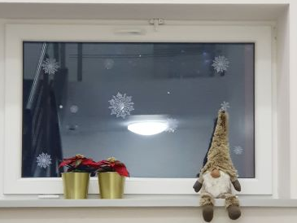
main goals of the Support Centre:
Lessen the negative effects on the child after the abuse;
To create and ensure safe environment for children, where they would receive all help they need from different specialists under the same roof;
To promote child friendly approach and environment;
To promote multidisciplinary and interagency service;
To ensure high professional standards.

Slide 5
What kind of services child can get at the Support Centre?
Temporary accommodation
Psychological assessment of the child
Psychological counseling
Provision of long term treatment recommendations
Forensic medical examination
Forensic Interviewing
Counseling of social worker

Slide 6
Expertise
(of your institution/company/university)
2014 July 01 The implementation agreement “No. 2014 / 4-9-8” FOR THE ESTABLISHMENT OF A SUPPORT CENTER FOR CHILDREN VICTIMS OF SEXUAL ABUSE was signed The project implemented in accordance with the 2009-2014. Measure of the Financial Mechanism Program LT05 “Children and Youth at Risk” of the European Economic Area Financial Mechanism. The project was funded by the European Economic Area Financial Mechanism and the Lithuanian budget together with a partner, the Icelandic Government Agency for the Protection of the Rights of the Child, Barnaverndarstofa.

Slide 7
Topic and project idea (edit)
We‘d prefer to establish a New Department of our Support Center for Sexually abused Children in other town, also in Lithuania.

Slide 8
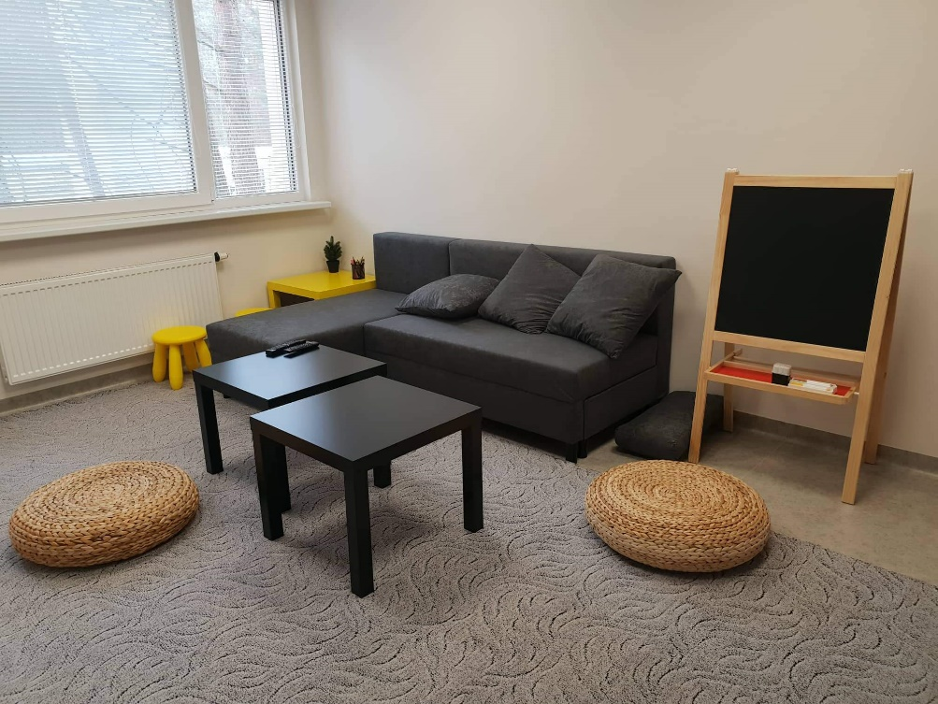
Contact details
E-mail address:
info@uzuoveja.lt
Phone number:
Gytė Bėkštienė +370 678 24965, Director

